Slide 1
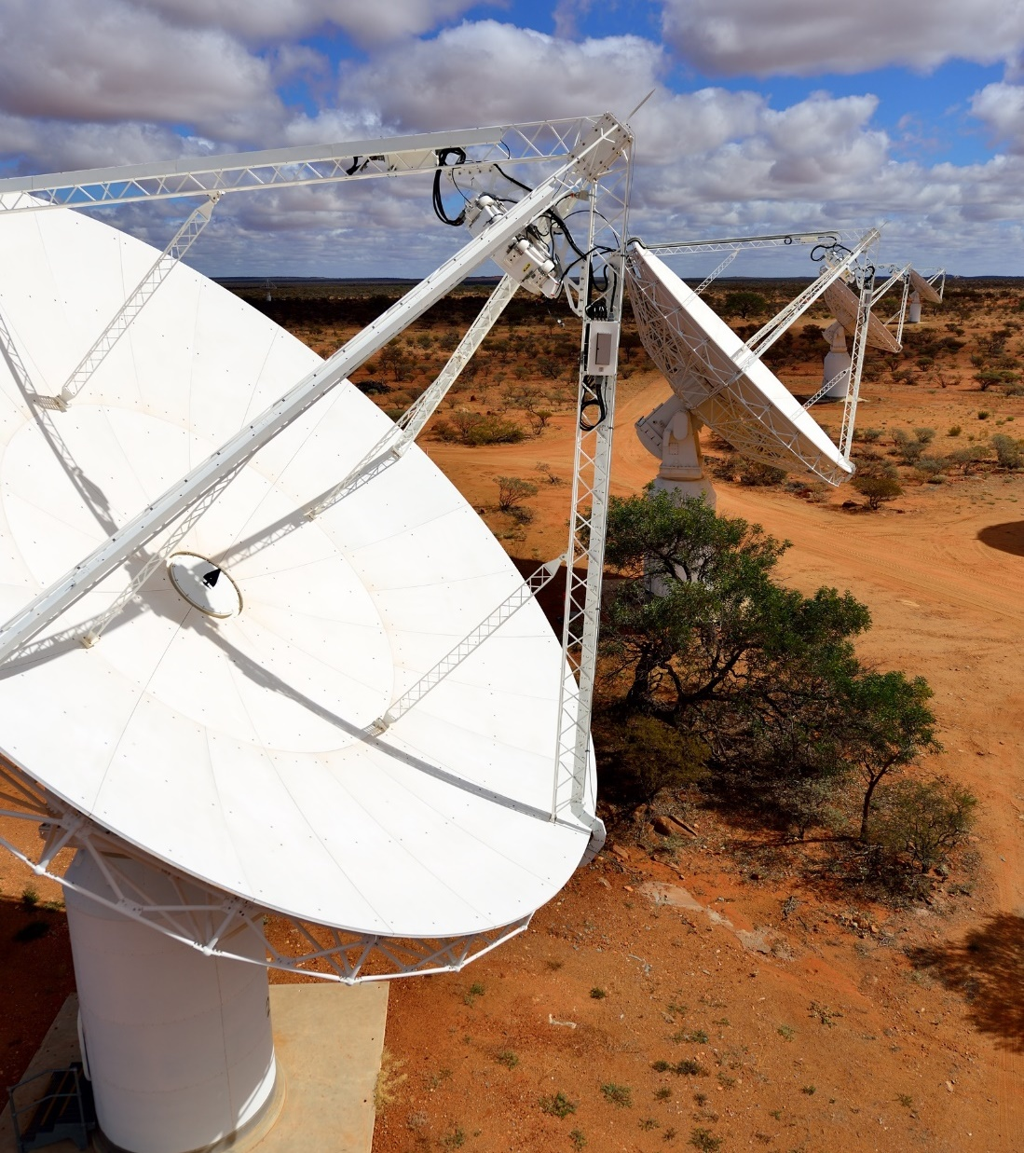
CASDA VO Use Cases
IVOA Radio Interest Group
James Dempsey | 2 July 2020

Slide 2
CASDA VO Motivation
Provide science ready data products
Images, catalogues, spectra etc.
One API for system and astronomer use
Interoperability

Slide 3
CASDA Documentation
Introduction to CASDA
  https://casda.csiro.au
Usage Guide
  https://www.atnf.csiro.au/observers/data/casdaguide.html
Astroquery
  https://astroquery.readthedocs.io/en/latest/casda/casda.html

Slide 4
Catalogue Use Cases
Find and download catalogues using TAP
Cone search on a catalogue
Programmatic search of source detection catalogues
Catalogue cross-match - external catalogue with ASKAP

Slide 5
TOPCAT Introduction
Simple queries
Plotting
SAMP to Aladin
Cross-match

Slide 6
Image and Cube Use Cases
Find images and image cubes (SIA2)
Programmatic access to data products
  Recommend Astroquery now
Generate cut-outs via script (SIA2 + SODA)

Slide 7
General Data Discovery Use Cases
Use ObsCore to data products
Can query with TAP
Most data products have s_region and ra/dec

Slide 8
Thank you
CSIRO Information Management & Technology
  James Dempsey
  Senior Developer, Information Services Applications
    +61 2 6214 2912
    James.Dempsey@csiro.au

