Slide 1


Provenance DM
CDS implementation
July 2017 status
Mireille Louys (CDS, ICube/Université Strasbourg)
François Bonnarel (CDS/CNRS)
François Bock (Université de Strasbourg, intern)

Slide 2
CDS Workflow 1:
from Photographic Schmidt Plate to RGB color composition
Digitization photographic plate → digital plate
Image cut_out extract a chunk digital plate→ Fits image
RGB composition 3 images from diff filters → 1 RGB image
CDS work plan :
  Apply the conception DM from our intern François Bock
  Implement into a Postgresql data base
  Feed data into the DB through a VOTable list of instances
  Design various training data sets
  Allow simple queries
  Allow for feed from a JSON file
  Allow for feed from an external IVOA provenance representation

Slide 3
PostGreSQL data base implementation:
relational model

Slide 4
A full set of python scripts
FillVOtable.py
Ingest a set of instances of IVOA Provenance classes described in VOTable format
QueryVO.py
Select → VOTable output
QueryJSon.py
Select → JSON output
ConvertJSonToProvN.py
still a bug for convergence . In progress

Slide 5
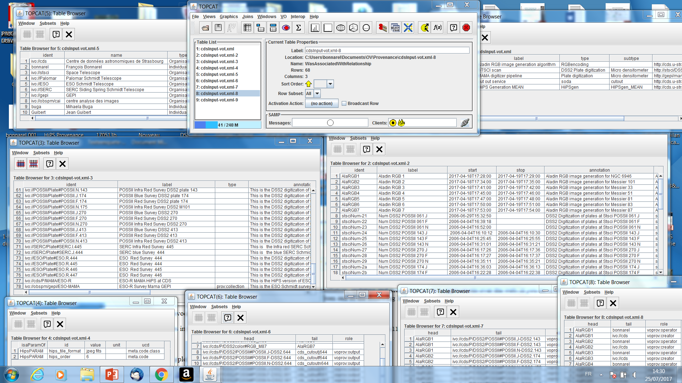
VOTABLE list of instances
(visualized in TOPCAT)
agents
Activity description
Topcat interface
entity
activity
Used
WasAssociatedWith
parameter
WasGeneratedBy

Slide 6
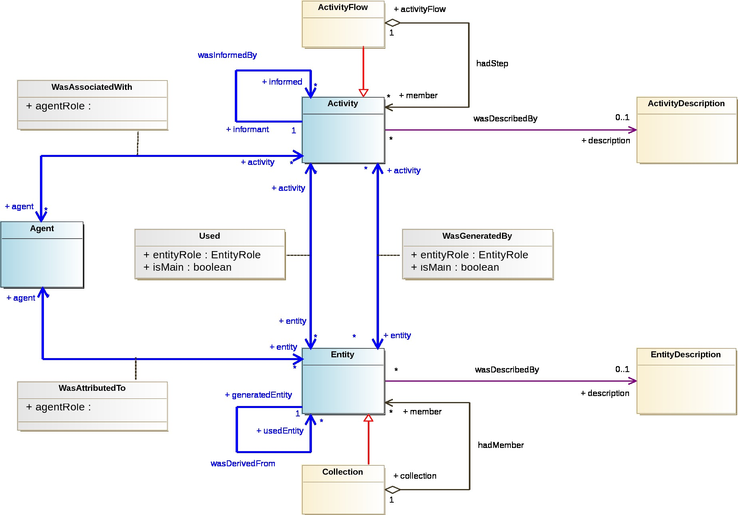
Implementation for Provenance - 2017 June 28
Number of Instances
for each class
68
5
53
10
66
50
82
77
UML diag
In WD Draft 2017_june 28
1

Slide 7
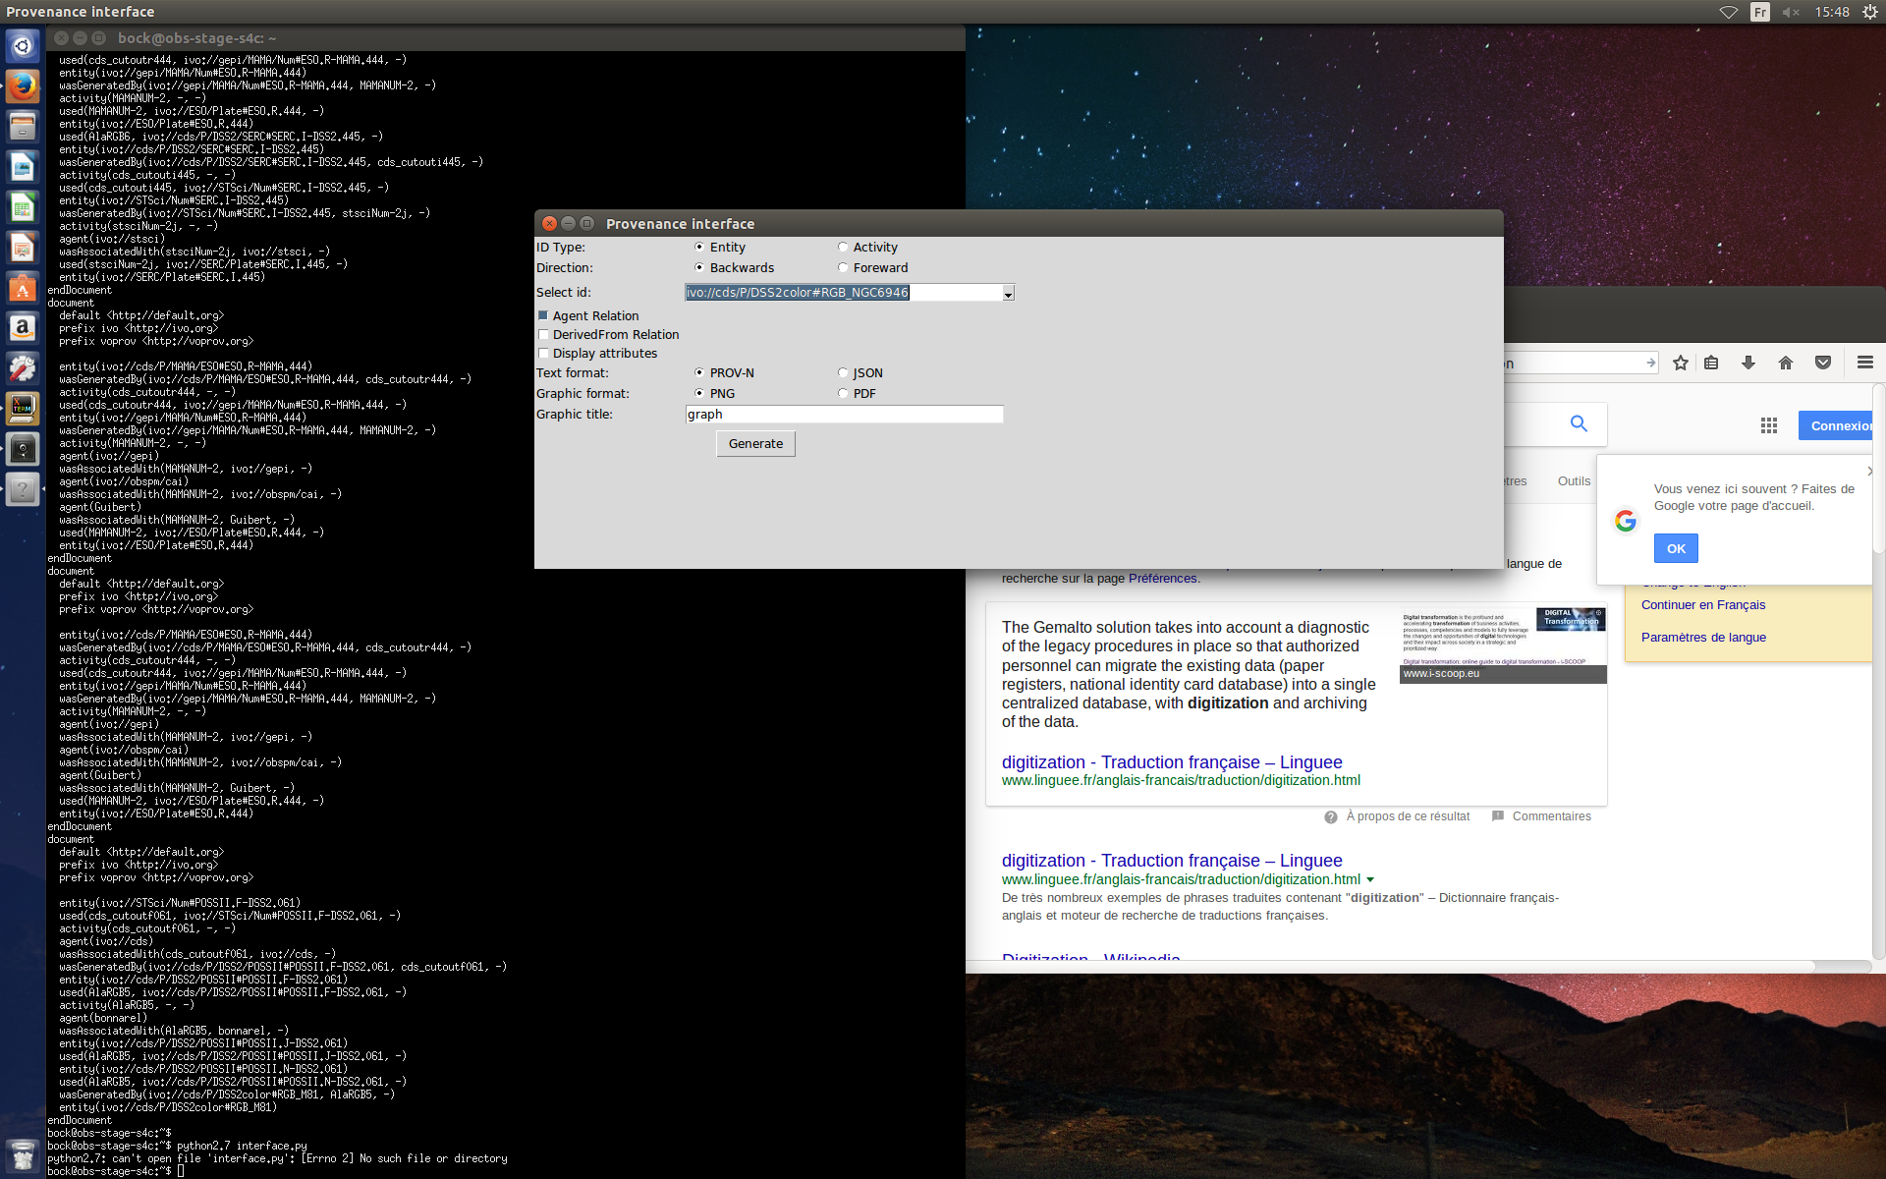
Graphical Query Interface :
To generate plots
This panel allows to select different kinds of graphs
Query response
Text output →
Graphic output →
JSON and Prov-N available
Votable format allowed by another script queryVO.py → see next slides

Slide 8
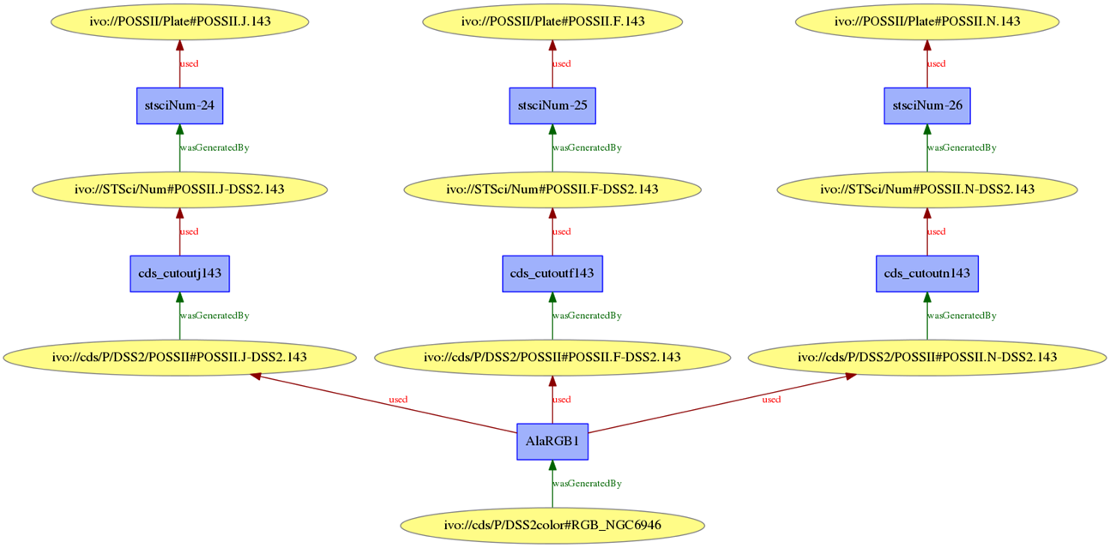
Graphical basic Output :
An RGB image provenance

Slide 9
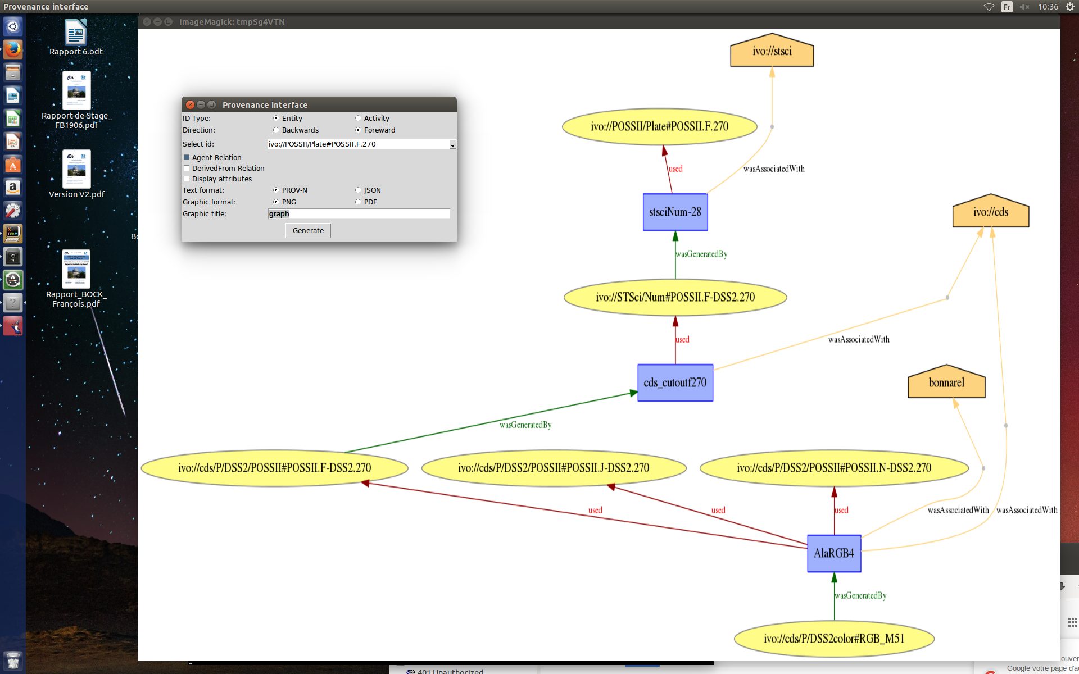
Graphical Output :
With agents

Slide 10
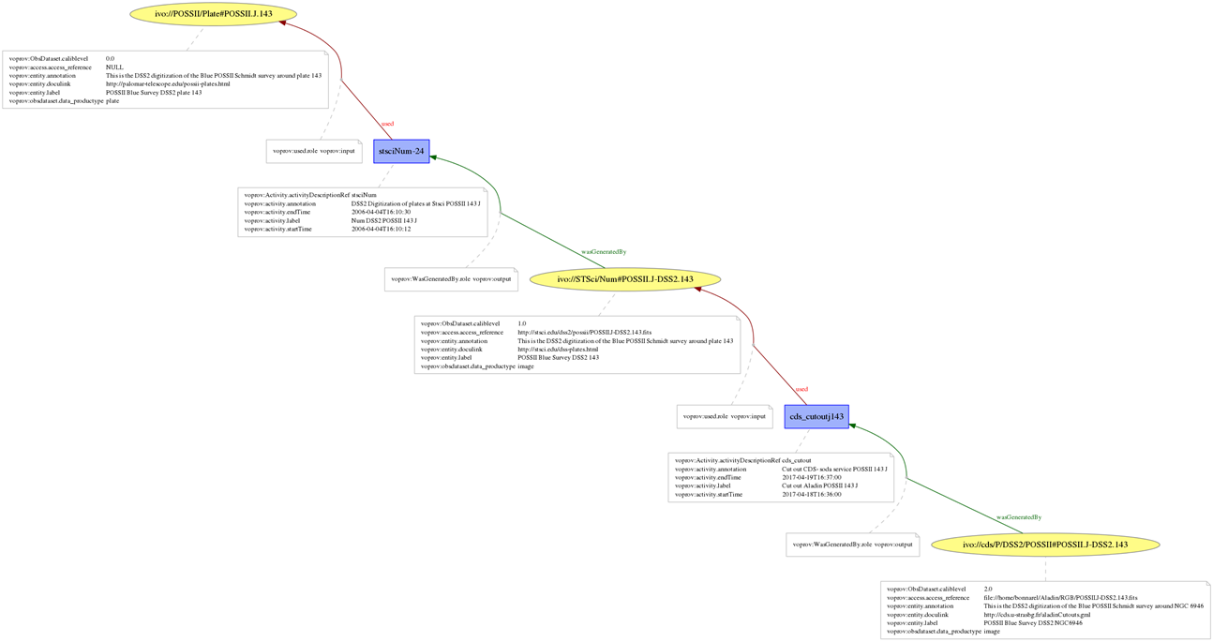
Graphical Output :
With attributes displayed

Slide 11
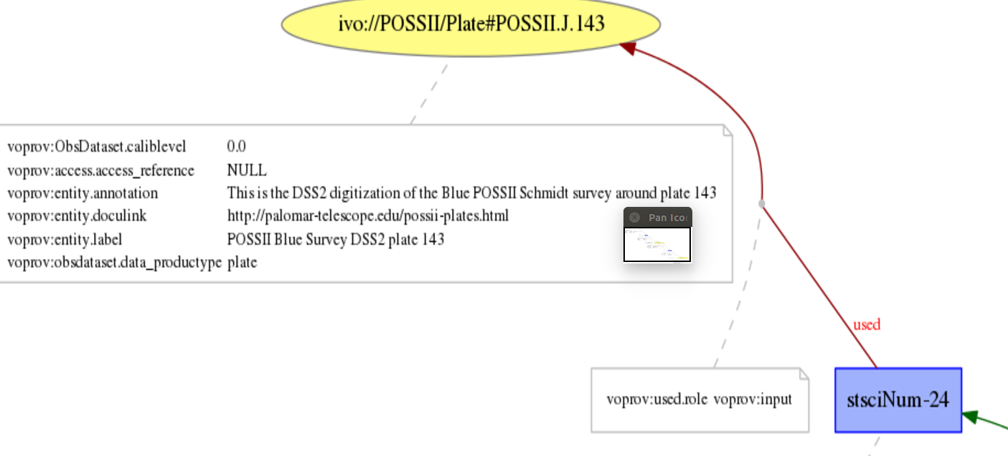
Graphical Output :
With attributes displayed

Slide 12
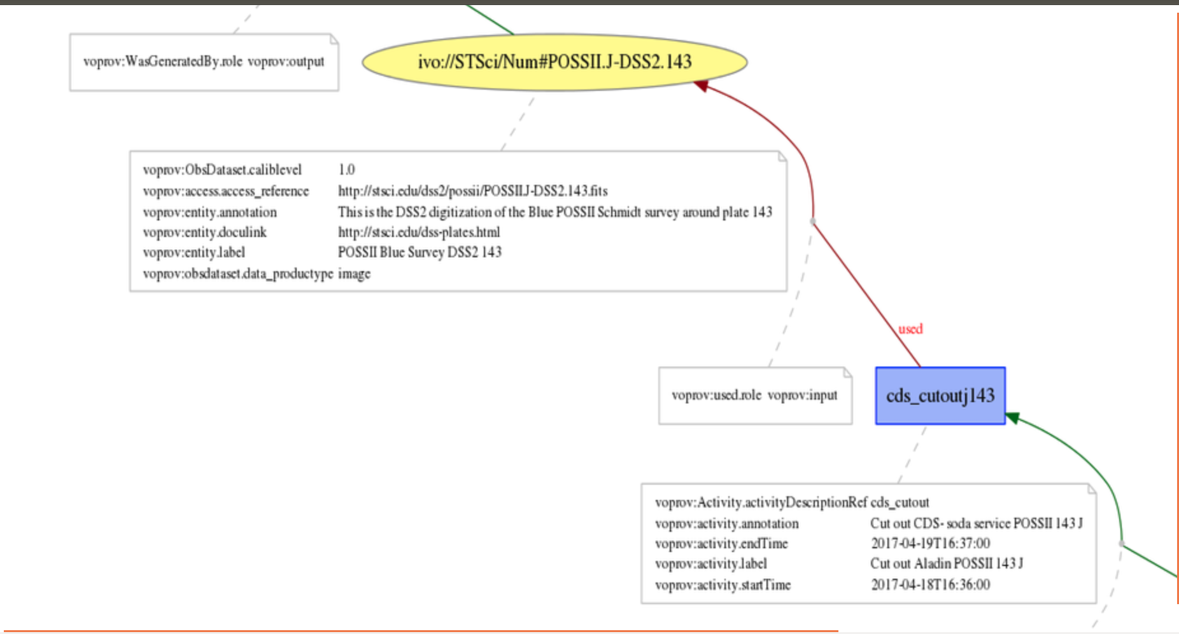
Graphical Output :
With attributes displayed

Slide 13
Text Output from graphic interface :
(foreward processing from MAMA digitization)
Prov-n
activity(MAMANUM-1, -, -)
entity(ivo://SERC/Plate#SERC.J.444)
used(MAMANUM-1, ivo://SERC/Plate#SERC.J.444, -)
wasGeneratedBy(ivo://gepi/MAMA/Num#SERC.J-MAMA.444, MAMANUM-1, -)
entity(ivo://gepi/MAMA/Num#SERC.J-MAMA.444)
used(cds_cutoutj444, ivo://gepi/MAMA/Num#SERC.J-MAMA.444, -)
activity(cds_cutoutj444, -, -)
wasGeneratedBy(ivo://cds/P/MAMA/SERC#SERC.J-MAMA.444, cds_cutoutj444, -)
entity(ivo://cds/P/MAMA/SERC#SERC.J-MAMA.444)
used(AlaRGB6, ivo://cds/P/MAMA/SERC#SERC.J-MAMA.444, -)
activity(AlaRGB6, -, -)
entity(ivo://cds/P/MAMA/ESO#ESO.R-MAMA.444)
used(AlaRGB6, ivo://cds/P/MAMA/ESO#ESO.R-MAMA.444, -)
entity(ivo://cds/P/DSS2/SERC#SERC.I-DSS2.445)
used(AlaRGB6, ivo://cds/P/DSS2/SERC#SERC.I-DSS2.445, -)
wasGeneratedBy(ivo://cds/P/DSS2color#RGB_M83, AlaRGB6, -)
entity(ivo://cds/P/DSS2color#RGB_M83)

Slide 14
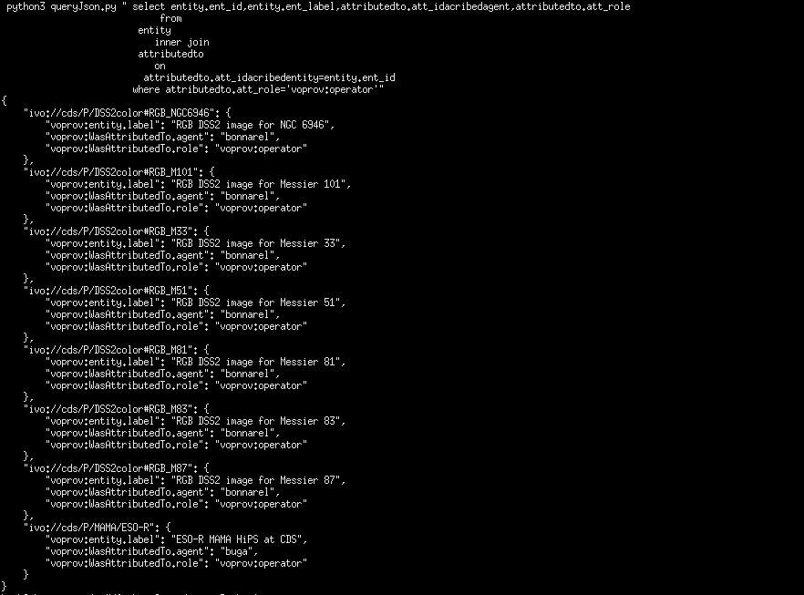
Advanced SQL query : Json output
QueryJson executes a join query on entity and
WasAttributedto
Query rationale:
Find out entities
Attributed to Agents
the role of which is :
« operator »

Slide 15
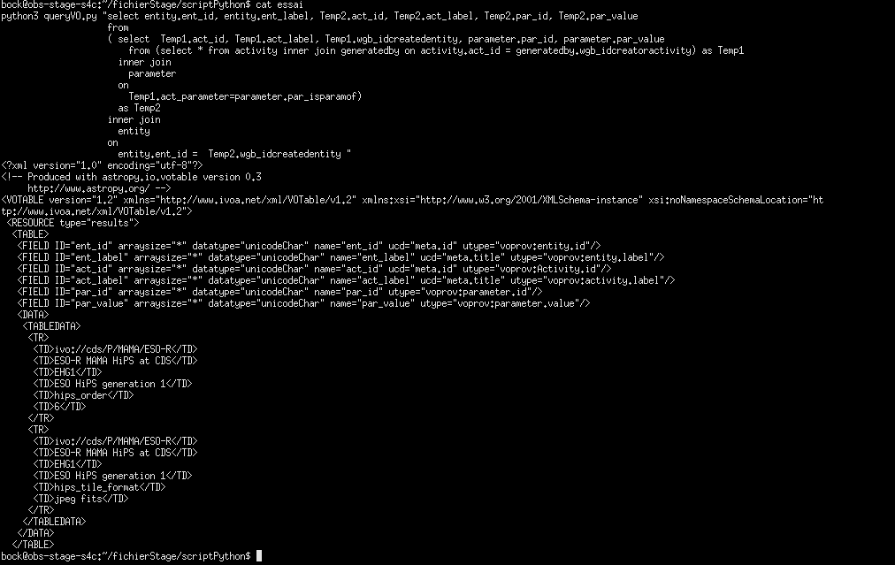
Advanced query : VOTABLE output
QueryVO executes successive
Joins query on WasGenertaedBy
Activity, parameter, and entity
Model utypes
And ucd
Query rationale:
Find out parameters used to generate
Entities through any activity

Slide 16
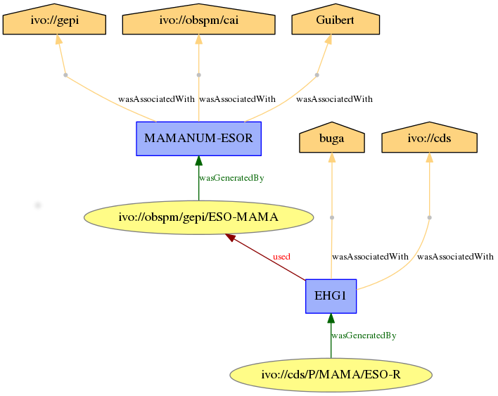
HispGen use case

Slide 17
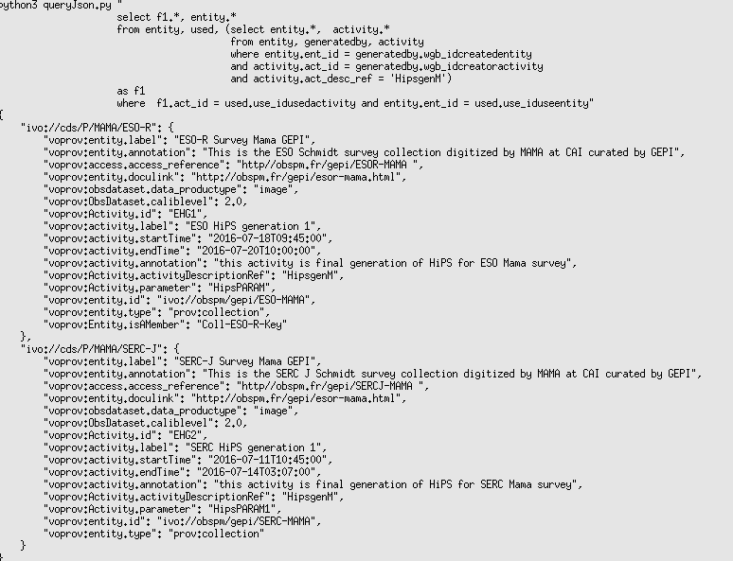
HipsGen use case (Json output)
Combined queries to discover
entities related by activities the activity description of which is ‘HipsGEn’

Slide 18
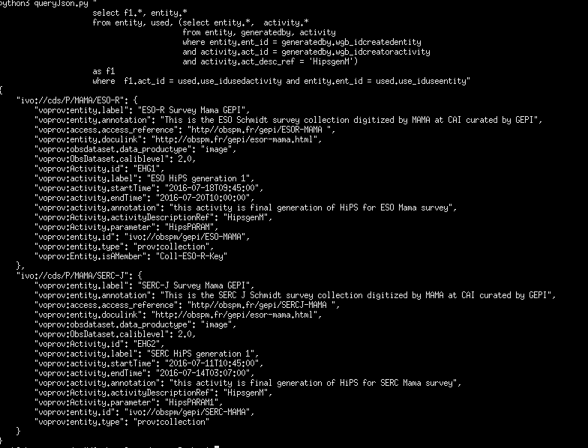
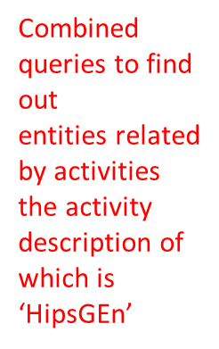
HipsGen use case (Json output)

