Slide 1
State of the TCG Urbana 21/May/2012
Christophe Arviset
For the TCG

Slide 2
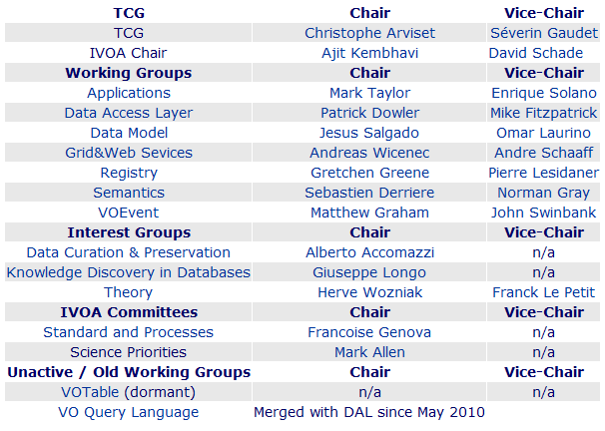
TCG Current Composition
Technical Coordination amongst WGs/IGs
Liaison with IVOA Exec
Specific role in Recommendation Process
New WG/IG chairs since May
Upcoming changes
http://www.ivoa.net/cgi-bin/twiki/bin/view/IVOA/IvoaTCG

Slide 3
The IVOA in 2011: Technical Assessment and Roadmap for 2012
IVOA main technical achievements in 2011
IVOA technical roadmap by WG / IG for 2012
Endorsed by the Exec and released on 26/Jan/2012
http://www.ivoa.net/Documents/Notes/IVOATechRoadmap2011

Slide 4
IVOA Architecture Level 0
Stable since creation

Slide 5
IVOA Architecture Level 1
Stable since creation

Slide 6
IVOA Architecture Level 3
Updated with new standards

Slide 7
Standards into REC since last Interop
[DM] ObsCoreDM 1.0
27 Oct 2011
[DAL] SSAP and [DM] SpectrumDM 1.1
27 Nov 2011
[Apps] SAMP 1.3
10 Apr 2012
[Registry] StandardsRegExt 1.0
28 Apr 2012
[DM] SimDM 1.0
05 May 2012

Slide 8
ObsCoreDM 1.0

Slide 9
ObsCoreDM 1.0

Slide 10
Standards to become REC soon
TAPRegExt 1.0, TCG review completed, update to be made and sent to Exec for recommendation
VOSpace 2.0, RFC started on 19/May/2012
PhotDM 1.0 to start RFC process on 4/June/2012
SimpleDALRegExt 1.0
VOUnits 1.0

Slide 11
TCG Meeting on 20/May/2012
Various cross WG/IG discussions
VOTable 1.3, VOUnits 1.0, Utypes 1.0
URI fragments, Registry monitoring
IVOA Publication Tools for Data Centres
Potential future standards to address new science cases
http://www.ivoa.net/cgi-bin/twiki/bin/view/IVOA/InterOpMay2012TCG

Slide 12
VOTable 1.3
Change process to be handled by Apps WG
VOTable 1.3 changes limited to handling NULL values
Then standard REC process
Dedicated plenary session this week
Monday 14:00

Slide 13
VOUnits 1.0
Agreement that it is ready to start REC process
Final discussion at plenary session this week
Monday 14:00
REC process to start soon after interop

Slide 14
Utypes 1.0
Tiger team to be formed
Collect use cases
Study current usage of Utypes
Used in a meaningful way?
Impact of changes on existing standards
Develop a standard

Slide 15
Note: URI fragments in IVOA specifications
URI fragment usage in various IVOA standards inconsistent with the URI standard IETF RFC 3986
TCG endorses the Note:
IVOA protocols should only use URI fragments in the following contexts
(a) the fragment is being used as a name for an object which is not expected to be retrieved, or
(b) there is an implication that the object so named will be retrieved in the way which is implied by the URI model.
If a resource named by a standard-specified URI will ever be retrieved, then to avoid doubt the standard should explicitly note that the fragment processing is expected to be performed by the client.

Slide 16
Registry monitoring
Two parallel efforts about monitoring of availability and quality of registered services
VAO and VO-Paris agreed to merge the results into common web pages, to be available at the registry
Need to determine policy how to handle non compliant or non responsive services
Actions on TCG and EXEC accordingly

Slide 17
Publication tools for Data Centre
IVOA Publication Tools
http://www.ivoa.net/cgi-bin/twiki/bin/view/IVOA/PublishingInTheVONew
Will be “reformatted” with new IVOA public web page style
To be released mid June 2012
Need to have more inputs from all interop ASAP
TCG will review content every 6 months

Slide 18
New science cases and future standards
Presentation from CSP – Committee on Science Priorities
Two new science cases are being studied
Time Series
Radio Astronomy
Science cases to be endorsed by Exec
Then TCG to look at required standards

Slide 19
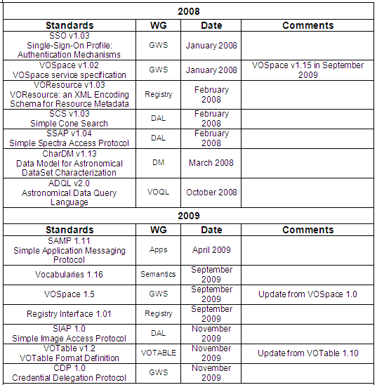
Existing IVOA REC standards - 2
More details can be found
on the IVOA Document pages at:
http://www.ivoa.net/Documents/

Slide 20
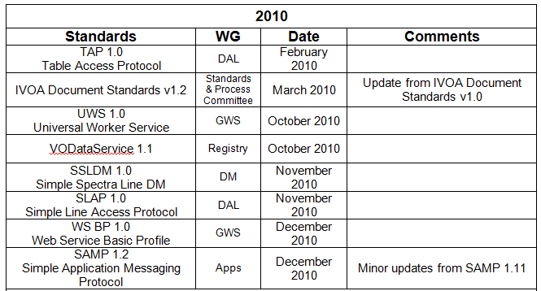
Existing IVOA REC standards - 3
More details can be found
on the IVOA Document pages at:
http://www.ivoa.net/Documents/

Slide 21
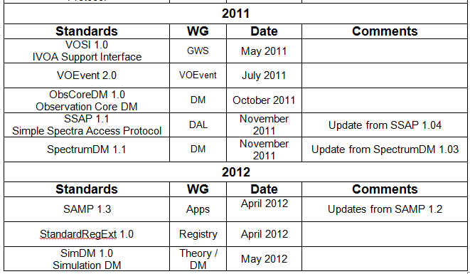
Existing IVOA REC standards - 4
More details can be found
on the IVOA Document pages at:
http://www.ivoa.net/Documents/

Slide 22
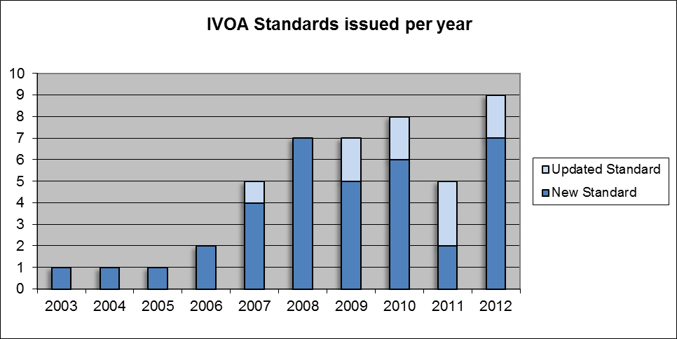
IVOA Standards per year
Planned

