Slide 1
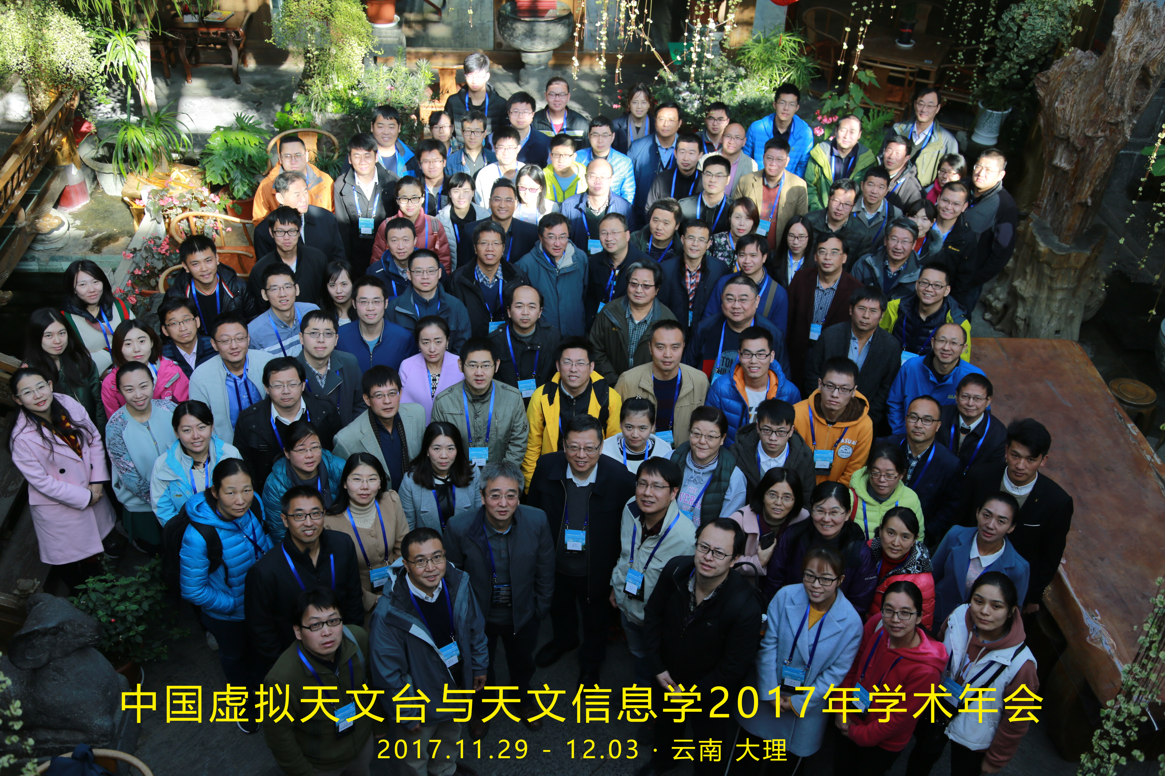

China-VO
Chinese Virtual Observatory
China-VO is the national VO project in China initiated in 2002 by Chinese astronomical community leading by National Astronomical Observatories, Chinese Academy of Sciences.
International Virtual Observatory Alliance

Slide 2
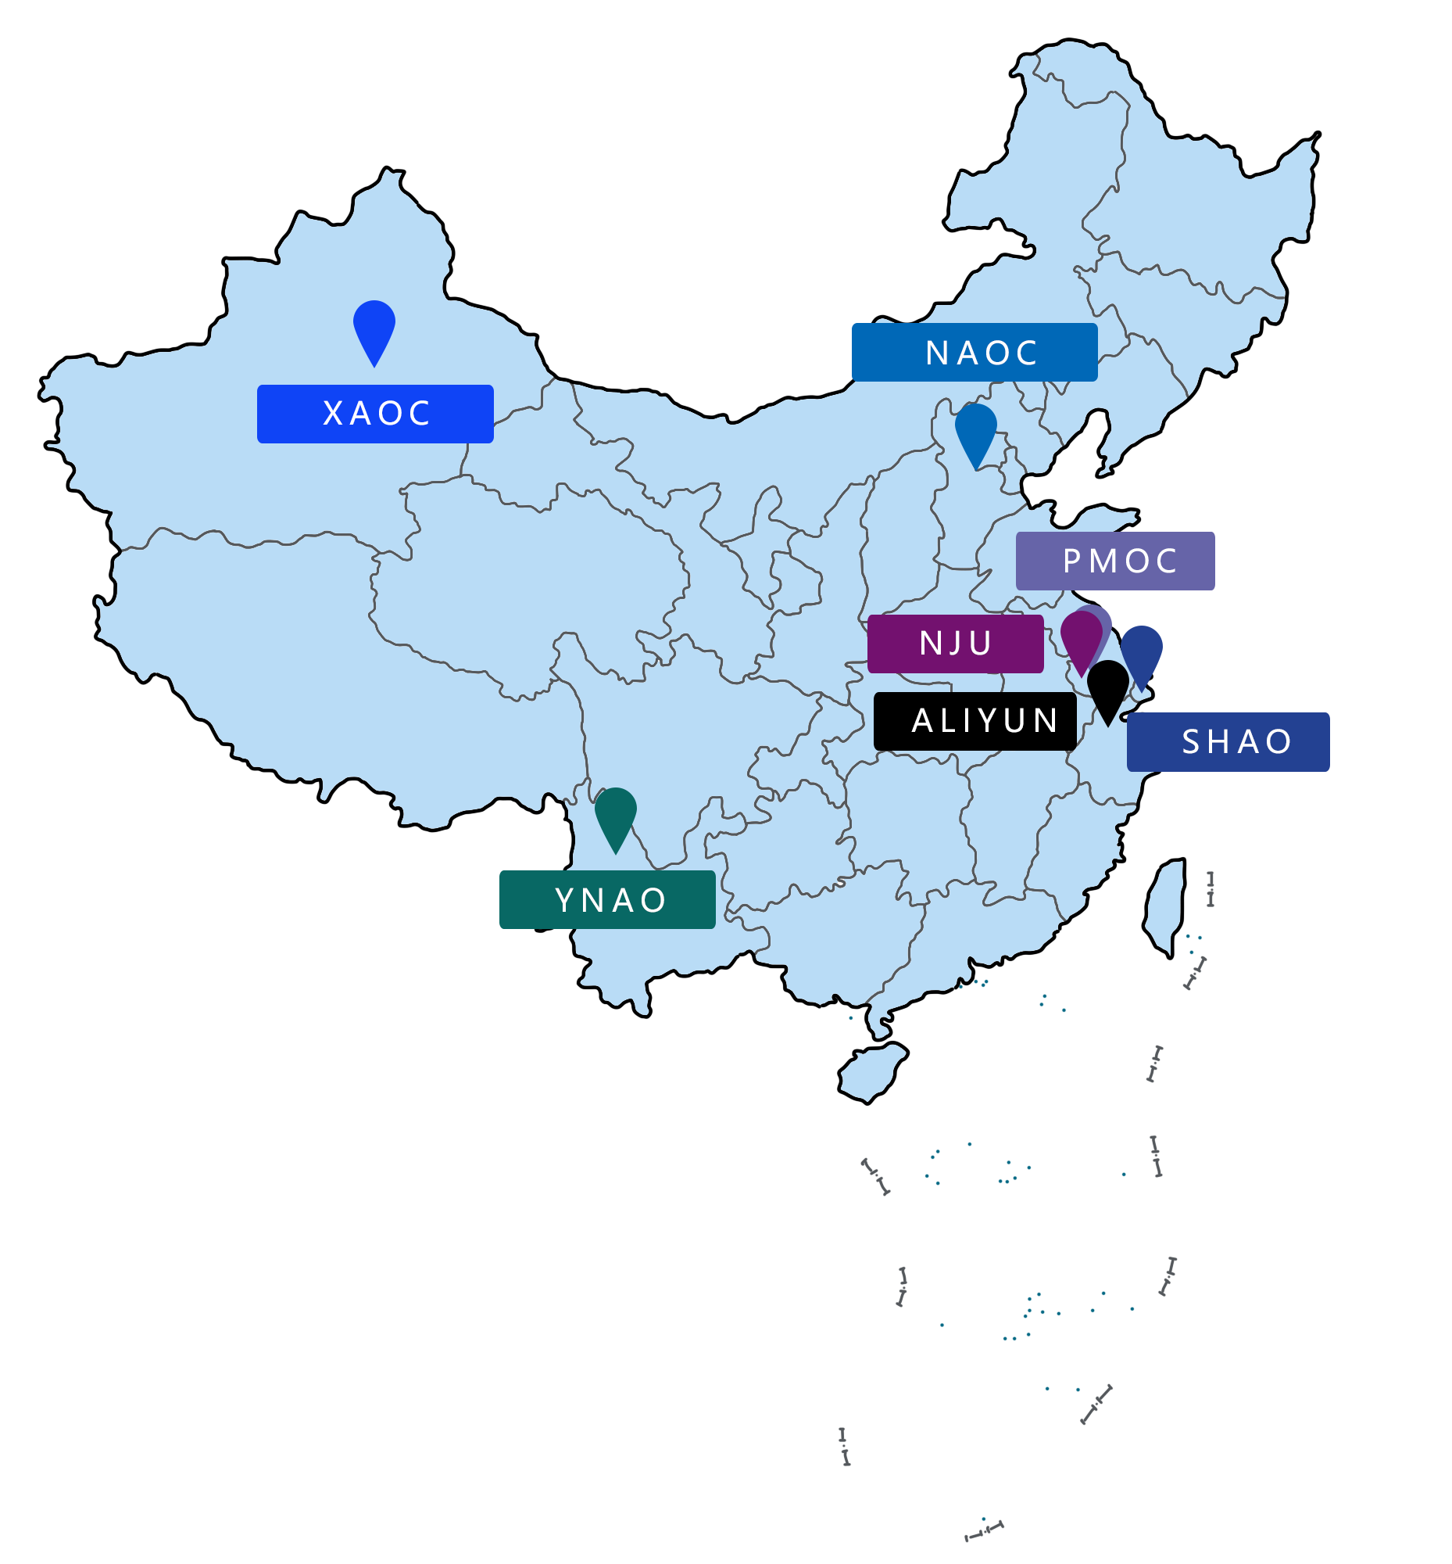


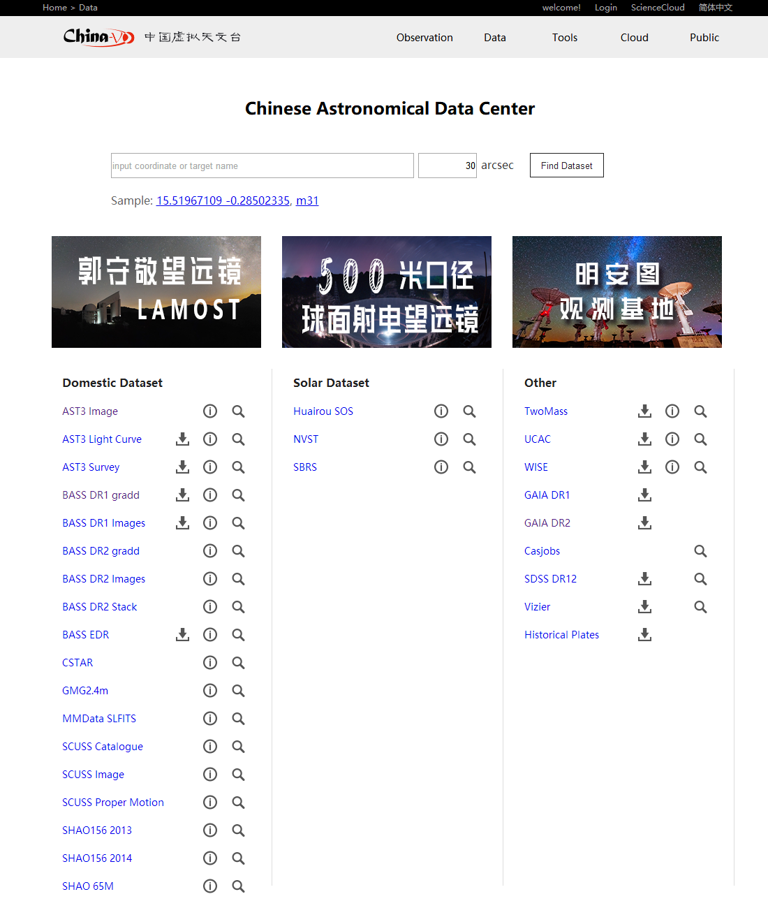





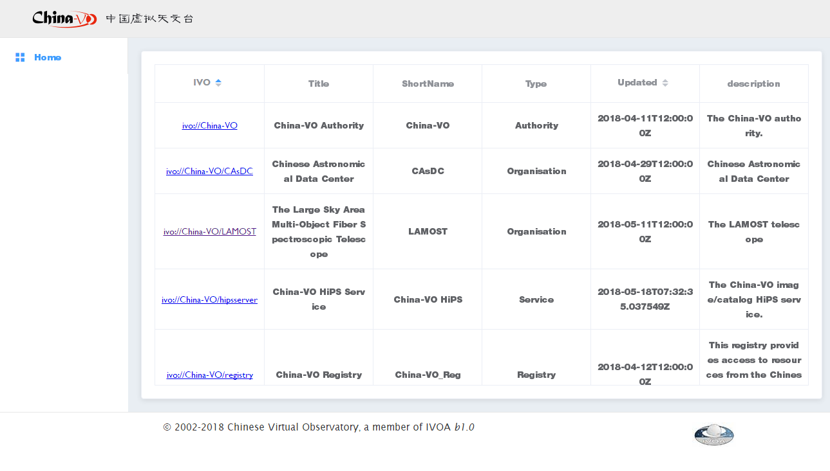

Data & Cloud Nodes
Support Astronomy Class in
Graduate School
Data-Driven Astronomy Education
Based on data and software on China-VO
WorldWide Telescope
Cloud Platform, more than 500 students in graduate school experienced.
Information / images / text about your project
Interactive
Astronomy
Class for
Primary
Schools
China-VO REGISTRY
China-VO Data centers physically distribute in Beijing, Nanjing, Shanghai, Xinjiang, Yunnan, and Alibaba Cloud. These centers connect all the observatories in China, provide data services and virtual machine services.
WWT Tour Contest
International Virtual Observatory Alliance

