Slide 1
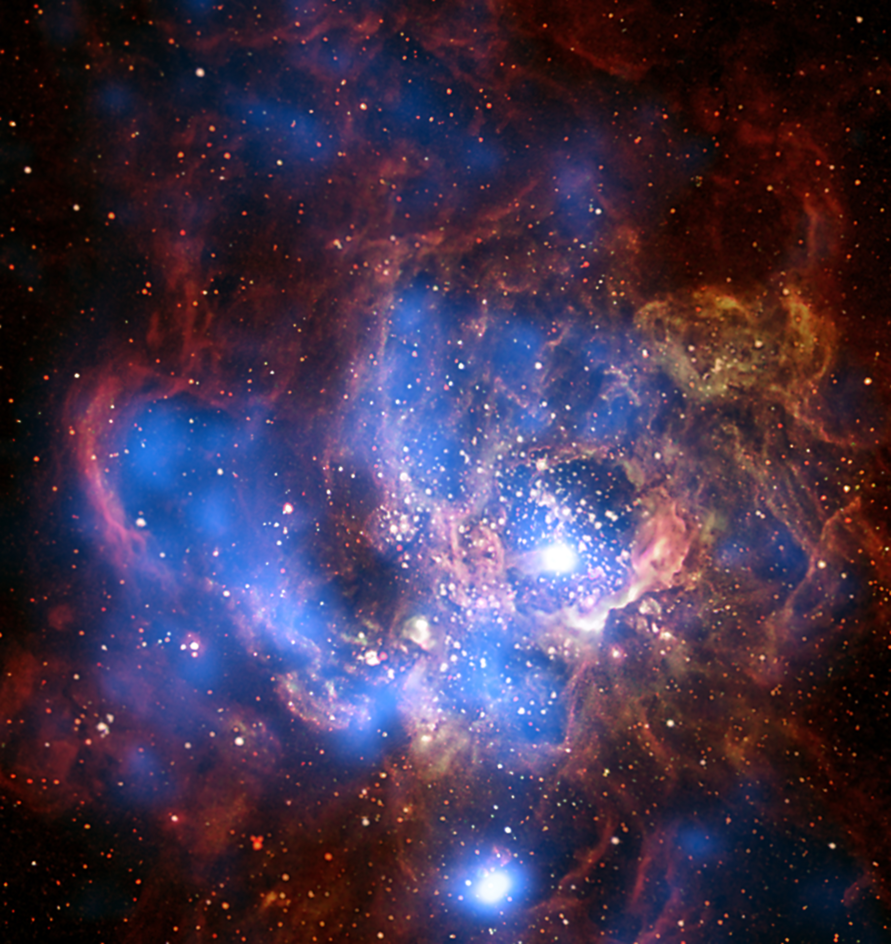
Ukrainian Virtual observatory (UkrVO) has been joined to the IVOA in 2011. The main task of UkrVO at that time was the integration of efforts of the Ukrainian astronomers in doing science on the basis of the cumulative multi-wave archives and state-of-the-art observational data. The core idea of UkrVO at that stage became the creation of the all-Ukrainian database of photographic, CCD, and spectral observations covered the period of more than 100 years, their digitizing and compilation into Joint Digital Archive prepared for further data processing and generation of new knowledge in combination with the new observational material. The main challenge we encountered consisted in the devising and developing the methods and means to attain the desired goals.
International Virtual Observatory Alliance
Credit: X-ray: NASA/CXC/CfA/R. Tullmann et al.; Optical: NASA/AURA/STScI

Slide 2
JOINT DIGITAL ARCHIVE
JDA is the core of the UkrVO project collecting photographic and CCD resources of 5 Ukrainian observatories. JDA database comprise metadata for 46 thousand direct photographic negatives of the sky, 12 thousand digital images of these negatives, and more than 30 thousand CCD frames from operating telescopes. The open access to JDA provided by DBGPA site http://gua.db.ukr-vo.org.
STELLAR CATALOGUES
JDA digital images have been used for the creation of enhanced versions of stellar catalogues obtained as projects of previous years. They are vast catalogues of FON project (FONAC-Kyiv, 24 million objects down to 16.5 B-mag; FONAC-Kitab, 13 million objects, 17.5 B-mag), catalogues of proper motions of stars (CP zone, 2 million objects, 15 B-mag), catalogues of stars in open clusters (1766 clusters, 2 million objects)
CATALOGUES OF SS BODIES
JDA data is a basis for reopening of asteroids on the archival photographic plates (54 objects), determining of positions and brightness of asteroids and comets (2 thousand asteroids, 11 comets), major planets and their satellites (Saturn and its 8 moons, 1400 positions ;Pluto, 100 positions; Uranus, Neptune and moons, 1500 positions; Jupiter and moons) .
COLITEC
CoLiTec (Collection Light Technology) software for the automated search for small celestial objects on a
series of CCD frames has been developed. CoLiTec software allows detecting of the objects with different velocities of the apparent motion for fast and slow moving objects, and objects with the near-zero apparent motion. Four comets and more than 1560 asteroids including 5 NEOs, 21 Trojan and one Centaur were discovered using CoLiTec. More than 700 000 positional CCD-measurements were sent to the Minor Planet Center.
International Virtual Observatory Alliance
Credit: X-ray: NASA/CXC/CfA/R. Tullmann et al.; Optical: NASA/AURA/STScI

