Slide 1
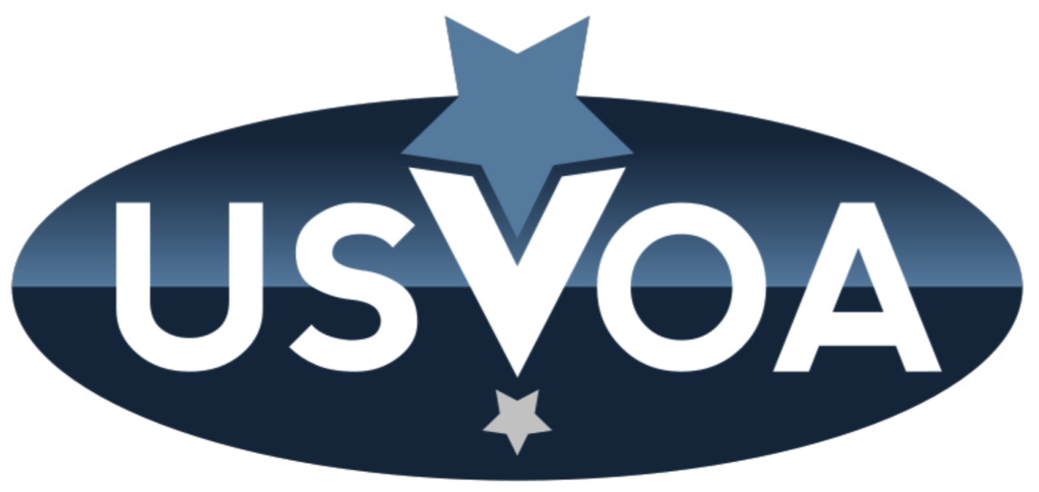
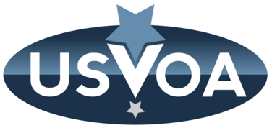
US Virtual Observatory Alliance
The USVOA is an open community of astronomers across the United States working on the development of Virtual Observatory standards and tools.
usvoa.cfa.harvard.edu
International Virtual Observatory Alliance
Image credit: Sloan Digital Sky Survey, DR3

Slide 2
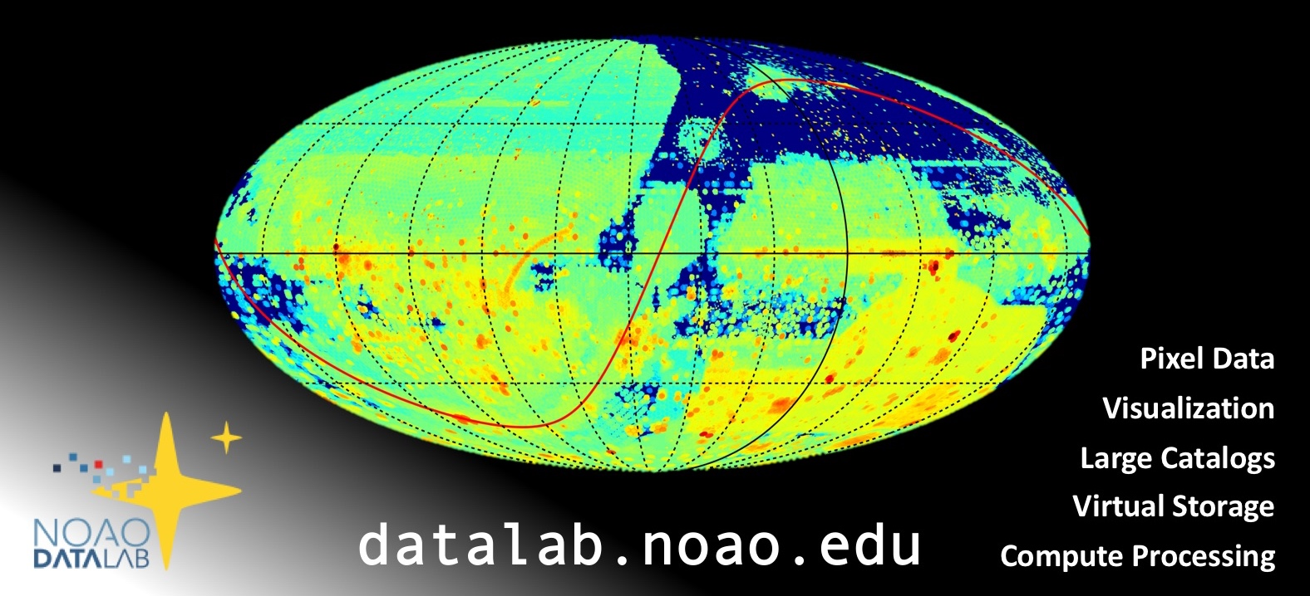
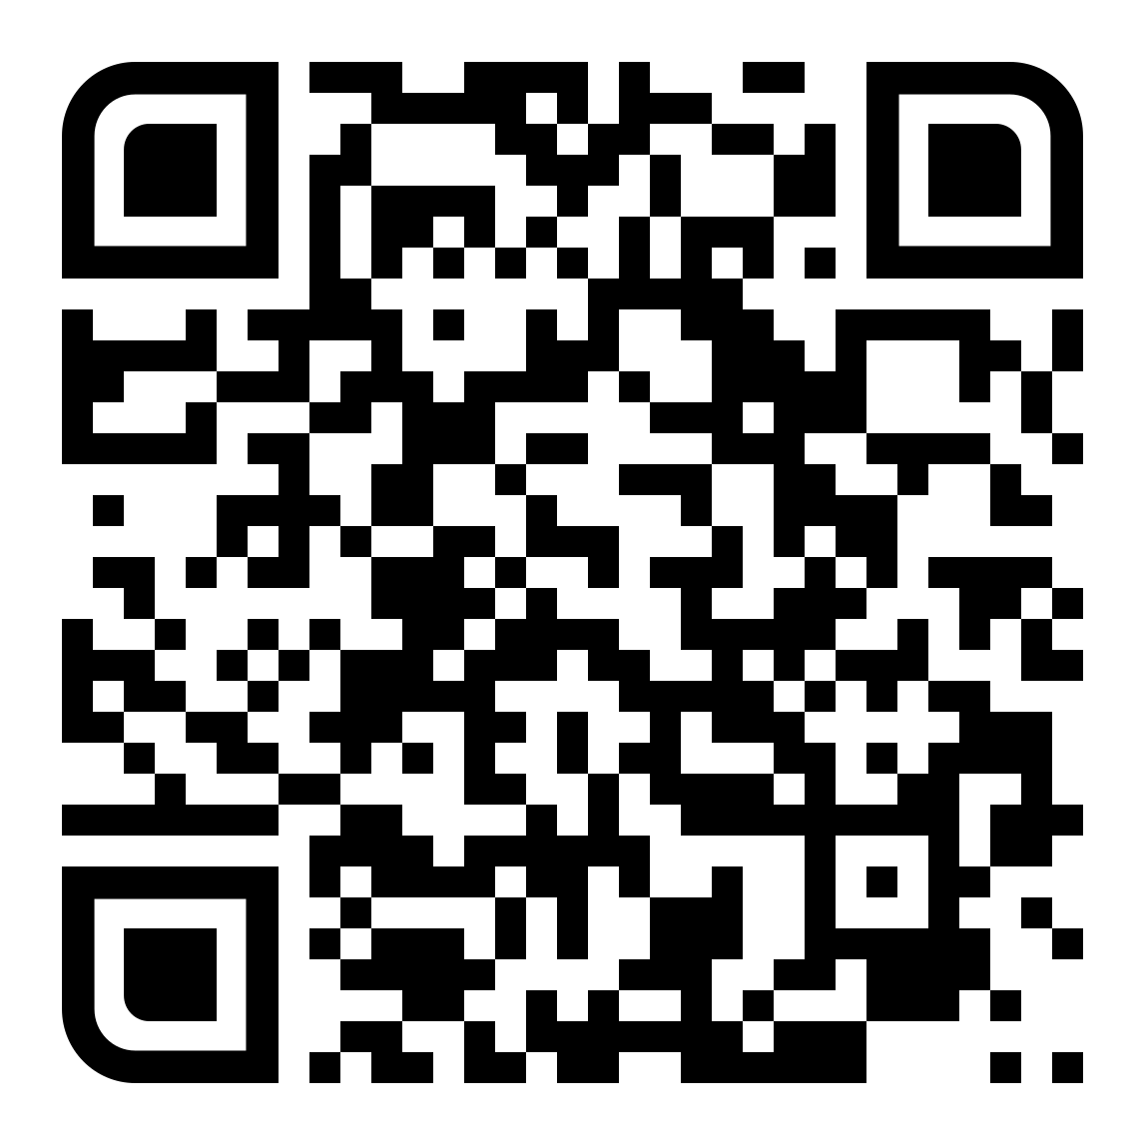
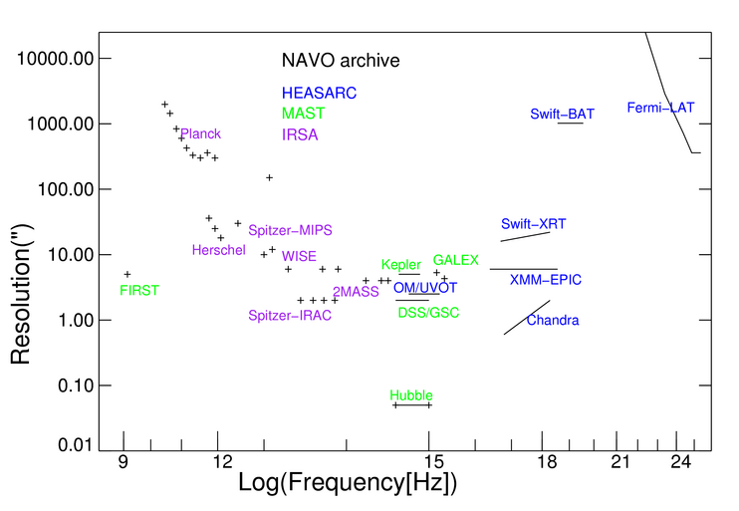
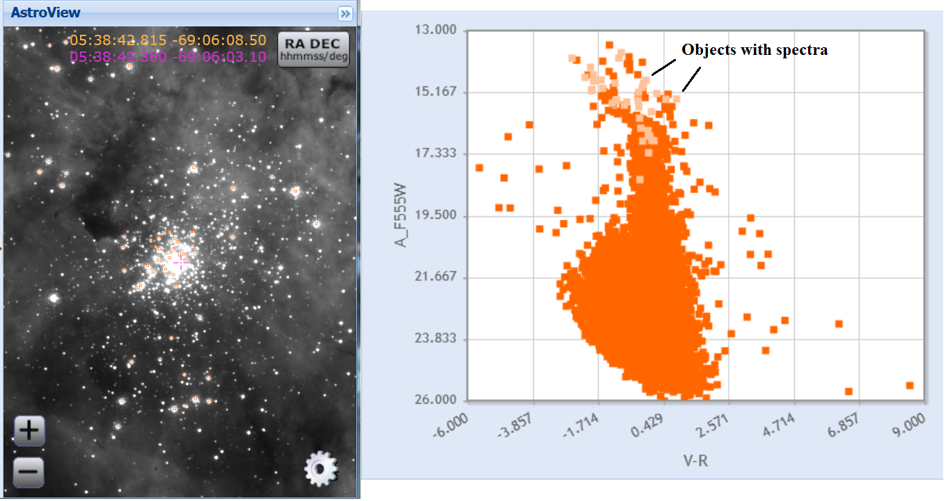
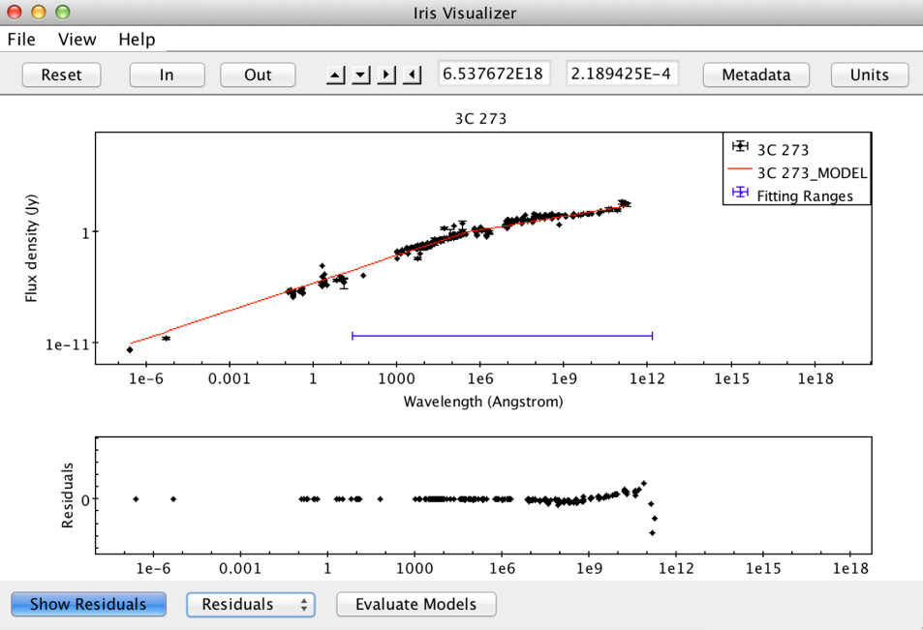
Discover… Access… Analyze…
NOAO Data Lab (NOAO)
VO: Simple Cone Search, SIAP, TAP, VOTable, VOSpace
World Wide Telescope (AAS)
VO: Simple Cone Search, VOTable, SAMP, TAP
See more
bit.ly/usvoa-iau
NASA Virtual Observatory:
Extensive, uniform access to NASA Archive holdings
MAST (STScI)
VO: Simple Cone Search, TAP, SIAP, VOTable, VO Registry
Iris (SAO/CXC)
VO: SAMP, VOTable, SpectrumDM
International Virtual Observatory Alliance
Image credit: Sloan Digital Sky Survey, DR3
SciServer (JHU/IDIES)
VO: Simple Cone Search, SIAP, TAP, VOTable, VOSpace
Notes:
python NASA-NAVO notebooks
IRSA archives updates
NED updates
https://hea-www.cfa.harvard.edu/USVOA/wp-content/uploads/2018/01/USVOA_AAS_231_reports.pdf

