Slide 1

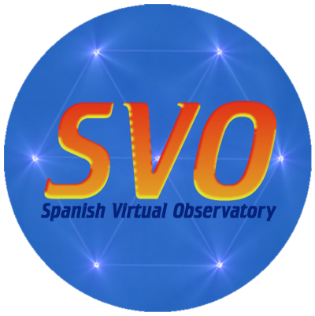
Spanish Virtual Observatory (SVO)
IVOA member since 2004.
Coordination of VO activities in Spain.
Four major lines of work:
  VO compliance of astronomical archives.
  Development of VO tools.
  VO-science.
  Education & Outreach.
http://svo.cab.inta-csic.es
International Virtual Observatory Alliance
Credit: X-ray: NASA/CXC/CfA/R. Tullmann et al.; Optical: NASA/AURA/STScI

Slide 2
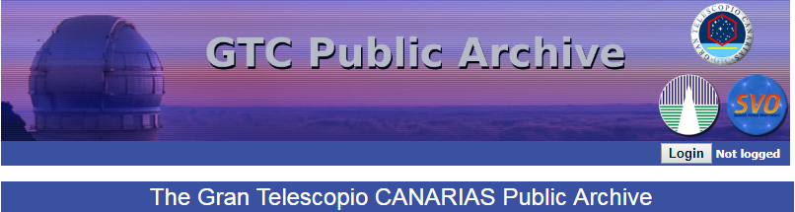



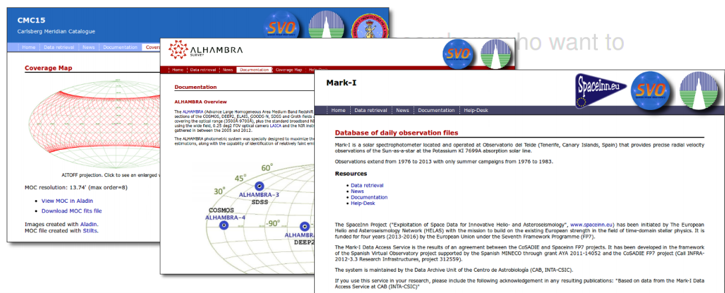

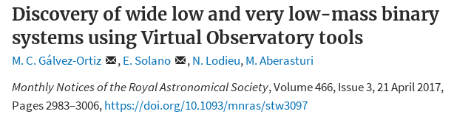
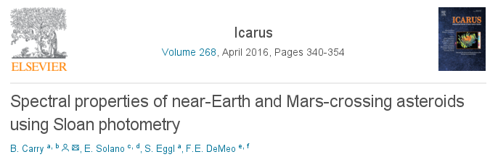
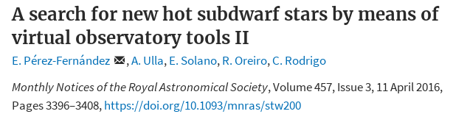
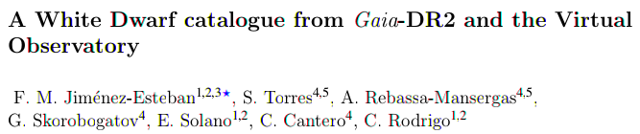
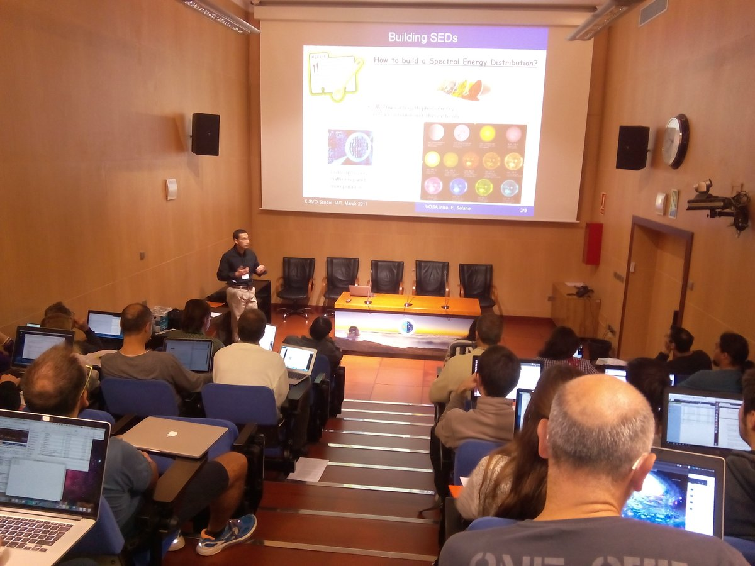
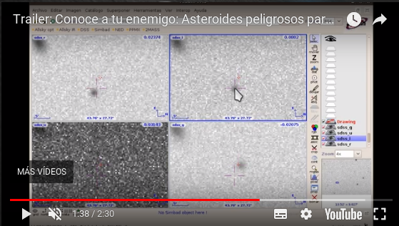
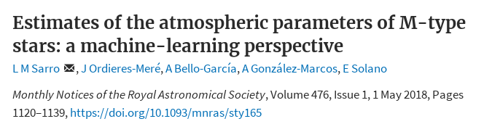
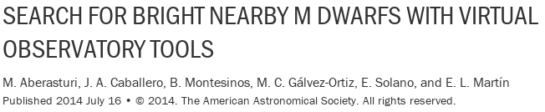
  Astronomical archives
  We host the largest VO data centre managed by a Spanish institution.
  VO tools
  We develop VO tools and services for data publishing and data analysis.
Stellar parameters from SED fitting.
Stellar cluster membership probability.
  VO-science
  VO project providing the largest number of VO-science papers.
Data discovery in VO archives.
  Education and Outreach
Liaison with Universities.
VO-schools.
Citizen-science.
And many more….
International Virtual Observatory Alliance
Credit: X-ray: NASA/CXC/CfA/R. Tullmann et al.; Optical: NASA/AURA/STScI

