Slide 1

Russian Virtual Observatory (RVO)
Current status and main projects
Started in Dec 2001, RVO has the following aims:
To promote integration of the Russian astronomical data resources into the International Virtual Observatory;
To construct VO science prototypes;
To take part in developing of software, techniques, standards, formats of the IVO;
To strengthen education and public applications of world astronomical data.
International Virtual Observatory Alliance

Slide 2

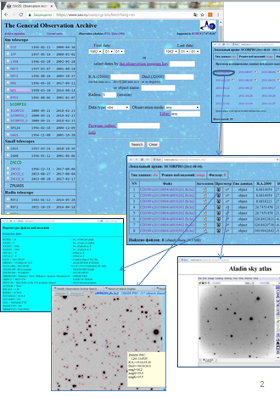
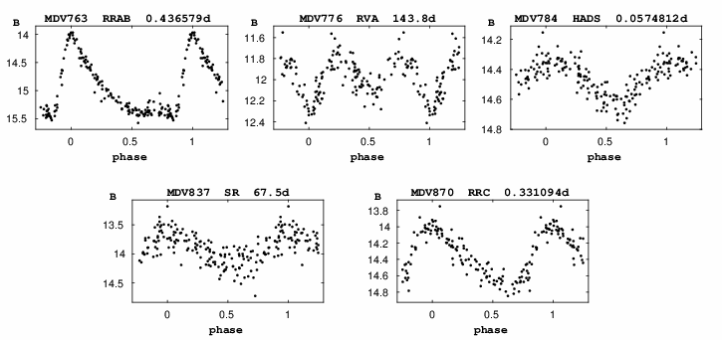
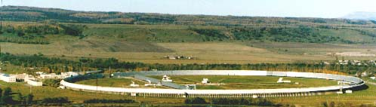
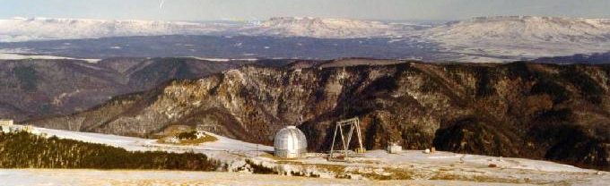

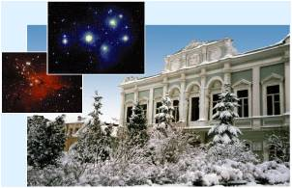

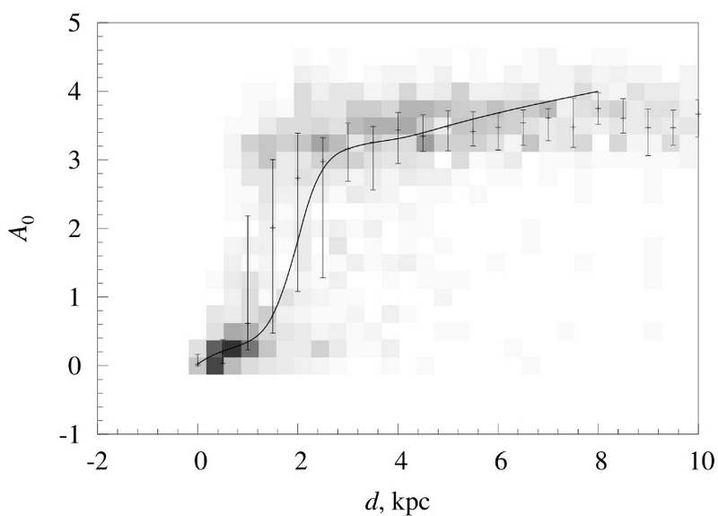
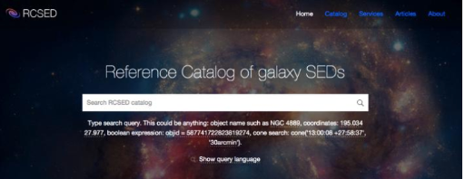
General Catalogue of Variable Stars: more variable stars discovered, new classification algorythms applied.
Special Astrophysical Observatory data archive system: since 1982, total volume ~7 ТB, 2 mln files, 1.7 mln database records. software for automatic astrometric calibration of direct images and for on-fly data visualization developed.
Binary star DataBase, BDB:
New algorythms of cross-identification implemented for multiple stars.
http://bdb.inasan.ru/
http://www.sai.msu.su/gcvs/
https://www.sao.ru/oasis/cgi-bin/fetch?lang=eng
Reference Catalog of galaxy Spectral Energy Distributions RCSED: a VO-compatible catalog of galaxies produced as join between GALEX, SDSS, and UKIDSS catalogs, and processed with state-of-the-art spectral analysis methods which were not available earlier.
Construction of 3D map of extinction and dust distribution in Galaxy: New methods developed involving analyzing and extracting multiwavelength photometric information from sky surveys with recently developed VO instruments. Bayesian probabilistic approach is used to estimate the distance-extinction relation.
http://rcsed.sai.msu.ru/
The presentation materials were provided by Dana Kovaleva, Nikolay Samus, Sergey Sichevsky, Olga Zhelenkova, Ivan Zolotukhin.
International Virtual Observatory Alliance

