Slide 1
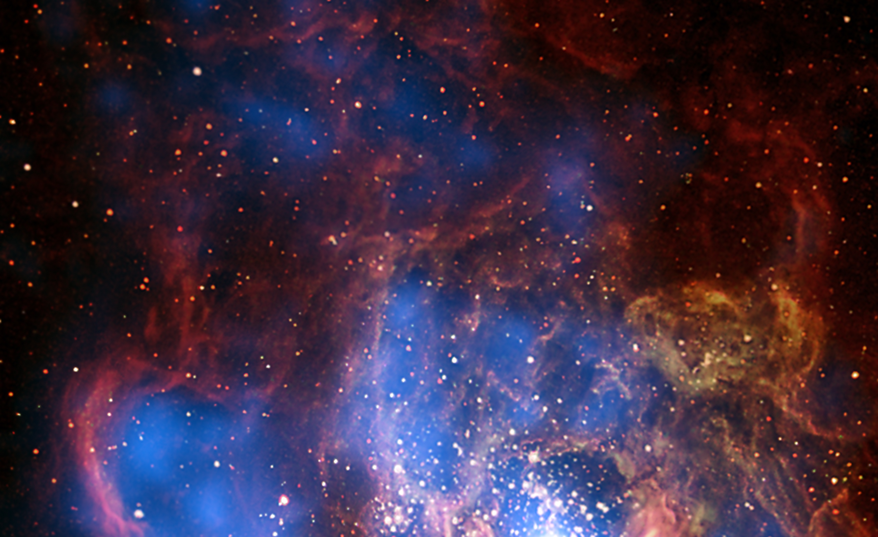



The NOAO Data Lab
We seek to empower astronomers through efficient exploration and analysis of large astronomy datasets with an emphasis on NOAO wide-field telescopes.
datalab.noao.edu
International Virtual Observatory Alliance
Credit: X-ray: NASA/CXC/CfA/R. Tullmann et al.; Optical: NASA/AURA/STScI

Slide 2
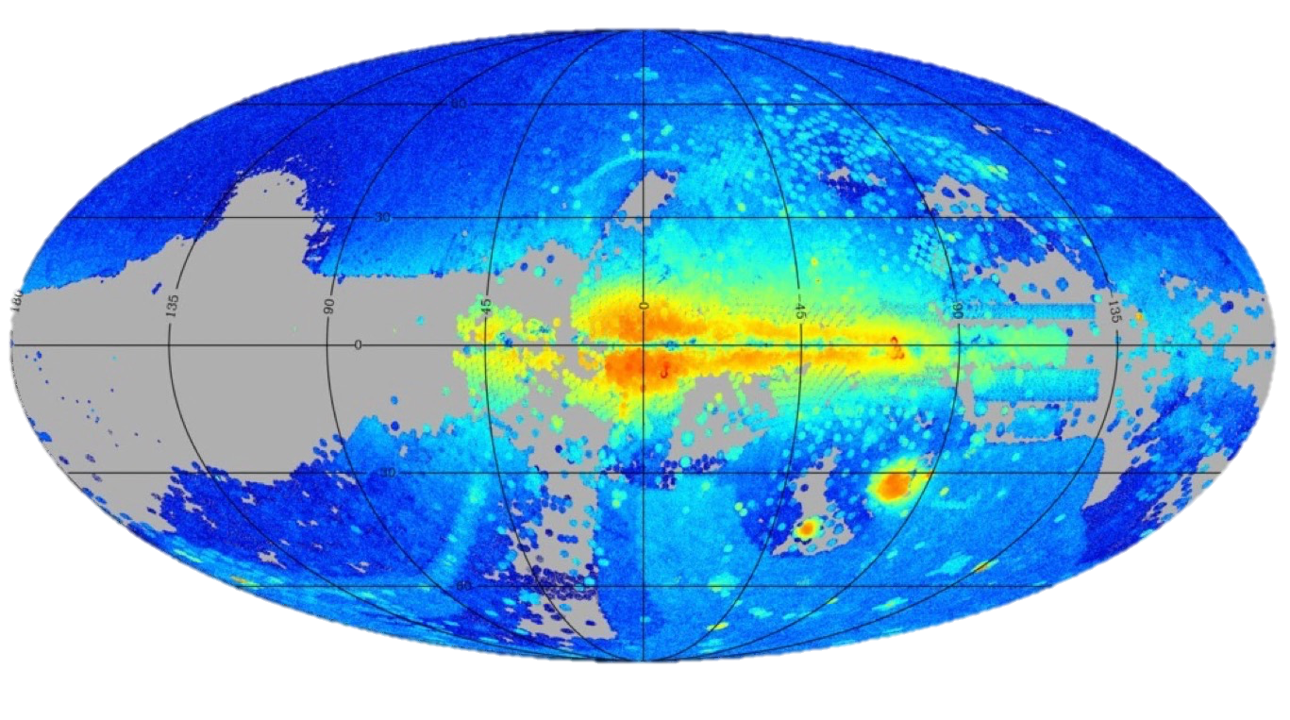
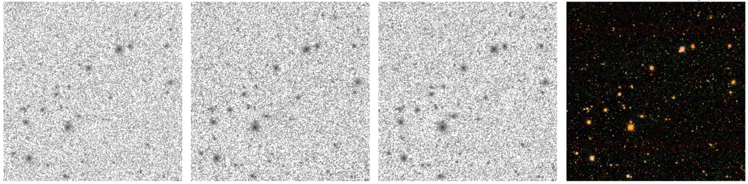
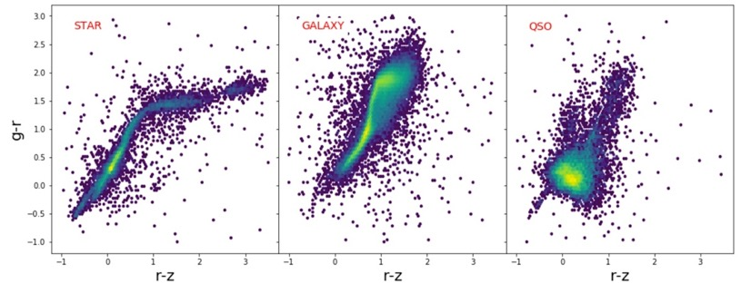
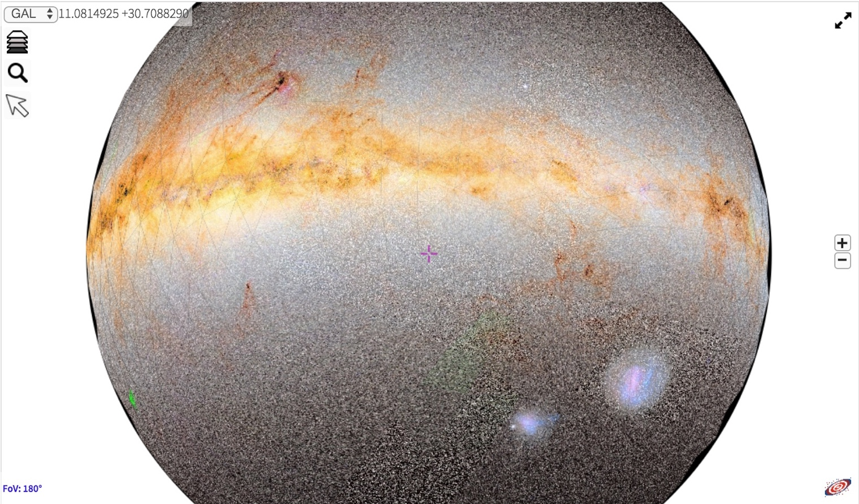
Large Catalogs – TB-scale databases
Pixel Data – images in NOAO Science Archive
datalab.noao.edu
g-band
r-band
i-band
gri
Virtual Storage – 1 TB per user
Compute Processing – workflows close to the data
Visualization – data exploration
STAR
GALAXY
QSO
International Virtual Observatory Alliance
Credit: X-ray: NASA/CXC/CfA/R. Tullmann et al.; Optical: NASA/AURA/STScI

