Slide 1




Japanese Virtual Observatory, NAOJ
The Japanese Data Hub for Astronomy
JVO provides astronomers with observational data from Subaru, ALMA, Nobeyama, ISAS, GAIA, and others through VO services worldwide.
http://jvo.nao.ac.jp/
International Virtual Observatory Alliance
Credit: X-ray: NASA/CXC/CfA/R. Tullmann et al.; Optical: NASA/AURA/STScI

Slide 2
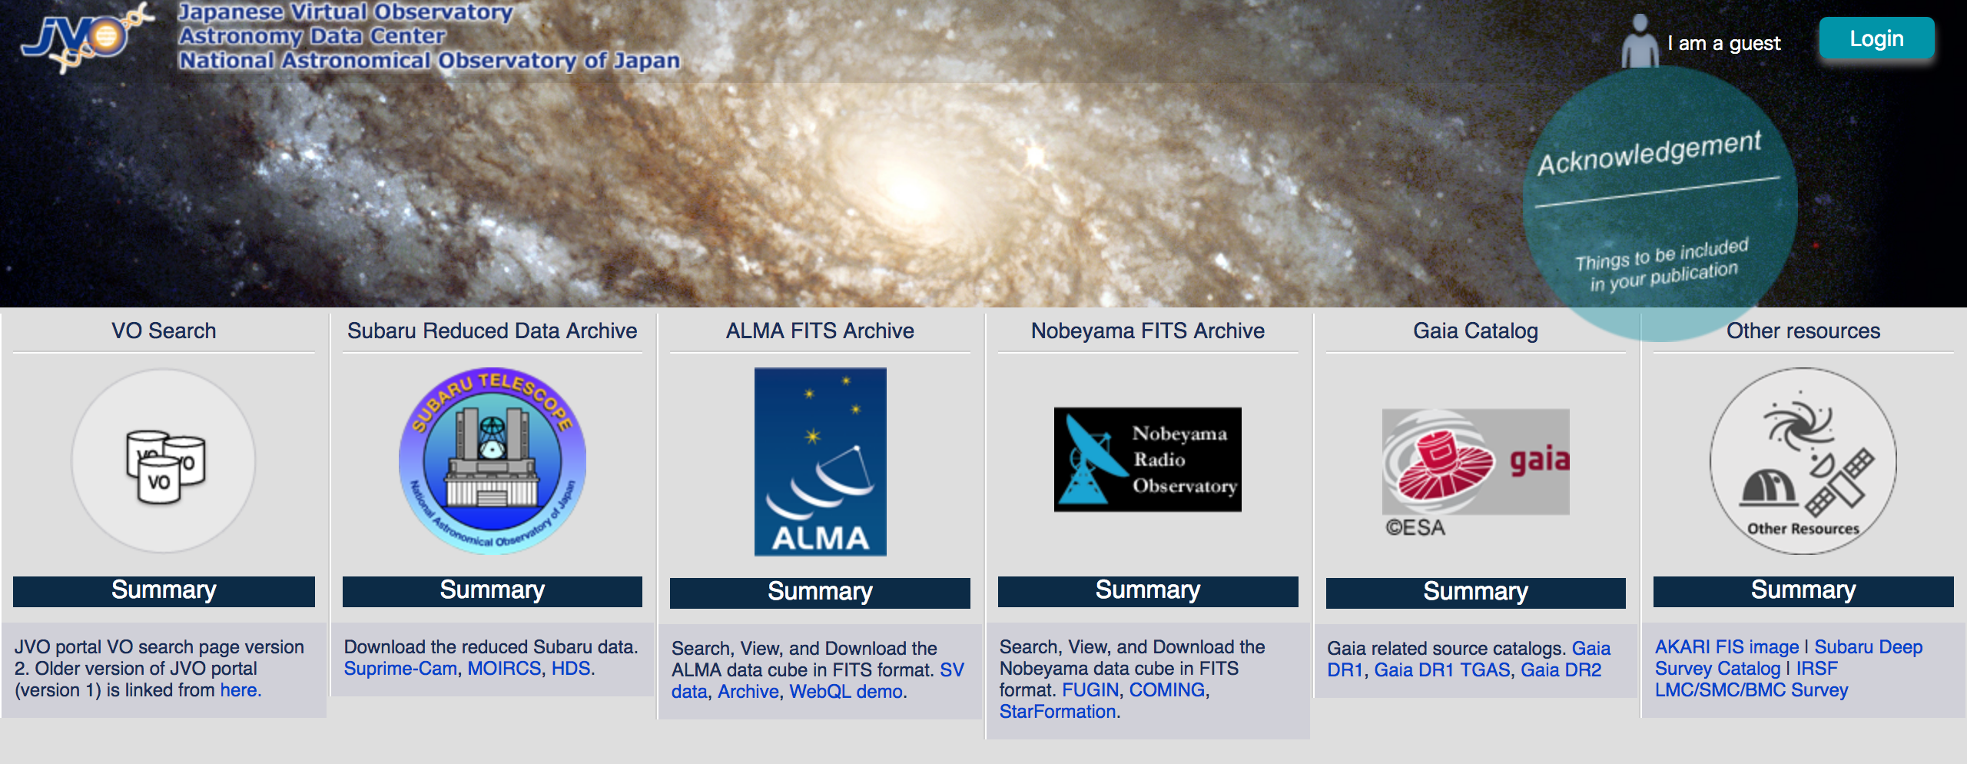
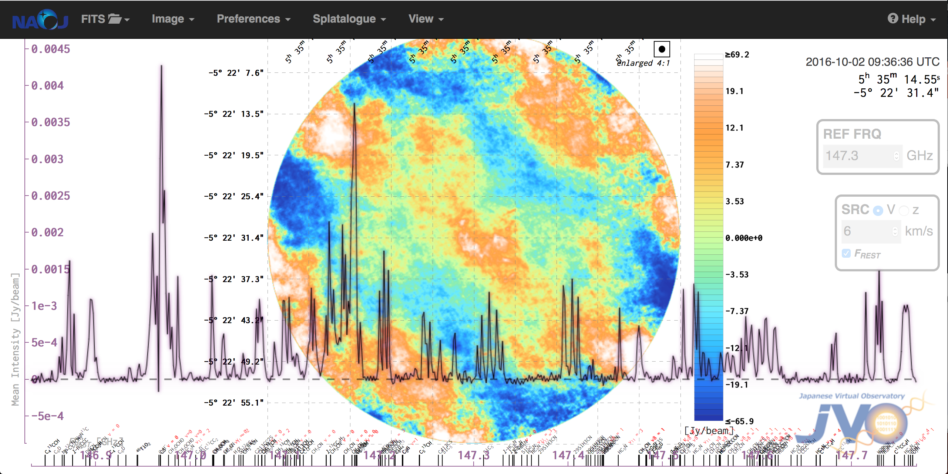
Information / images / text about your project
JVO provides a unique
quick-look service for the
ALMA FITS files.
↓
One stop data services from Japanese telescopes
and those from all over the world.
Visit us at http://jvo.nao.ac.jp/
International Virtual Observatory Alliance
Credit: X-ray: NASA/CXC/CfA/R. Tullmann et al.; Optical: NASA/AURA/STScI

