Slide 1


Armenian Virtual Observatory (ArVO)
ArVO is a project of the Byurakan Astrophysical Observatory (BAO) aimed at construction of a modern system for data archiving, extraction, acquisition, reduction, use and publication. ArVO is based on the Digitized First Byurakan Survey (DFBS) and is the Armenian contribution to the International Virtual Observatories Alliance (IVOA). One of the ArVO's main tasks is to create and utilize a global Spectroscopic Virtual Observatory, which will combine data from DFBS and other low-dispersion spectroscopic databases, as well as provide the first understanding on the nature of any object up to B=18^{m}.
In frame of the ArVO, BAO collaborates with the Institute of Information Technologies (IIT) of the Armenian National Academy of Sciences to develop software for ArVO corresponding to the IVOA standards. Beside the DFBS, ArVO is being complemented by the Digitized Second Byurakan Survey (SBS) database, the Byurakan photographic archive, and the BAO 2.6m telescope observations, and will be a part of IVOA.
International Virtual Observatory Alliance
Credit: X-ray: NASA/CXC/CfA/R. Tullmann et al.; Optical: NASA/AURA/STScI

Slide 2
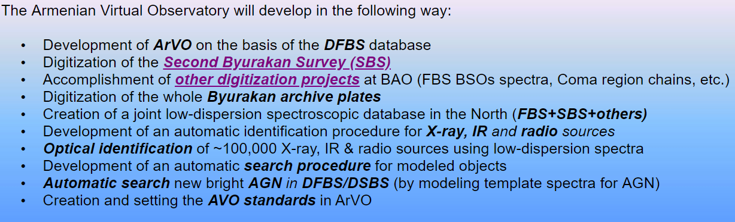
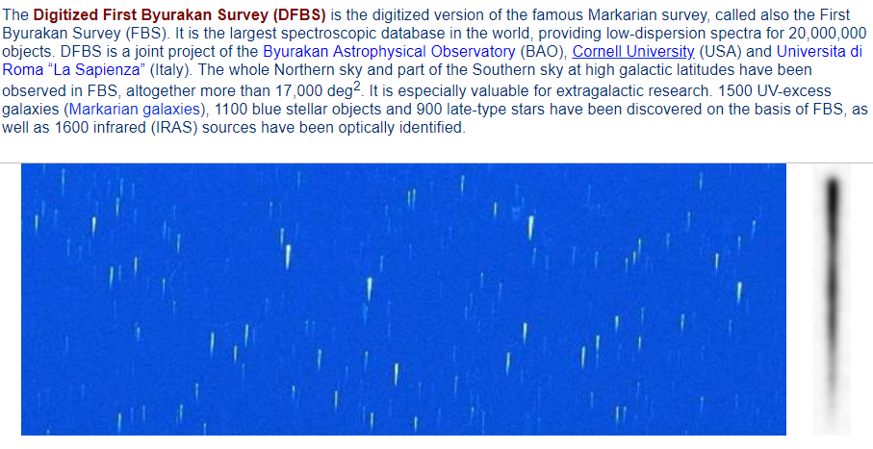
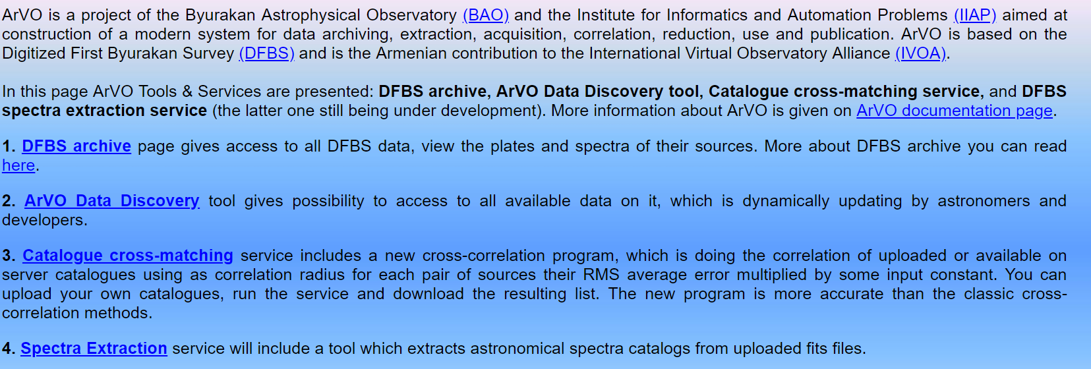
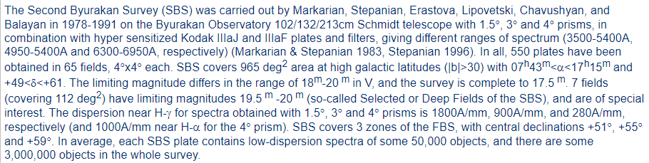
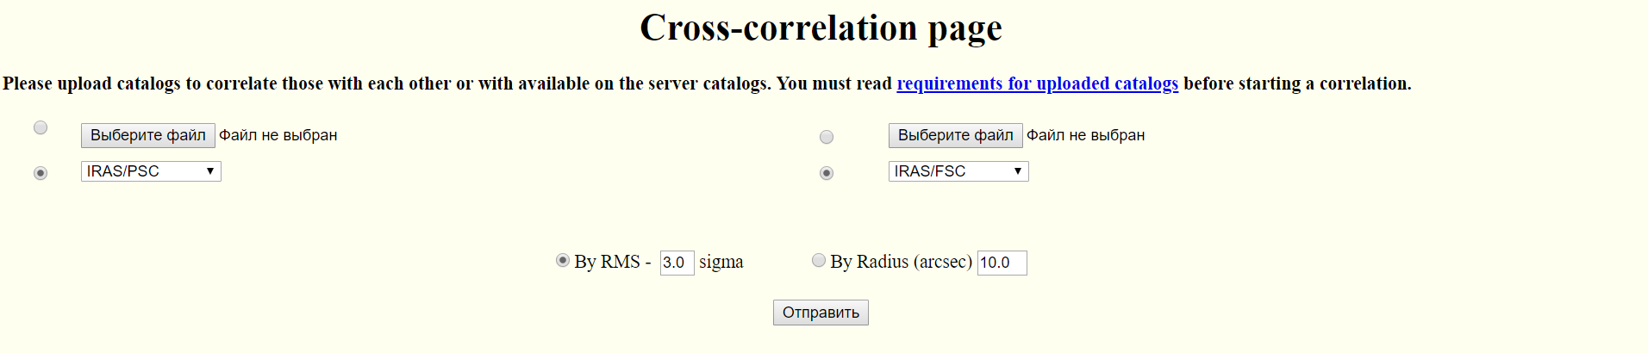
International Virtual Observatory Alliance
Credit: X-ray: NASA/CXC/CfA/R. Tullmann et al.; Optical: NASA/AURA/STScI

Slide 3





The Chilean Virtual Observatory (ChiVO)
The Chilean Virtual Observatory (ChiVO) is a VO developed in Chile. It was born out of the need to archive data that require large storage capacities and the need to develop new tools for the analyzing large volumes of data and better algorithms for intelligent processing of astronomical data. Due to the large scale volumes of data that will be generated by astronomical observatories in Chile, mainly the ALMA project that will generate over 1TB of data per day, then ChiVO´s datacenter is able to store the data in the local territory to optimize the access and availability to the Chilean community of astronomers.
International Virtual Observatory Alliance
Credit: X-ray: NASA/CXC/CfA/R. Tullmann et al.; Optical: NASA/AURA/STScI

Slide 4
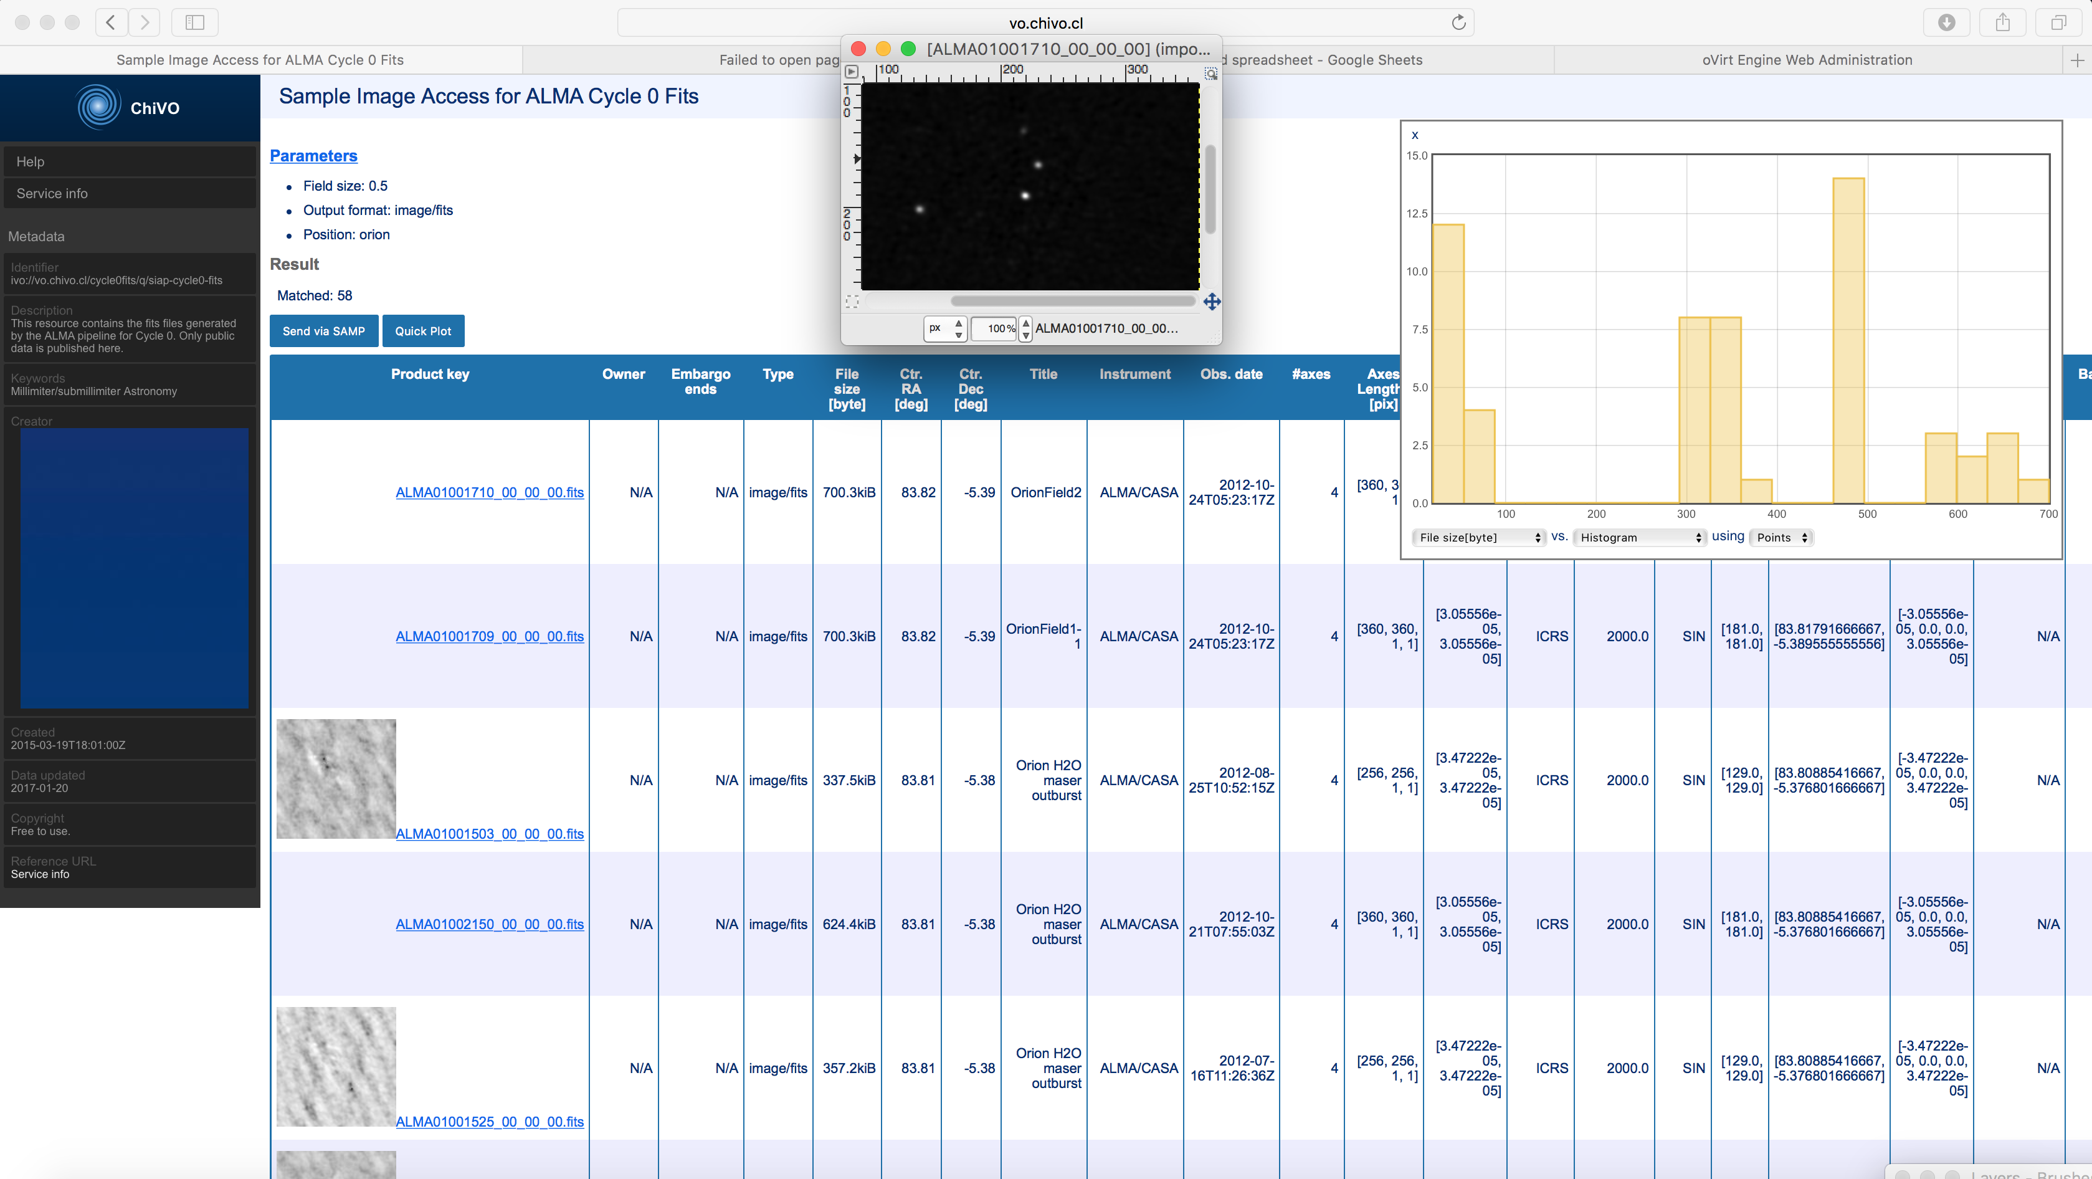

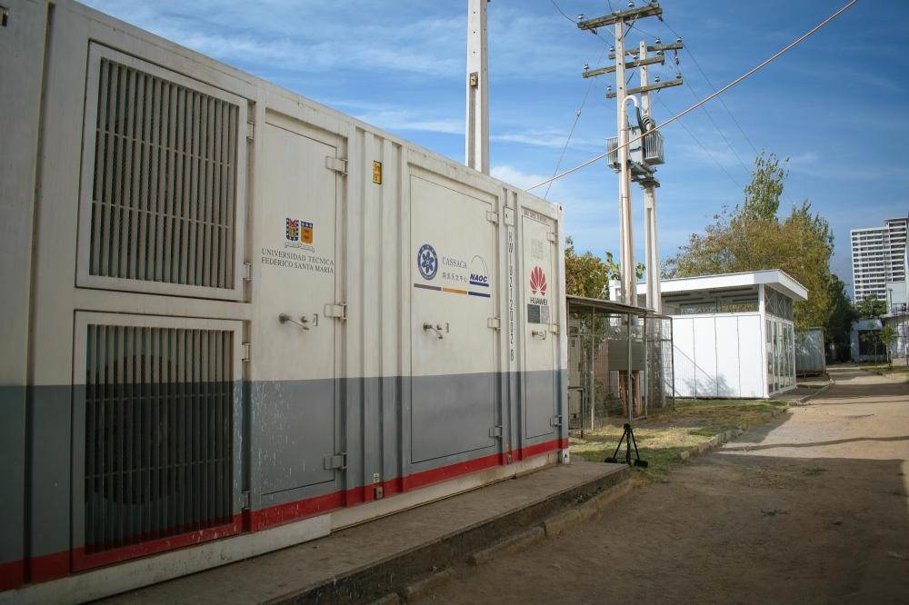
ChiVO ALMA-VO Data Repository
The ALMA-VO Data Repository service offers the cycles 0, 1, 2 and 3 of ALMA data (28,236 FITS) access through IVOA standard web-services/VO-apps or through a web-page. Currently we support single FITS files search [SCS, SIA and TAP] and complete data products (TAR files) [SCS and TAP]. In addition we are ingesting the raw data of ALMA, the ASDM. Of these files we have already stored 2079 files with a total weight of 88 [TB]. https://vo.chivo.cl/
ChiVO The Jupyter OVerride for Astronomical Libraries (JOVIAL)
It is a notebook-based cloud environment to process astronomical data on-line. This service provides Jupyter Notebooks to astronomers, that are executed in the cloud under a python environment. No installation is required so it is accessible from any device. This service is in beta testing so you need an account to use it. If you are interested in participating of this project please contact maray@inf.utfsm.cl - https://github.com/ChileanVirtualObservatory/jovial.chivo.cl
ChiVO The Advanced Computing for Astronomy Library (ACALib)
It is a package with state of the art Algorithms for Astronomers including novel algorithms produced by ChiVO and some HPC versions of them. The official documentation can be found in http://acalib.readthedocs.io/en/latest/
ChiVO DataCenter (VO-HPC)
The datacenter has the objective of providing storage and processing capacities to the local and foreign astronomers, including mirroring astronomical data generated in Chile. And also will allow the astronomers re-process the raw data of ALMA over HPC support. The storage capacity is ≈ 1PB, but for 2019 it will be ≈ 2 PB. https://www.chivo.cl/
International Virtual Observatory Alliance
Credit: X-ray: NASA/CXC/CfA/R. Tullmann et al.; Optical: NASA/AURA/STScI

Slide 5


Chandra X-Ray data in the
Virtual Observatory
The Chandra X-ray Observatory has nearly 20 years of public data in its archive. Chandra data is easily accessible to the scientific community through VO-enabled services and interfaces.
cxc.harvard.edu
International Virtual Observatory Alliance
CXC
Image credit: X-ray: NASA/CXC/UMass/D. Wang et al.; Optical: NASA/ESA/STScI/D.Wang et al.; IR: NASA/JPL-Caltech/SSC/S.Stolovy

Slide 6
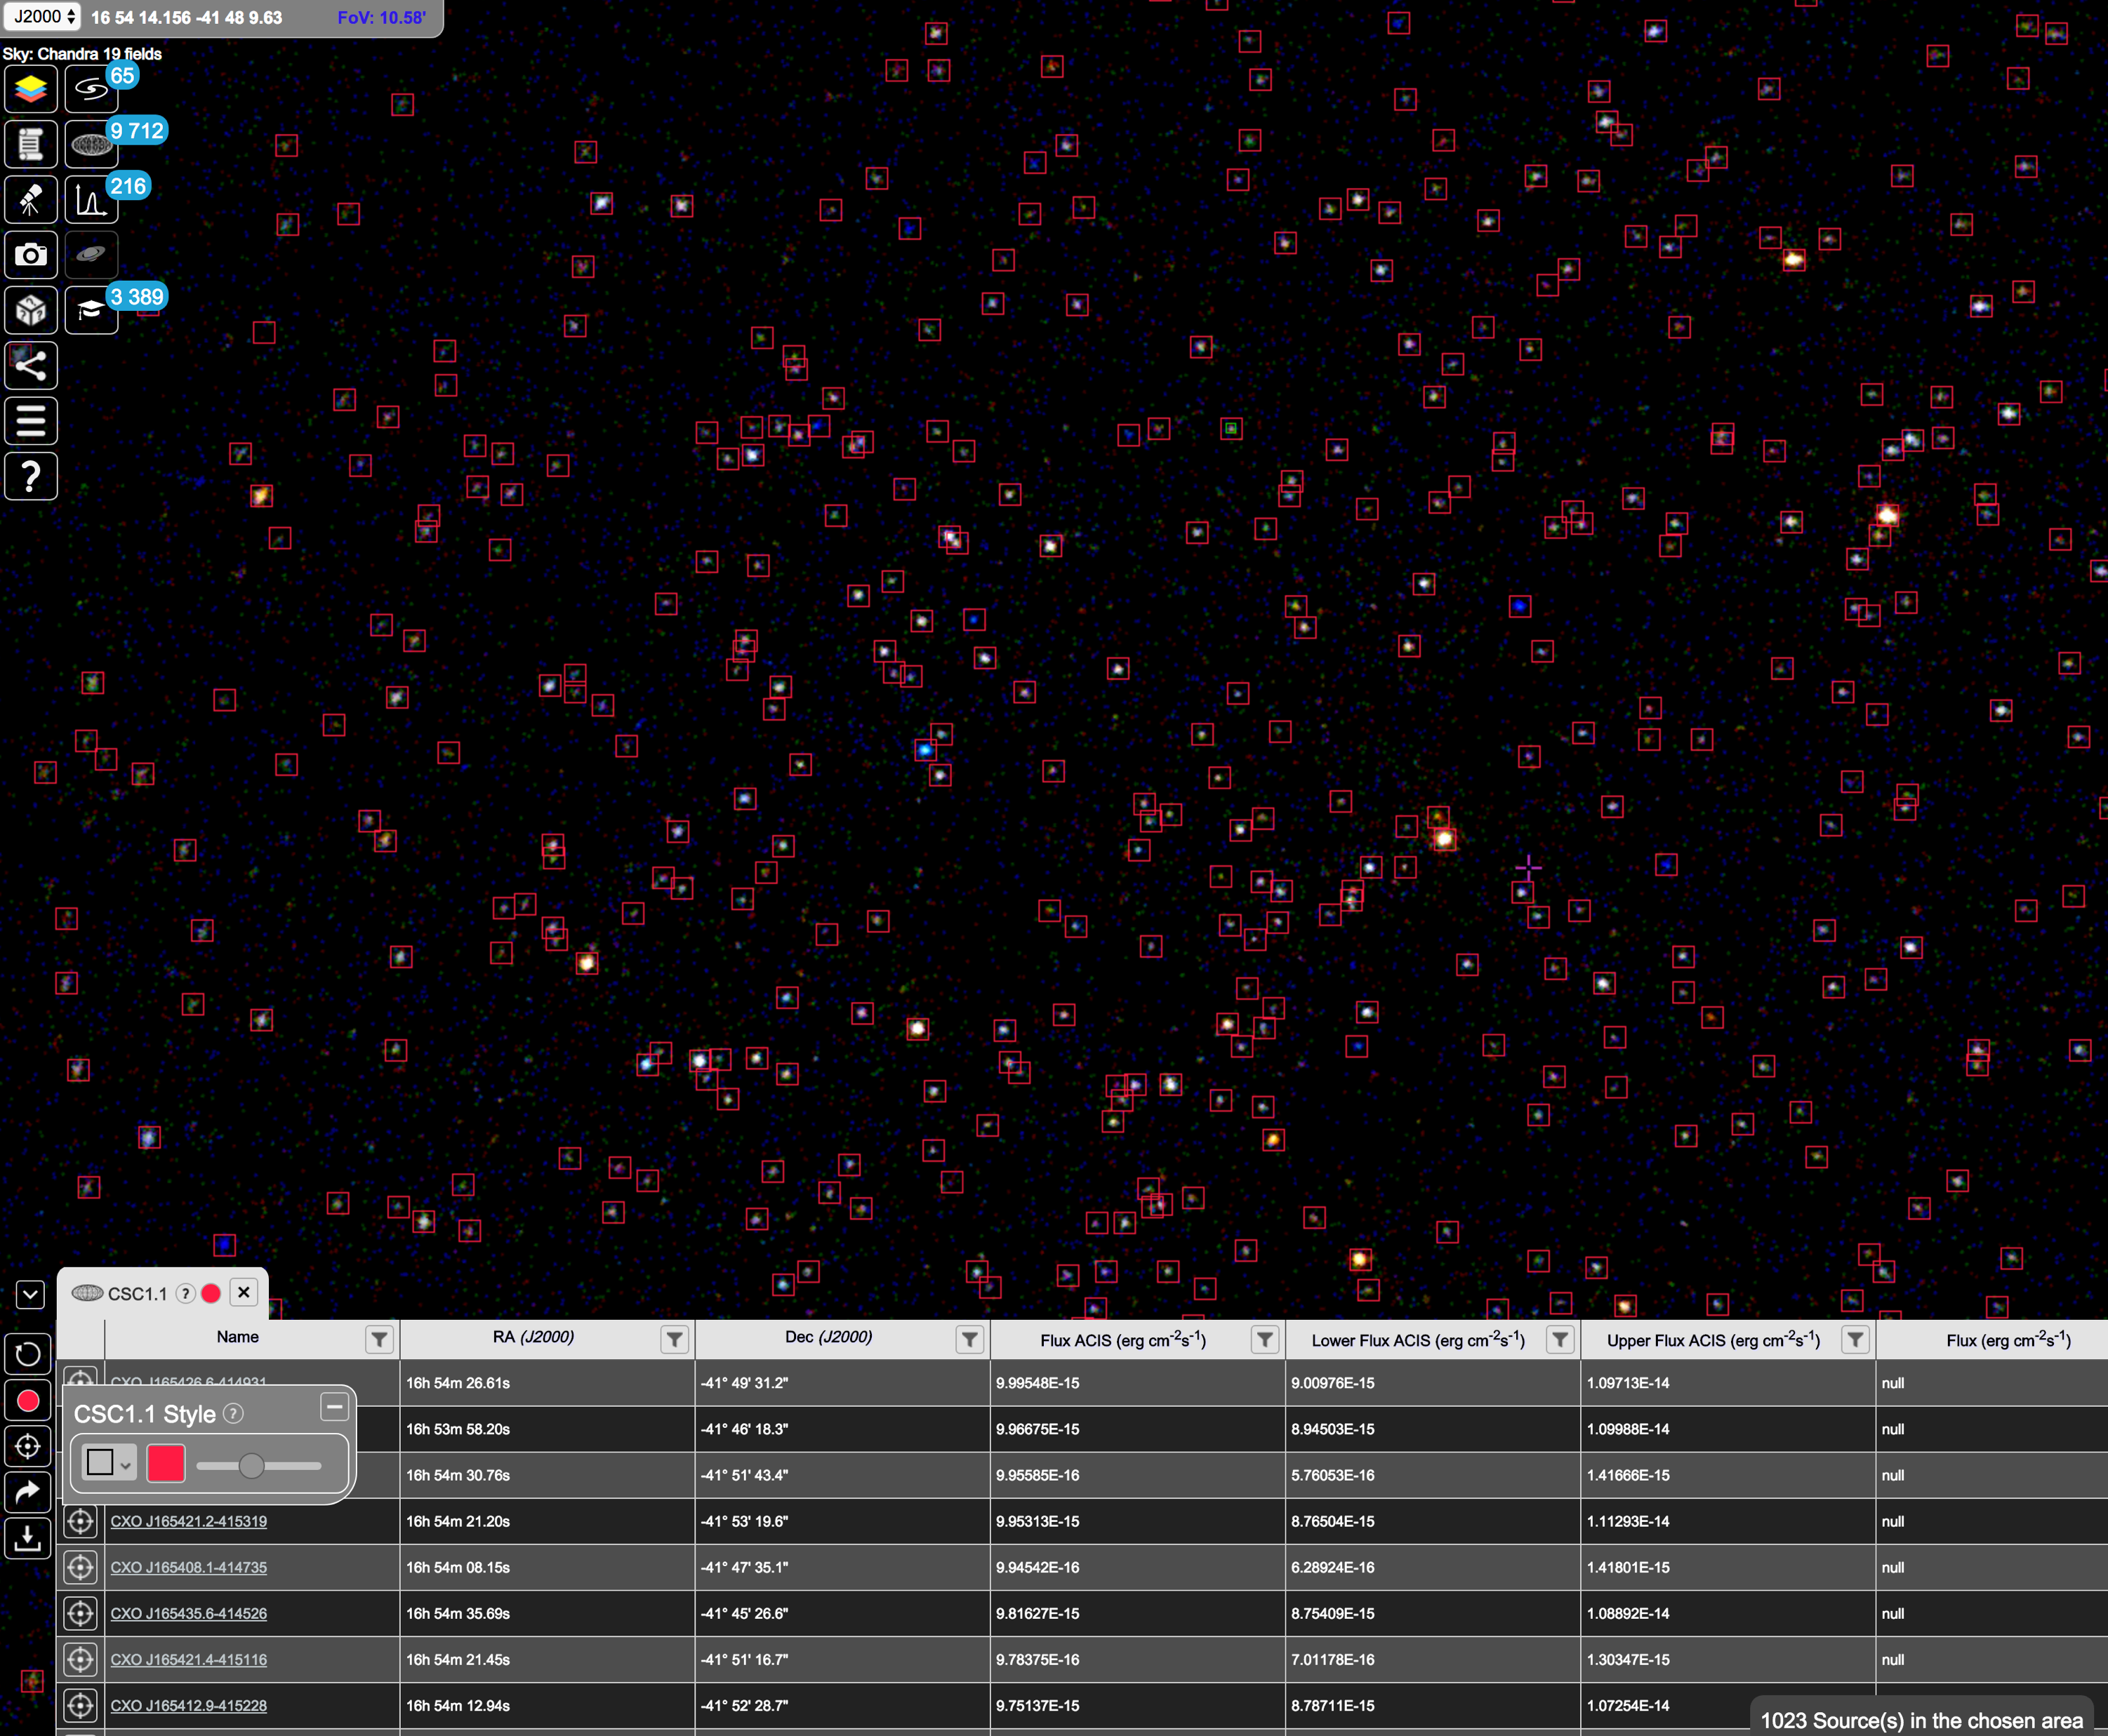
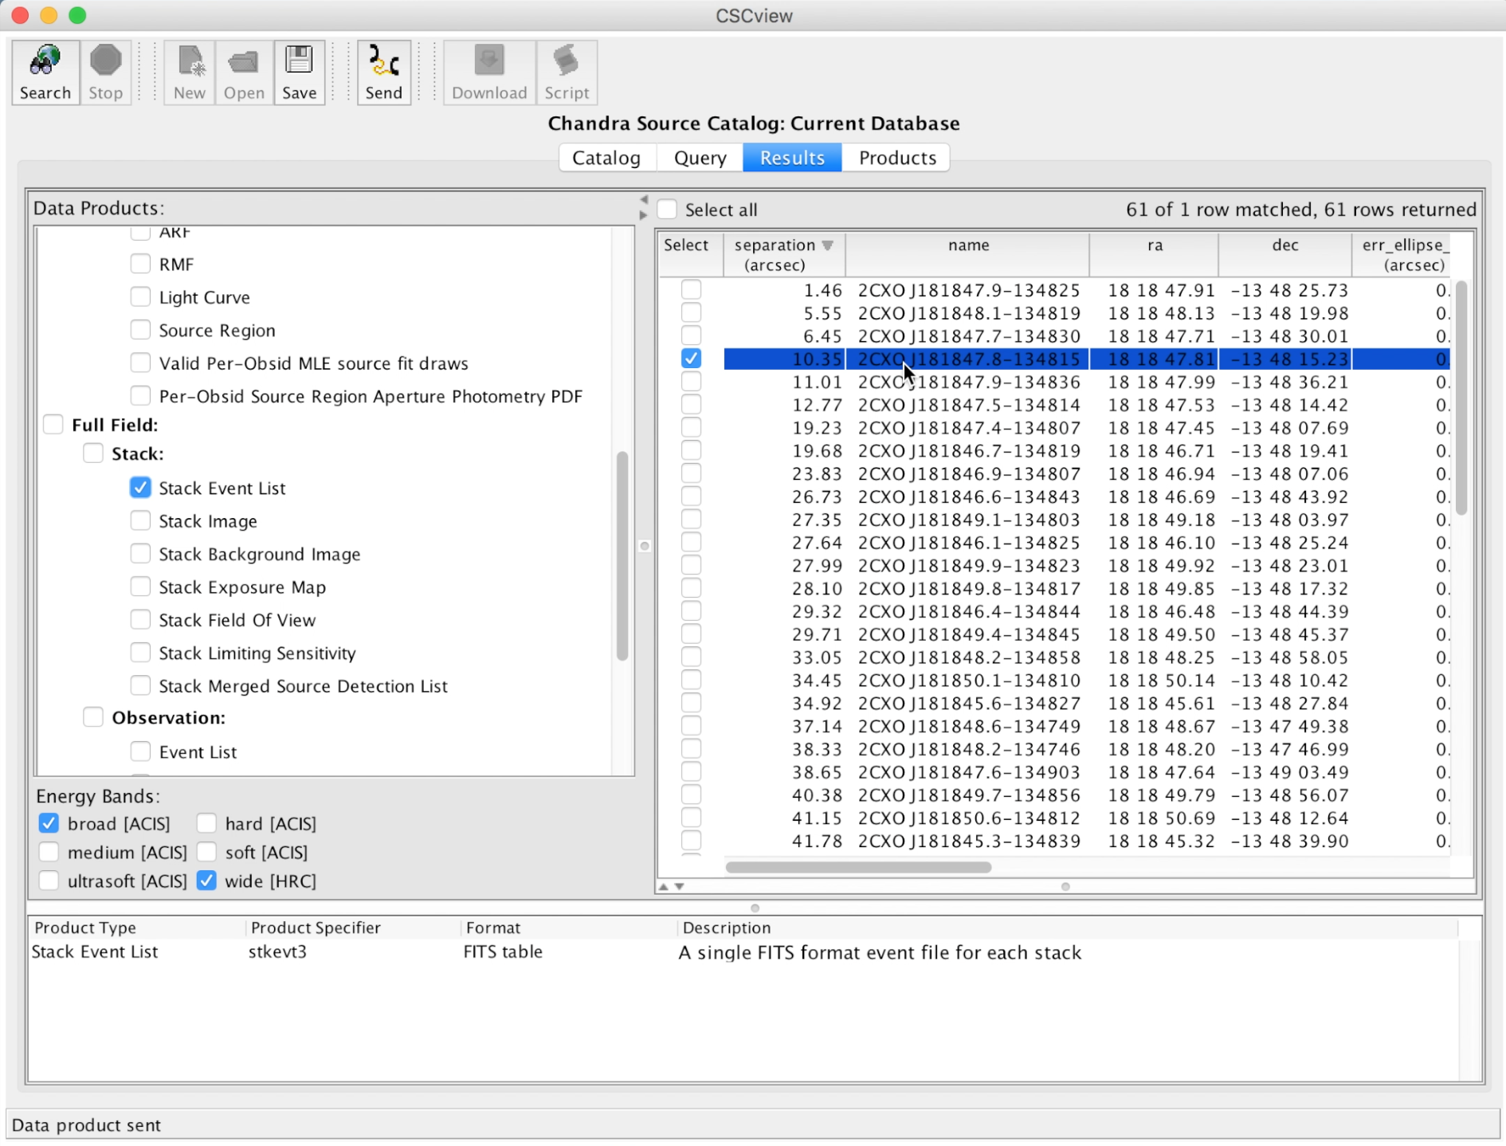
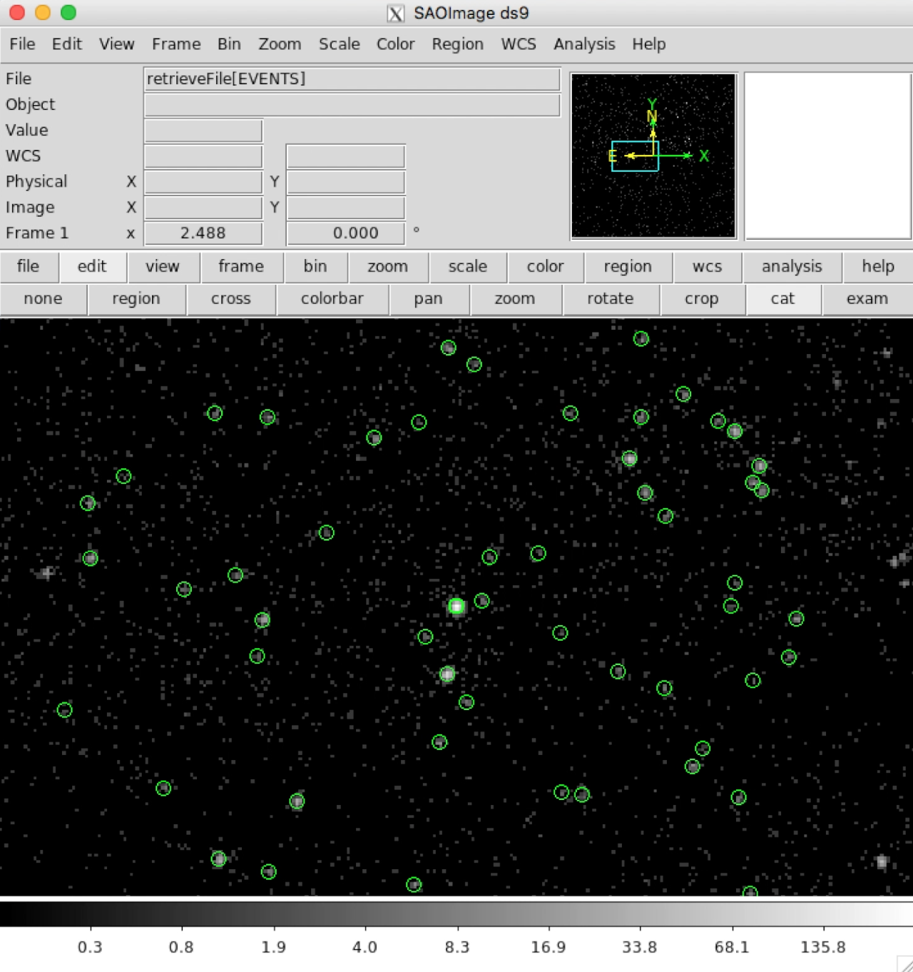
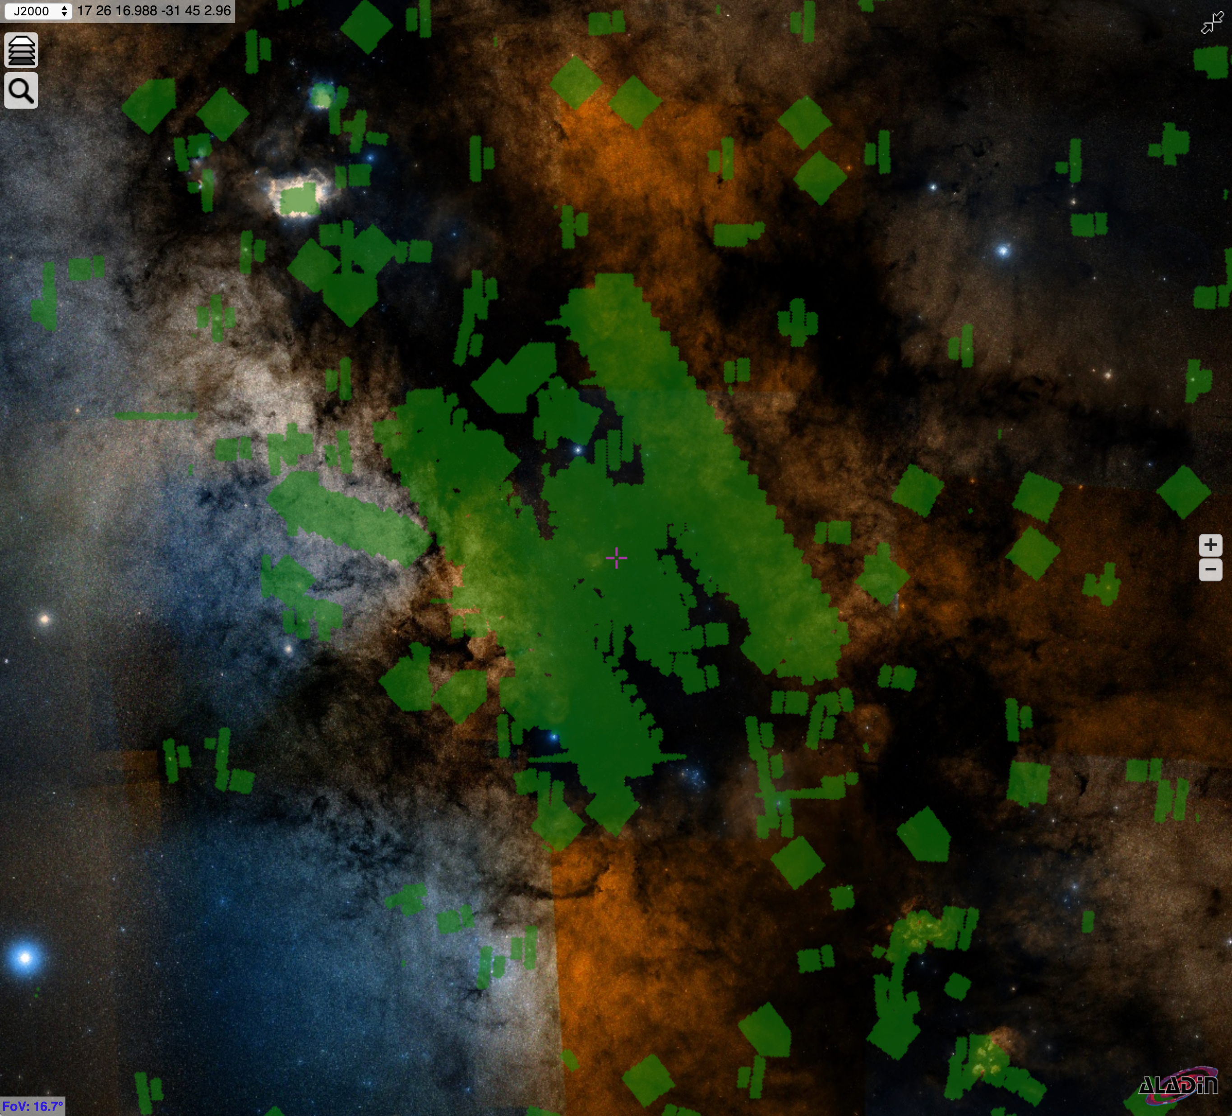

Access Chandra X-ray data through Virtual Observatory Services & Interfaces
Chandra Hierarchical Progressive Survey (HiPS)
Visualize sky regions with source overlays as you zoom in/out
VO-enabled archive interfaces: ChaSeR & CSCview
Discovery, Query & Access Chandra data through VO interfaces
VO: ADQL, VOTable, SAMP
HEALPix Multi-Order Coverage maps (MOCs)
Find sky regions that have been observed by Chandra
Chandra HiPS of NGC 6231 with
CSC1.1 sources in ESA Sky
More Chandra VO
Access Chandra data from other VO tools
and services with:
Simple Cone Search
Simple Image Access (SIAP)
Table Access Protocol (TAP)
Chandra coverage in the Galactic center on DSS HiPS
Visualized in ESA Sky
bit.ly/cxc-iau30
International Virtual Observatory Alliance
CXC
Image credit: X-ray: NASA/CXC/UMass/D. Wang et al.; Optical: NASA/ESA/STScI/D.Wang et al.; IR: NASA/JPL-Caltech/SSC/S.Stolovy

Slide 7



Japanese Virtual Observatory, NAOJ
The Japanese Data Hub for Astronomy
JVO provides astronomers with observational data from Subaru, ALMA, Nobeyama, ISAS, GAIA,
and others through VO services worldwide.
http://jvo.nao.ac.jp/
International Virtual Observatory Alliance
Credit: X-ray: NASA/CXC/CfA/R. Tullmann et al.; Optical: NASA/AURA/STScI

Slide 8
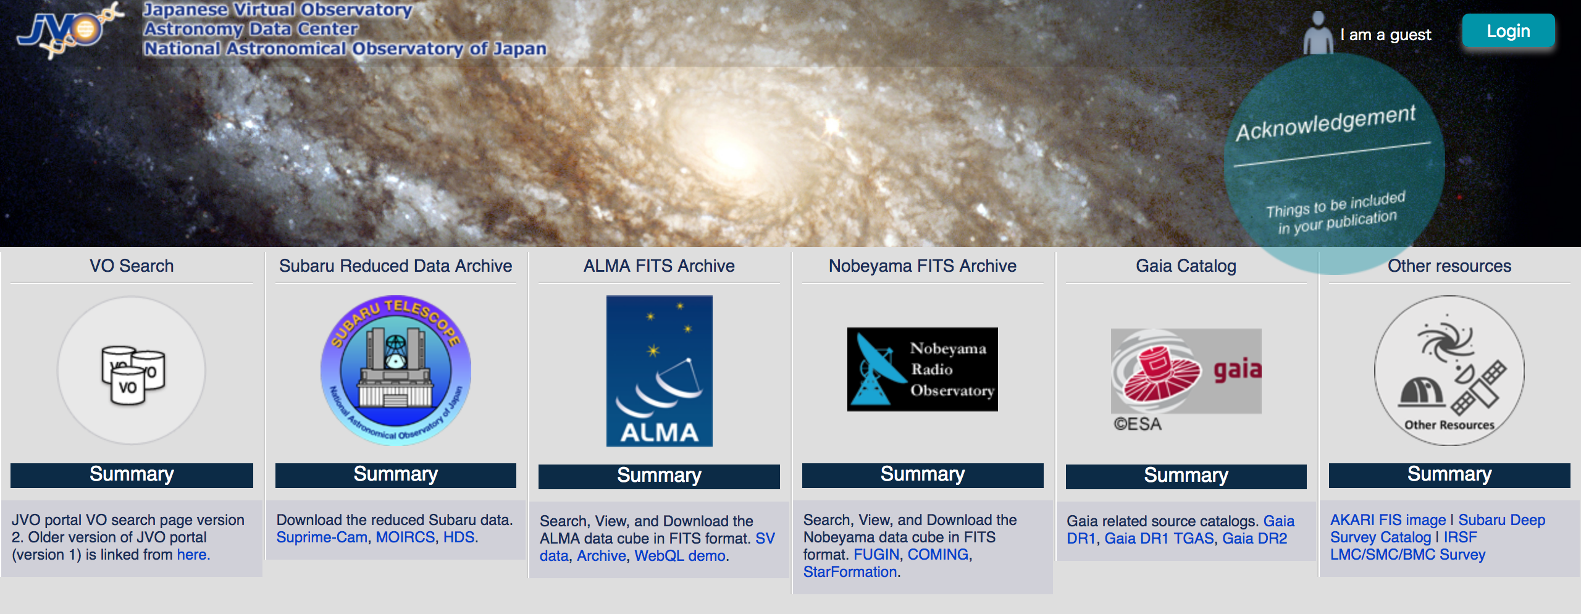
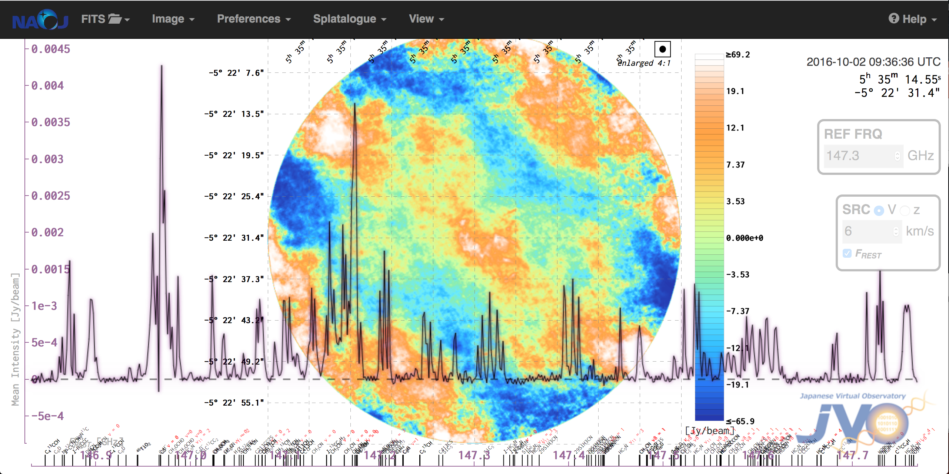
Information / images / text about your project
JVO provides a unique
quick-look service for the
ALMA FITS files.
↓
One stop data services from Japanese telescopes
and those from all over the world.
Visit us at http://jvo.nao.ac.jp/
International Virtual Observatory Alliance
Credit: X-ray: NASA/CXC/CfA/R. Tullmann et al.; Optical: NASA/AURA/STScI

Slide 9




The NOAO Data Lab
We seek to empower astronomers through efficient exploration and analysis of large astronomy datasets with an emphasis on NOAO wide-field telescopes.
datalab.noao.edu
International Virtual Observatory Alliance
Credit: X-ray: NASA/CXC/CfA/R. Tullmann et al.; Optical: NASA/AURA/STScI

Slide 10
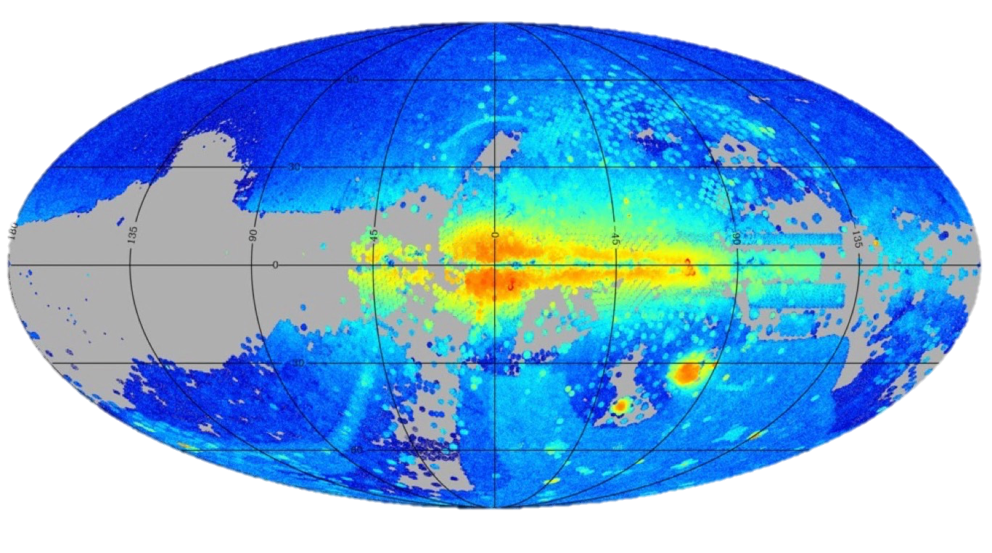
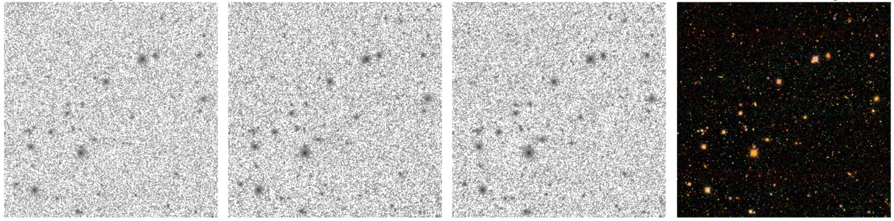
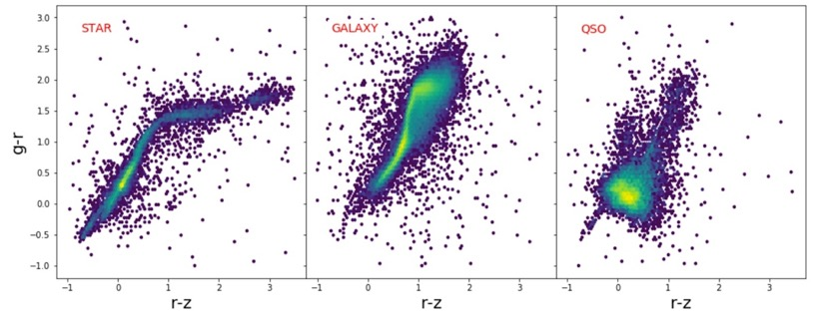
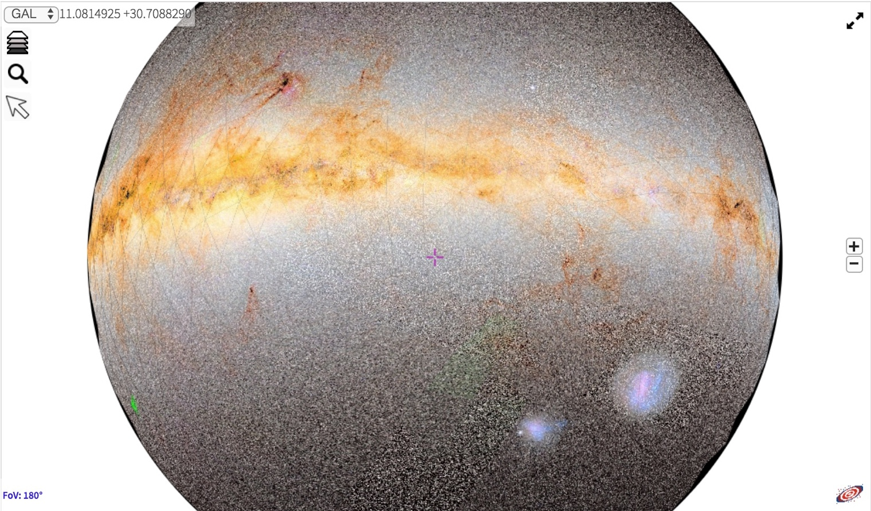
Large Catalogs – TB-scale databases
Pixel Data – images in NOAO Science Archive
datalab.noao.edu
g-band
r-band
i-band
gri
Virtual Storage – 1 TB per user
Compute Processing – workflows close to the data
Visualization – data exploration
STAR
GALAXY
QSO
International Virtual Observatory Alliance
Credit: X-ray: NASA/CXC/CfA/R. Tullmann et al.; Optical: NASA/AURA/STScI

Slide 11

New Virtual Observatory of Argentina
NOVA is a federally funded project that initiated activities in January 2009 with a mandate to coordinate the open development of astronomical data and software across all of Argentina, from Ushuaia to La Quiaca.
Objectives include:
Coordinate access to astronomical resources provided by individuals or groups within the broader astronomical community.
Coordinate the integration of local data to the standards convened by the International Observatory Alliance.
Promote the generation and integration of astro-informatics with special emphasis on data reduction and statistical analysis.
Promote astronomy as an educational tool to help develope the scientific method in an E-Science framework.
International Virtual Observatory Alliance
Credit: X-ray: NASA/CXC/CfA/R. Tullmann et al.; Optical: NASA/AURA/STScI

Slide 12
Database hosted on a PC and includes several photometric catalogues plus spectra:
NOVA Spectral Collection
VVV Survey Band Merged (J,H,Ks) catalogue
Catalogue of HI Parameters (CHIPA)
High-resolution optical spectra of HD165052
Unveiling the circumstellar environment toward a massive young stellar object at NOVA
WR 35a: A new double-lined spectroscopic binary
NOVA is currently without a technical officer and is investigating the use of BLOCKCHAIN technology to support the open development model in Astronomy to better unite IVOA with other astronomical communities (eg: Astropy) .
International Virtual Observatory Alliance
Credit: X-ray: NASA/CXC/CfA/R. Tullmann et al.; Optical: NASA/AURA/STScI

Slide 13

Russian Virtual Observatory (RVO)
Current status and main projects
Started in Dec 2001, RVO has the following aims:
To promote integration of the Russian astronomical data resources into the International Virtual Observatory;
To construct VO science prototypes;
To take part in developing of software, techniques, standards, formats of the IVO;
To strengthen education and public applications of world astronomical data.
International Virtual Observatory Alliance

Slide 14
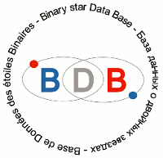
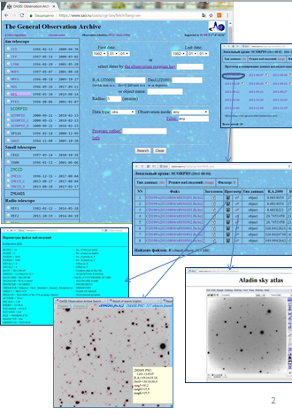
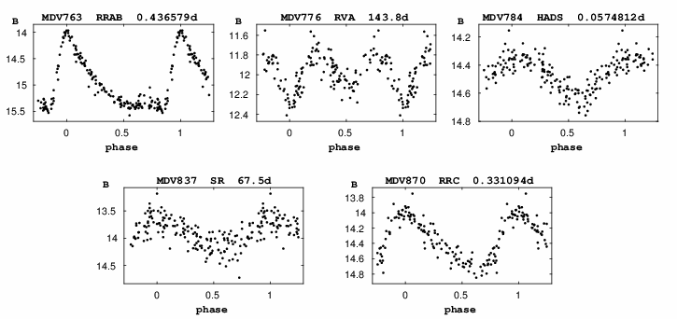
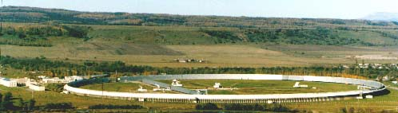
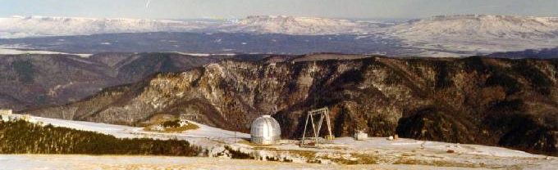

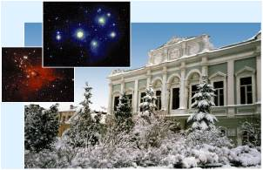

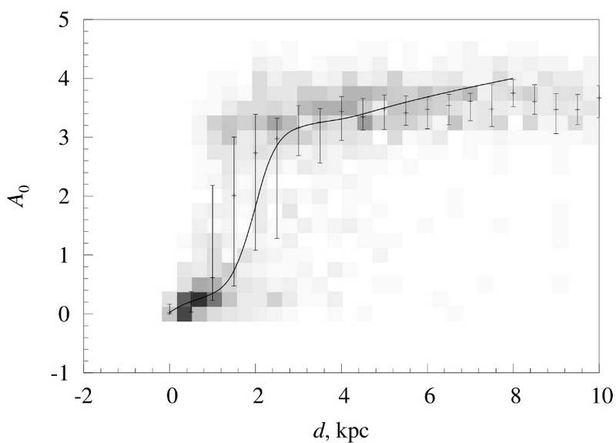
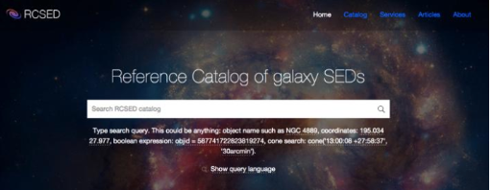
General Catalogue of Variable Stars: more variable stars discovered, new classification algorythms applied.
Special Astrophysical Observatory data archive system: since 1982, total volume ~7 ТB, 2 mln files, 1.7 mln database records. software for automatic astrometric calibration of direct images and for on-fly data visualization developed.
Binary star DataBase, BDB:
New algorythms of cross-identification implemented for multiple stars.
http://bdb.inasan.ru/
http://www.sai.msu.su/gcvs/
https://www.sao.ru/oasis/cgi-bin/fetch?lang=eng
Reference Catalog of galaxy Spectral Energy Distributions RCSED: a VO-compatible catalog of galaxies produced as join between GALEX, SDSS, and UKIDSS catalogs, and processed with state-of-the-art spectral analysis methods which were not available earlier.
Construction of 3D map of extinction and dust distribution in Galaxy: New methods developed involving analyzing and extracting multiwavelength photometric information from sky surveys with recently developed VO instruments. Bayesian probabilistic approach is used to estimate the distance-extinction relation.
http://rcsed.sai.msu.ru/
The presentation materials were provided by Dana Kovaleva, Nikolay Samus, Sergey Sichevsky, Olga Zhelenkova, Ivan Zolotukhin.
International Virtual Observatory Alliance

Slide 15
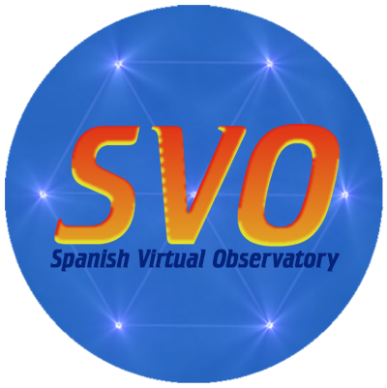
Spanish Virtual Observatory (SVO)
IVOA member since 2004.
Coordination of VO activities in Spain.
Four major lines of work:
  VO compliance of astronomical archives.
  Development of VO tools.
  VO-science.
  Education & Outreach.
http://svo.cab.inta-csic.es
International Virtual Observatory Alliance
Credit: X-ray: NASA/CXC/CfA/R. Tullmann et al.; Optical: NASA/AURA/STScI

Slide 16
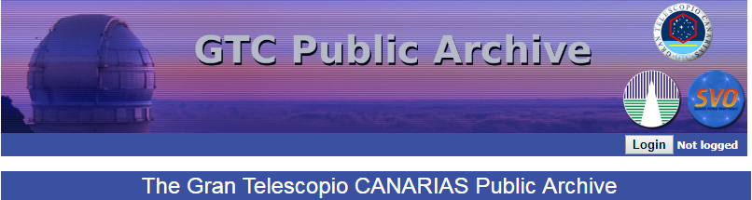



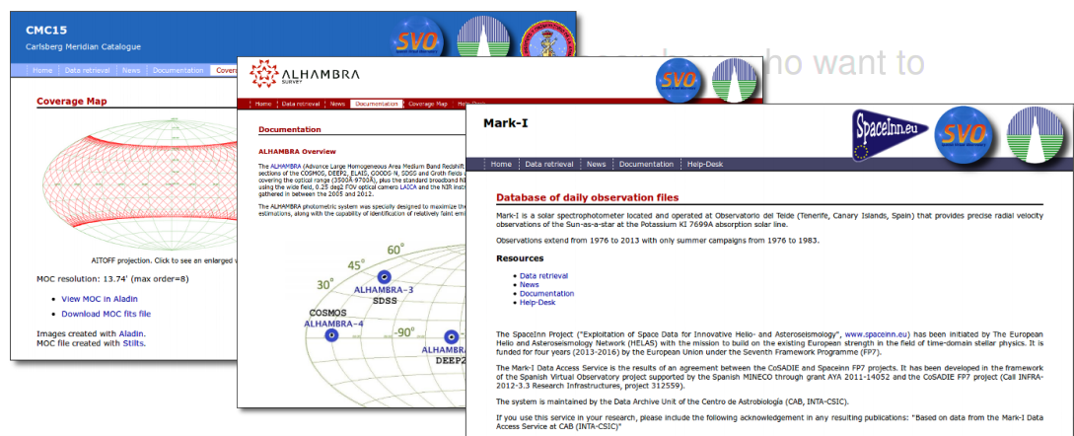

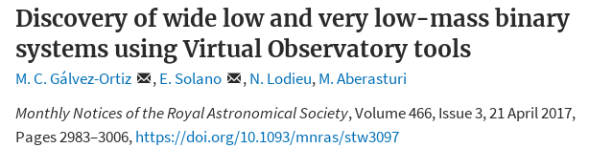
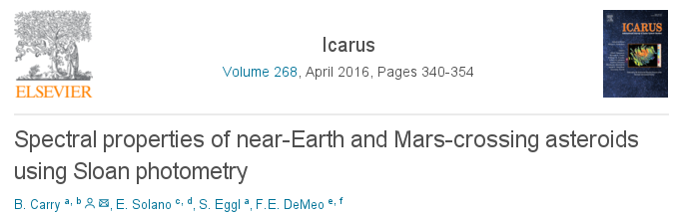
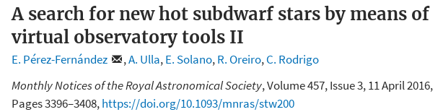
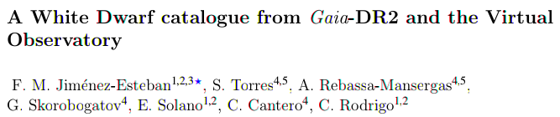
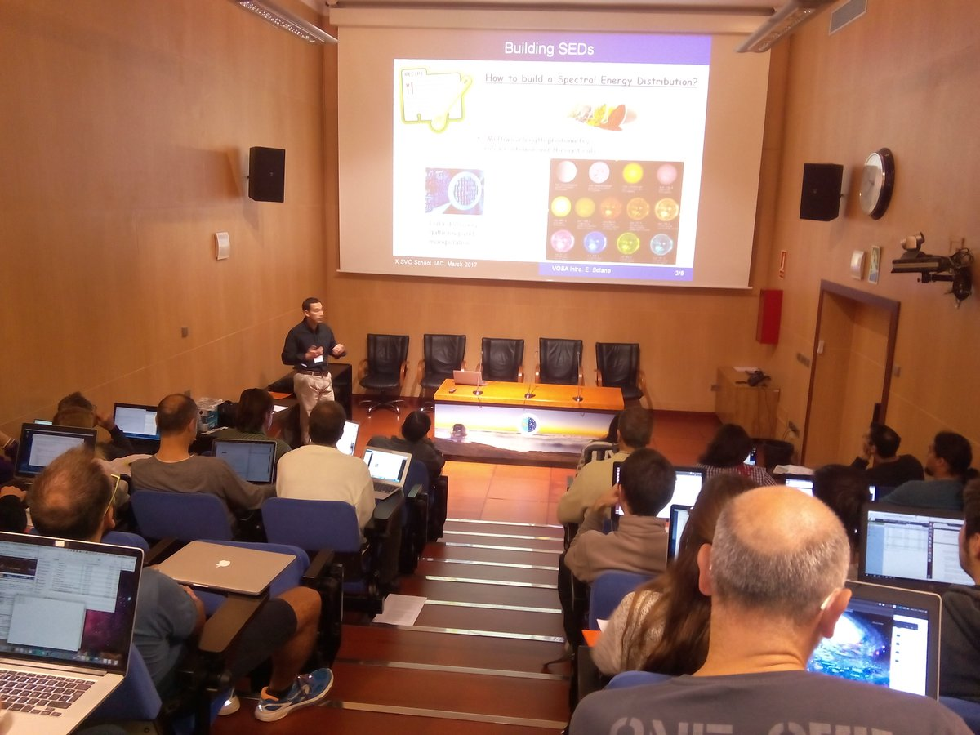
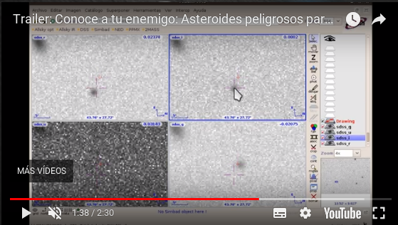
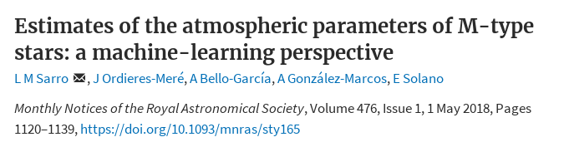
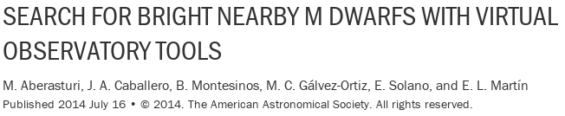
  Astronomical archives
  We host the largest VO data centre managed by a Spanish institution.
  VO tools
  We develop VO tools and services for data publishing and data analysis.
Stellar parameters from SED fitting.
Stellar cluster membership probability.
  VO-science
  VO project providing the largest number of VO-science papers.
Data discovery in VO archives.
  Education and Outreach
Liaison with Universities.
VO-schools.
Citizen-science.
And many more….
International Virtual Observatory Alliance
Credit: X-ray: NASA/CXC/CfA/R. Tullmann et al.; Optical: NASA/AURA/STScI

Slide 17
Ukrainian Virtual observatory (UkrVO) has been joined to the IVOA in 2011. The main task of UkrVO at that time was the integration of efforts of the Ukrainian astronomers in doing science on the basis of the cumulative multi-wave archives and state-of-the-art observational data. The core idea of UkrVO at that stage became the creation of the all-Ukrainian database of photographic, CCD, and spectral observations covered the period of more than 100 years, their digitizing and compilation into Joint Digital Archive prepared for further data processing and generation of new knowledge in combination with the new observational material. The main challenge we encountered consisted in the devising and developing the methods and means to attain the desired goals.
International Virtual Observatory Alliance
Credit: X-ray: NASA/CXC/CfA/R. Tullmann et al.; Optical: NASA/AURA/STScI

Slide 18
JOINT DIGITAL ARCHIVE
JDA is the core of the UkrVO project collecting photographic and CCD resources of 5 Ukrainian observatories. JDA database comprise metadata for 46 thousand direct photographic negatives of the sky, 12 thousand digital images of these negatives, and more than 30 thousand CCD frames from operating telescopes. The open access to JDA provided by DBGPA site http://gua.db.ukr-vo.org.
STELLAR CATALOGUES
JDA digital images have been used for the creation of enhanced versions of stellar catalogues obtained as projects of previous years. They are vast catalogues of FON project (FONAC-Kyiv, 24 million objects down to 16.5 B-mag; FONAC-Kitab, 13 million objects, 17.5 B-mag), catalogues of proper motions of stars (CP zone, 2 million objects, 15 B-mag), catalogues of stars in open clusters (1766 clusters, 2 million objects)
CATALOGUES OF SS BODIES
JDA data is a basis for reopening of asteroids on the archival photographic plates (54 objects), determining of positions and brightness of asteroids and comets (2 thousand asteroids, 11 comets), major planets and their satellites (Saturn and its 8 moons, 1400 positions ;Pluto, 100 positions; Uranus, Neptune and moons, 1500 positions; Jupiter and moons) .
COLITEC
CoLiTec (Collection Light Technology) software for the automated search for small celestial objects on a
series of CCD frames has been developed. CoLiTec software allows detecting of the objects with different velocities of the apparent motion for fast and slow moving objects, and objects with the near-zero apparent motion. Four comets and more than 1560 asteroids including 5 NEOs, 21 Trojan and one Centaur were discovered using CoLiTec. More than 700 000 positional CCD-measurements were sent to the Minor Planet Center.
International Virtual Observatory Alliance
Credit: X-ray: NASA/CXC/CfA/R. Tullmann et al.; Optical: NASA/AURA/STScI

Slide 19


US Virtual Observatory Alliance
The USVOA is an open community of astronomers across the United States working on the development of Virtual Observatory standards and tools.
usvoa.cfa.harvard.edu
International Virtual Observatory Alliance
Image credit: Sloan Digital Sky Survey, DR3

Slide 20
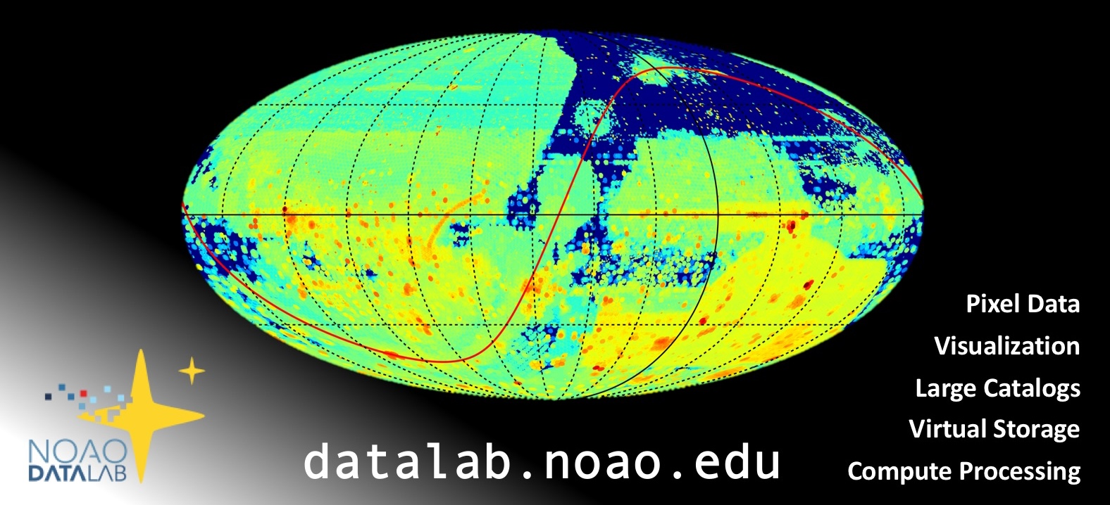

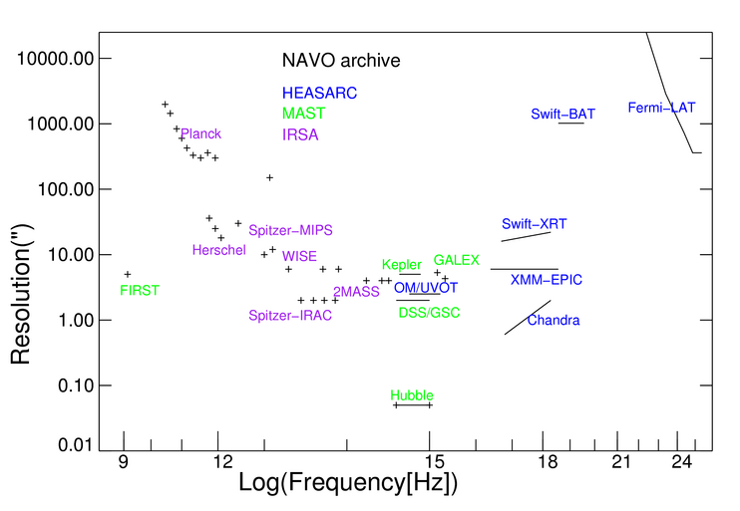
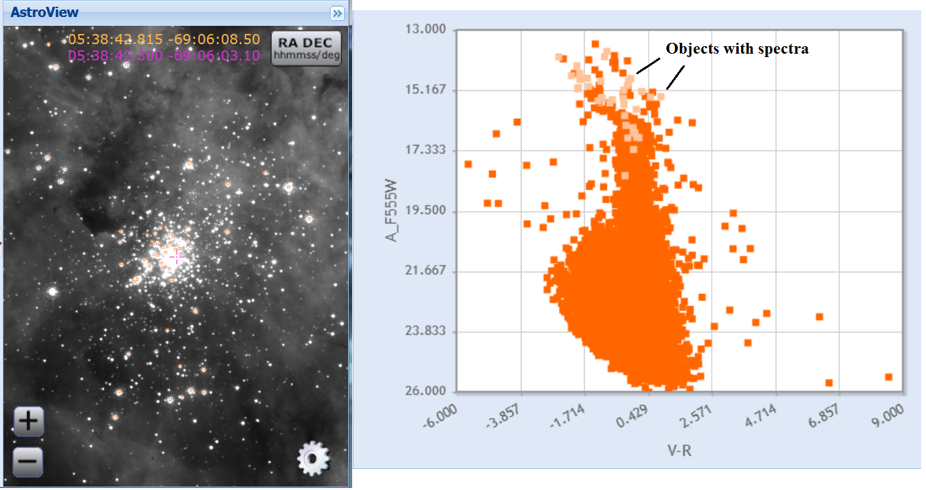
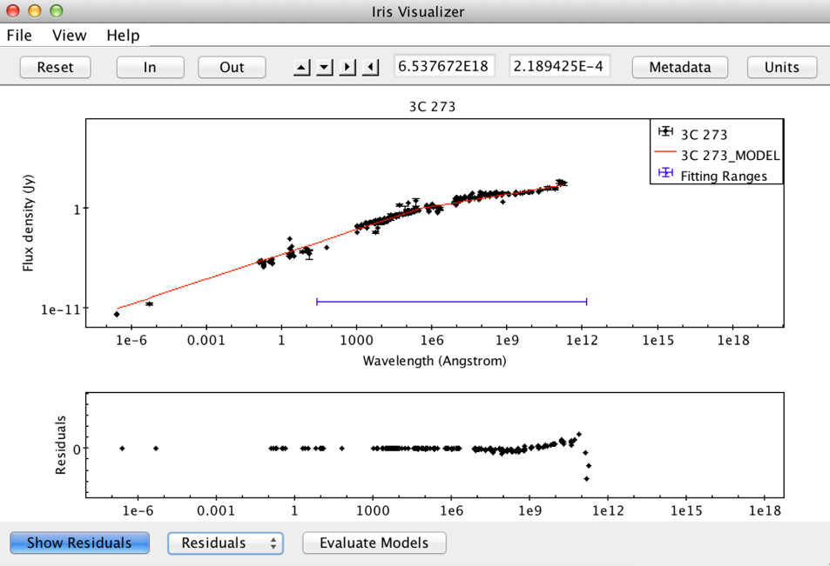
Discover… Access… Analyze…
NOAO Data Lab (NOAO)
VO: Simple Cone Search, SIAP, TAP, VOTable, VOSpace
World Wide Telescope (AAS)
VO: Simple Cone Search, VOTable, SAMP, TAP
See more
bit.ly/usvoa-iau
NASA Virtual Observatory:
Extensive, uniform access to NASA Archive holdings
MAST (STScI)
VO: Simple Cone Search, TAP, SIAP, VOTable, VO Registry
Iris (SAO/CXC)
VO: SAMP, VOTable, SpectrumDM
International Virtual Observatory Alliance
Image credit: Sloan Digital Sky Survey, DR3
SciServer (JHU/IDIES)
VO: Simple Cone Search, SIAP, TAP, VOTable, VOSpace
Notes:
python NASA-NAVO notebooks
IRSA archives updates
NED updates
https://hea-www.cfa.harvard.edu/USVOA/wp-content/uploads/2018/01/USVOA_AAS_231_reports.pdf

Slide 21


VObs.it
Italian Virtual Observatory
From 2003 to 2005, the participation of Italy in the international VO activities has been delegated to a Ministry-funded project called DRACO (Italian Datagrid for Research in Astrophysics and Coordination with the virtual Observatory). In October 2005, a separate VO initiative (VObs.it) was established and funded by INAF (Italian National Institute for Astrophysics). The aim of this initiative is to coordinate within the unified VO approach the archives and databases developed by the Italian community. From time to time, VObs.it has obtained collaboration from several institutions outside INAF (ASI, CINECA, some Universities).
International Virtual Observatory Alliance
Credit: X-ray: NASA/CXC/CfA/R. Tullmann et al.; Optical: NASA/AURA/STScI

Slide 22
PARTICIPATION IN THE IVOA
VObs.it participates in many IVOA WGs and IGs: Chair of DAL and Vice-Chair of GWS. VObs.it hosts the IVOA internet domain, the mailing lists and the wiki. It also provides the IVOA Document Coordinator.
THEORY DATA IN THE VO
Italian Theoretical Virtual Observatory (ITVO): test project for the inclusion of theoretical data and related tools inside the VO. Integration of the BaSTI facility: stellar evolution models,.
DISSEMINATION TO ASTRONOMY PROFESSIONALS
Take-up of the VO within the scientific community, also within Euro-VO projects funded by the EU. Tutors at Euro-VO schools; specific activities for the Italian community (“VO-Days… in tour”).
DISTRIBUTED COMPUTING AND DATA
Interconnection of VO and computational infrastruc-tures (grid and cloud): Grid Data Source Engine, FITS on the Grid, Grid-VO coordination, Cloud federation, Cloud-VO interoperability, Workflows.
VO APPLICATIONS
VisIVO (visualization and analysis of astrophysical 3D data), VO-Dance (creates services compliant with VO DAL standards), VOdka (agent which monitors the status of user services).
OUTREACH AND EDUCATION FOR THE GENERAL PUBLIC AND SCHOOLS
Services for higher education and outreach: dedicated simplified software and use cases. Specific VObs.it responsibilities in Euro-VO projects funded by the EU. VAPE (web app for VO publishing of educational data).
International Virtual Observatory Alliance
Credit: X-ray: NASA/CXC/CfA/R. Tullmann et al.; Optical: NASA/AURA/STScI

Slide 23

Virtual Observatory
INDIA
The VO-India (VOI) project was jointly executed by the Inter-University Centre for Astronomy and Astrophysics, Pune and Persistent Systems Ltd., Pune. The primary aim of VOI has been to contribute to the rich ecosystem of VO tools as well as provide data archival solutions to major projects around the world. Tools developed in the past include VOPlot (a versatile plotting package), VOStat/AstroStat (for statistical analysis), mosaicking tools, file parsers, and various Android applications. The VOI also helped provide mirror sites for databases such as 2dfGRS, 2MASS, SDSS, 2QZ and more. Data archival systems were developed for the Southern African Large Telescope (SALT) and the Himalayan Chandra Telescope (HCT). Efforts under the VOI project also resulted in the design of proposal management such systems as such as the AstroSat Proposal Processing System (APPS).
More details at: http://voi.iucaa.in
International Virtual Observatory Alliance
Credit: X-ray: NASA/CXC/CfA/R. Tullmann et al.; Optical: NASA/AURA/STScI

Slide 24
The activities originally carried out under VOI continue presently continue under another independent grant provided by the National Knowledge Network. The ongoing project has already resulted in very sophisticated data archival and management systems such as the Kodaikanal Solar Observatory Digitized Data Archive (which serves more than 100 years of solar observations), a data processing and product management tool for the AstroSat CZTI Payload Operations Centre and the CRTS Data Release 3 (for which IUCAA is the sole provider for image cut-outs). The Vizier mirror hosted at IUCAA, as a part of this project, is the only mirror to contain the complete big data catalogues such as GAIA DR2 and SDSS DR12. Solutions are being provided to the Office of Astronomy for Development (OAD) for managing and sharing diverse content as well as the IUCAA instrumentation lab for an enterprise grade content management system.
International Virtual Observatory Alliance
Credit: X-ray: NASA/CXC/CfA/R. Tullmann et al.; Optical: NASA/AURA/STScI

