Slide 1
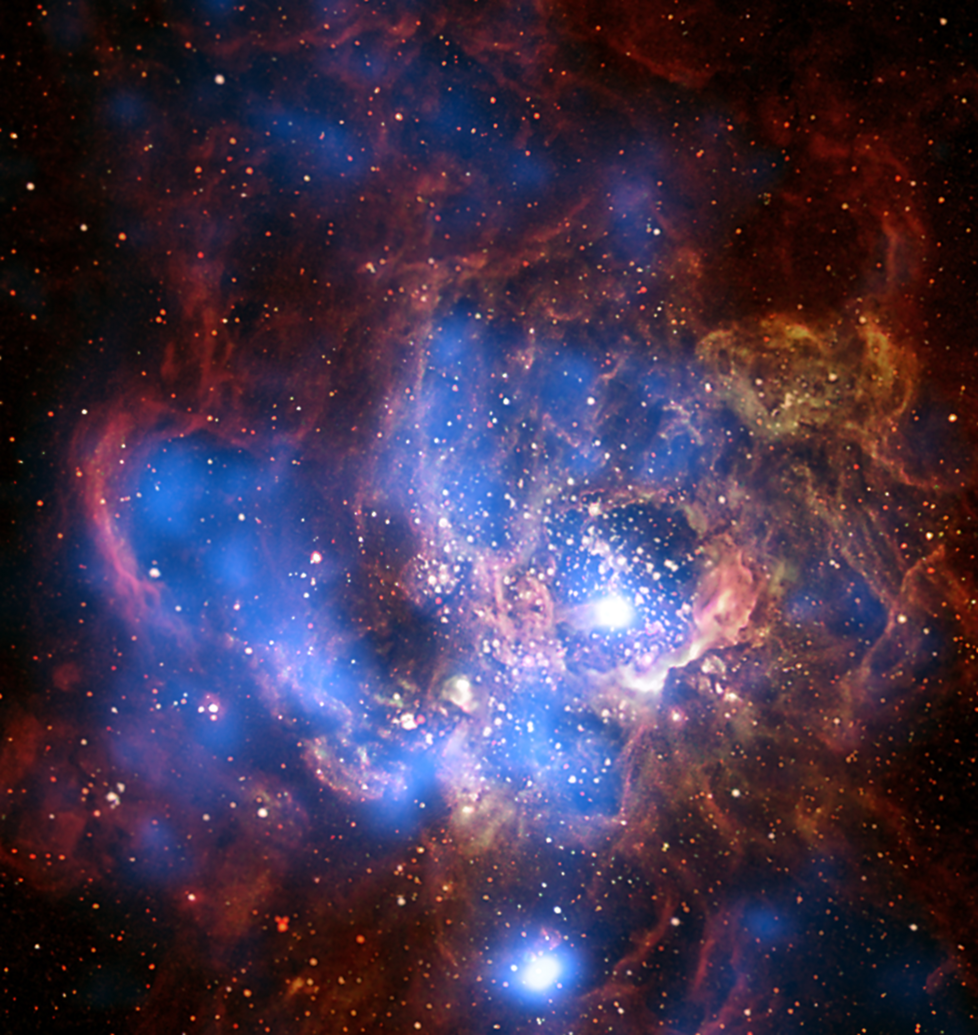





The Chilean Virtual Observatory (ChiVO)
The Chilean Virtual Observatory (ChiVO) is a VO developed in Chile. It was born out of the need to archive data that require large storage capacities and the need to develop new tools for the analyzing large volumes of data and better algorithms for intelligent processing of astronomical data. Due to the large scale volumes of data that will be generated by astronomical observatories in Chile, mainly the ALMA project that will generate over 1TB of data per day, then ChiVO´s datacenter is able to store the data in the local territory to optimize the access and availability to the Chilean community of astronomers.
International Virtual Observatory Alliance
Credit: X-ray: NASA/CXC/CfA/R. Tullmann et al.; Optical: NASA/AURA/STScI

Slide 2
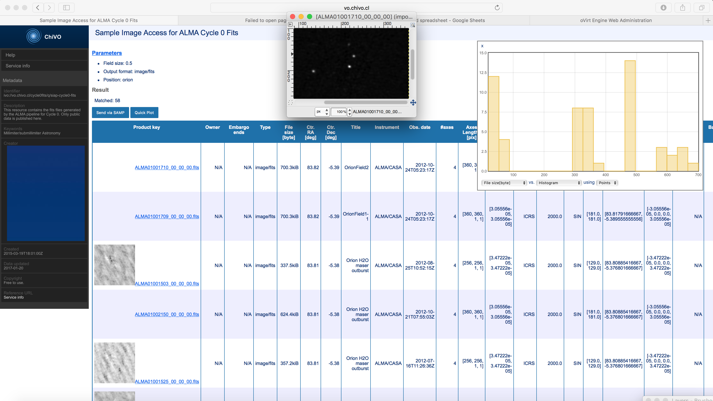

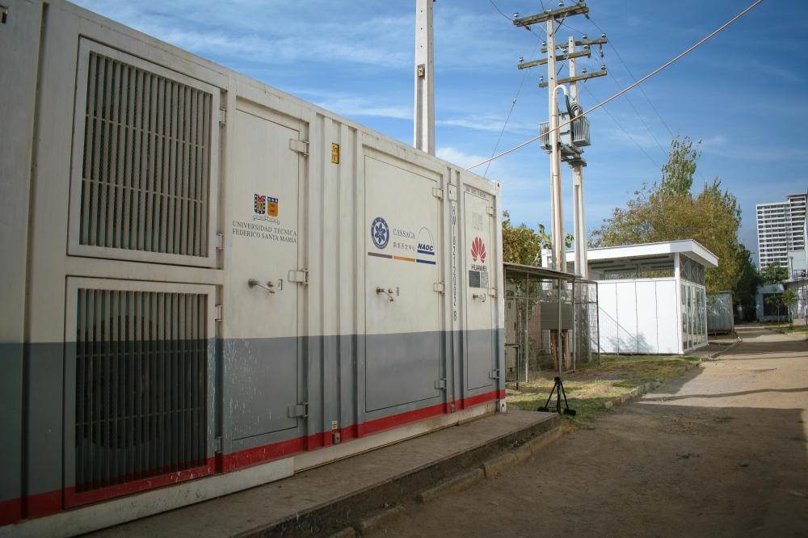
ChiVO ALMA-VO Data Repository
The ALMA-VO Data Repository service offers the cycles 0, 1, 2 and 3 of ALMA data (28,236 FITS) access through IVOA standard web-services/VO-apps or through a web-page. Currently we support single FITS files search [SCS, SIA and TAP] and complete data products (TAR files) [SCS and TAP]. In addition we are ingesting the raw data of ALMA, the ASDM. Of these files we have already stored 2079 files with a total weight of 88 [TB]. https://vo.chivo.cl/
ChiVO The Jupyter OVerride for Astronomical Libraries (JOVIAL)
It is a notebook-based cloud environment to process astronomical data on-line. This service provides Jupyter Notebooks to astronomers, that are executed in the cloud under a python environment. No installation is required so it is accessible from any device. This service is in beta testing so you need an account to use it. If you are interested in participating of this project please contact maray@inf.utfsm.cl - https://github.com/ChileanVirtualObservatory/jovial.chivo.cl
ChiVO The Advanced Computing for Astronomy Library (ACALib)
It is a package with state of the art Algorithms for Astronomers including novel algorithms produced by ChiVO and some HPC versions of them. The official documentation can be found in http://acalib.readthedocs.io/en/latest/
ChiVO DataCenter (VO-HPC)
The datacenter has the objective of providing storage and processing capacities to the local and foreign astronomers, including mirroring astronomical data generated in Chile. And also will allow the astronomers re-process the raw data of ALMA over HPC support. The storage capacity is ≈ 1PB, but for 2019 it will be ≈ 2 PB. https://www.chivo.cl/
International Virtual Observatory Alliance
Credit: X-ray: NASA/CXC/CfA/R. Tullmann et al.; Optical: NASA/AURA/STScI

