Slide 1

Planetary Data System
The PDS4 Information Model
An Implementation-Agnostic Model for Interoperability
J. Steven Hughes
Anne C. Raugh
DM II - Thursday, May 11
11:00-12:30, Plenary Room
2023 IVOA Interop Meeting
Monday 8 - Friday 12, May 2023
Congress Center, CNR Research Area, Bologna, Italy
Copyright 2023. All rights reserved.

Slide 2
Topics
ISO Standards for Digital Repositories
Ontologies for Semantic Interoperabilty
Information Model
  Model Governance
  Architectural Principles for Interoperability
    between Science Disciplines
    across Tools, APIs, etc
Notes:
Some Definitions – Read
Domain of discourse
Set of entities that we are interested in
Things of interest
Im is a formal definition of the domain of discource
Theme is communication
Allows unambiguous communication between machines and humans and between machines
Activity of exchanging information and meaning
Also has a role as information requirements for the domain, information system.

Slide 3
Interoperability
Two mature ISO level standards exist that provide guidance for the long-term preservation of digital data.
  Several important architectural principles have been identified that help enable interoperability.
Open Archival Information System (OAIS) Reference Model (ISO 14721)
Metadata Registry Specification (ISO/IEC 11179)

Slide 4
The Information Object¹
Data Object + Representation Information
= Information Object
  Data Object = Physical Object or a Digital Object
  Representation Information is the information that maps a Data Object into more meaningful concepts so that the Data Object may be understood.
  The Information Object is a fundamental building block in the development of a common understanding.
¹ Open Archival Information System (OAIS) Reference Model (ISO 14721)

Slide 5
Preservation Description Information
(PDI)
The information, which along with Representation Information which is necessary for adequate preservation of the Data Object
PDI is an Information Object.

Slide 6
Categories of PDI
Reference Information is necessary for referencing this data as well as referencing data that is in a meaningful relationship with this data.
Provenance Information provides the history of the data and is essential for authenticity.
Context Information is the information that helps orient the data within an environment.
Fixity Information is required to ensure that data in general has not been unintentionally altered
Access Rights Information identifies the access restrictions pertaining to the data, including the legal framework, licensing terms, and access control.

Slide 7
PDI (cont)
Each category of PDI is itself an Information Object
  This ensures that each has its own Representation Information to ensure that that it can be interpreted.
  For example, each instance of Provenance Information has its own Representation Information so that the consumer can understand it.
Context Information in particular has an important role in enabling data reusability
  Defines the relationships of the Data Object to the other Things within its environment
  Relationships add semantic information.

Slide 8
Metadata Registry¹
A data dictionary schema for Data Element information
  Example the “start_time” of an event.
  alternate names, definition sources, definitions in other languages, effective dates, submitting organization, and stewardship.
  data representation, units of measurement, effective dates, submitter, and steward.
  permissible values and value meanings
¹ Metadata Registry Specification (ISO/IEC 11179)

Slide 9
Interoperability
In 2001, Uschold [1] argued that a “single shared ontology” is critical for developing a digital library that enables semantic interoperability across disciplines.
¹ M. Uschold and Gruninger. M., "Ontologies and Semantics for Seamless Connectivity,"
SIGMOD Record, vol. 33, 2004.

Slide 10
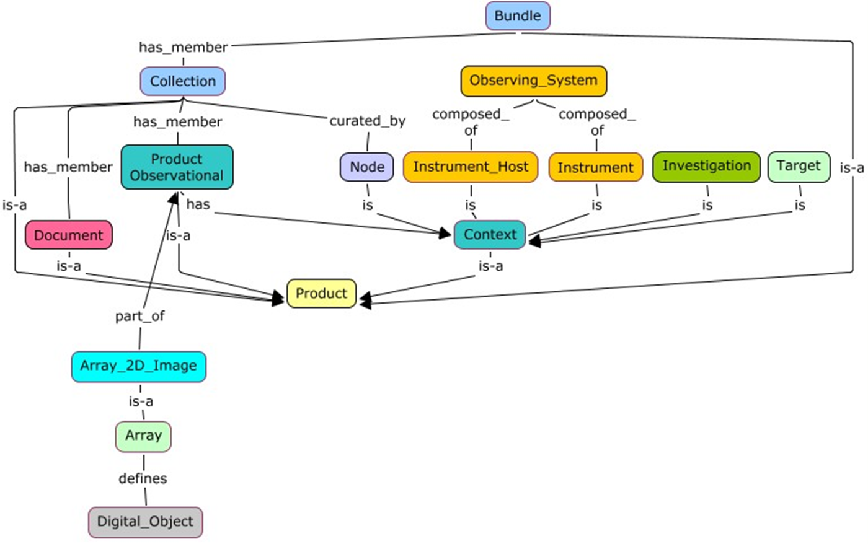
PDS4 Concept Map

Slide 11
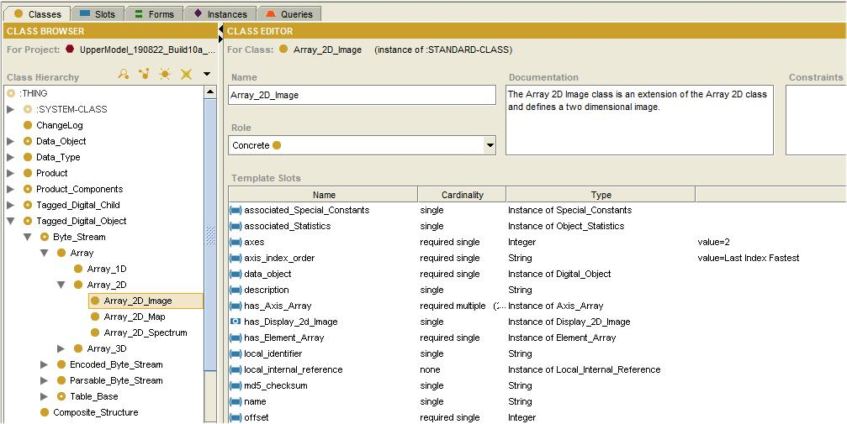
PDS4 Ontology (1)

Slide 12
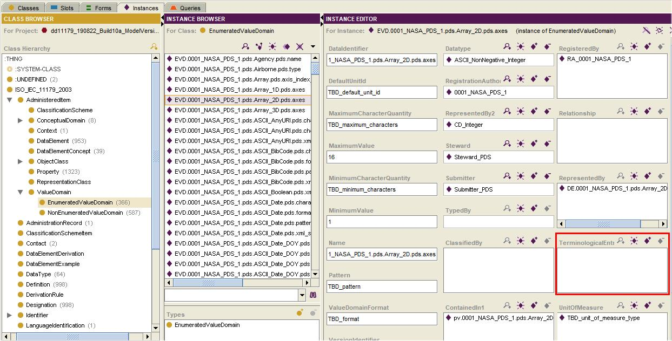
PDS4 Ontology - 2
ISO/IEC 11179 – Metadata Registry

Slide 13
Information Model (IM)
“An information model is a representation of concepts, relationships, constraints, rules, and operations to specify data semantics for a chosen domain of discourse.” ¹
The Information Model (IM) defines a knowledge base for the community.
The IM remains independent of the implementation
It provides a sharable, stable, and organized structure of information requirements for information systems development
¹ Lee, Y. T. 1999. Information Modeling: From Design To Implementation. In Proceedings of the Second World
Manufacturing Congress, ed. S. Nahavandi and M. Saadat, 315-321. Canada/Switzerland: International Computer
Science Conventions.
Notes:
Some Definitions – Read
Domain of discourse
Set of entities that we are interested in
Things of interest
Im is a formal definition of the domain of discource
Theme is communication
Allows unambiguous communication between machines and humans and between machines
Activity of exchanging information and meaning
Also has a role as information requirements for the domain, information system.

Slide 14
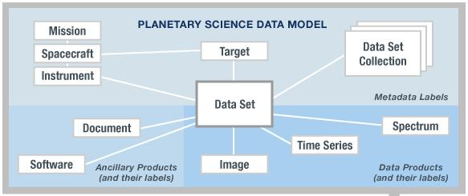
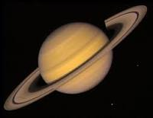
From Information Model to Product Label
Information
Model
Product
Used to
Create
Tagged Data Object
(Information Object)
<local_identifier>MPFL_M_IMP_IMAGE</local_identifier>
<offset unit="byte">0</offset>
<axes>2</axes>
<axis_index_order>Last_Index_Fastest</axis_index_order>
<encoding_type>Binary</encoding_type>
<Element_Array>
<data_type>SignedMSB4</data_type>
<unit>pixel</unit>
</Element_Array>
<Axis_Array>
<axis_name>Line</axis_name>
<elements>248</elements>
<sequence_number>1</sequence_number>
</Axis_Array>
<Axis_Array>
<axis_name>Sample</axis_name>
<elements>256</elements>
<sequence_number>2</sequence_number>
</Axis_Array>
</Array_2D_Image>
Validates
XML
Schema
Expressed As
Extracted/Specialized
Data Element
has
Describes
Class
Planetary Science
Data Dictionary
Data Object

Slide 15
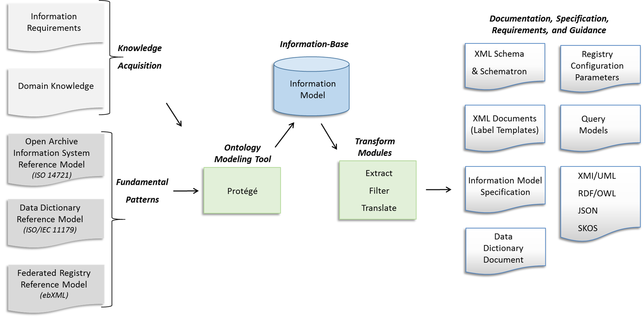
Model Driven Architecture

Slide 16
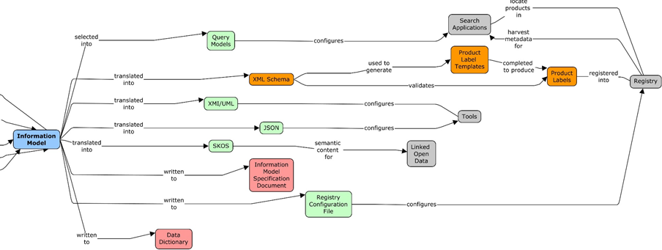
Artifacts Generated from the Model

Slide 17
XML Schema and
Schematron Files
<xs:complexType name="Array">
<xs:annotation>
<xs:documentation>The Array class defines a homogeneous N-dimensional array of scalars. …
</xs:annotation>
<xs:complexContent>
<xs:extension base="pds:Byte_Stream">
<xs:sequence>
<xs:element name="offset" type="pds:offset" minOccurs="1" maxOccurs="1"> </xs:element>
<xs:element name="axes" type="pds:axes" minOccurs="1" maxOccurs="1"> </xs:element>
<xs:element name="axis_index_order" type="pds:axis_index_order" minOccurs="1“ …
<xs:element name="description" type="pds:description" minOccurs="0" maxOccurs="1"> …
<xs:element name="Element_Array" type="pds:Element_Array" minOccurs="1“ …
<xs:element name="Axis_Array" type="pds:Axis_Array" minOccurs="1“ …
…
<sch:pattern>
<sch:rule context="pds:Array/pds:axis_index_order">
<sch:assert test=". = ('Last Index Fastest')">
The attribute pds:axis_index_order must be equal to the value 'Last Index Fastest'.</sch:assert>

Slide 18
XML Product Templates and Labels
<Product_Observational
<Identification_Area>
<logical_identifier>urn:nasa:pds:example.dph.sampleproducts:exampleproducts:array2d_image …
<version_id>1.0</version_id>
<title>MARS PATHFINDER LANDER Experiment</title>
<Array_2D_Image>
<local_identifier>MPFL-M-IMP_IMG_GRAYSCALE</local_identifier>
<offset unit="byte">0</offset>
<axes>2</axes>
<axis_index_order>Last Index Fastest</axis_index_order>
<Element_Array>
<data_type>UnsignedMSB2</data_type>
<unit>data number</unit>
<scaling_factor>1</scaling_factor>
<value_offset>0</value_offset>
</Element_Array>
<Axis_Array>
<axis_name>Line</axis_name>
<elements>248</elements>
<sequence_number>1</sequence_number>
</Axis_Array>
<Axis_Array>
<axis_name>Sample</axis_name>
<elements>256</elements>
<sequence_number>2</sequence_number>

Slide 19
JSON File (Tool Configuration)
"class": {
"identifier": "0001_NASA_PDS_1.pds.Array_2D_Image" ,
"title": "Array_2D_Image" ,
"registrationAuthorityId": "0001_NASA_PDS_1" ,
"nameSpaceId": "pds" ,
"steward": "pds" ,
"versionId": "1.1.0.0" ,
"description": "The Array 2D Image class is an extension of the Array 2D class and …
, "associationList": [
{"association": {
"identifier": "0001_NASA_PDS_1.pds.Array.pds.offset" ,
"title": "offset" ,
"isAttribute": "true" ,
"isChoice": "false" ,
"isAny": "false" ,
"minimumCardinality": "1" ,
"maximumCardinality": "1" ,
"classOrder": "1010" ,
"attributeId": [
"0001_NASA_PDS_1.pds.Array.pds.offset"
]
}
}

Slide 20
RDF File (Semantic Processing)
<kb:NonEnumeratedValueDomain rdf:about="&pdsns;NEVD.0001_NASA_PDS_1.pds.Array.pds.offset"
kb:dataIdentifier="0001_NASA_PDS_1.pds.Array.pds.offset"
kb:versionIdentifier="1.13"
kb:maximumCharacterQuantity="TBD_maximum_characters"
kb:minimumCharacterQuantity="TBD_minimum_characters"
kb:maximumValue="TBD_maximum_value"
kb:minimumValue="0"
kb:pattern="TBD_pattern"
kb:valueDomainFormat="TBD_format"
kb:defaultUnitId="byte"
rdfs:label="0001_NASA_PDS_1.pds.Array.pds.offset">
<kb:representedBy1 rdf:resource="&pdsns;DE.0001_NASA_PDS_1.pds.Array.pds.offset"/>
<kb:representedBy2 rdf:resource="&pdsns;CD_Integer"/>
<kb:datatype rdf:resource="&pdsns;ASCII_NonNegative_Integer"/>
<kb:unitOfMeasure rdf:resource="&pdsns;Units_of_Storage"/>
<kb:registeredBy rdf:resource="&pdsns;RA_0001_NASA_PDS_1"/>
<kb:steward rdf:resource="&pdsns;pds"/>
<kb:submitter rdf:resource="&pdsns;Submitter_PDS"/>
<kb:terminologicalEntry rdf:resource="&pdsns;TE.0001_NASA_PDS_1.pds.Array.pds.offset"/>
<kb:administrationRecord rdf:resource="&pdsns;DD_1.13.0.0"/>
<kb:registrationAuthorityIdentifier rdf:resource="&pdsns;0001_NASA_PDS_1"/>
</kb:NonEnumeratedValueDomain>

Slide 21
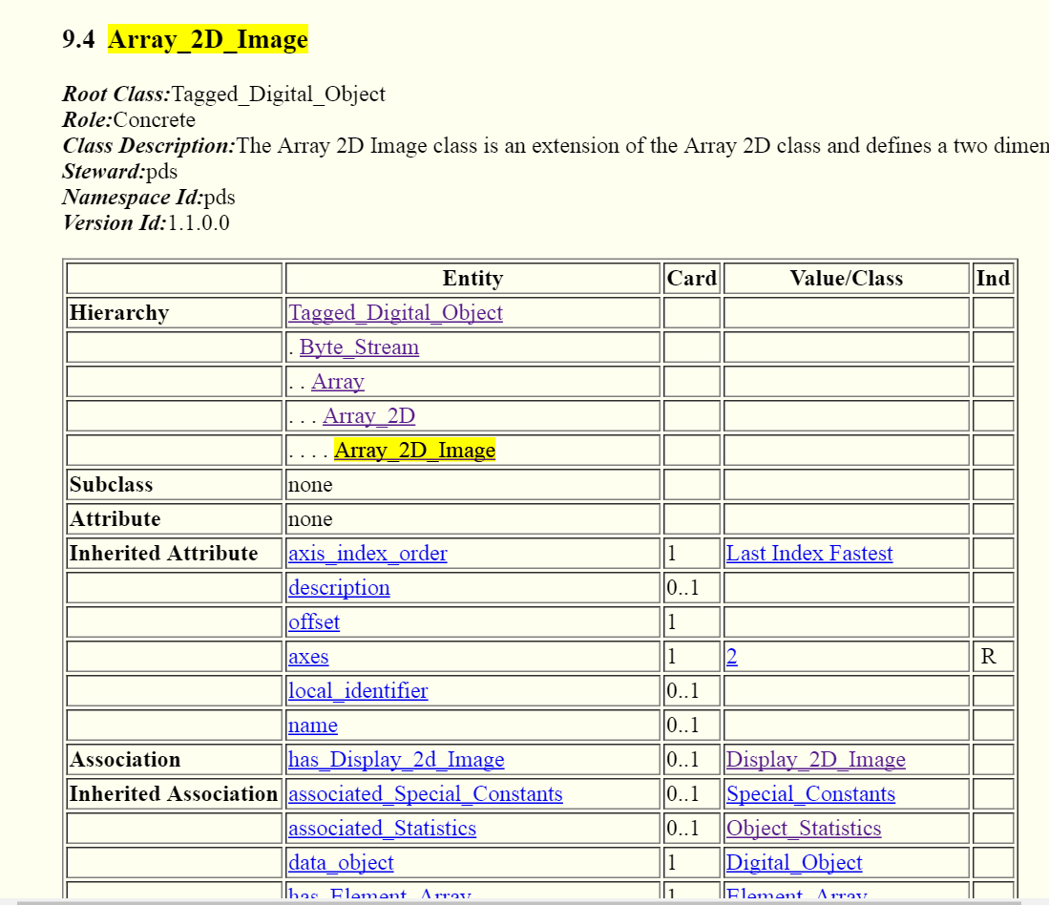
Information Model Specification

Slide 22
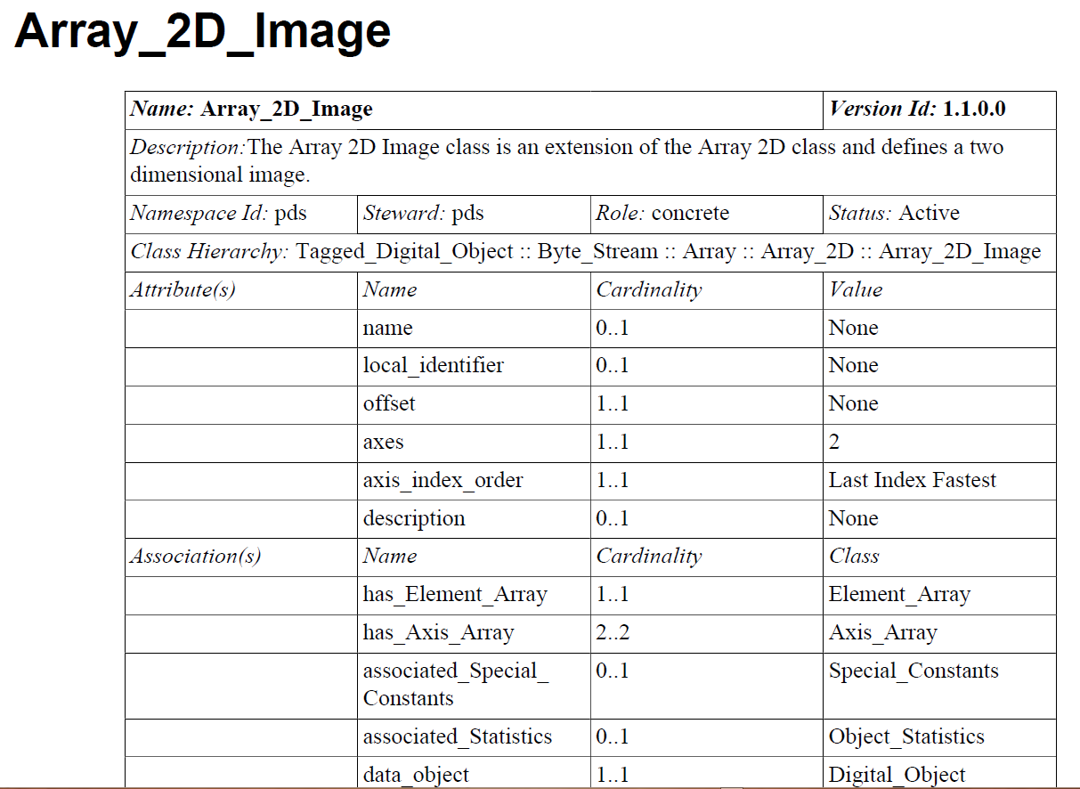
Data Dictionary Document
(pdf and html formats)

Slide 23
Governance
The Information Model (IM) consists of a hierarchy of models.
  Common model
  Discipline models
  Mission models
The partitioning of the IM into individual models reduces the impact of change.
Each model
  has a steward that manages the development and maintenance of that model.
  has a unique namespace
Notes:
Some Definitions – Read
Domain of discourse
Set of entities that we are interested in
Things of interest
Im is a formal definition of the domain of discource
Theme is communication
Allows unambiguous communication between machines and humans and between machines
Activity of exchanging information and meaning
Also has a role as information requirements for the domain, information system.

Slide 24
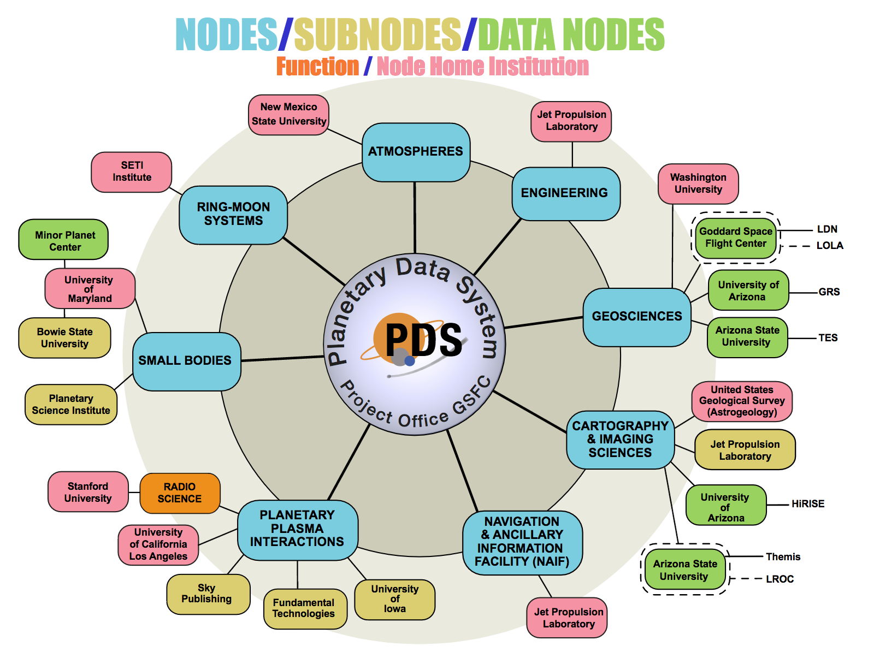
Diverse Disciplines
Notes:
.

Slide 25
Information Model
Multi-level Governance
Registration Authority
Steward
governs
Common
pds:
Discipline
disp:
rings:
img:
geom:
cart:
Mission
ladee:
mvn:
mgs:
insight:
orex:
Notes:
.

Slide 26
Extensions to the “Common”
Local Data Dictionaries (LDDs)

Slide 27
Trustworthy Digital Repository (TDR)
A Trustworthy Digital Repository (TDR) is an organization or system responsible for the long-term preservation and access to digital materials, such as data, records, documents, and other digital objects.
  A TDR must be able to guarantee the authenticity, integrity, and usability of its digital content over time.
The aim of a TDR is to ensure that digital content remains accessible, usable, and reliable for as long as it is needed.
  This is particularly important for materials that have long-term value, such as cultural heritage objects, scientific research data, and government records.

Slide 28
Architectural Principles as a Graph

Slide 29
Conclusion
A framework for capturing the information required to support data interoperability has been developed using principles adopted from two ISO information systems standards.
Key principles have been identified that support interopeability.
However this is simply a framework.
  The really hard work involves acquiring the appropriate knowledge from domain experts and populating an domain information model using the framework as a guide.

Slide 30
Backup
Notes:
Some Definitions – Read
Domain of discourse
Set of entities that we are interested in
Things of interest
Im is a formal definition of the domain of discource
Theme is communication
Allows unambiguous communication between machines and humans and between machines
Activity of exchanging information and meaning
Also has a role as information requirements for the domain, information system.

Slide 31
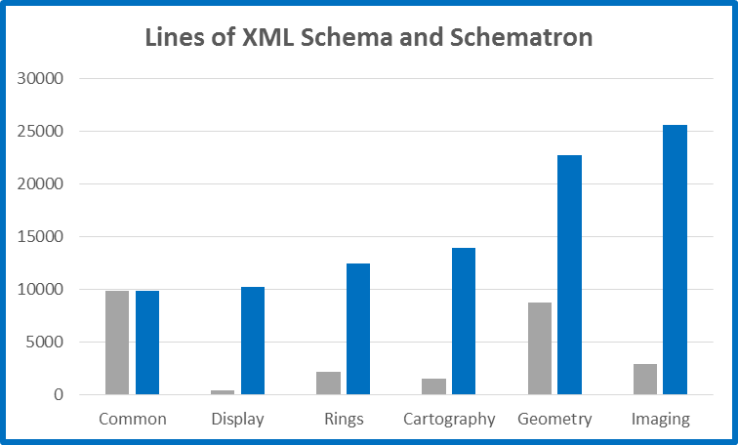
Auto-generated Validation Code
Common
Discipline

Slide 32
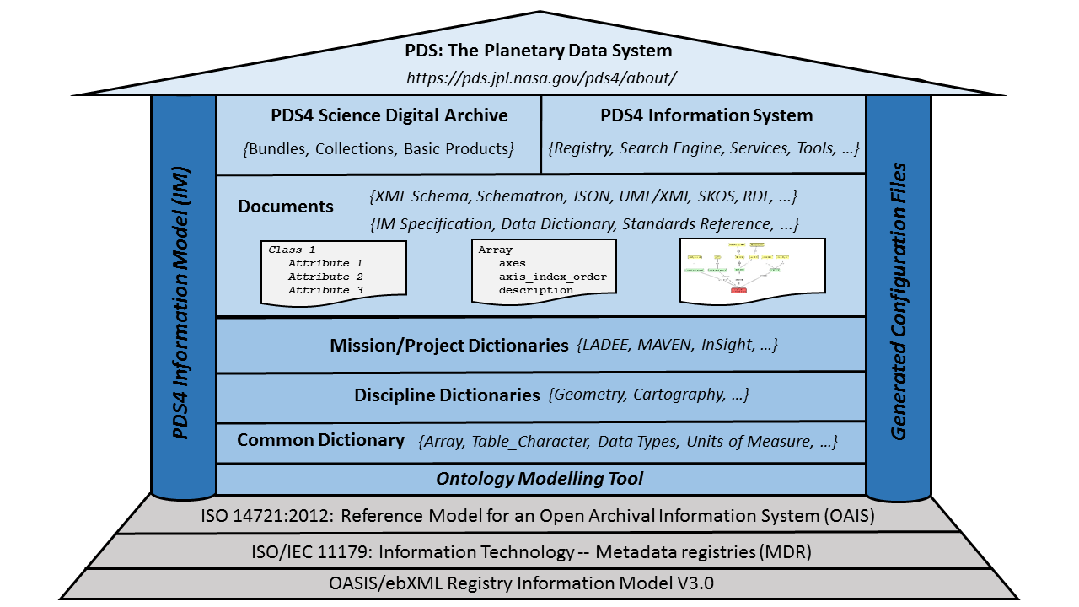
PDS4

Slide 33
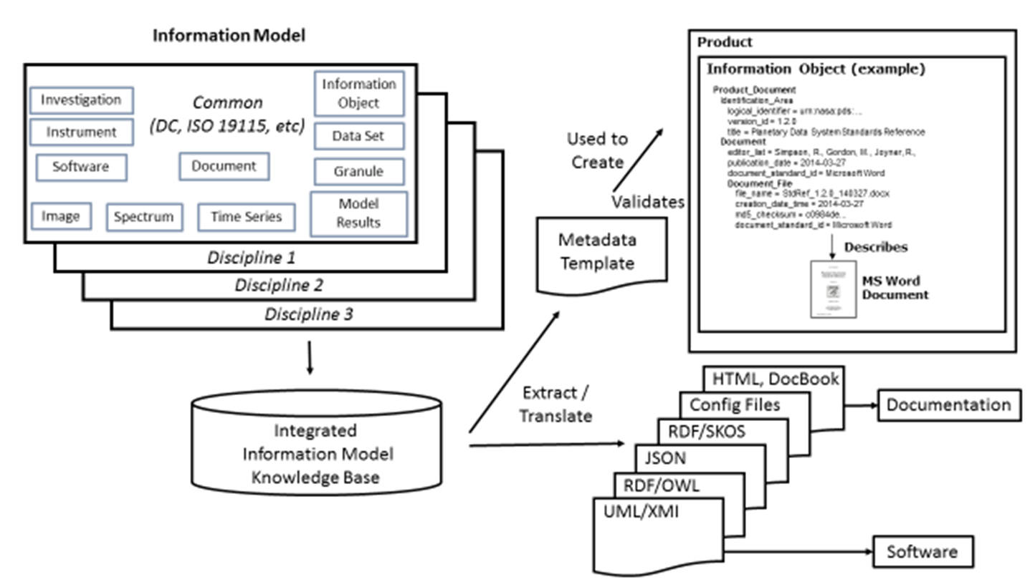
Information Model
and Generated Artifacts

