Slide 1
IVOA SIA v2 Services for NED
With feedback on SIA2 2015-07-30 and
related specifications
Olga Pevunova
Rick Ebert
Joe Mazzarella
(IPAC, Caltech)
Bruce Berriman
October 2015 IVOA Meeting

Slide 2
NED’s Image Archive and
Current SIA Service
The NASA/IPAC Extragalactic Database (NED) provides a large archive of FITS images spanning a wide variety of telescopes, instruments, and spectral regions ranging from X-rays through radio frequencies.
NED currently provides about 430,000 images with valid WCS FITS header keywords
  About 20,000 files are hypercubes
  The content is growing rapidly
Most of the images were contributed by authors, who wish to share their data, linked to other information in NED.
All NED images can be queried by object name (target) on the NED interface.
The subset with valid WCS FITS header keywords can be queried by position using Simple Image Access (SIA v1.0) interface, integrated into a service operated by IRSA.

Slide 3
SIA2 and IVOA Specs
We evaluated SIA 2.0 2015-07-30 (Proposed Recommendation) as a reference.
The SIA2 document tree references
  Multiple instances of the same document
  Misidentified or missing documents
  Documents with various levels of maturity (other than Rec)
  Example: do we use the version/date of VOSI referenced by DataLink,
  or the version/date referenced by ObsCore? Which one should be referenced by SIA2?
This complexity presents a barrier to IVOA interoperability

Slide 4
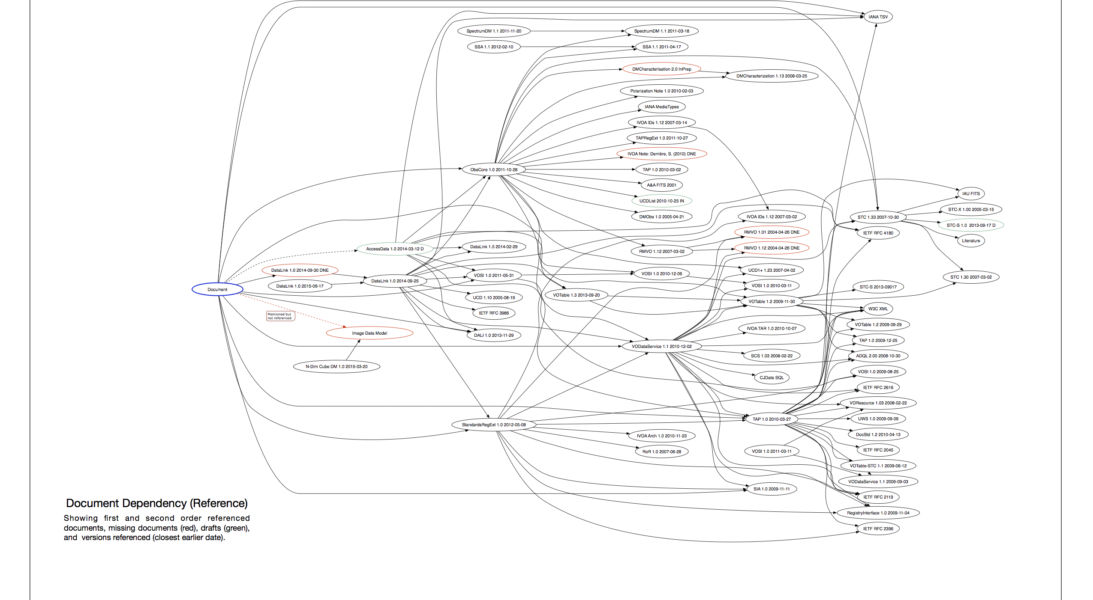
Document Reference Tree

Slide 5
Plan
In order to proceed, NED plans to suggest to NASA/NAVO an implementation standard based on the available versions of IVOA specifications, including:
Currently
  SIAv2 (2015-07-30) (Proposed Recommendation)
  DALI 1.0 2013-11-29 (Recommendation)
  AccessData 1.0 2014-03-12 (Working Draft)
  N-Dimensional Cube Model 1.1 20150320 (Working Draft)
  DataLink 1.0 20140930 (Proposed Recommendation)
  Support Interfaces 1.0 20110531 (VOSI) (Recommendation)
  et al.

Slide 6
Plan
NED will support an SIA2 image data query service for Data Discovery (returning a list of objects for which metadata is available) constrained by position (POS, a single range or cone), or target name (TARGET, ‘Recognized Object Name’ in NED parlance).
Additional query parameters that will be supported in our first SIA2 prototype instance are BAND, SPATRES, FOV, EXPTIME, and TIME.
The "AccessData" specification requires the filtering, transforms, pixel operations, and functional operations on parts of Images. NED has no current plans to support transforms, pixels operations or functions.

Slide 7
Summary
The SIA v2 spec (2015-07-30) is an adequate basis for the query specification of a NED implementation.
However, other specifications necessary to build an operational service are not all the IVOA “Recommended” level.
So, NED, coordinating with NAVO, will identify an interim implementation for NED.
Using an existing architecture from other SIA2 service implementations (e.g., KOA (IPAC) and CAOM (CADC)) is the mots practical approach.
IVOA document reference complexity is a barrier to interoperability.

