Slide 1
Worldwide Telescope
Using the WWT HTML5 Web Control in your applications
Jonathan Fay
Microsoft Research

Slide 2
WorldWide Telescope API options
WorldWide Telescope desktop clinet using Layer Control API
  Use any language that supports HTTP calls
  Desktop client is windows only, but LCAPI can run anywhere.
  Use full dome, HMD, Kinect and other technologies
WebClient for HTML5
  Jscript client code glue
  Runs on virtually any HTML5 client
WebClient for Silverlight (deprecated)

Slide 3
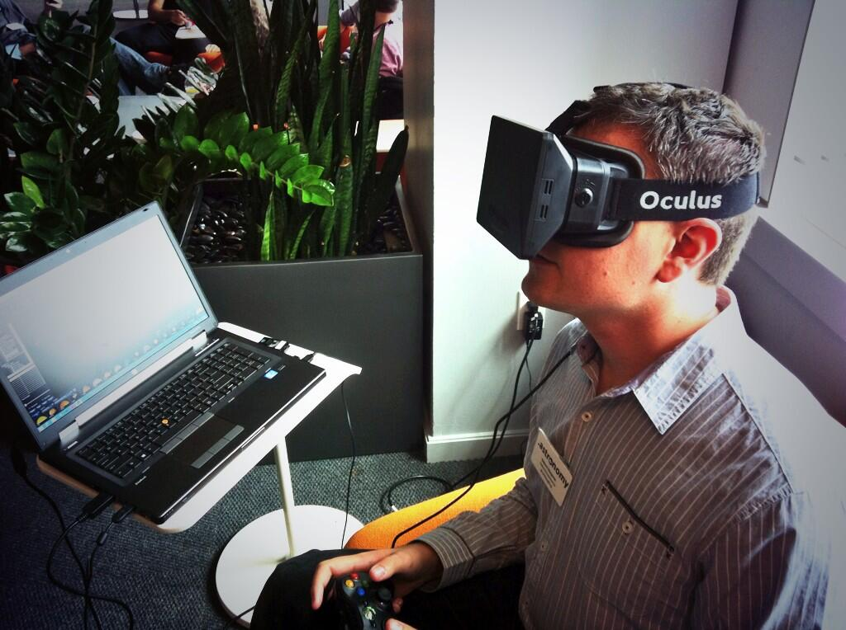
When to use the LAYER Control API

Slide 4
What is the HTML5 control
A Scriptable Sky & Planet viewer
A canvas for adding interactive visual elements using coordinate systems
A scalable viewer for your images and data
Hundreds of all-sky surveys in several bands instantly available for reference
Playback of tours by script control

Slide 5
Getting started
On-line user guide at: http://www.worldwidetelescope.org/authoring/Developer.aspx?Page=WebControlScriptReference

Slide 6
Hello World Sample

Slide 7
<!DOCTYPE html >
<html>
<head>
<title>Hello World with WWT</title>
<script src="http://www.worldwidetelescope.org/scripts/wwtsdk.aspx"></script>
<script>
var wwt;
function initialize() {
wwt = wwtlib.WWTControl.initControl("WWTCanvas");
wwt.endInit();
}
</script>
</head>
<body onload="initialize()">
<div id="WWTCanvas" style="width:750px; height:750px; border-style: none; border-width: 0px;"></div>
</body>
</html>

Slide 8
Adding a ready event
function initialize() {
wwt = wwtlib.WWTControl.initControl("WWTCanvas");
wwt.add_ready(wwtReady);
wwt.endInit();
}
function wwtReady() {
wwt.loadImageCollection("http://www.worldwidetelescope.org/COMPLETE/wwtcomplete.wtml");
wwt.gotoRaDecZoom(286.485, -27.5231666666667, 60, false);
}

Slide 9
Adding your data
You add your own glue to bind together your database/images to viewer
Load WTML collections for custom background, foreground image sets
Plot data points, lines and polygons with click-back notification
Use libraries your favorite Library for VOTable & WebSAMP handling

Slide 10
Sample “Complete coverage map tool”
http://www.worldwidetelescope.org/complete/wwtcoveragetool5.htm

Slide 11

Mahalo!

