Slide 1
Open Source Science and Open Science Policy at NASA
Steve Crawford
Science Data Officer
October 19, 2022

Slide 2
Overview
Open Source Science
Open Science Policy and Guidance
Open Licenses

Slide 3
NASA Commitment to Open Data
National Aeronautics and Space Act of 1958
Section 203
(3) provide for the widest practicable and appropriate dissemination of information concerning its activities and the results thereof.
Earth Observation System Background Package 1988
Notes:
Based on strategies derived from community workshops

Slide 4
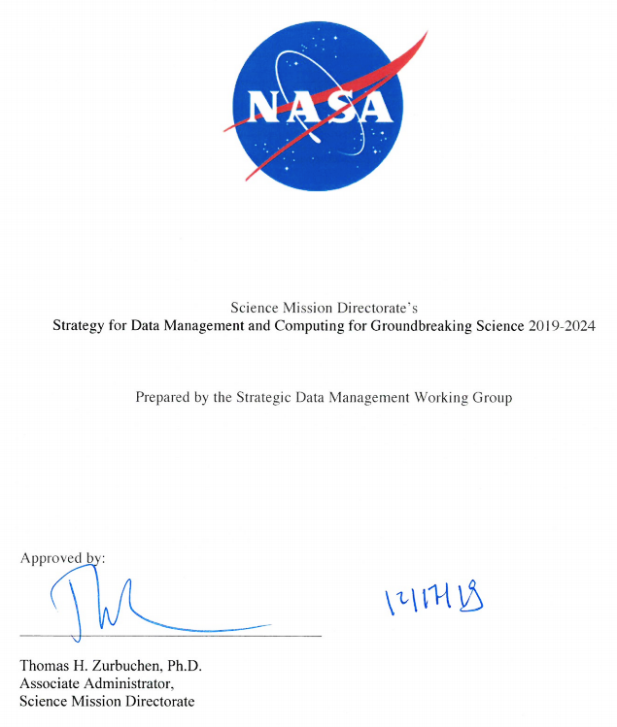
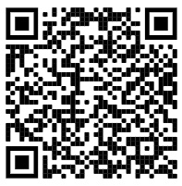
What is the SMD Strategy for Data and Computing?
An SMD-approved strategy to enable transformational open science through continuous evolution of SMD’s science data and computing systems.
Goal 1: Develop and Implement
Capabilities to Enable Open Science
Goal 2: Continuous Evolution of
Data and Computing Systems
Goal 3: Harness the Community
and Strategic Partnerships for Innovation
Notes:
Based on strategies derived from community workshops

Slide 5
NASA Open Source Science Initiative (OSSI)
https://science.nasa.gov/open-science-overview
Policy development, education, compliance tool development
Updating NASA policies on scientific information to better enable the activation of open science (SPD-41A)
Core Services for Science Discovery
Developing core data & computing services, tools, and training to enable open science
ROSES Elements
Supporting open-source software, tools, frameworks, libraries, platforms, and training with over $5 million dollars in grants
Community Building & Partnerships Transform to Open Science (TOPS)
Fostering and accelerating adoption of open science practices across the scientific community
‹#›
Notes:
Newly established Chief Science Data Officer, Kevin Murphy, and his team at HQ
Strategically enable transformational open science through continuous evolution of SMD’s science data and computing systems
Increase the accessibility, inclusion, and reproducibility of SMD scientific activities
SPD-41 brings together existing NASA and Federal guidance
SPD-41a was released in November with proposed additions.
An RFI was released to the community and closed on March 4, 2022.
Core services: Research Data and Software Archive, User Registration, Data Set Search, Journal Search, AI/ML models, and more
More current activitie sbut don’t have tim eso will touch on these
We define Open Science as:
a collaborative culture enabled by technology that empowers the open sharing of data, information, and knowledge within the scientific community and the wider public to accelerate scientific research and understanding.
Open-Source Science is NASA’s method for putting Open Science into practice.
OSSI aims to implement NASA SMD’s Strategy for Data and Computing ​
Scientific information management
Hybrid data & computing framework
Collaboration tools
Open source science training
Deep science data archive
​
OSSI is a comprehensive program of activities to enable and support moving science towards openness, including:​
policy adjustments​
supporting open-source software​
enabling cyberinfrastructure

Slide 6
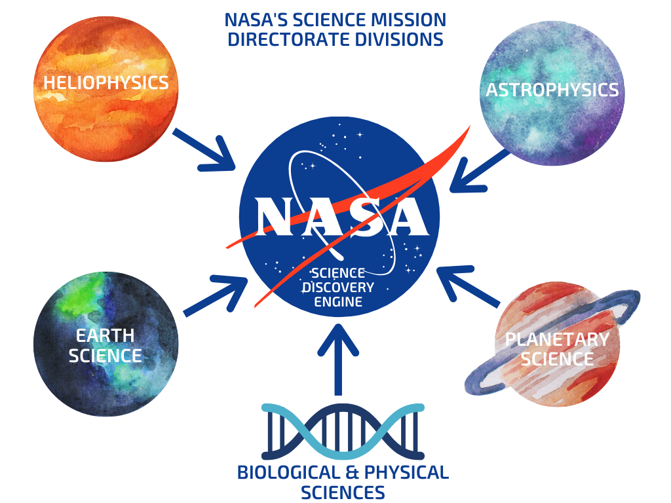
SMD Science Discovery Engine
Create an SMD discovery capability to enable open source science. Scope includes:
Astrophysics: NAVO registry
BPS: GeneLab, Life Sciences Data Archive
Earth Science: Common Metadata Repository
Heliophysics: SPASE registry, Events Knowledgebase
Planetary Science: PDS API
+ Models, software, tools and other contextual information from all 5 divisions
Over 1 million documents & metadata included at this time.
Incorporated 3 SMD relevant facets into the interface
Platforms
Instruments
Missions
Notes:
https://science.nasa.gov/science-red/s3fs-public/atoms/files/SDMWG%20Strategy_Final.pdf

Slide 7
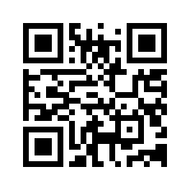
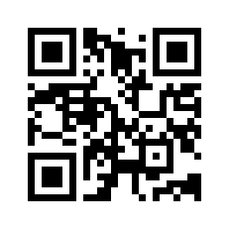
SMD Scientific Information Policy (SPD-41)
SPD-41 was released in Aug. 2021
SPD-41 brought together existing NASA and Federal guidance on open data, software, and publications
Applies to all new SMD-funded activities starting Sept. 2021 and later
SPD-41: Scientific Information Policy https://go.usa.gov/xtNTJ
Scientific Information Policy Website & FAQ https://science.nasa.gov/researchers/science-data/science-information-policy
https://science.nasa.gov/researchers/science-data/science-information-policy_faq
Notes:
SPD-41 brings together existing NASA and Federal guidance on open data, software, and publications. ​
SPD-41 applies to all new SMD-funded activities related to producing scientific information. (start date September 2021 and later)
It covers

Slide 8
SMD Scientific Information Policy (SPD-41A)
SPD-41A draft released in Nov. 2021
Community RFI soliciting feedback closed Mar. 2022; main concerns around software, support, and further guidance
Compliance with SPD-41A will be required no earlier than Jan. 2025
SPD-41: Scientific Information Policy https://go.usa.gov/xtNTJ
Scientific Information Policy Website & FAQ https://science.nasa.gov/researchers/science-data/science-information-policy
https://science.nasa.gov/researchers/science-data/science-information-policy_faq
Policy development, education, compliance tool development
Updating NASA policies on scientific information to better enable the activation of open science (SPD-41A)
SPD-41A is forward looking and will be released soon
Compliance for new activities no earlier than Jan. 2025
TOPS OpenCore modules will provide relevant training
Training events will be held during 2023 Year of Open Science
Further guidance on implementation will be provided
SMD Core Services aim to provide support for implementation
SMD Divisions will release companion policies in 2023
Notes:
Updated to be forward-leaning toward open science
Draft released about a year ago, RFI closed this past march soliciting feedback on how the changes would impact research communities and what support like training, funding, services, or further guidance would be needed to support successful implementation of the policy
Got a lot of responses that were supporting of goals of policy and movement toward open science
Main concerns were around opening up of software and the need for support and further guidance
The RFI responses were taken very seriously and we have been working hard to address the concerns
The new policy should be published soon
Much of the OSSI efforts are geared toward addressing the support and further guidance concerns
This is a policy document, so by nature it doesn’t include these things
Individual SMD divisions will also be publishing companion information policies that address specific concerns and needs within those communities.
Compliance with SPD-41A will only apply to new SMD-funded activities and no earlier than Jan. 2025
But encourage you do adopt parts of this policy consistent wtih available resoruces
SPD-41a is forward looking - it is meant to apply to work going forward. Existing missions and investigations should adopt parts of this policy consistent with available resources.
The RFI asked the following two questions: • How will the proposed changes to the existing information policy impact the research activities of your communities? • What support, services, training, funding, or further guidance is needed to support the successful implementation of the existing or proposed information policy?

Slide 9
What is the current policy in SPD-41?
Data Scientific data shall be made publicly available with a clear, open, and accessible data license no later than the publication of the research.
Mission data shall be openly available with no period of exclusive access.
Software Research software should be publicly available no later than the publication of the research and assigned a permissive software license.
Publications Manuscripts versions of as-accepted manuscripts shall be deposited in a NASA repository and made publicly available within 12-months.
Mission publications shall additionally be made publicly available at the time of their publication.

Slide 10
What are the new proposed changes in the SPD-41a draft?
Data Scientific data should be FAIR and shall be made publicly available with a clear, open, and accessible data license no later than the publication of the research, and be citable.
Mission data shall be openly available with no period of exclusive access.
Software Research software shall be publicly available no later than the publication of the research, assigned a permissive software license, and be citable.
Mission software shall additionally be developed openly in a publicly accessible, version-controlled platform that allows for contributions and engagement from the community.
Publications Manuscripts versions of as-accepted manuscripts shall be deposited in a NASA repository and made publicly available within 12-months. Publishing as open access is supported and posting preprints is encouraged.
Mission publications shall additionally be made publicly available at the time of their publication.
Science workshops and meetings shall be open to broad participation and documented in public repositories.
Notes:
NOTE: On this slide - got a question what level mission software public - if ITAR L0 to L1, then private, only private where export control - long term vision is as much open as possible - while remaining secure. In SPD41 what is scientifically useful is left up to the divisions *at this point*

Slide 11
Overview of the implementation SPD-41a
Future implementation plans include:
Improving Software release process for NASA scientist
Guidance for awards, contracts, solicitations, and Announcement of Opportunities; PIs should include these costs in proposals
Incentives for the community to make the transition - e.g ROSES22 F8. Supplement for Open Source Software
SPD-41a is forward looking - it is meant to apply to work going forward. Existing missions and investigations should adopt parts of this policy consistent with available resources.

Slide 12
Open Science Guidance
Developing processes to incorporate community best practices and community-led development of Open Science guidelines
Adopt practices already in place in our community especially those developed through standards groups (IVOA, IPDA, SPASE, RDA, FAIR)
Establish community-led guidelines for how to practice open science for our researchers, missions, and data repositories
Example: Open Science Guidelines working group (Led: Mark Parsons) developed a request for comment DOI policy for SMD Data Repositories.
Now out for comment. Please review and comment! https://github.com/nasa/smd-open-science-guidelines

Slide 13
Scope: Where on the spectrum below?
Figure based on the work of Peter Pulsifer, Carleton University, Ottawa, Canada
Notes:
OK, so we have our basic objectives and our underlying principles, but what are these standards things we are trying to address? There is a broad spectrum to consider from general ethics to enforced law.

Slide 14
Open Licenses
SMD’s policy is that scientific data should be released with a Creative Commons Zero license if there are no other restrictions on the data.
This provides a clear license that the data is in the worldwide public domain and that there are no restrictions on how to use the data.
Why?
It’s the law: Open Government Data Act of 2018 specificies US public data assets should be released with a license “with no restrictions on copying, publishing, distributing, transmitting, citing, or adapting such asset.” Unless otherwise restricted, US government works are also usually in the public domain.
Notes:
There are also further arguments

Slide 15
Open Licenses
SMD’s policy is also that scientific data should be cited, however, this is not required.
When using data by scientists, it is ethical to cite the data and should be a norm/best practice for our communities. It is in the NASA SMD policy that data should be citable.
How to make sure data is citable?
Making it clear how to cite the data (have a DOI and clear instructions)
As a reviewer, check for data citation in articles
Work with journals to include data citation
Notes:
There are also further arguments on to why a

Slide 16
Process of developing licenses
When developing licenses or looking at what license to use on the data, there are many considerations:
Work with Legal: Work with legal experts on intellectual property. Regulations on copyright differ from country to country and on different types of artifacts (e.g. data vs software). Also contractor vs grantee vs civil servant may have different conditions.
Use recognized licenses: There already exists common licenses for most needs in the scientific community. Do not reinvent the wheel.
Use the most open license: Make it as easy as possible for others to use your data. Licenses with any restrictions will cause some people to not use your data.

Slide 17
Back up slides

Slide 18
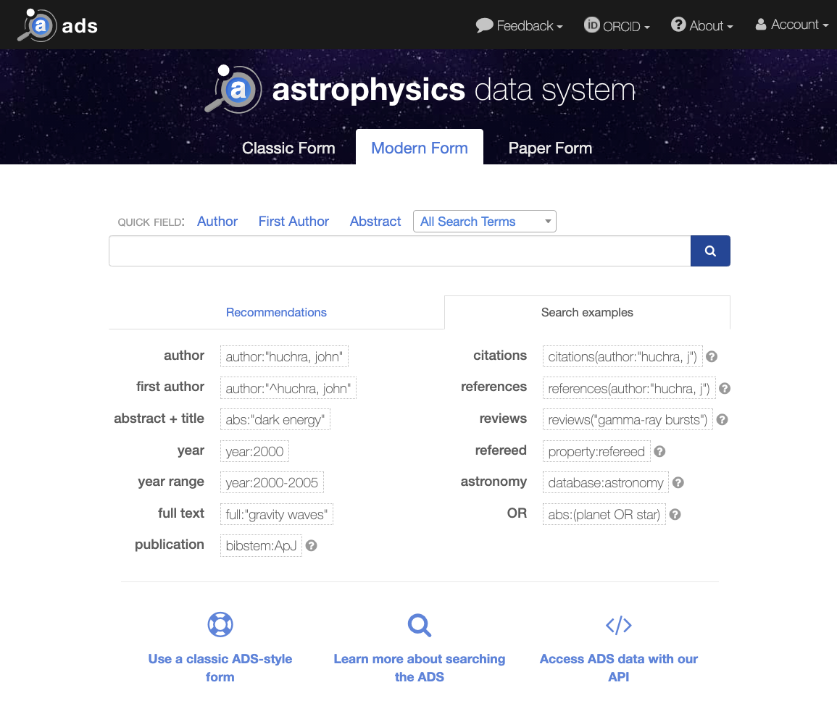
The NASA Astrophysics Data System (ADS)
NASA-funded is funding an expansion of ADS beyond Astronomy & Physics to included:
Heliophysics
Earth Science
Planetary Science
NASA studies in Biological & Physical Sciences
https://ui.adsabs.harvard.edu

Slide 19
What is Transform to Open Science (TOPS)?
TOPS is a 5-year NASA SMD initiative to foster adoption of Open Science practices across the scientific community.
Strategic Objectives:
Increase understanding & adoption of open science
Accelerate major scientific discoveries
Broaden participation by historically underrepresented communities

Slide 20
What is TOPS doing?
NASA has allocated $3 million/year to fund projects related to Open Science Training via the “TOPST” ROSES 22 element.
Develop ScienceCore
OpenCore summer schools
OpenCore virtual cohorts
OpenCore is a community developed introduction to open science
CSDO is participating in the Office of Science and Technology Policy (OSTP) Subworking group on the Year of Open Science
Maintaining GitHub to share resources and ensure an open and transparent working environment

Slide 21
SMD Strategy for Data Management and Computing for Groundbreaking Science 2019-2024
Goal 1: Develop and Implement Capabilities to Enable Open Science |  | Goal 2: Continuous Evolution of Data and Computing Systems |  | Goal 3: Harness the Community and Strategic Partnerships for Innovation
1.1 | Develop and implement a consistent open data and software policy tailored for SMD | 2.1 | Establish standardized approaches for all new missions and sponsored research that encourage the adoption of advanced techniques | 3.1 | Develop community of practice and standards group
1.2 | Upgrade capabilities at existing archives to support machine readable data access using open formats and data services | 2.2 | Integrate investment decisions in High-End Computing with the strategic needs of the research communities | 3.2 | Partner with academic, commercial, governmental and international organizations
1.3 | Develop and implement a SMD data catalog to support discovery and access to complex scientific data across divisions | 2.3 | Invest in capabilities to use commercial cloud environments for open science | 3.3 | Promote opportunities for continuous learning as the field evolves through collaboration
1.4 | Increase transparency into how science data are being used through a free and open unified journal server | 2.4 | Invest in the tools and training necessary to enable breakthrough science through application of AI/ML
‹#›
Notes:
Note: table may need to be reformatted to accommodate screen reader?

Slide 22
Context for Data and Computing Architecture Study
The CSDO is conducting two activities to develop cyberinfrastructure to support the Strategy for Data Management and Computing and SPD41:
1. Defining Core Data and Computing Services Requirements Common SMD IT policies, software and computing capabilities to support: Moving to hybrid cloud environments: computing, storage, cybersecurity, networking, and business processes Open-Source Science/SPD-41 requirements: Research Data and Software Archive, User Registration, Data Set Search, Journal Search, AI/ML models, and more
2. Data and Computing Architecture Study Study to evaluate architecture options for scientific data and computing elements of Core Services infrastructure. Produce recommendations for a Hybrid Cloud Infrastructure for SMD (mixed computing, storage, and services environment made up of on-premises infrastructure, private cloud services, high-end computing, and a public cloud)
Core Services funding initiates in FY24 and ramps up fully in FY25.

Slide 23
Timeline for Core Services
Divisions continue to support their existing data and computing activities
FY22 | FY23 | FY24 | FY25 | FY26
CSDO supports pilot cloud environments for divisions
Study: Scientific Data and Computing Architecture
Develop Core Services requirements and cost models
Refine and approve
Initiate HQ and Center Offices
Develop and deploy initial capabilities
Transition plan execution
Core Services Operational
today
Open-Source Science Initiative Council and SMaC will guide and approve Core Services.

Slide 24
SMD Science Discovery Engine
Notes:
https://science.nasa.gov/science-red/s3fs-public/atoms/files/SDMWG%20Strategy_Final.pdf

