Slide 1
Visualisation of Astronomical Data In a Stereoscopic Dome
O.R.Williams, CIT
11/03/2018

Slide 2
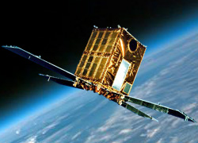
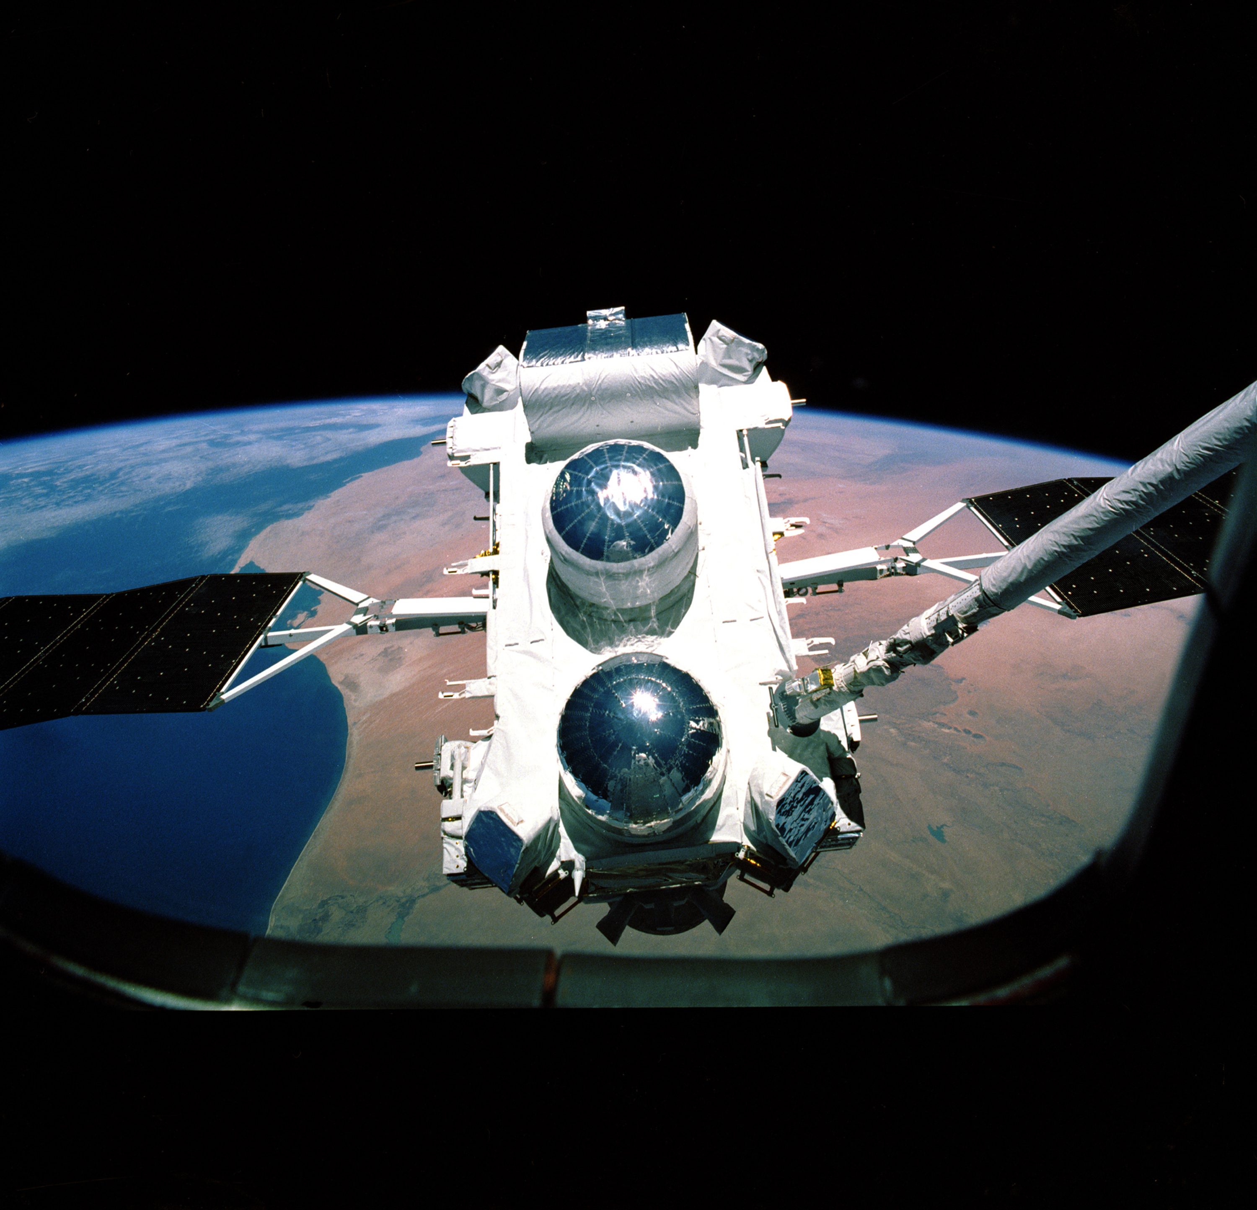
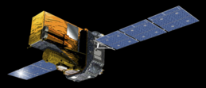
About me

Slide 3
Visualisation of Data in a Dome: Contents
Why use 3D & Immersive Visualisation
Principles of Immersive Visualisation
Projecting in a dome
Projection systems & limitation
Software system available
Stereoscopic Devices: Passive stereo & Active stereo
Data sources used in a dome
Astronomical data sets (catalogues)
Images and videos
3D data models
Simulations

Slide 4
3D & Immersive Visualisation in Astronomy: I
Mainly used for data discovery & outreach
Not yet used for analysis (as far as the speaker knows)
Three most active fields for progress in data discovery are
Large-N particle data
Spectral data cubes
Stellar and galaxy catalogues

Slide 5
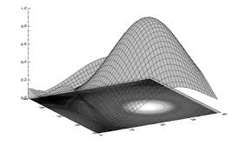
3D & Immersive Visualisation in Astronomy: II
Need to distinguish between techniques for exploring 3D data using a flat screen and using stereoscopic or immersive techniques
Flat screen example1 : a catalogue can be read into a suitable program (e.g. Partiview, WWT, OpenSpace) and the user can fly around that view of the universe
Flat screen example 2: a data cube can be displayed using IDL and the user can then rotate the image to further explore the data

Slide 6
Projecting in a Dome
Multiple projectors each covering a segment of the screen
9 Projectors in this dome
Problems with reflected light
A bright source on the dome will illuminate the opposite side
Mitigated by having a dome which is less than 50% reflective
Results in a reduction of ~50% brightness
Stereoscopic systems result in a reduction of brightness by 60%

Slide 7
Stereoscopic Visualisation: Display Devices
3D Televisions (now increasingly rare)
Single projector and screen
Multiple projectors and screen (e.g. VR Theater in CIT)
Cave Automatic Virtual Environments (CAVE)
Domes (e.g. DOT)

Slide 8
Stereoscopic Visualisation Basics

Slide 9
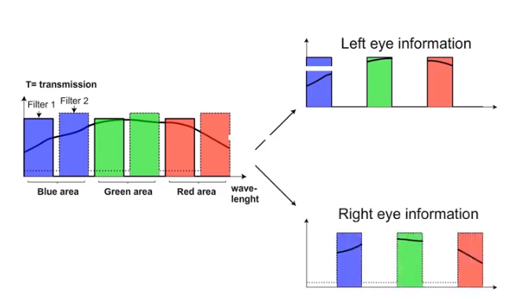
Stereoscopic Projection: Passive Stereo

Slide 10
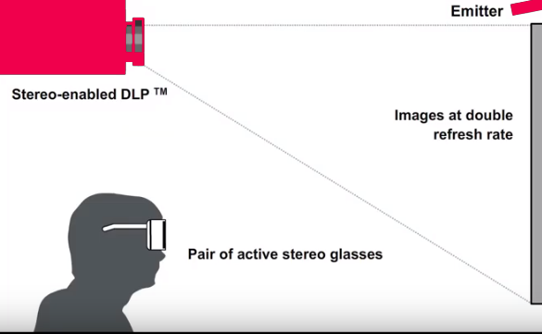
Stereoscopic Projection: Active Stereo

Slide 11
Advanced Visualisation Systems
The following can all be used on systems varying from Domes to a simple laptop. All are stereo capable
Uniview – The earliest system. A commercial product based on a system developed by Norkopping Visualisation Centre.
SkySkan – Commercial product (used in this Dome and will be demonstrated shortly)
DigiSTAR – Commercial product mainly used in domes.
OpenSpace – Open source visualisation programme. Collaboration including NASA, Norkopping and Hayden Planetarium

Slide 12
Data types in the Dome I
Astronomical catalogues.
A large number of astronomical catalogues are available in the SkySkan system.
New catalogues can be imported
Options exist to view and fly through these catalogues
Different type of source characteristics can be programmed to determine the source colour.
Various different file formats depending software
Partiview (Ascii files one line per sources starting with position in X,Y,Z
FITS
Octtree

Slide 13
Data types in the Dome II
3D Models
Can be used to show planets and satellites such as the ISS or Euclid
Useful for outreach
The CIT visualization group in RUG works with the 3dsmax software.
This software allows for 3D models to be built from scratch but it can also import up to 60 different graphics formats.
The final 3D model should always be in .x or .obj format as these are the only two formats supported by the current dome software.

Slide 14
Data types in the dome III
Geographical Information Systems (GIS)
Some systems (e.g. OpenSpace) include a large amount of planetary data
Unfortunately OpenSpace does not yet work in this dome (installation underway)
The SkySkan system in this dome does not contain a library of such data.
Custom made planetary maps an be wrapped on a sphere when imported into the SkySkan software system.
The only requirement is that the map you use is of a high enough resolution (min 4kx2k) and is created in equirectangular map projection.

Slide 15
Data types in the dome IV
Fisheye images and videos
Circular fisheye photos or images can be added to the SkySkan system.
If the resolution is 4k x 4k or higher, the image can cover the entire dome.
Photographers should point the camera with the fisheye lens upwards (between 45 and 90 deg) when shooting to create an image in the dome displaying objects correctly at the horizon.

Slide 16
Data Types in the Dome V
Simulations
Many scientific simulations work with cube datasets.
There are several ways to bring such visualizations into the dome either taking a 2D cross section of the cube to be displayed on the dome, or creating a fly-through effect.
As an example we have earlier translated cubemaps to dome videos for several dark matter simulations

Slide 17
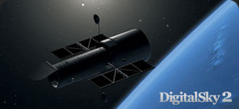
SkySkan DigitalSky Demo

Slide 18
Demo visualisations
Simulations (one of):
Millenium
Aquarius
Illustrius
3D Models
Hubble
Catalogue datasets In stereo
SDSS
Tully

