Slide 1
Centre to Dot
Bus 10 can be caught at Groningen Central Station. Get off at the Korreweg (5 minute walk in a southerly direction to reach Dot)
Bus 3 or 4 from the Groningen Central Station to P+R Kardinge. Then Bus 64 getting off a “UMCG Noord”
Bus 10 may not or may not run to the MartiniPlaza. The QBUZZ website is very obscure. If it doesn’t run walking to the station is probably the only option.

Slide 2
Dot to centre
Bus 10 can be caught on the Korreweg (5 minute walk north)
Bus 64 from stop "UMCG Noord" to P+R Kardinge where bus 3 and 4 leave to the main station.
Bus 2 (south) from “UMCG Noord” to Europapark Station and then a local train to Assen or Groningen.
Bus 2 (north) from “UMCG Noord” to Station North. There a train to Groningen Central or Bus 10.

Slide 3
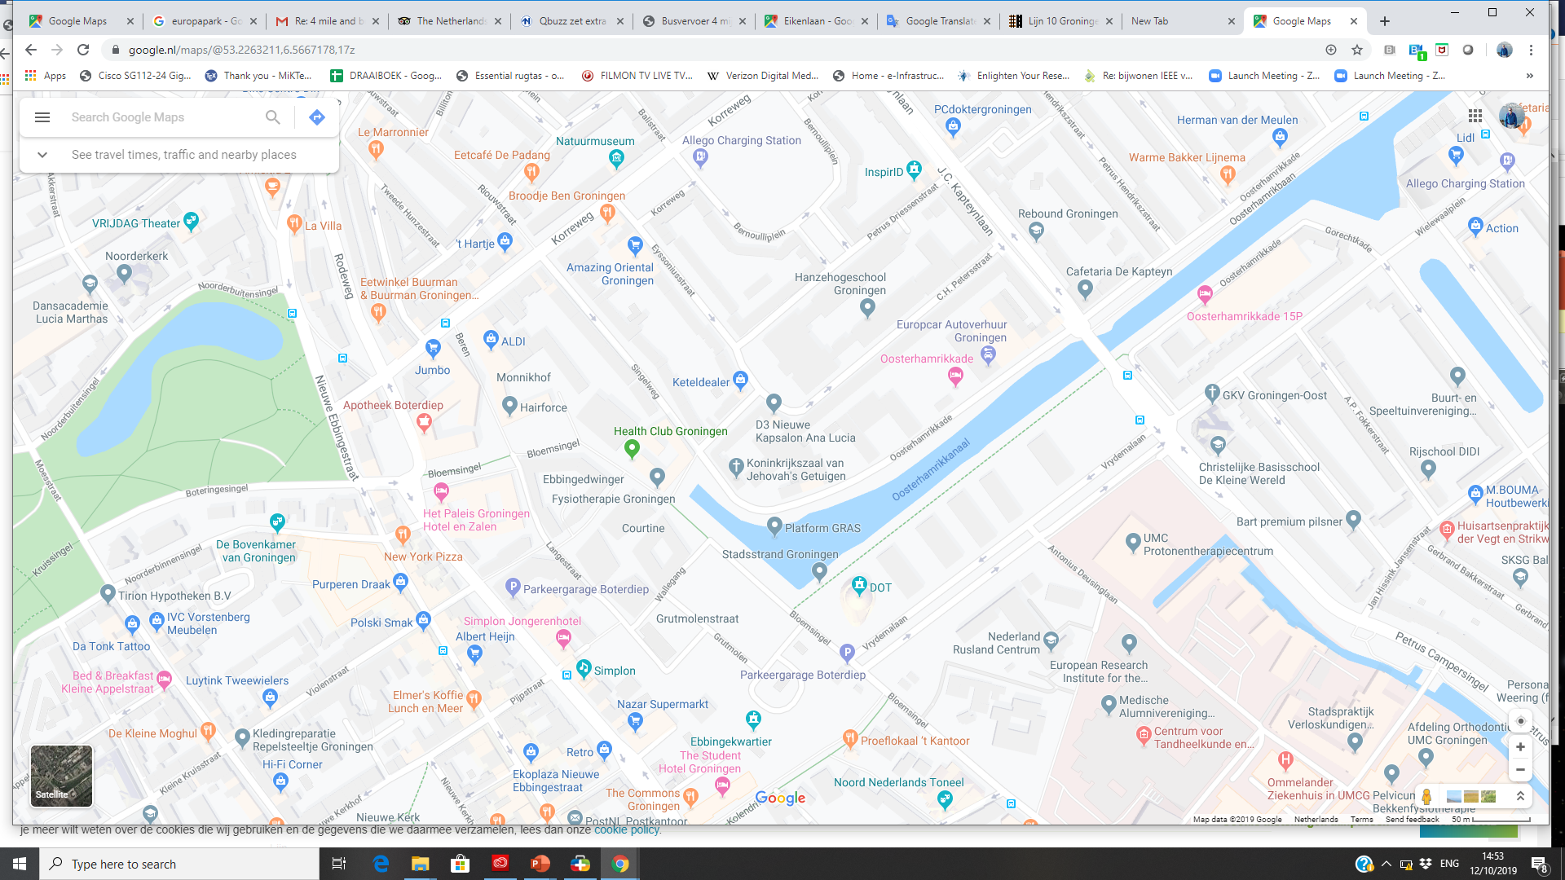
10
64/2(N)
2(S)

