Slide 1
SimpleTimeSeries Overview
Mike Fitzpatrick

Slide 2
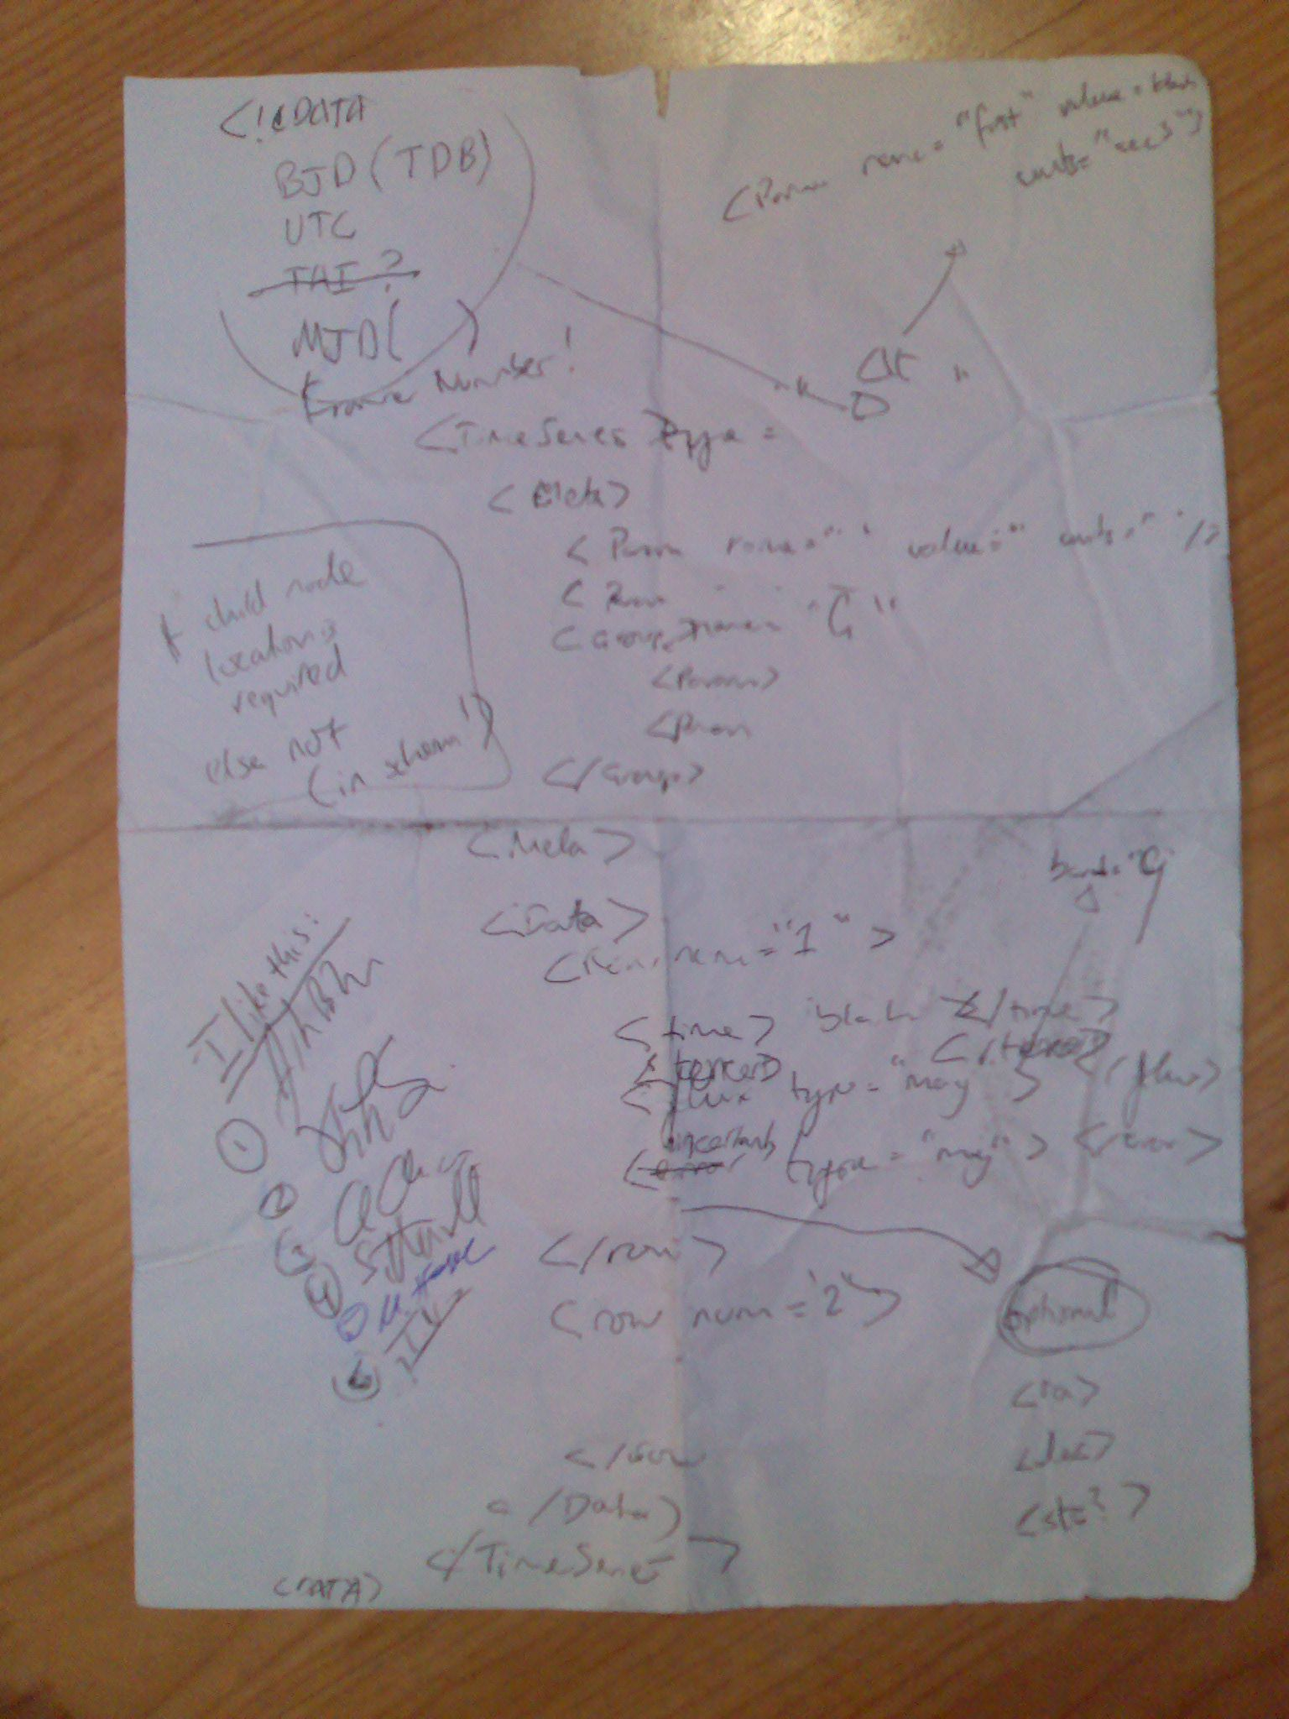
History and TL;DR
First light curve DM proposed by Enrique Solano (7/2007)
This led to the Napkin Representation and much discussion

Slide 3
History and TL;DR
Light curve data collected for analysis (2010)
http://wiki.ivoa.net/twiki/bin/view/IVOA/CSPTimeSeries
http://wiki.ivoa.net/twiki/bin/view/IVOA/LightCurves
John Brewer put together a schema for Josh Bloom’s group,
http://www.cacr.caltech.edu/hotwired2/book/chapters/TimeSeries.pdf
Arnold suggested revisions for consistency
No response from berkely, STS is as it is
STS reviewed by DM w/ agreement to publish as a Note (Feb13)
Final STS Note published May14

Slide 4
SimpleTimeSeries
Four basic elements:
<TIMESYS> - contains details of time system used (units, defaults) and whether peiod folded data
<BAND> - description of bandpasses used, allowing multi-bp data in same document
<FIELD> - UCD references to fields used
<SERIES> - one or more <ELEM> containing the data itself

Slide 5
<TIMESYS>
<TIMESYS>
<TimeType ucd="time;pos.frame;pos.heliocentric" unit="day">hjd</TimeType>
<TimeZero ucd="time.epoch;arith.zp" unit="day">0</TimeZero>
<!-- describe the progress of the time axis -->
<TimeUnits ucd='time.epoch' datatype='float' unit='day' />
<TimeWidthDefault ucd="time.period" unit="seconds">10.0</TimeWidthDefault>
<TimeSystem ucd="frame.time.scale">UTC</TimeSystem>
</TIMESYS>

Slide 6
<BAND> and <FIELD>
<BAND ucd="instr.filter;em.opt" bandid="I" description="This is the Johnson-Cousins I-band">I</BAND>
<BAND ucd="instr.filter;em.opt" bandid="V">V</BAND>
<FIELD fld="imag" bandid="I" ucd="opt;phot;i" datatype="float" unit="mag">I-band photometry</FIELD>
<FIELD fld="vmag" bandid="V" ucd="opt;phot;v" datatype="float" unit="mag">V-band photometry</FIELD>

Slide 7
<SERIES>
<SERIES>
<ELEM>
<TIME><T>2448919.8</T></TIME>
<MAG fld="imag"><VAL>17.535</VAL><ERR>0.03</ERR></MAG>
<MAG fld="vmag"><VAL>17.327</VAL><ERR>0.03</ERR></MAG>
</ELEM>
<ELEM>
<TIME>2448920.72</T>
<MAG fld="vmag"><VAL>17.37</VAL><ERR>0.036</ERR></MAG>
</ELEM>
<ELEM>
<TIME><T>2448922.82</T></TIME>
<MAG fld="imag"><VAL>17.697</VAL></MAG>
<MAG fld="vmag"><VAL>17.424</VAL></MAG>
</ELEM>
</SERIES>

Slide 8
STS Limitations
SimpleTimeSeries meets all of the IVOA science use cases for time series except for those where time is not the dependent variable, e.g., frequency with astroseismology data.
SimpleTimeSeries cannot be used to represent power spectra.
However, it can be argued that both of these are really spectra and so the Spectral DM serializations should be used to represent such data rather than a time series.

Slide 9
IVOA DM Compatibility
See Sec 3 of STS Note for details
However, generally good agreement in mapping
Some issues with Spatial Axis, e.g. STS allows unit differences between values and their errors.

Slide 10
Alternatives
http://hea-www.harvard.edu/~arots/nvometa/STC/TimeSeriesTableFormats.pdf
STC-based representation, but lacks UCD/Utype attributes on values

