Slide 1
Preview Images in SIA
Tom Donaldson, STScI

Slide 2
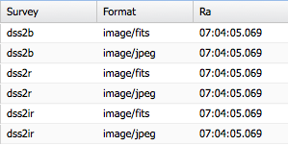
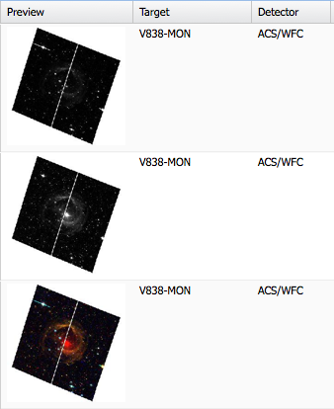
Motivation
Enrich client display possibilities by embedding preview image information in SIA results.

Slide 3
Doesn’t SIA Already Support This?
SIA results can reference any images, including previews.
Shortcomings:
Most services that currently include preview images only include full-resolution previews. Not helpful for displaying multiple thumbnail previews.
Only one image product per line, so supplying a single resolution preview image doubles the result size.
Given a result row that represents a preview image, there is no standard way to find the “real” image that it’s previewing.

Slide 4
Goals
Allow clients to select from multiple different preview sizes to suit their needs.
Make clear the associations between a preview and its “real” image.
Avoid dramatic increase in result size. (Shrink results if practical.)
Any new convention should be:
Optional
Backward compatible
Fairly easy to implement for data providers
Fairly easy to use for clients

Slide 5
Suggested Convention
SIA results would contain one row for each “real” image, a no extra rows for previews.
Additional elements would be added to tell the client how to access the previews. <LINK> element(s) in table metadata (*)
Standardize 5 preview sizes:
Thumbnail | 128x128
Small | 256x256
Medium | 512x512
Large | 1024x1024
Full | Actual image resolution

Slide 6
<LINK> Element
<LINK> elements in table metadata define templates URL for accessing previews.
Column values substituted into template URL for retrieving the specific preview. (Extension suggested in appendix A.1. of VO Table document.)
Two options for specifying size:
One LINK per available size (*)
One LINK total, with size specified as a URL parameter
Would require additional info somewhere to indicate which sizes are available.

Slide 7
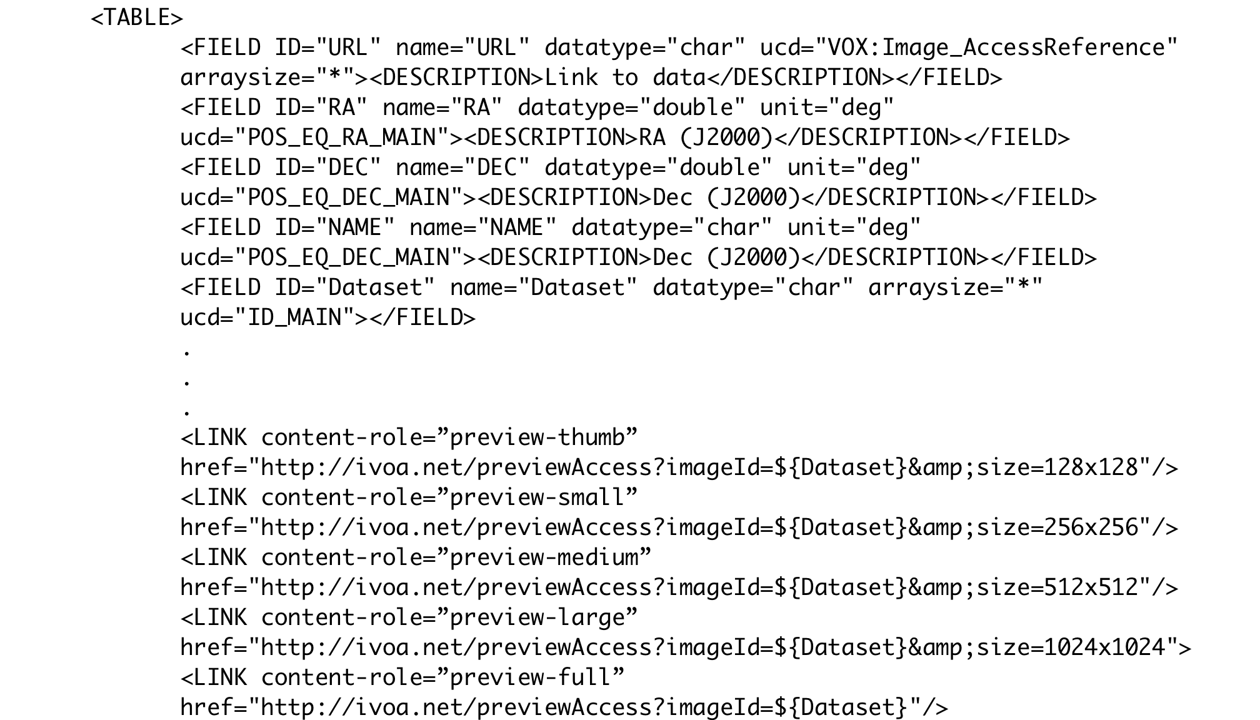
<LINK> Element – Example 1
Example 1:

Slide 8
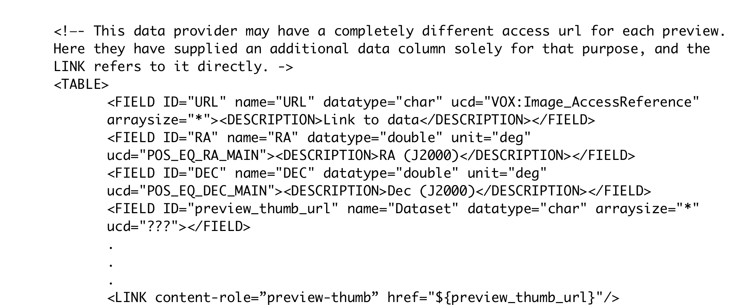
<LINK> Element – Example 2
Example 2:

Slide 9
<LINK> Element – other examples
Other examples:

