Slide 1
MAST/VAO Discovery Portal
Tom Donaldson, STScI/VAO
Dean Hinshaw, HEASARC/VAO
Tony Rogers, STScI
Geoff Wallace, STScI

Slide 2
Project Summary
Joint effort between MAST and VAO
Operational as Data Discovery Tool for VAO
Plan to make some MAST features operational soon.

Slide 3
Architecture Overview
OO web app written in JavaScript which controls all rendering
  Infrastructure for inter-component communication
Server implemented in C# and only sends data to the client (not html)
  Can retrieve tabular data from many sources
    VO Table URL or file
    SQL query
    CSV URL or file
  Can send that tabular data to the client as
    JSON
    VO Table
    CSV
    Html table

Slide 4
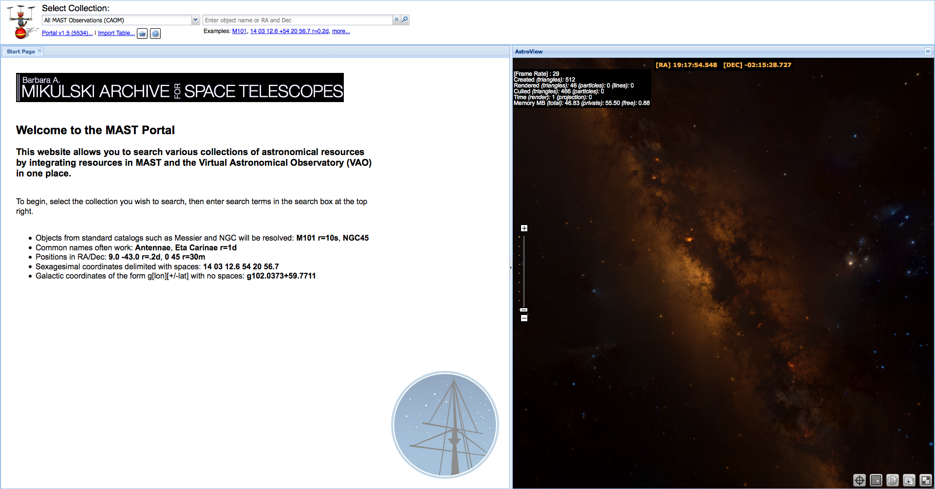
Demo
http://www.usvao.org/science-tools-services/vao-tools-services-data-discovery-tool/

