Slide 1
Leveraging Large Language Model(LLM)-based Agents with Multiple Tool Integration for Enhanced Search in the Canadian Astronomy Data Centre
Sara Shishehchi, Shaylin Thadani, Shavon Thadani, Patrick Dowler, Adrian Damian, Hossen Teimoorinia

Slide 2
Agenda
Introduction to LLms and text to SQL
History and challenges of text to SQL
LLM-Based Agents and Tool Integration
Project Overview:
Background, Goal and Objectives
Architecture
Benchmarking Against Existing Solutions
Demo

Slide 3
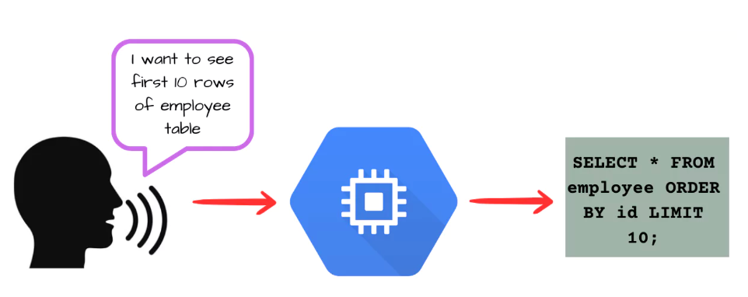
LLMs and Text to SQL
Text-to-SQL: a well-established task in natural language processing (NLP) designed to translates natural language queries into executable SQL commands that can retrieve data from a database.
Why text-to-SQL:
Democratize access to data
No need to learn SQL syntax
Eliminates the need for manual data searches through complex GUIs
Why LLMs:
Superior abilities in understanding human instructions and generating code.

Slide 4
History and Challenges of Text to SQL
Hong et al., arXiv:2406.08426v1, Jun 2024
Challenges of Text-to-SQL:
Linguistic Complexity and Ambiguity
Schema Understanding and Representation
Domain-specific table rules
Lack of generated SQL verification.
Model’s context window limits when dealing with large-scale real-world databases
Lack of large curated dataset to use for fine-tuning
Most recent research focused on In-Context Learning prompt strategies and supervised fine-tuning using data from the target

Slide 5
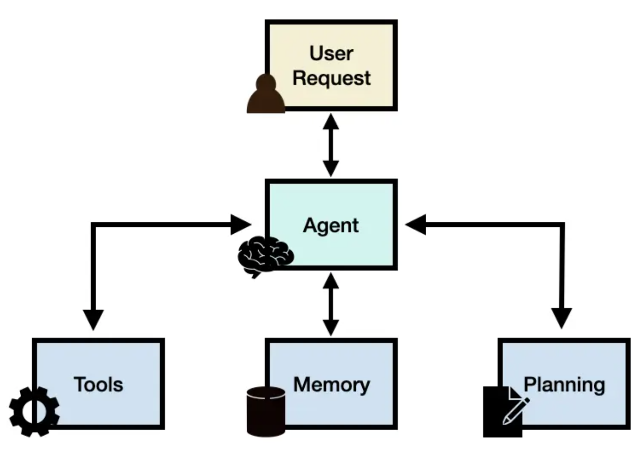
LLM-Based Agents and Tool Integration
Agent: LLM applications that can execute complex tasks through the use of an architecture that combines LLMs with key modules like planning, tools and memory
Benefits:
Verify SQL query and iterate to correct it
Incorporate various tools to:
Enrich the prompt with additional data (e.g. RAG)
Verify a user’s input against factual data. Iterate back with the user and correct
Scale and extend to additional agents/use cases
Collaborative multi-agent systems proved to accomplish complex tasks

Slide 6
Project Background and Goal
Canadian Astronomical Data Centre Database
15 tables with varying relationships
2 primary tables
Observation
Plane
335 columns of various data types
7 primary columns
Band
Collection
Instrument
Filter
Calibration Level
Data Type
Observation Type
Current Data Query Process
Astronomers search data through applying filters on the CADC website
The backend constructs and executes ADQL (Astronomical Data Query Language) code to retrieve the requested observational data
The CADC website displays the list of results
Astronomers can select certain rows and download FITS files

Slide 7
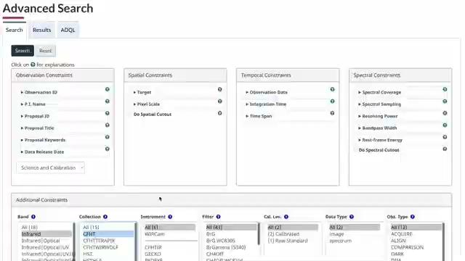
Current Implementation - CADC Advanced Search

Slide 8
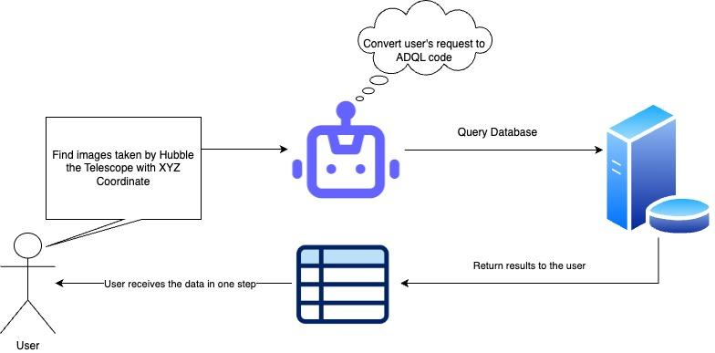
Project Goal

Slide 9
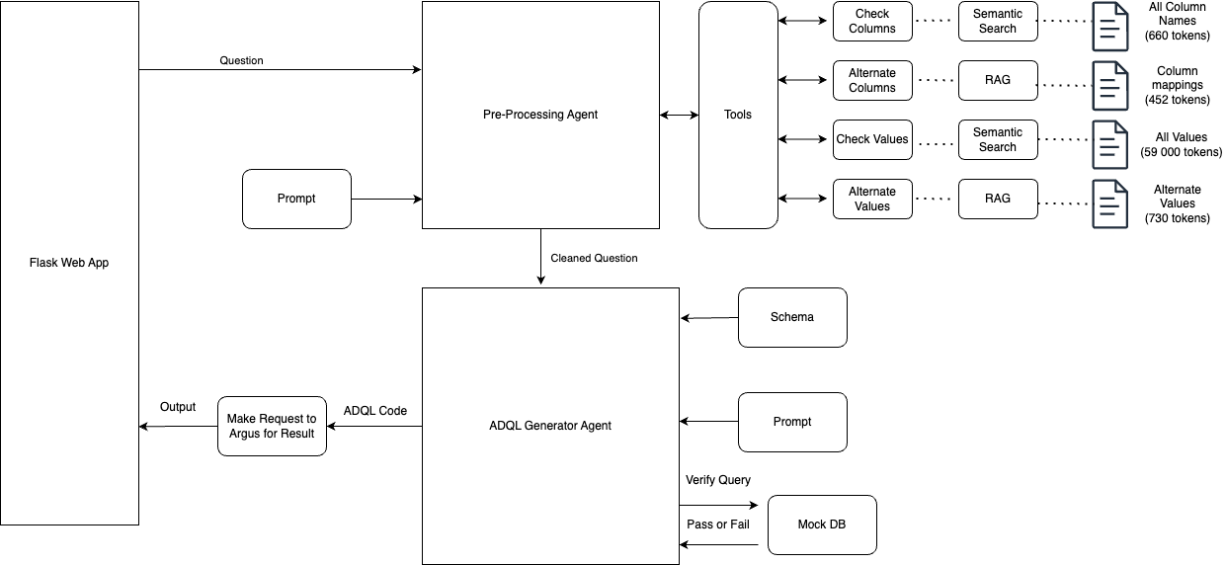
Architecture

Slide 10
Key Characteristics of our Architecture
An Existing solution: CADC Access GPT
Our Architecture
1. Preprocessing Agent: Corrects and refines user query
Tools: • Check Column: Recommends columns if specified column is missing
• Alternate Column: Substitutes columns with their correct names
• Check Values: Recommends values if specified value is missing
• Alternate Values: Substitutes values with their correct names
2. ADQL Generator Agent: Builds ADQL code from refined query Tools: • Database Schema
• Mock Database: Cloned copy to test and self-correct before final output
• A specialized version of Chat GPT tailored to generating ADQL code • Access to DB Schema and limited information about the Database
• Generates code in one shot

Slide 11
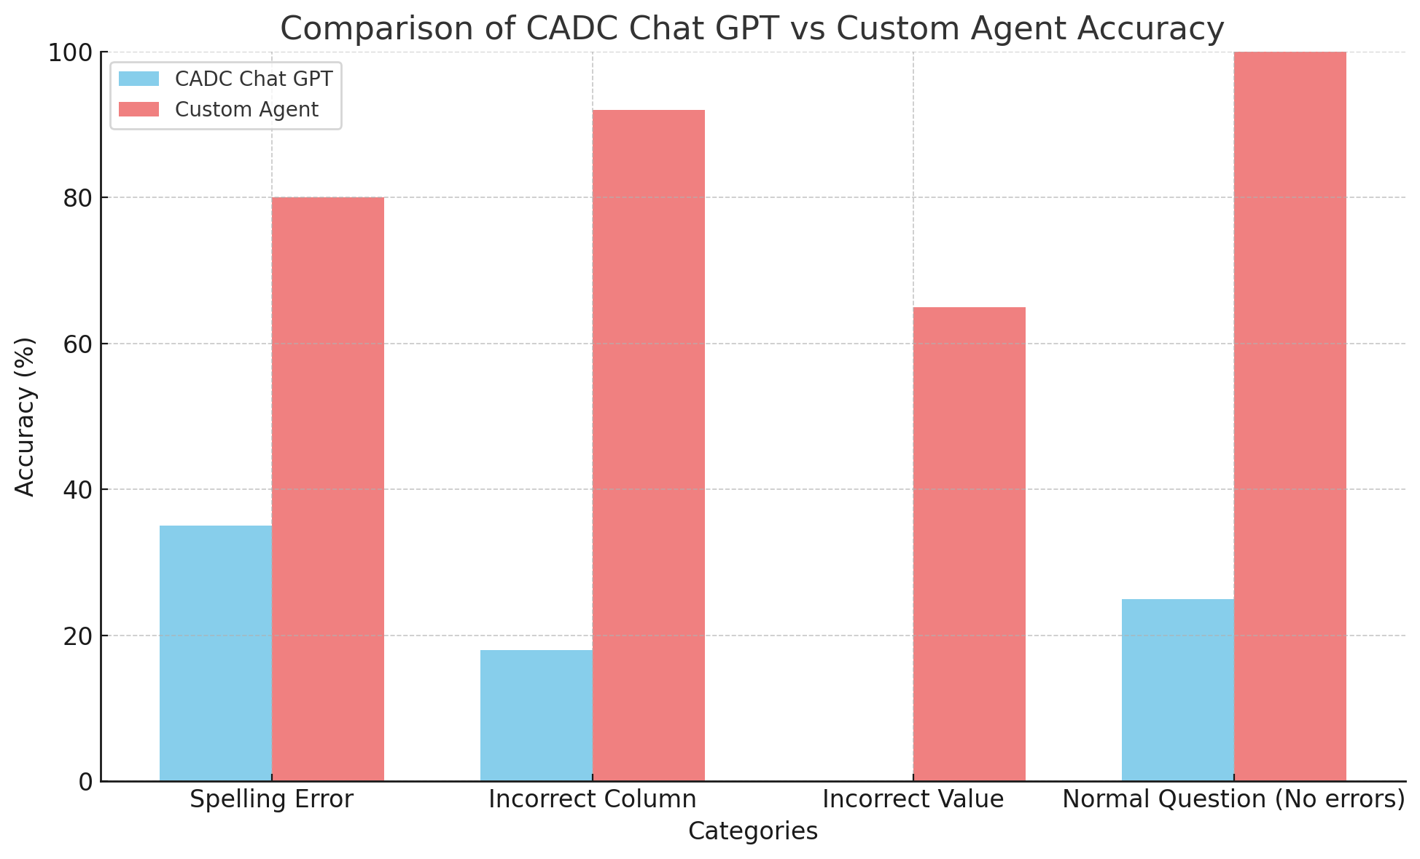
CADC Access GPT vs Our Custom Agent
Criteria for grading
75 questions
4 categories:
Spelling Error
Incorrect Column
Incorrect Value
Normal Question (No errors)

Slide 12
Conclusion and Future Work
Conclusion:
Supervised fine-tuning and limited model context window pose challenges in text-to-SQL tasks.
We developed a chatbot that allows users to interact with Canadian Astronomy Data Center using English language.
The chatbot leverages the power of LLM-based agents and integration of various tools to enhance accuracy.
Our system outperforms GPT systems built only based on table schema and prompt information.
Future work:
Additional tools:
Include a tool to fact-check user’s request
Apply extra pre-processing steps to understand astronomical language and coordinates
Collect more questions to benchmark
Extend to collaborative multi-agent systems
Extend to use cases beyond text-to-SQL (chat, Q&A)

Slide 13
Demo: Using Incorrect Column Names
Query: Select the columns collection and Data Type from the observation table and plane table where Band is 'UV'
Substitutions:
Data Type dataProductType
Band energy_emBand

Slide 14
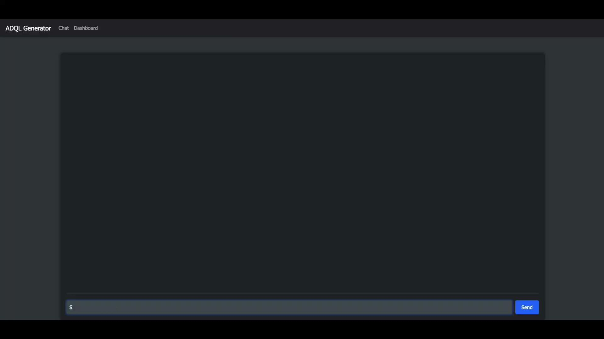
Demo: Using Incorrect Column Names

Slide 15
Demo: Using Incorrect Column Names
Query: Select the columns collection and Data Type from the observation table and plane table where Band is 'UV'
Output: SELECT o.collection, p.dataProductType, p.publisherID FROM observation o JOIN plane p ON o.obsID = p.obsID WHERE p.energy_emBand = ‘UV’ LIMIT 5;

Slide 16
Demo: Using Incorrect Value Names
Query: Find the first 20 rows of the instrument_name column where the instrument_name is 3rd band, Fourth band, B-Five, or Sixth band in the observation table.
Substitutions:
3rd band Band 3
Fourth band Band 4
B-Five Band 5
Sixth band Band 6

Slide 17
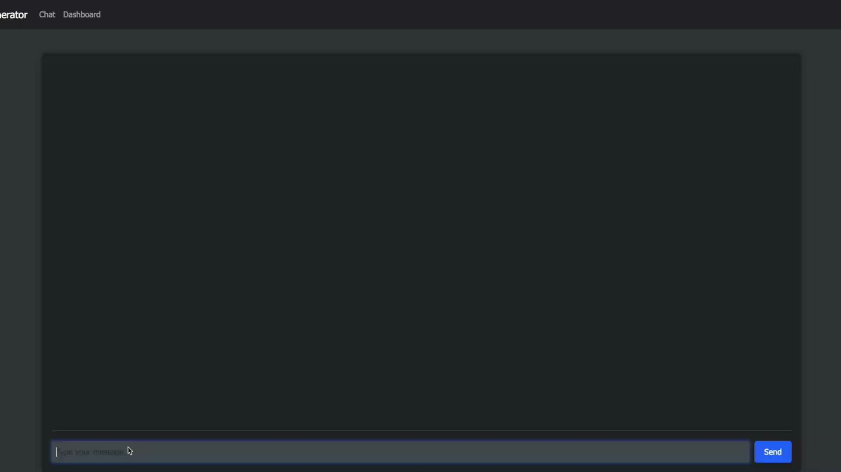
Demo: Using Incorrect Value Names

Slide 18
Demo: Using Incorrect Value Names
Query: Find the first 20 rows of the instrument_name column where the instrument_name is 3rd band, Fourth band, B-Five, or Sixth band in the observation table.
Output: SELECT p.publisherOD, o.instrument_name FROM observation o JOIN plane p ON o.obsID p.obsID WHERE o.instrument_name IN (‘Band 3’, ‘Band 4’, ‘Band 5’, ‘Band 6’) LIMIT 5;

Slide 19
Demo: Spelling Errors
Query: Get all obsevrations with 'Infrraed' or 'Opitcal' enregy_emBand and colection GEMINY.
Substitutions:
obsevrations observations
Infrraed Infrared
Opitcal Optical
enregy_emBand energy_emBand
colection collection

Slide 20
Demo: Spelling Errors

Slide 21
Demo: Spelling Errors
Query: Get all obsevrations with 'Infrraed' or 'Opitcal' enregy_emBand and colection GEMINY.
Output: SELECT p.publisherID, o.* FROM observation o JOIN plane p ON o.obsID = p.obsID WHERE (p.energy_emBand = ‘Infrared’ OR p.energy_emBand = ‘Optical’) AND o.collection = ‘GEMINI’ LIMIT 5;

