Slide 1
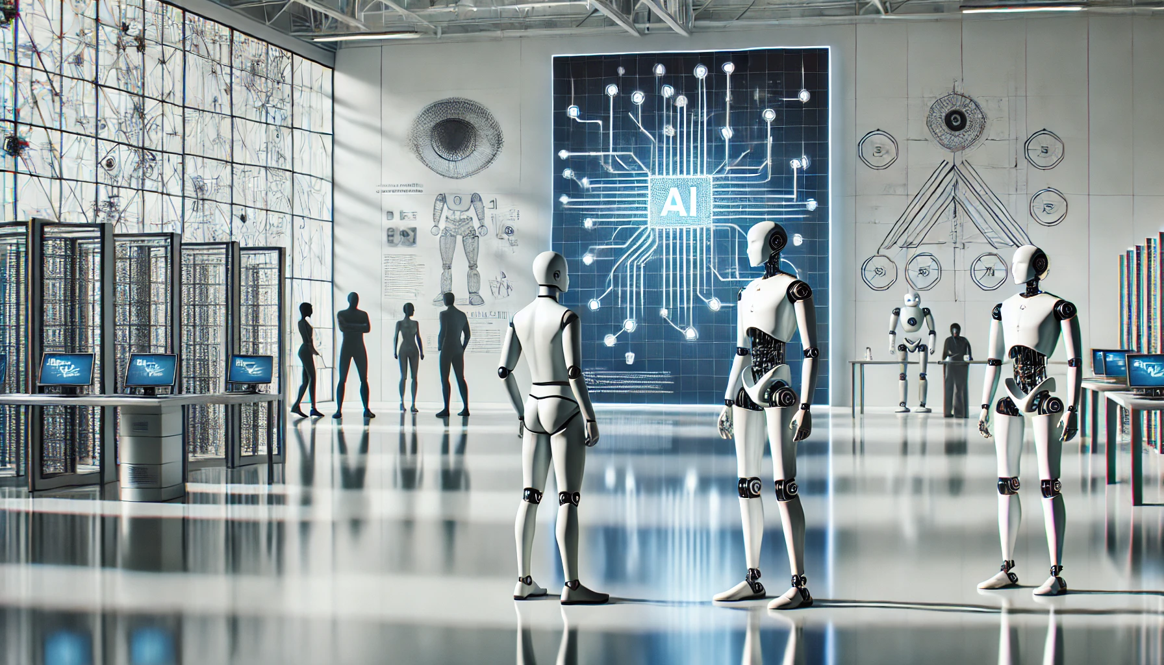


The Computational Evolution of Human Intelligence in AI
John Abela
16 November 2024
University of Malta
Valletta Campus, Malta

Slide 2
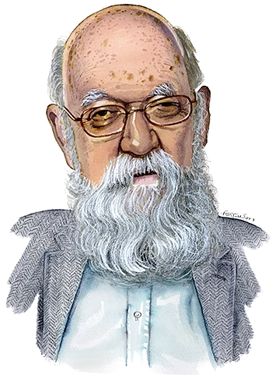

Is Intelligence just an Algorithm?
2
IVOA
Seminar
08:26
The debate about whether intelligence is merely computation lies at the heart of AI philosophy.
One perspective is that if a system can perform tasks requiring 'intelligent behaviour' with the same efficacy as a human, it could then be considered intelligent.
This perspective assumes that human intelligence is, in fact,
Turing computable.
If human intelligence is not Turing-computable then the
implications are enormous.
LLMs such as ChatGPT reinforced the belief of many people
who subscribe to the computational theory of the mind.
However, others argue that true intelligence entails more than
just processing symbols or data
Daniel Dennett
16 November 2024
University of Malta Valletta Campus

Slide 3
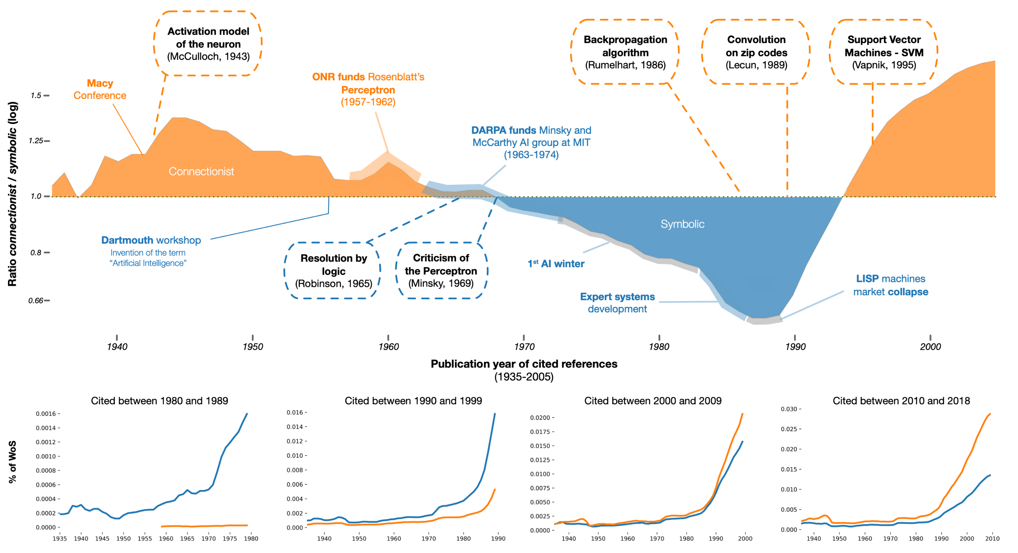
Symbolic vs Connectionist (Vector Space) AI
3
IVOA
Seminar
08:26

Slide 4
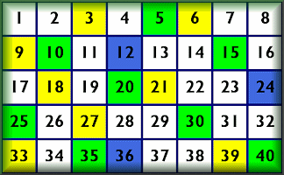
Vector (Tensor) Space Methods
4
IVOA
Seminar
08:26
Input
Vector Space Method
Algebraic Operations
linear and non-linear
Matrix arithmetic
Vector arithmetic
Tensor algebra
Output
Parameters
(weights)
16 November 2024
University of Malta Valletta Campus

Slide 5
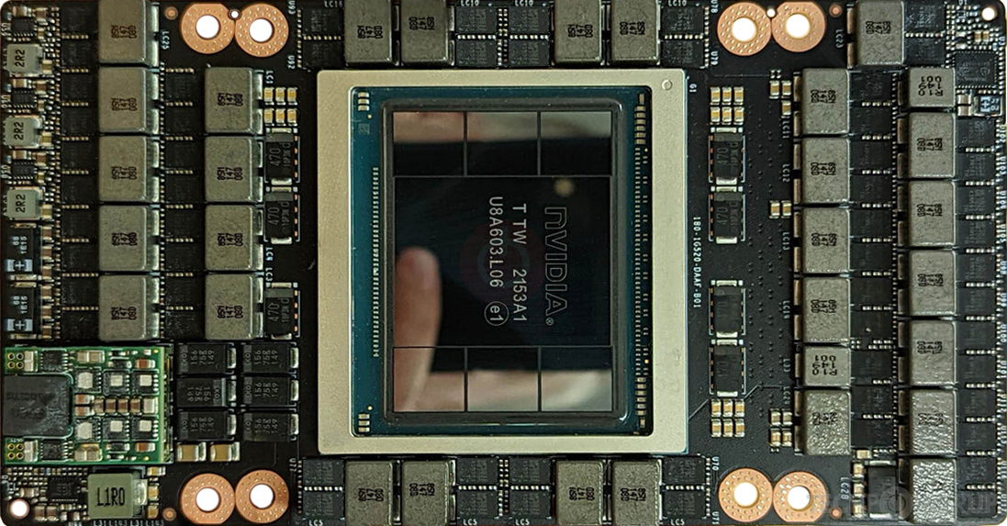

5
IVOA
Seminar
Neural Network Training is Linear (Tensor) Algebra
08:26
H100 60 teraFLOPS GPU
output
hidden
input
wO[]
input[]
5
wH[]
4
netH[]
4
3
netO[]
3
target[]
3
1
1 | 0 | 0 | 1 | 1
1
1
1
outH[]
4
4
outO[]
3
error[]
3
5
1
1
1
Nonlinearity
16 November 2024 - University of Malta Valletta Campus

Slide 6
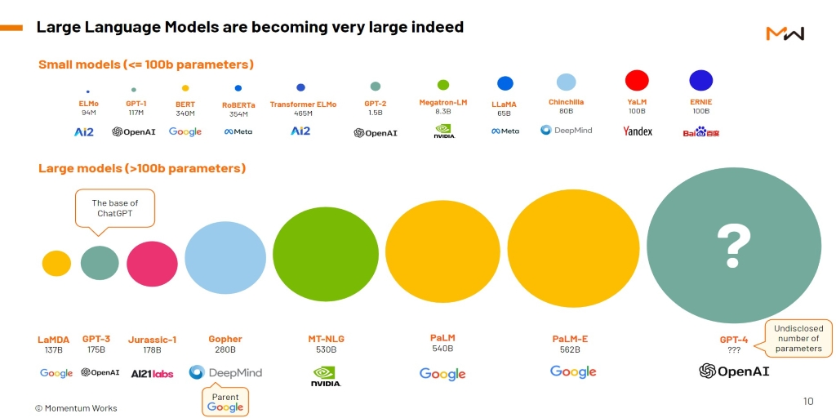
Large Language Models
6
IVOA
Seminar
08:26
1.76 x 10¹²

Slide 7
Transformers for Astrophysics
7
IVOA
Seminar
08:26
Transformer models have tremendous potential for applications in astrophysics.
Transformer have the ability to handle long-range dependencies in the data and efficiently parallelize training, which made them a breakthrough in language models, leading to large language models such as ChatGPT and beyond.
Vision Transformers (ViTs), which adapt the Transformer architecture to process image patches instead of tokens (words), demonstrate the versatility of Transformer models beyond text. ViTs have now become SOTA in many areas of machine vision and pattern recognition.
Graph Transformers apply the principles of Transformer architectures to graph-structured data. They combine the strengths of graph neural networks (GNNs) and Transformer models by leveraging attention mechanisms to model interactions between nodes in a graph.

Slide 8
Transformers for Astrophysics – Limitations
8
IVOA
Seminar
08:26
Transformers require large amounts of data to train effectively, and some astrophysical datasets may not be sufficiently large or labelled.
However, upcoming surveys (e.g., SKA, JWST, Vera Rubin Observatory) will generate enormous datasets.
The black-box nature of Transformers is a concern in astrophysics where interpretability and explainability can be as important as prediction accuracy.
Training Transformers from scratch is computationally expensive, which might be a limitation for smaller research groups without access to high-performance computing facilities.
Many of the top-end GPUs, such as Nvidia H200 and B200, are going to Big Tech for AI.

Slide 9
Emergent Properties in Transformers
9
IVOA
Seminar
08:26
Emergent properties are model capabilities that appear only when models reach a certain size or architectural complexity—properties that were not explicitly programmed or expected based on smaller model behaviours.
Examples in language models include reasoning abilities, understanding subtle nuances in text, and even basic arithmetic.
As Transformers increase in size (number of parameters) and architectural depth, they begin to exhibit these complex behaviours spontaneously, which is distinct from the effects of simply training on more data. This emergence suggests that larger models do not just learn better — they learn qualitatively different things.

Slide 10
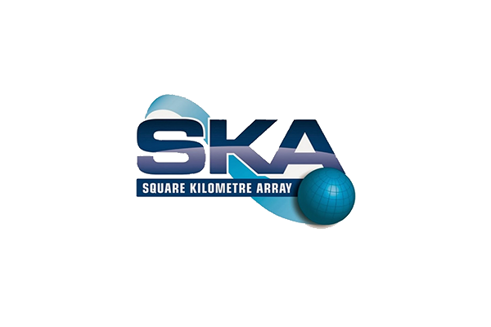
Emergent Properties in Transformers
10
IVOA
Seminar
08:26
For fields such as astrophysics/cosmology, emergent properties mean that Transformers could recognize complex, multi-dimensional patterns in data that smaller models miss. These could include identifying rare astrophysical phenomena, discerning correlations across spatial and temporal scales, or clustering objects based on nuanced spectral features.
Upcoming instruments such as the Square Kilometer Array (SKA), James Webb Space Telescope (JWST), and Vera Rubin Observatory (LSST). These facilities will generate massive datasets at unprecedented resolutions and frequencies. The SKA, for instance, will produce petabytes of data per day, which will contain subtle signals embedded in noise and require sophisticated pattern recognition.

Slide 11

11
IVOA
Seminar
Daniel Dennett to Transformers
08:26
john.abela@um.edu.mt
16 November 2024
University of Malta
Valletta Campus, Malta
All images are copyright their respective owners

