Slide 1
Integrating AI tools in data analysis frameworks: the Vera Rubin LSST and Euclid cases
Riccio G.¹, Cavuoti S.¹, Angora G.¹, Brescia M.^{2,1}
INAF - Astronomical Observatory of Capodimonte, Napoli (Italy)
Department of Physics “E. Pancini”, University of Naples Federico II (Italy)
IVOA Interoperability Meeting -
15 - 17 November 2024 – La Valletta, Malta

Slide 2
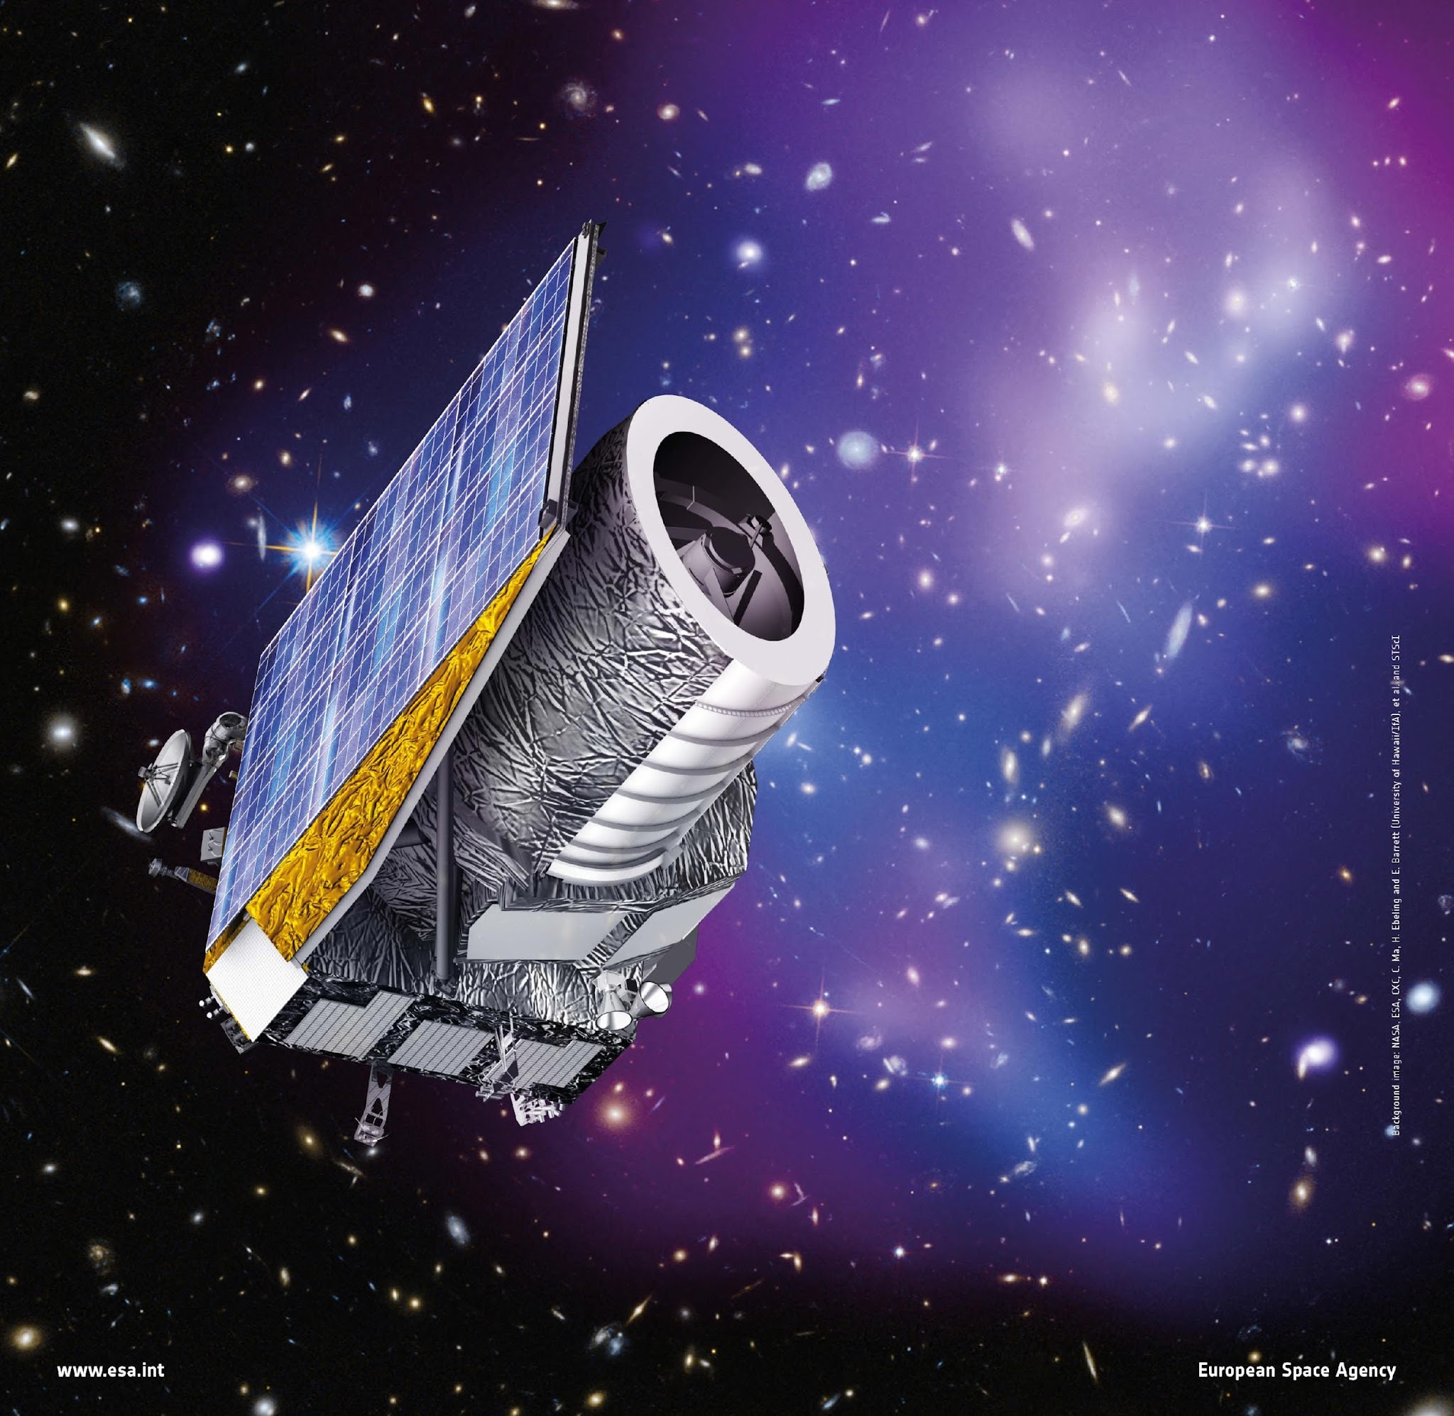
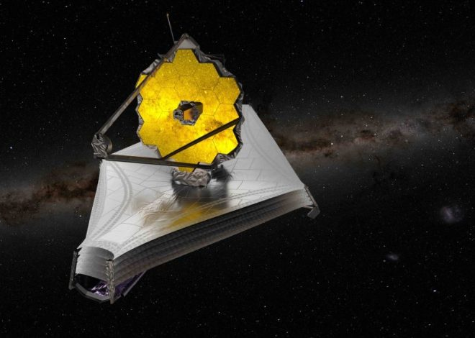
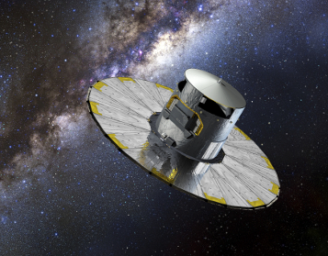
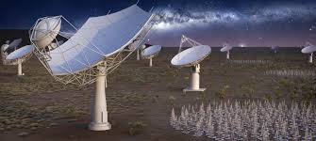
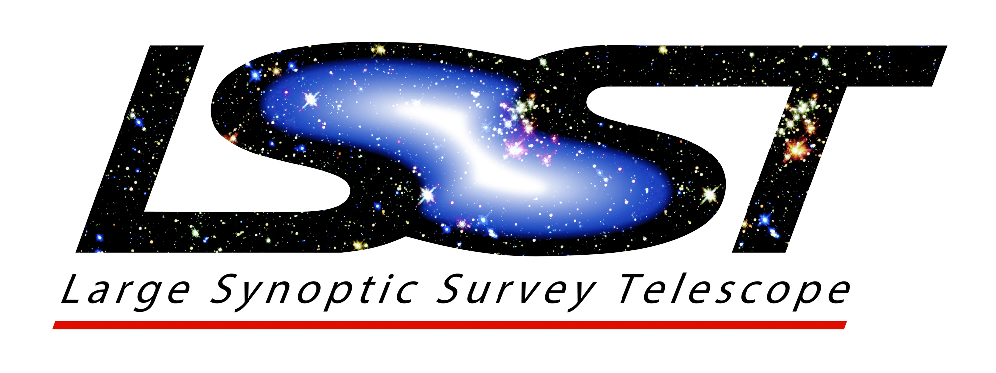
Context
In the last two decades, Astronomy has been the scene of the realization of panchromatic surveys, with sophisticated instruments acquiring a huge amount of exceptional quality data.
NEEDS
to integrate advanced data-driven science methodologies for the automatic exploration of huge and multi-dimensional data archives
efficient short- and long-term monitoring and diagnostics systems
ESA Euclid : ~100 GB/day for 6 years → 200 TB
Rubin/LSST : ~20 TB/night for 10 years → >60 PB
JWST : ~30GB/day for 10 years (and more)
GAIA : ~1 PB in 5 year
SKA : 100 Pbytes – 3 EBytes/year
Pan-STARRS, KiDS, DES, Herschel-ATLAS, Hi-GAL, E-ELT…
GOALS
To keep the quality of the observations under control
To detect and circumscribe anomalies and malfunctions
To facilitate rapid and effective corrections
To ensure correct maintenance of all components and the good health of scientific data over time mainly crucial for space-borne observation systems, both in logistical and economic terms

Slide 3
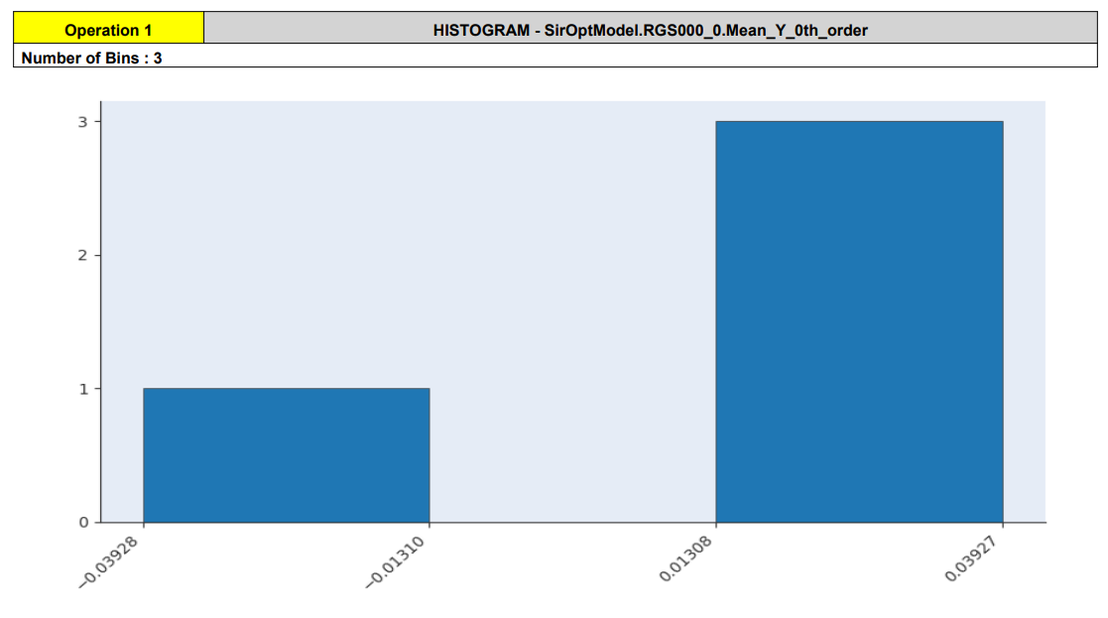
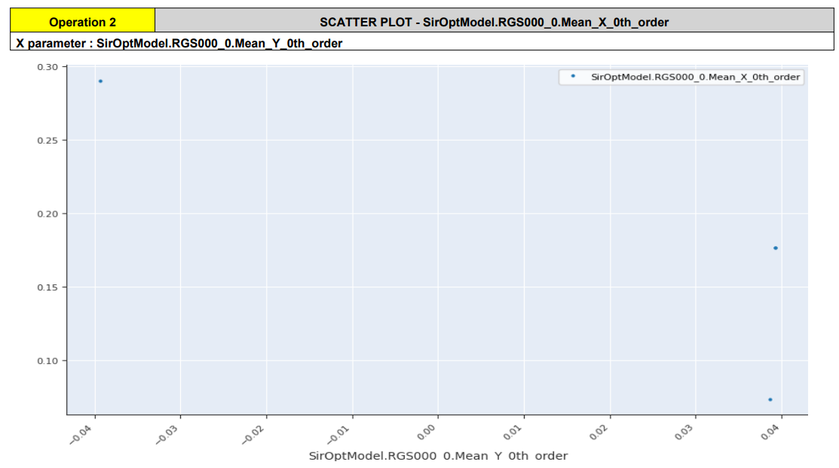
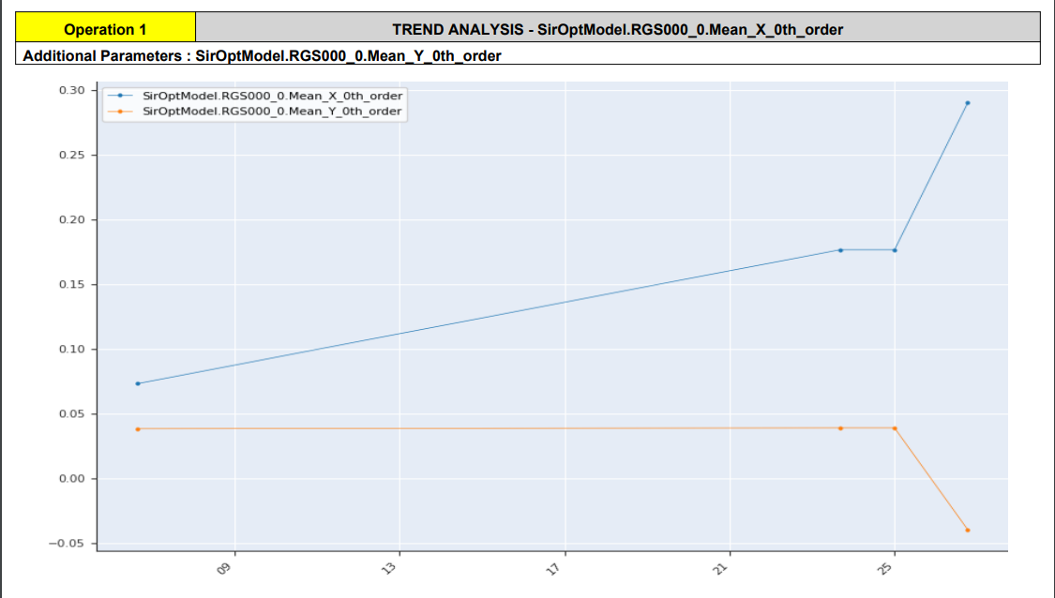
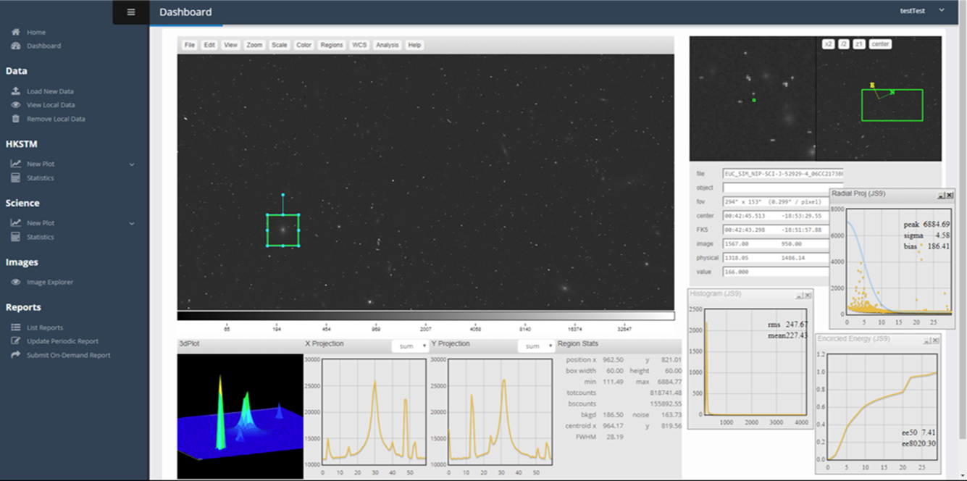
AIDA - Advanced Infrastructure for Data Analysis
AIDA is a portable and modular web application, designed to provide an efficient and intuitive software infrastructure to support monitoring of data acquiring systems over time, diagnostics and both scientific and engineering data quality analysis, particularly suited for astronomical instruments
Remote Client
Remote Client
Remote Client
Hosting Machine
Virtualization Platform Environment
Container #1
Container #2
Web Application
MySql Internal DB

Slide 4
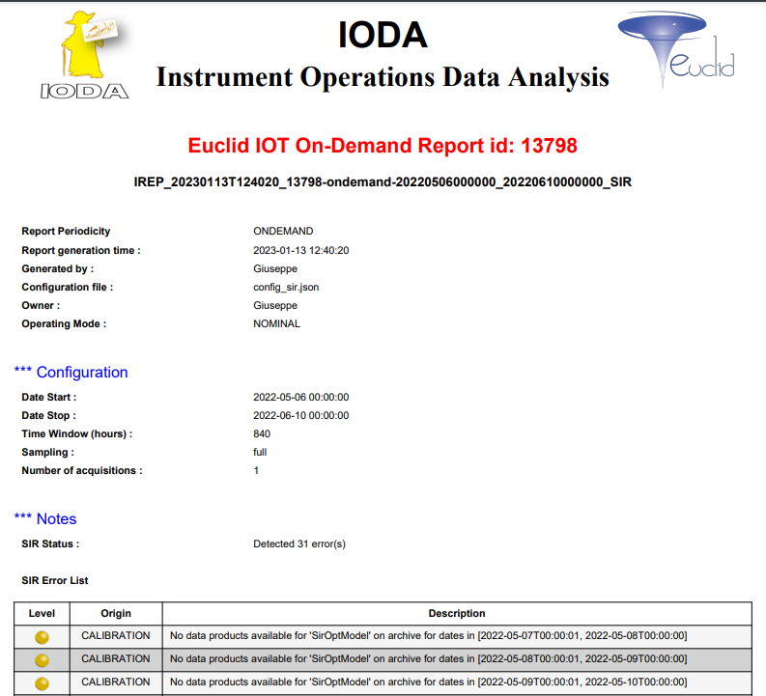
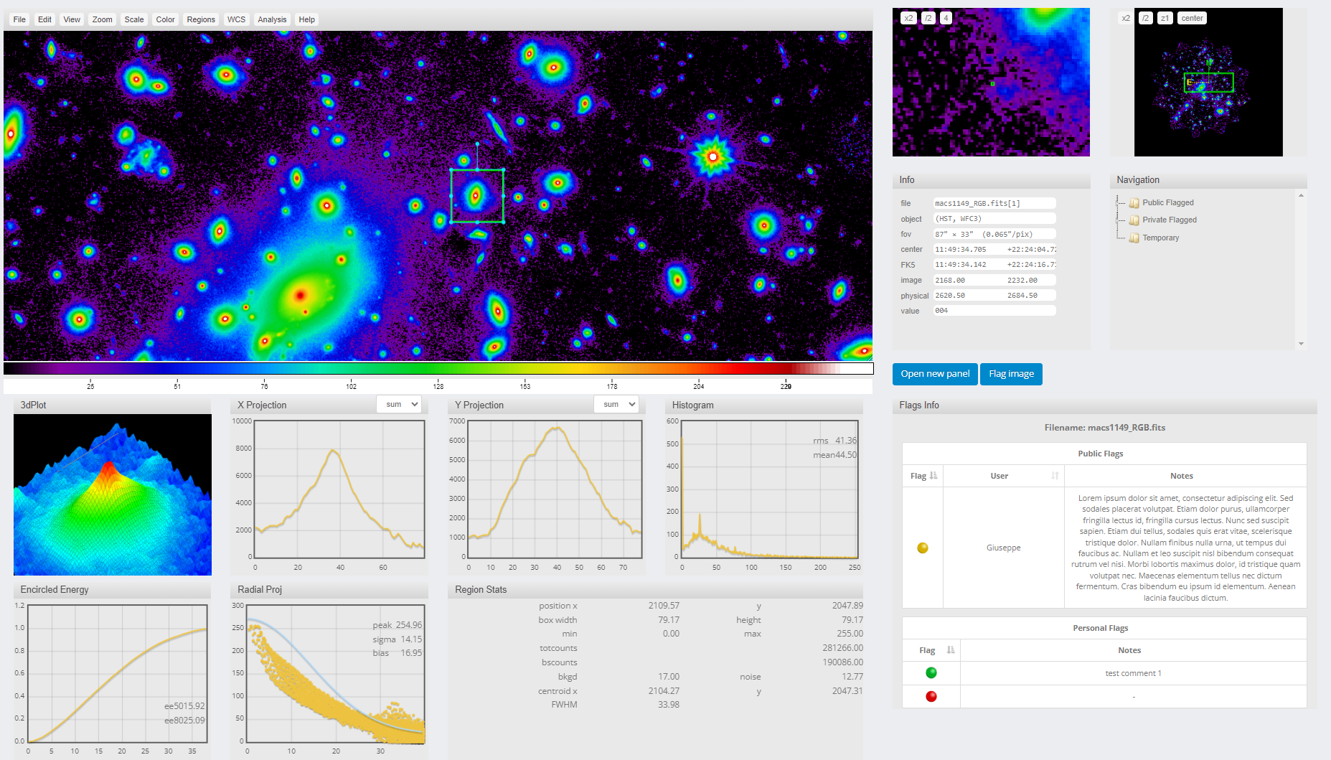
AIDA - Main Features
Instrument monitoring, report generation and delivery
periodic report generation on a user-defined parameters list and delivery to remote archive
on demand customised report generation on a user selected parameter list, locally stored
Visualization/Exploration
series of plots on user selected parameters/data products and ranges
pre-generated histograms stored into remote archives
observed images (static view, dynamic windowing, statistical characterization)
Statistics
standard (default) estimators
special estimations (tables/images)
statistical analysis on image pixels
Machine Learning
Regression/classification experiments on available data
Notes:
We can summarize its main features in four groups of tools:
Instrument monitoring, report generation and delivery – a set of tools to generate periodic or on demand reports on analysis results for a user-defined list of parameters
Visualization/Exploration
A series of highly customizable plots both on remote and local data, and an explorer for images, including tools to view and analyze them
Statistical tools, both a number of standard and special estimators on tabular data and image pixels
And machine/deep learning models for regression and classification experiments on data

Slide 5
Code Name : Flexibility
AIDA has been designed as a modular system, based on Object-Oriented Programming and specific information on DB, so it is possible to extend its functionalities, by integrating and customizing monitoring and diagnostics systems, as well as scientific data analysis solutions, including machine/deep learning and data mining methods
Available plots and statistics are defined as classes/functions linked to a specific table in DB. To add a new operation, it is sufficient to implement the related class/function and add it to the local DB;
A JSON configuration file is associated to every system monitored by AIDA. It includes info about the instrument and connection to the related data and metadata archives;
Repositories and systems have a dedicated classes which implement methods for interfacing AIDA with the data repository. To add a new system/repository, it is sufficient to create its own configuration file (only for systems), implement the related class and methods, and fill DB with required information.
A specialized version of AIDA is already the official monitoring and analysis tool for the ESA Euclid space mission and another one is going to be used for the commissioning of the V. Rubin Telescope, suitable also for LSST survey data

Slide 6
AIDA/IODA for Euclid Data
Start
System
Parameters configuration (subsystem, detectorID…)
Optional Extra Filters
Plot configuration (i.e. Bin Size, statistics definition)
Dates Range
QLA (NISP & VIS)
Data Output
Extract JSON file list from metadata
Download JSON files
Read data from JSON Files
Data from filled form
HKTM (NISP & VIS)
Create Plot & Stats
Extract SOC FITS file list from metadata
Download SOC FITS files
Read data from FITS Tables
Query to archive
XML metadata
NISP Science
END
3 KIND OF DATA
HKTM - LE1 HouseKeeping Telemetry
SCIENCE TM - Telemetry related to scientific images (LE1 & LE2)
CALIBRATION - LE2 DPs monitoring
Extract HK FITS file list from metadata
Download HK FITS files
Read data from HK FITS
6 Different DATA sources
JSON
FITS tables for HKTM
FITS tables for SCIENCE
TXT
CSV
XML
+Image files
+MySQL DB (Contingency)
+at least 1 source for Rubin/LSST
VIS Calibration
Extract TXT/CSV file list from metadata
Download TXT/CSV files
Read data from TXT/CSV Files
5 MONITORED SYSTEMS
NISP : HKTM, SCIENCE TM
VIS : HKTM, SCIENCE TM, CALIBRATION
QLA : under SCIENCE TM
NIR : CALIBRATION
SIR : CALIBRATION
NIR Calibration
Get Data from METADATA directly

Slide 7
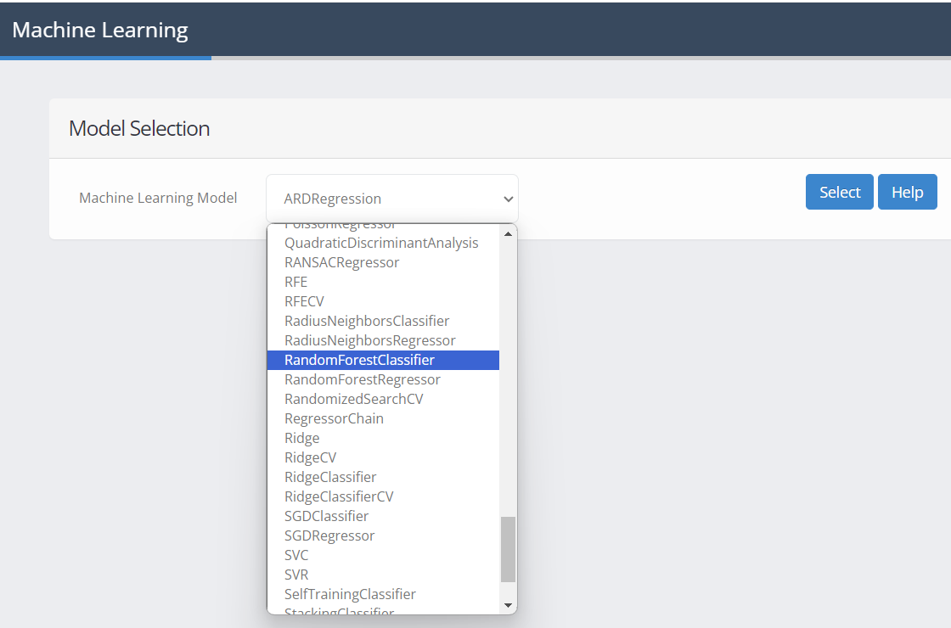
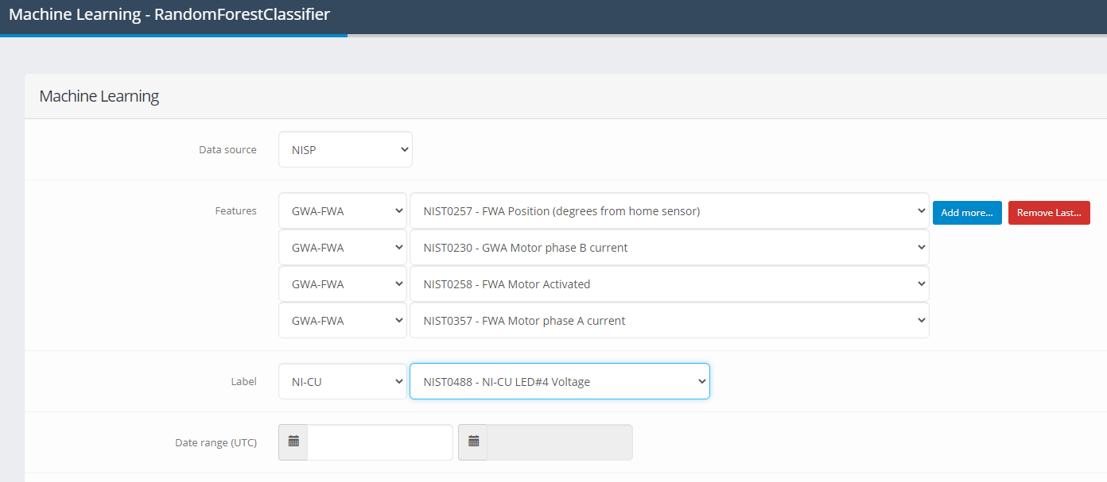
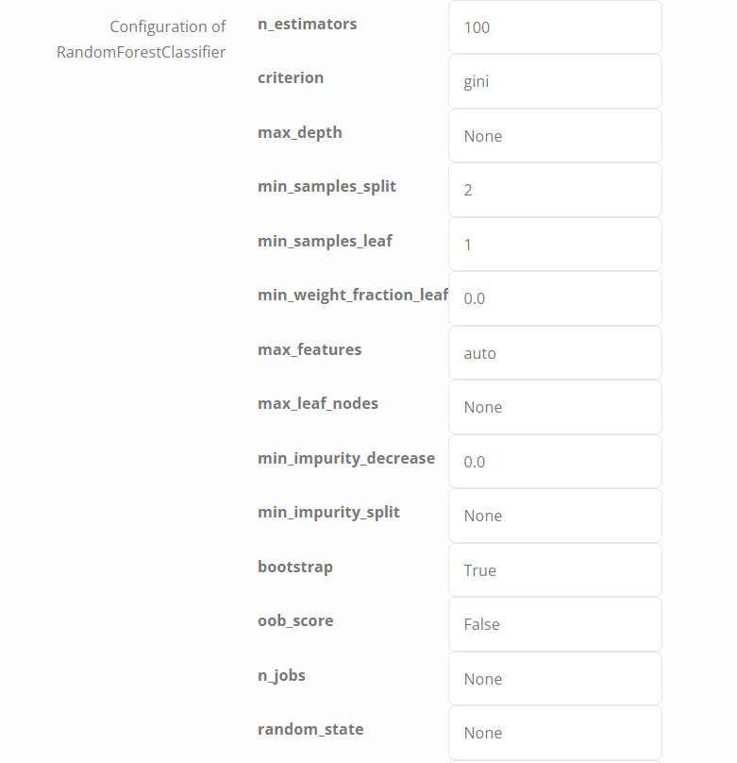
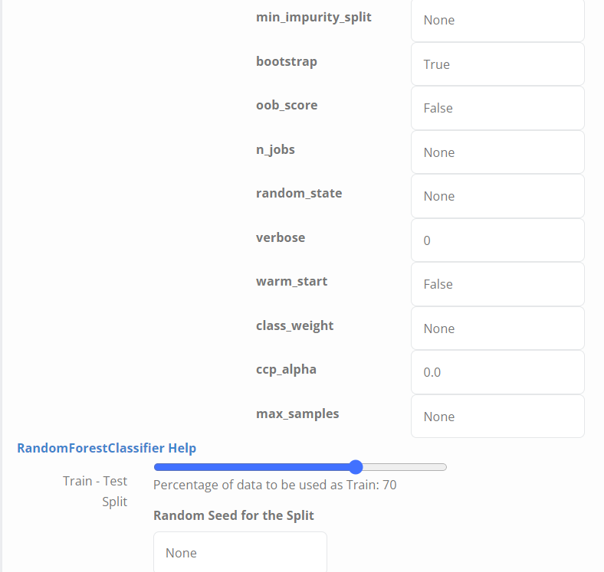
Machine Learning Tools
The tool includes more than 100 prediction, classification and regression models based on Machine Learning to apply on available tabular data, useful in this case to identify operating anomalies or correlations between instrumental information.
Deep Learning methods coding is on going

Slide 8
Summary
The AIDA web application has been designed to provide an efficient and intuitive software infrastructure to support monitoring of data acquisition systems over time, diagnostics and both scientific and engineering data quality analysis, in particular for astronomical instruments
It provides a number of tools for data analysis & system diagnostics
Instrument monitoring, report generation and delivery
Visualization Exploration
Statistics
Machine/Deep Learning
a specific version of AIDA is already the official monitoring and analysis tool for the ESA Euclid space mission and another one is going to be used for the commissioning of the V. Rubin Telescope, suitable also for LSST survey data
Being designed as a modular system, it is possible to integrate and customize monitoring and diagnostics systems, as well as scientific data analysis solutions
An high level of standardization for data and tools is crucial to easily customize AIDA to have a general infrastructure for as many astronomical projects as possible

Slide 9
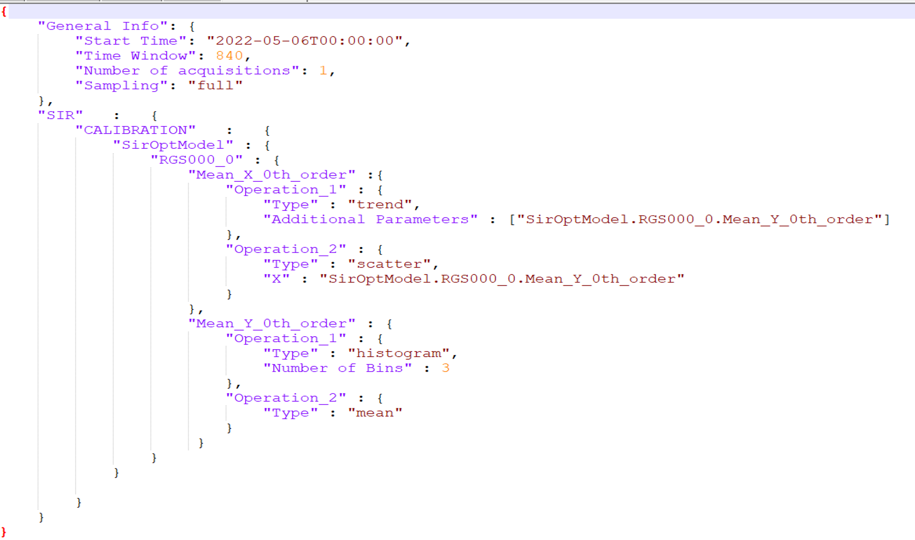
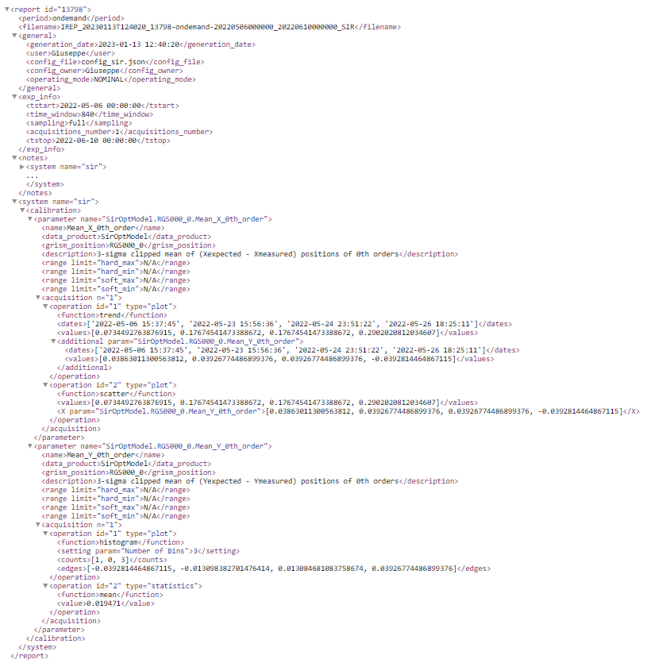
Ideas for next AI tools (1)
REPORT
Periodic automatic or on-demand generation
Why not a pre-trained LLM to automatically create configuration files?

Slide 10
Ideas for next AI tools (2)
A very useful tool could be a function, runnable from the Image Explorer panel, to automatically generate thumbnails from images, to be used by Deep Learning methods
A standard and automatic thumbnail extractor would be very useful for astronomical community in general
Based on JS9 Library : https://js9.si.edu/

Slide 11
May the plots be with you…
Thank you!

