Slide 1
ESAC TAP Upload Use Cases
IVOA November 2024 Interoperability Meeting
Jose Osinde (Starion for ESA)
C. Rios (Starion for ESA, M. Henar (Starion for ESA), J. Ballester (Starion for ESA)
R. Parejo (Starion for ESA), R. Bhatawdekar (ESA)
SCO-08: Archives Software Development
ESAC
Camino Bajo del Castillo s/n, Urb. Villafranca Del Castillo
28692 Villanueva de la Cañada (Madrid) Spain

Slide 2
Data upload requirements in ESAC archives using TAP
The ESA TAP+ upload features provide end users with data upload options, enabling dynamic data input for both temporary and long-term storage needs. Two primary upload types, "On-the-fly" and "Persistent," serve distinct purposes:
"On-the-fly" uploads support immediate, query-specific data that is deleted once the query is finished.
"Persistent" uploads allow users to upload data via a local file or a URL, store it within a user-specific schema, and optionally share or reuse query results.
Notes:
The "On-the-fly" upload feature enables users to upload immediate, query-specific data. Tables are uploaded to a custom schema and deleted once the query is finished. There is no specific entry point required; data is uploaded together with the job request.

Slide 3
"On-the-fly" Upload Capabilities
Part of the standard since TAP 1.0
Immediate, query-specific data support: UPLOAD/QUERY/DELETE
Tables uploaded to a custom schema and deleted once the query is finished
Typical use cases:
Crossmatch of local sources against a table in the server
Select a list of rows in the server according to a list of elements available locally
Use local results with a remote TAP service
Notes:
Table Access Protocol
Version 1.0
IVOA Recommendation 2010 March 27
https://www.ivoa.net/documents/TAP/20100327/REC-TAP-1.0.html
2.5 Table Upload
2.5.1 UPLOAD
2.5.2 Inline Table Upload
Table AccessProtocol
Version 1.1
IVOA Recommendation 2019-09-27
https://www.ivoa.net/documents/TAP/20190927/REC-TAP-1.1.html
2.7.6 UPLOAD
The UPLOAD parameter is described in DALI. Services should support the upload of temporary tables in VOTable (Ochsenbein and Taylor et al., 2013) format via the standard UPLOAD parameter. The table-name(s) must be legal table names as defined in ADQL (Osuna and Ortiz et al., 2008) but restricted as described in section 4.2. URIs may be simple URLs (e.g. with a URI scheme of http or https) or URIs that must be resolved (e.g. with a URI scheme of vos or param) to give the location of the table content.
If table upload is supported, the service must accept tables in VOTable format. The client specifies the name of the uploaded table; this name must be a legal ADQL table name with no catalog or schema (i.e., a string following the regular identifier production of ADQL). Uploaded tables must be referred to in queries as TAP_UPLOAD.<tablename>, where <tablename> is the name specified by the user. Tables in the TAP_UPLOAD schema are transient and persist only for the lifetime of the query (although caching might be used behind the scenes) and are never visible in the TAP_SCHEMA metadata.
For uploaded tables, the name attribute of the FIELD element is used as the column name. Services must support delimited identifiers so that FIELD names that are not valid ADQL column names work correctly.
The DALI UPLOAD parameter supports both external resources and in-line content. For external resources, one provides a URI (usually an HTTP URL) the TAP service can use to obtain the table content. For example,
HTTP POST http://example.com/tap/async/42
UPLOAD=mytable,http://otherplace.com/path/votable.xml
The service would retrieve the table from the provided URL and make it visible to the query as TAP_UPLOAD.mytable.
If the TAP service supports VOSpace URIs, one may specify an upload table using a URI to a table stored in a VOSpace, for example:
HTTP POST http://example.com/tap/async/42
UPLOAD=mytable,vos://space/path/votable.xml
The service would resolve the URI, contact the VOSpace, retrieve the table, and make it visible to the query as TAP_UPLOAD.mytable.
UPLOADs are accumulating, i.e., each UPLOAD parameter given will create one or more tables in TAP_UPLOAD. When the table names from two or more upload items agree after case folding, the service behaviour is unspecified. Clients thus cannot reliably overwrite uploaded tables; to correct errors, they have to tear down the existing job and create a new one. In principle, any number of tables can be uploaded using the UPLOAD parameter and any combination of URI schemes supported by the service as long as they are assigned unique table names within the query. Services may limit the size and number of uploaded tables; if the service refuses to accept the entire table it must respond with an error as described in section 3.3.
Table upload must support all valid VOTable content even if they do not support all features and uses of extended data types; clients must be able to upload and then query a valid table and round-trip all values. Services should store extended types (e.g. timestamp) in an appropriate database column type in order to facilitate predictable use in queries.

Slide 4
"On-the-fly" Upload Capabilities
Gaia example (https://astroquery.readthedocs.io/en/latest/gaia/gaia.html):
1.5. Synchronous query on an ‘on-the-fly’ uploaded table
A votable can be uploaded to the server in order to be used in a query.
You have to provide the local path to the file you want to upload. In the following example, the file ‘my_table.xml’ is located to the relative location where your python program is running.
Notes:
URL: https://astroquery.readthedocs.io/en/latest/gaia/gaia.html
Gaia TAP+ (astroquery.gaia)
Gaia is a European space mission providing astrometry, photometry, and spectroscopy of more than 1000 million stars in the Milky Way. Also data for significant samples of extragalactic and Solar system objects is made available. The Gaia Archive contains deduced positions, parallaxes, proper motions, radial velocities, and brightnesses. Complementary information on multiplicity, photometric variability, and astrophysical parameters is provided for a large fraction of sources.
If you use public Gaia data in your paper, please take note of our guide on how to acknowledge and cite Gaia data.
This package allows the access to the European Space Agency Gaia Archive (https://gea.esac.esa.int/archive/).
Gaia Archive access is based on a TAP+ REST service. TAP+ is an extension of Table Access Protocol (TAP) specified by the International Virtual Observatory Alliance (IVOA).
The TAP query language is Astronomical Data Query Language (ADQL), which is similar to Structured Query Language (SQL), widely used to query databases.
TAP provides two operation modes:
Synchronous: the response to the request will be generated as soon as the request received by the server (do not use this method for queries that generate a big amount of results).
Asynchronous: the server will start a job that will execute the request. The first response to the request is the required information (a link) to obtain the job status. Once the job is finished, the results can be retrieved.
Gaia TAP+ server provides two access modes:
Public: this is the standard TAP access. A user can execute ADQL queries and upload votables to be used in a query ‘on-the-fly’ (these tables will be removed once the query is executed). The results are available to any other user and they will remain in the server for a limited time.
Authenticated: some functionalities are restricted to authenticated users only. The ADQL queries and their outcomes will remain in the server until the user deletes them. The dedicated functionalities include:
Cross-match operations: a catalog cross-match operation can be executed.
Persistence of uploaded tables: a user can upload a table in a private space. These tables can be used in queries as well as in cross-match operations.
This python module provides an Astroquery API access that implements the query_object and query_object_async methods.
The Gaia Archive table used for the methods where no table is specified is the latest data release catalogue.

Slide 5
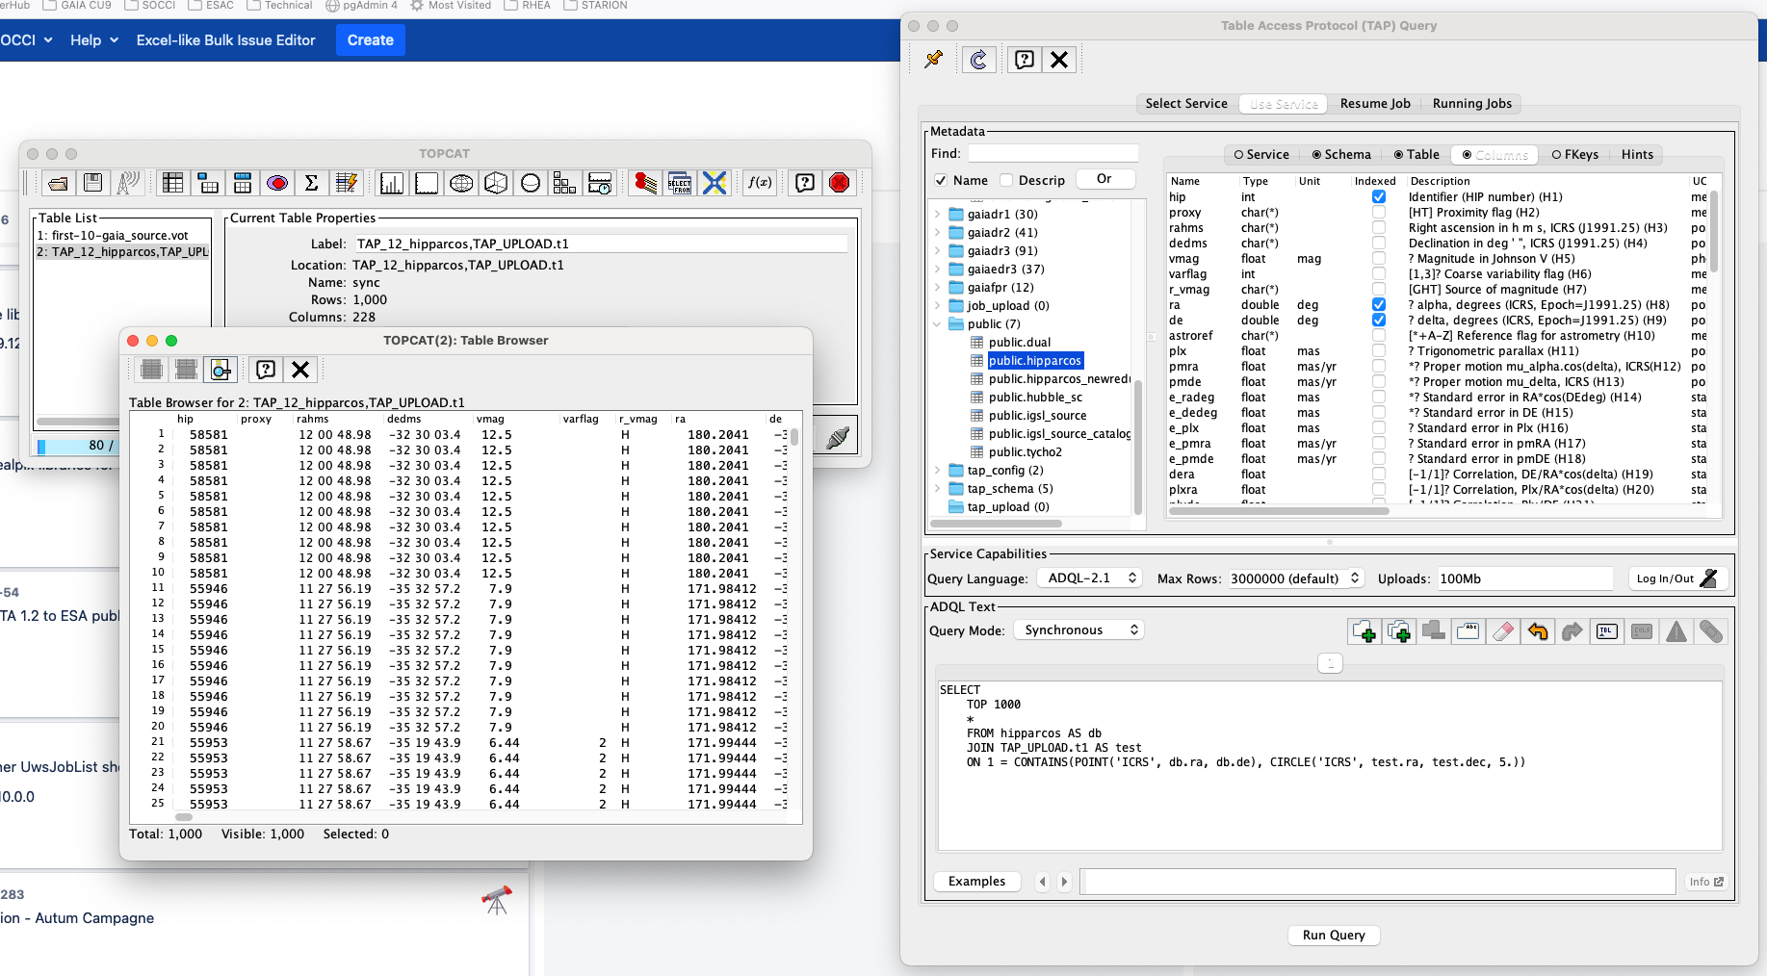
"On-the-fly" Upload Capabilities
Fully supported by other applications as TopCat
Notes:
URL: https://www.star.bristol.ac.uk/mbt/topcat/sun253/TapTableLoadDialog_query.html#TapTableLoadDialog_query_text
Examples line
Clicking on the Examples button at the bottom left of the panel will pop up a menu that allows you to select from a number of example ADQL queries. If you select one, the relevant ADQL text will be pasted into the editing panel; you should be able to hit the Run Query button straight away and execute it to get a result. In some cases the example text is influenced by the table you're currently looking at in the Metadata panel, and by the ADQL version of the Query Language currently selected in the Service Capabilities panel. Until you are experienced with ADQL, starting from one of these examples and editing it to taste is often a good way to write a query of your own.
The Examples menu is divided into a number of sub-menus, though not all will be enabled for all services. The sub-menus are:
Basic: Basic examples that should be applicable to most services.
Upload: Examples that involve uploading a tables from TOPCAT to the TAP server and executing queries using it. Only enabled if the service supports table uploads and at least one table is currently loaded into TOPCAT.
Service-Provided: Examples provided by the TAP service. These are likely to provide some insight into the kinds of query that make sense and make good use of the particular tables available from the service, so it is often instructive to look at these. Only enabled if the service actually provides some examples (at time of writing, not many do, but hopefully this will improve). Note to TAP service implementers: at time of writing, there are two variants of the standard way for services to provide examples (DALI sec 2.3 and TAPNotes sec 4.2.1), and it's not clear which is preferred. For now, TOPCAT will recognise either.
TAP_SCHEMA: Examples using the tables in the TAP_SCHEMA schema, which describes metadata about the tables in the service. You can use these to do things like count tables or columns in the current service, or locate tables with columns having particular physical meaning.
ObsTAP: Examples using the IVOA ObsCore data model (ivoa.obscore table), which describes astronomical observations in a standardised way. You can use these to do things like search for all observations at a particular sky position, or observation time, or waveband etc. Only available if the service declares support for the ObsCore data model.
RegTAP: Examples using the IVOA RegTAP data model (tables in the rr schema). You can use these to do things like search for all TAP services containing tables having columns with particular physical meanings, or all cone search services relating to particular wavebands, etc. You can use queries like this to perform more sophisticated searches for TAP services than you can do using the Select Service tab. Only available if the TAP service declares support for the RegTAP data model (i.e. if it hosts an IVOA searchable registry).
When you select an example from one of the sub-menus, its name and title will be displayed to the right of the Examples button. Little left and right arrow buttons allow you to cycle through the examples in the current submenu so you can browse what's available.
Some examples come with additional explanation on the web. If the example you're currently looking at has such additional documentation then the Info button to the right will be enabled, and clicking on that should open the relevant page in a browser on your desktop.
Some TAP services permit Table Uploads. What this means is that you can upload tables from TOPCAT into the remote database and perform queries on your table directly. In this way you can perform joins between your own tables (anything loaded into TOPCAT) and any of the tables in the remote database. This is an extremely powerful feature. To take advantage of it, you just need to use a special form for the table name to reference a TOPCAT-based table: you write "TAP_UPLOAD.t<n>", where <n> is the ID number of the table in TOPCAT, that is the number before the colon in the Control Window Table List. If the table's label has a suitable form (roughly, if it's alphanumeric and unique) you can use that instead of "t<n>". So, if a table is identified as "1: messier" in the table list, you can reference it in ADQL as "TAP_UPLOAD.t1" or as "TAP_UPLOAD.messier" - see the Upload sub-menu of the Examples menu described above for some examples. Note the table uploaded in this way is the Apparent Table corresponding to the given ID number, i.e. current subset and column selections apply. It's a good idea to ensure that any table you are uploading has columns with sensible names, otherwise the service may rename the columns or otherwise have trouble handling it.

Slide 6
”On-the-fly" Upload Capabilities
Using a job result in a query (I)
Typical use case: Upload local data to an external TAP
This mechanism allows to run a query against a job executed in our archive, using the unique alpha-numeric code assigned to each job
SELECT upload.*, catwise.*
FROM tap_upload.job1641568769115O AS upload
JOIN "II/365/catwise" AS catwise ON 1 = CONTAINS(
POINT('ICRS', catwise.RA_ICRS, catwise.DE_ICRS),
CIRCLE('ICRS', upload.ra, upload.dec, 1. / 3600.))
Notes:
https://www.cosmos.esa.int/web/gaia-users/archive/extract-data#AdvancedADQLfeatures
ADVANCED ARCHIVE FEATURES
Authors: Héctor Cánovas, Jos de Bruijne, and Alcione Mora
The Gaia ESA Archive is based on the Virtual Observatory Table Access Protocol (TAP), which allows to retrieve data from astronomical databases using ADQL queries. The Archive offers a number of powerful functionalities for advanced users, as presented in this tutorial. Tutorial content:
JOB UPLOAD
Download data from an external TAP server
TAP_UPLOAD: Run queries in an external TAP server
Common table expressions: WITH
Set operators (UNION, EXCEPT, INTERSECT)
1. JOB_UPLOAD
This mechanism allows to run a query against a job that already exists in the Archive, using the unique alpha-numeric code assigned to each job (the job ID, as explained in Sect. 2 of this tutorial). For example, let us assume that we have retrieved a sample of Gaia DR2 sources encompassed by a 1 degree radius circle centred in HL Tauri, located in the Taurus star forming region, as follows:
SELECT source_id, ra, dec, pmra, pmdec, parallax, phot_g_mean_mag FROM gaiadr2.gaia_source WHERE DISTANCE(POINT(67.91046, 18.23274), POINT(ra, dec)) <1. AND parallax_over_error > 10. The job associated to this query will appear in the job list area of the Advanced (ADQL) tab of the Archive. In our case, it is job ID "1696340111393O". Having this information at hand, it is easy to identify the Gaia EDR3 sources matched to the output of the previous query using the pre-computed Gaia EDR3 - Gaia DR2 cross-match table ("gaiaedr3.dr2_neighbourhood" - see Chapter 10 of the Gaia EDR3 online documentation) as follows:
SELECT intermediate.*, dr3Xdr2.* FROM job_upload."job1696340111393O" AS intermediate JOIN gaiaedr3.dr2_neighbourhood AS dr3Xdr2 ON dr3xdr2.dr2_source_id = source_id
Authentication:
curl -k -c cookies.txt -X POST -d username=USER -d password=PASSWORD -L "https://eas.esac.esa.int/tap-server/login"
curl -k -b cookies.txt -X POST -d -L "https://eas.esac.esa.int/tap-server/logout"
Target resolver will return a VOTable with the resolved ra/dec values for the list of elements in the file

Slide 7
”On-the-fly" Upload Capabilities
Using a job results into a query (II)
No external TAP is involved in this case
Data is uploaded to the database as a new table persistent during the execution of the query
Use a different schema to store data into the database: JOB_UPLOAD
Simple example:
SELECT * FROM job_upload.”job1641568769115O”
Notes:
https://www.cosmos.esa.int/web/gaia-users/archive/extract-data#AdvancedADQLfeatures
ADVANCED ARCHIVE FEATURES
Authors: Héctor Cánovas, Jos de Bruijne, and Alcione Mora
The Gaia ESA Archive is based on the Virtual Observatory Table Access Protocol (TAP), which allows to retrieve data from astronomical databases using ADQL queries. The Archive offers a number of powerful functionalities for advanced users, as presented in this tutorial. Tutorial content:
JOB UPLOAD
Download data from an external TAP server
TAP_UPLOAD: Run queries in an external TAP server
Common table expressions: WITH
Set operators (UNION, EXCEPT, INTERSECT)
1. JOB_UPLOAD
This mechanism allows to run a query against a job that already exists in the Archive, using the unique alpha-numeric code assigned to each job (the job ID, as explained in Sect. 2 of this tutorial). For example, let us assume that we have retrieved a sample of Gaia DR2 sources encompassed by a 1 degree radius circle centred in HL Tauri, located in the Taurus star forming region, as follows:
SELECT source_id, ra, dec, pmra, pmdec, parallax, phot_g_mean_mag FROM gaiadr2.gaia_source WHERE DISTANCE(POINT(67.91046, 18.23274), POINT(ra, dec)) <1. AND parallax_over_error > 10. The job associated to this query will appear in the job list area of the Advanced (ADQL) tab of the Archive. In our case, it is job ID "1696340111393O". Having this information at hand, it is easy to identify the Gaia EDR3 sources matched to the output of the previous query using the pre-computed Gaia EDR3 - Gaia DR2 cross-match table ("gaiaedr3.dr2_neighbourhood" - see Chapter 10 of the Gaia EDR3 online documentation) as follows:
SELECT intermediate.*, dr3Xdr2.* FROM job_upload."job1696340111393O" AS intermediate JOIN gaiaedr3.dr2_neighbourhood AS dr3Xdr2 ON dr3xdr2.dr2_source_id = source_id
Authentication:
curl -k -c cookies.txt -X POST -d username=USER -d password=PASSWORD -L "https://eas.esac.esa.int/tap-server/login"
curl -k -b cookies.txt -X POST -d -L "https://eas.esac.esa.int/tap-server/logout"
Target resolver will return a VOTable with the resolved ra/dec values for the list of elements in the file

Slide 8
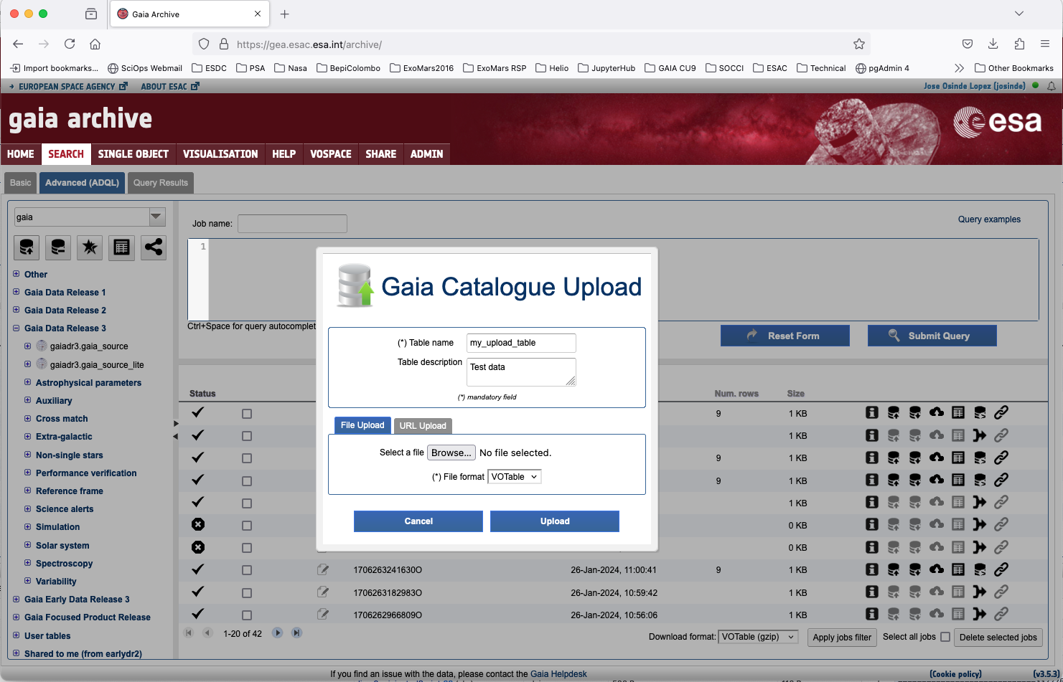
Persistent uploads
Service accessible only to registered users
Users can upload data from local files or URLs
User can also upload job results stored in the archive
Data stored in a schema associated to the user
Once uploaded it can be used as any other table in the archive and shared with other users if required.
Notes:
The "Persistent" upload feature is accessible only to registered users and allows them to upload data via files or URLs. The data is stored in a user-specific schema and can optionally be shared or reused. Essential prerequisites for these services include user authentication and quota management, with potential enhancements for data-sharing mechanisms and notifications.

Slide 9
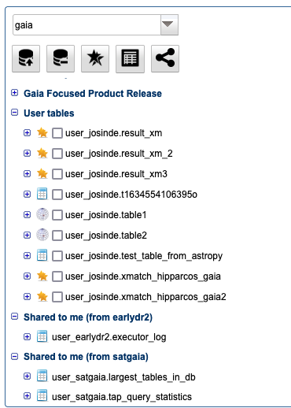
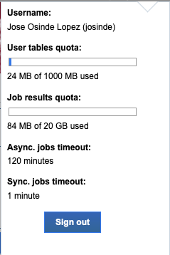
Persistent uploads
Private areas involves:
User authentication
Integration with directory services (LDAP)
Quota management
Space organization in the database (schemas)
Notes:
The "Persistent" upload feature is accessible only to registered users and allows them to upload data via files or URLs. The data is stored in a user-specific schema and can optionally be shared or reused. Essential prerequisites for these services include user authentication and quota management, with potential enhancements for data-sharing mechanisms and notifications.

Slide 10
Upload endpoints
Command line examples:
Upload a table from a file:
Delete a user table from the database:
curl -k -b cookies.txt -X POST -F FILE=@file.name
-F TABLE_NAME=table_name
https://host:port/context/Upload
curl -k -b cookies.txt -X POST -F TABLE_NAME=table_name
-F DELETE=TRUE
-F FORCE_REMOVAL=TRUE
https://host:port/context/Upload
Notes:
https://s2e2.cosmos.esa.int/confluence/pages/viewpage.action?pageId=28803661#UWS+-2.6.Sharerelatedfunctions
https://s2e2.cosmos.esa.int/confluence/pages/viewpage.action?pageId=938737704

Slide 11
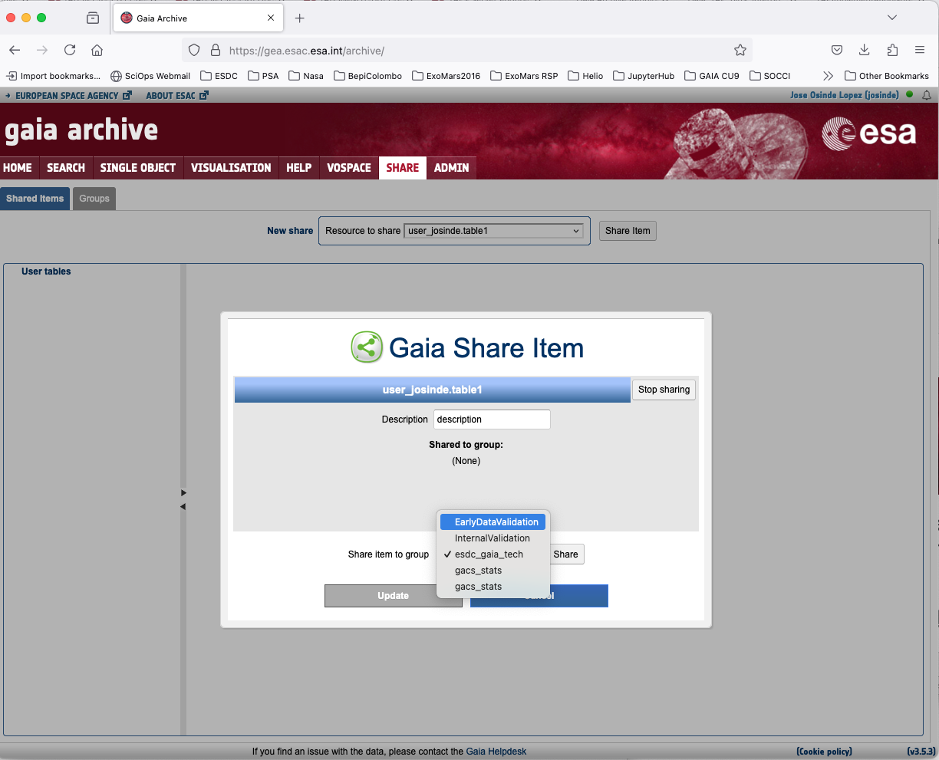
Persistent uploads
Sharing data involves:
Implement management tools:
Create/update/delete user or groups
Handle the reference between these two elements
Register resources and link these resources with one or more groups
New end-points supporting this functionality
Notes:
The "Persistent" upload feature is accessible only to registered users and allows them to upload data via files or URLs. The data is stored in a user-specific schema and can optionally be shared or reused. Essential prerequisites for these services include user authentication and quota management, with potential enhancements for data-sharing mechanisms and notifications.

Slide 12
Share endpoint
Create group:
Add user to a group:
Create a shared item:
Create a shared item relation:
http://host:port/context/share?action=CreateOrUpdateGroup&title=My+group&users_list=user1,user2
http://host:port/context/share?action=CreateUserGroup&group_id=group_id&user_id=user_id
http://host:port/context/share?action=CreateOrUpdateItem&resource_type=table
&title=My+table&description=Description&items_list=group_id_1,Group,Read|user_id_1,User,Write
http://host:port/context/share?action=CreateItemRelation&resource_id=resource_id
&resource_type=0&share_to_id=identifier&share_type=Group&share_mode=Read
Notes:
https://s2e2.cosmos.esa.int/confluence/pages/viewpage.action?pageId=28803661#UWS+-2.6.Sharerelatedfunctions

Slide 13
Questions / feedback
Thank you for your attention

