Slide 1
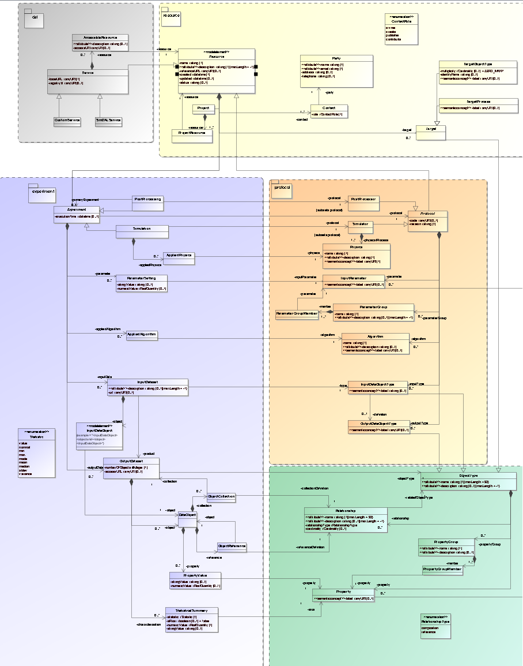
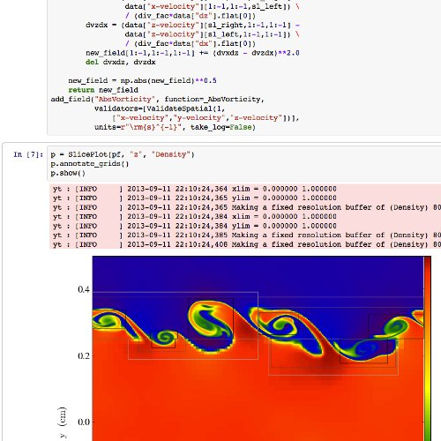
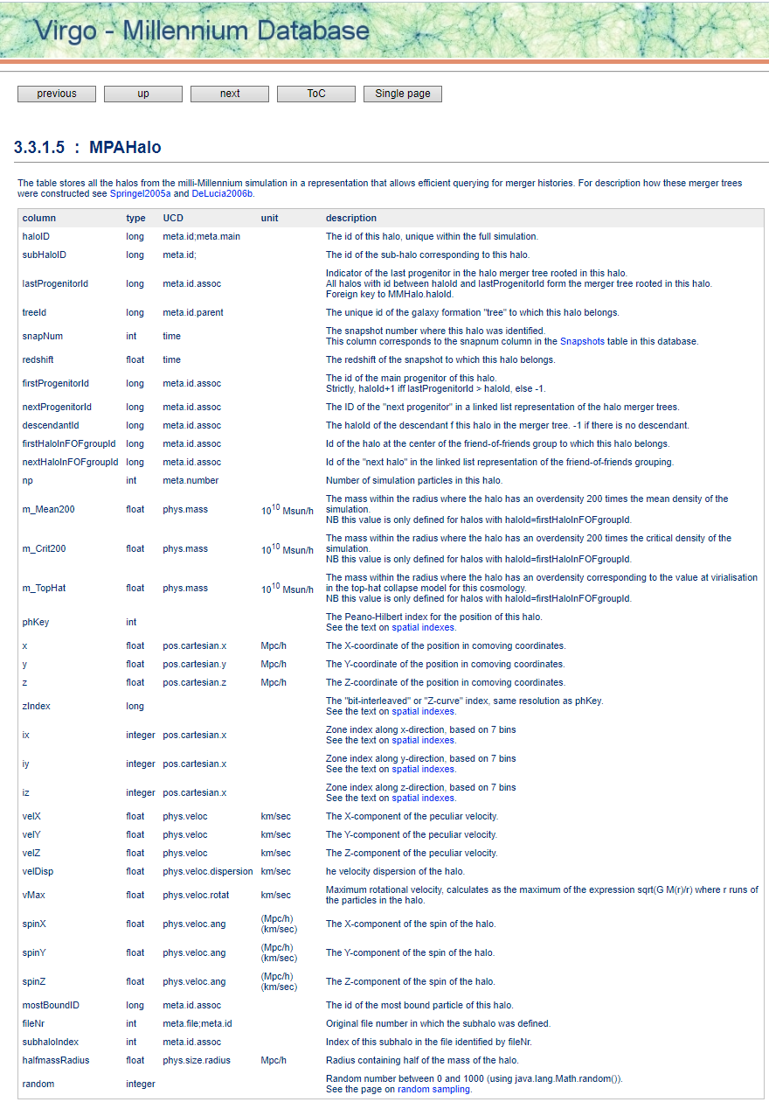
Theory Interest Group at IVOA
20:30 UTC 4 November 2021
Chair: Gerard Lemson
Vice-chair: Simon O’Toole

Slide 2
Discussion items
Implementations of SimDM (and SimDB)
Intro
Implementation experiences at Paris Observatory
Standard libraries for accessing cosmological simulations on science platforms
Intro
The yt library and others
Data model for products of cosmological simulations
Intro
Raw data vs post-processed data

Slide 3
SimDM implementations (& SimDB)
Data model since 2012
https://ivoa.net/documents/SimDM/20120503/index.html
Version 1.1 VO-DML version available, not yet pushed DO THIS?
Implementations?
Proof-of-concept based on VO-URP (L. Bourges, GL)
More? Franck?
Questions:
Can 3rd parties use an existing SimDB
Can code be shared?
Can 3rd parties collaborate on code?
…

Slide 4
Standard libraries for accessing cosmological simulations
(on science platforms)
I/O libraries providing standard-like data structures for common simulation types: nbody, SPH, (adaptive) meshes, …
See discussion 3
Examples of such codes:
E.g. yt: https://yt-project.org slides Matt Turk last interop https://matthewturk.github.io/2021-05-26-ivoa-yt/#/)
E.g. pynbody : https://pynbody.github.io/pynbody/
More or less private codes for specific simulation codes like gadget (https://github.com/jchelly/VirgoDC ), …
Questions:
How would we organize standardizing a general simulation access code?
Pick one and expand collaboratively?
Add to astropy? To pyvo?
How deployed on science platforms? Docker images?
How discover whether deployed? (D. Morris?)
…

Slide 5
Standard data model for cosmological simulations
E.g. for N-Body particles (raw), clusters/halos (post), mesh cells (raw)
snapshots vs individual timestampe-ed orbits vs …
Chris?
Questions:
Use cases: how would the data model be used?
As basis for item 2 standard libraries?
Standard data formats?
Relation to SimDM?
What does SimDAL have to say about this?
…

Slide 6
Conclusions?
Implementations of SimDM (and SimDB)
mv SimDM to v1.1+VO-DML
Standard libraries for accessing cosmological simulations (on science platforms)
Data model for products of cosmological simulations
Any takers?

