Slide 1
ObsLocTAP status report
Jesús Salgado¹,
Aitor Ibarra¹, Karl Foster⁵, Richard Saxton², Jan-Uwe Ness⁴, Erik Kuulkers⁴,
Carlos Gabriel⁴, Bruno Merín⁴, Peter Kretschmar⁴,Emilio Salazar³, Celia Sánchez³
1 Quasar for ESA - 2 TPZ-VEGA for ESA - 3 ATG for ESA - 4 ESA 5 NuSTAR

Slide 2
Observations Life cycle
Planned
Scheduled
Performed
Archived
Aborted

Slide 3
Planned Observations Services

Slide 4
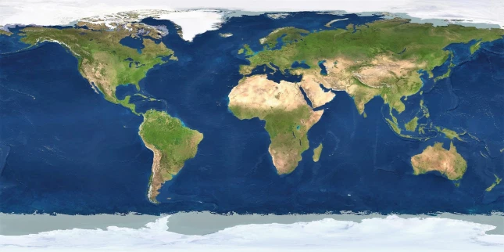
Astronomical event identified/foreseen: <ra,dec> and a certain time range

Slide 5
Step 1: ObjVisSAP (Object Visibility Simple Access Protocol) call for <ra,dec>, time range:
Is visible the target for your observatory during this period?

Slide 6
Step 1: ObjVisSAP (Object Visibility Simple Access Protocol) call for <ra,dec>, time range:
Is visible the target for your observatory during this period?
Step 2: ObsLocTAP (Observation Locator Tabular Access Protocol) call on this time range for this list of observatories:
Is this period available? If not, could observations be rescheduled?

Slide 7
Step 1: ObjVisSAP (Object Visibility Simple Access Protocol) call for <ra,dec>, time range:
Is visible the target for your observatory during this period?
Step 2: ObsLocTAP (Observation Locator Tabular Access Protocol) call on this time range for this list of observatories:
Is this period available? If not, could observations be rescheduled?
Step 3: Propose observation/coordinated observation on selected observatories

Slide 8
ObsLocTAP RFC Status
TCG revision of PR 1.0
2020-10-19 - 2020-11-27
https://wiki.ivoa.net/twiki/bin/view/IVOA/ObsLocTAP10RFC
No comments yet (please, review it!)
Server reference implementations:
Integral Science Archive
https://ila.esac.esa.int/tap/tap/
Chandra CFA
https://cda.cfa.harvard.edu/cxctap/
Docker implementation

Slide 9
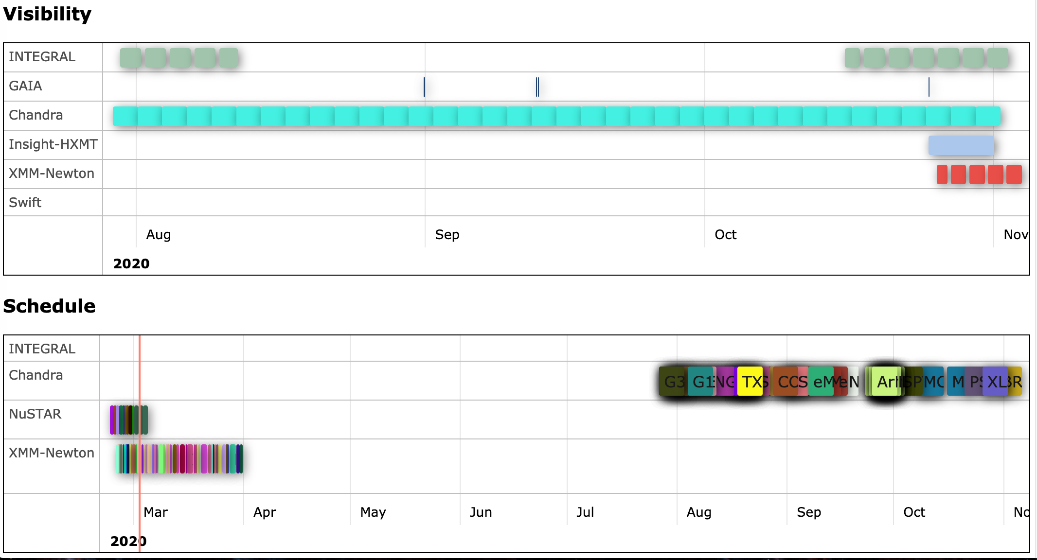
Reference implementation client
TOBY, reference client implementation (E. Salazar)
http://integral.esa.int/toby/
Other clients expected: MySpaceCal (calendar for many missions), ESASky, etc

Slide 10
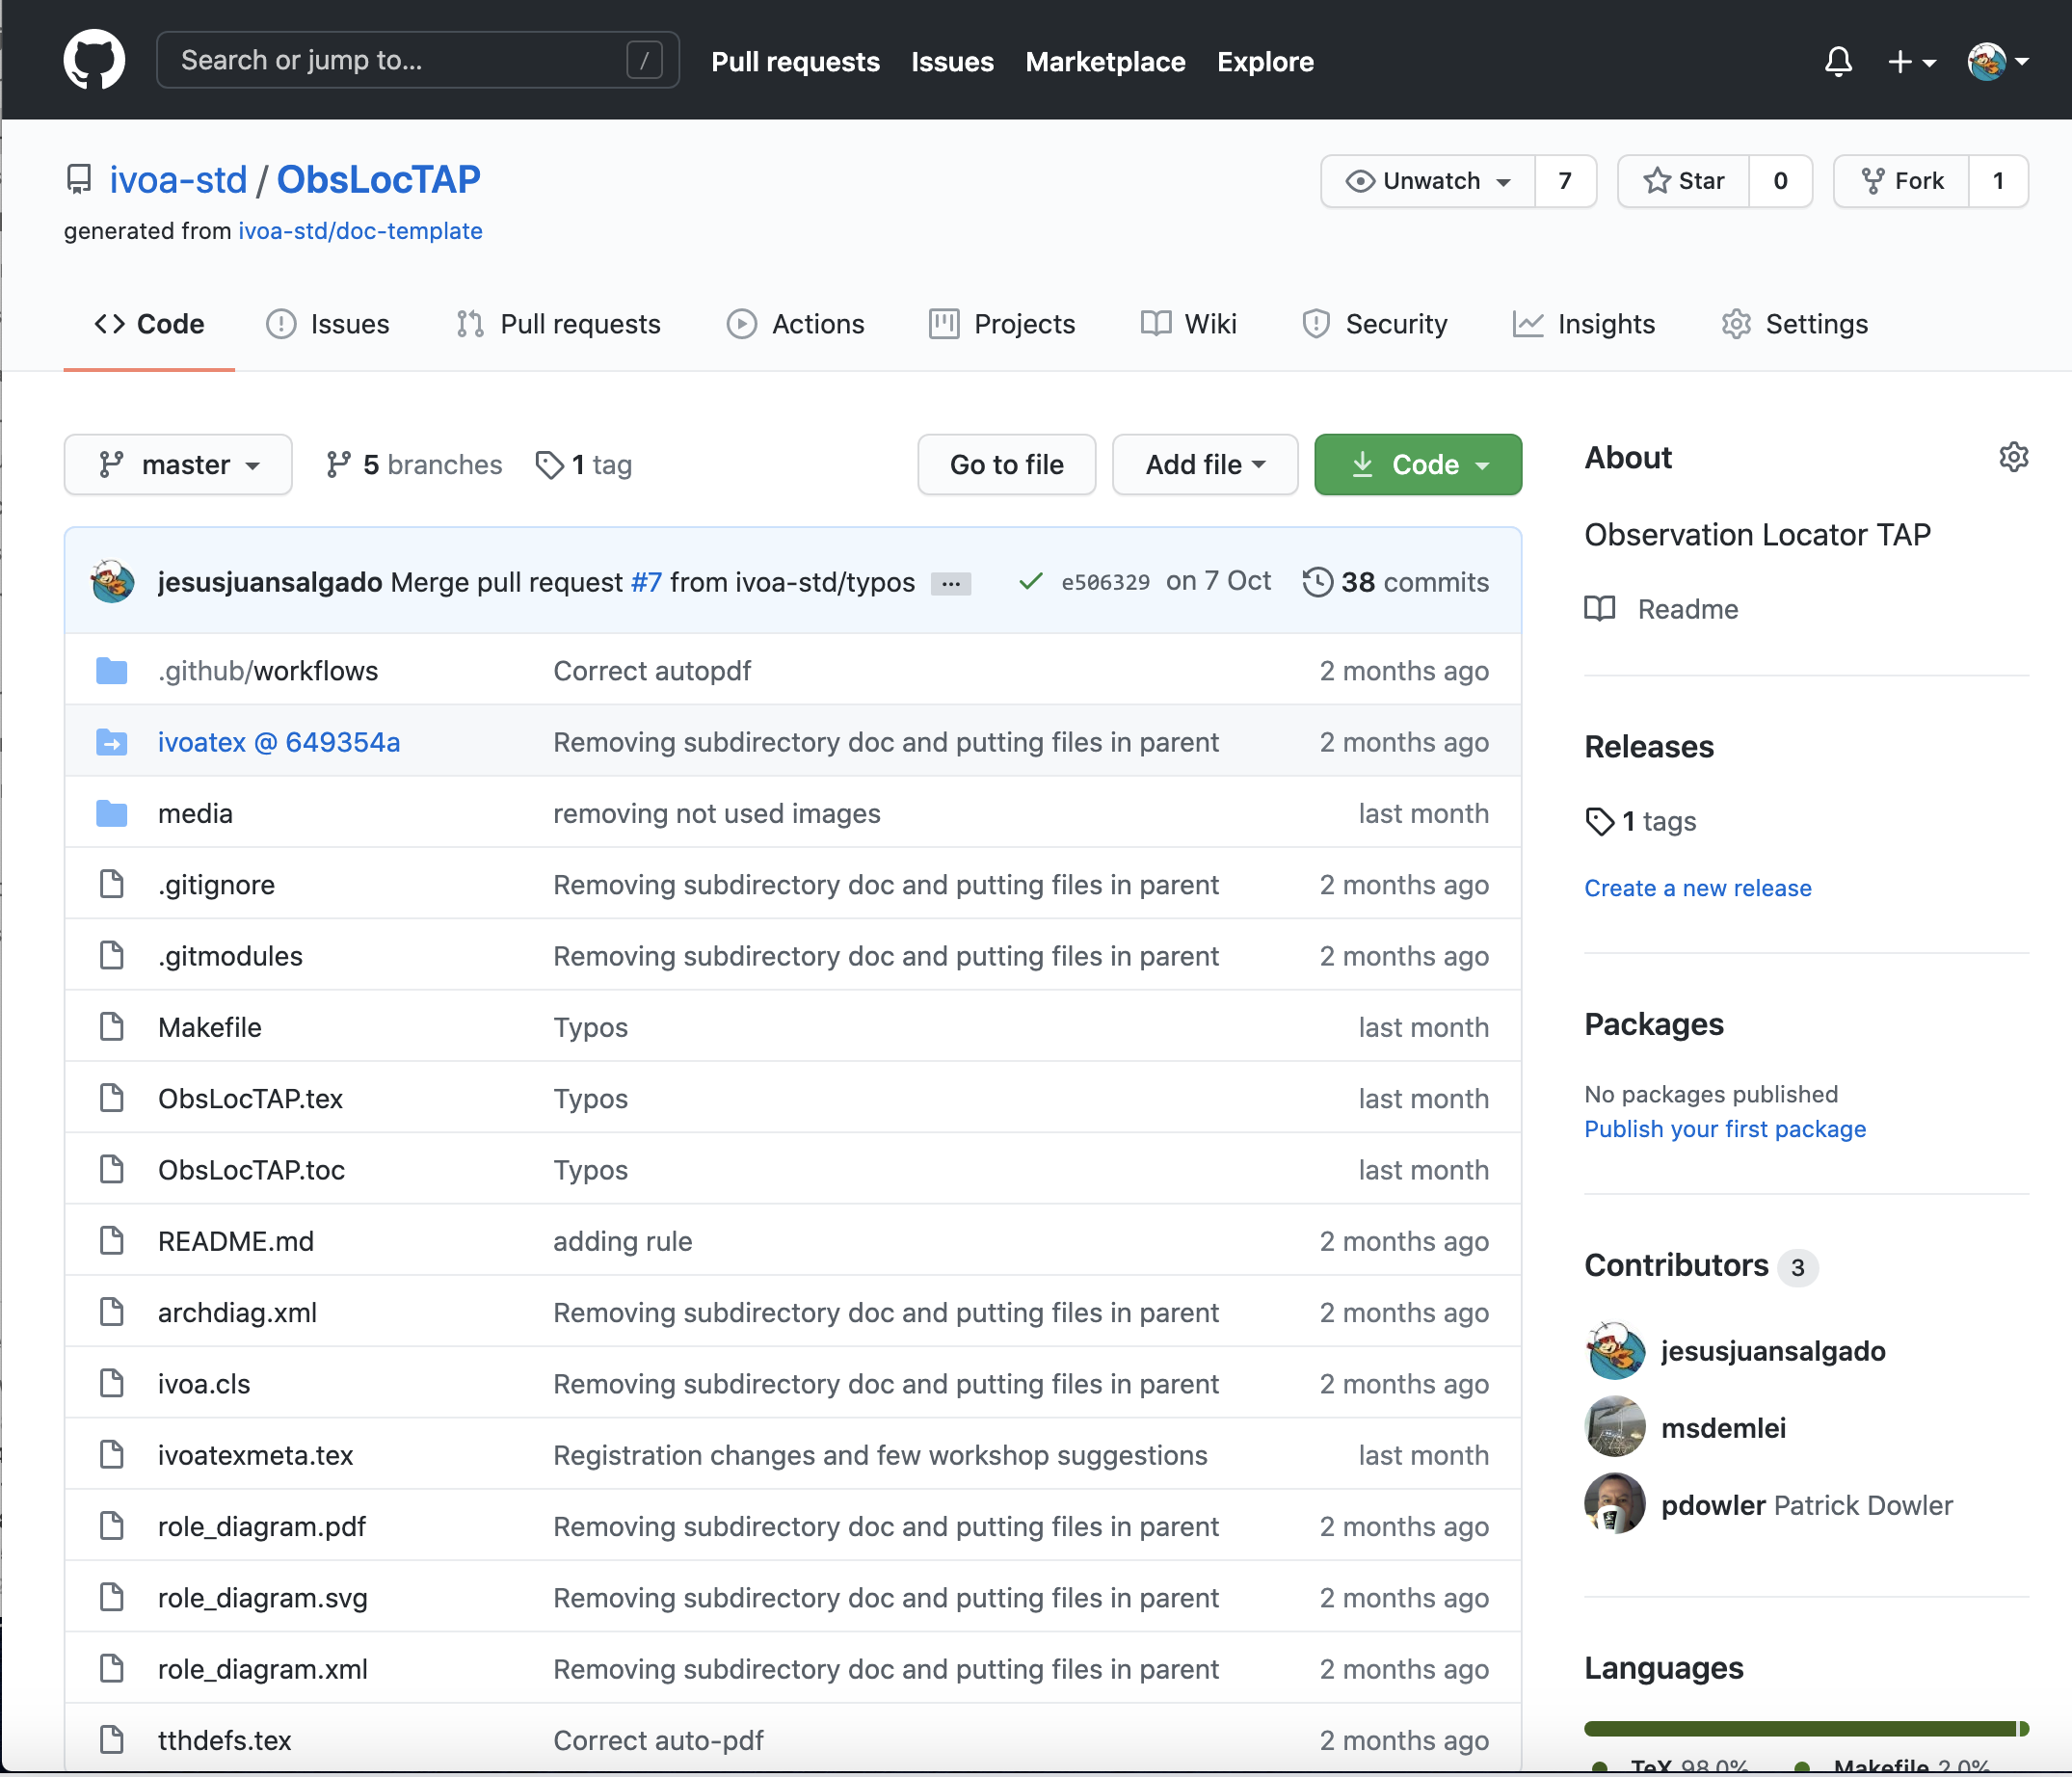
RFC status comments
Few comments received during community review
Comments from Markus Demleitner on formatting and typos issues (thanks!)
github integration comments
ivoatex discrepancies
Limitation of size of lines for github
Misspelling
https://github.com/ivoa-std/ObsLocTAP
No problems or changes related with the content

Slide 11
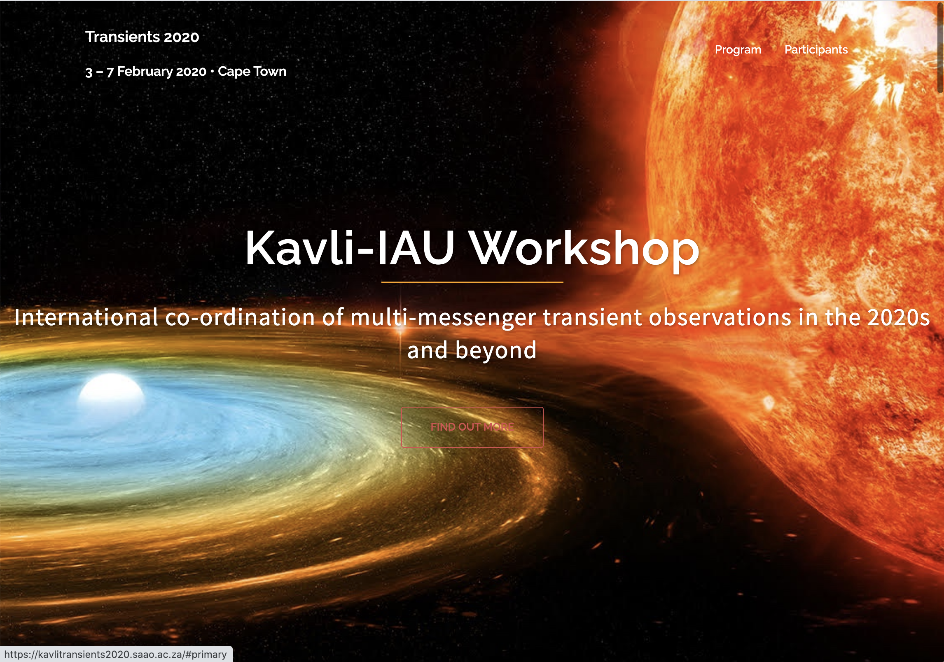
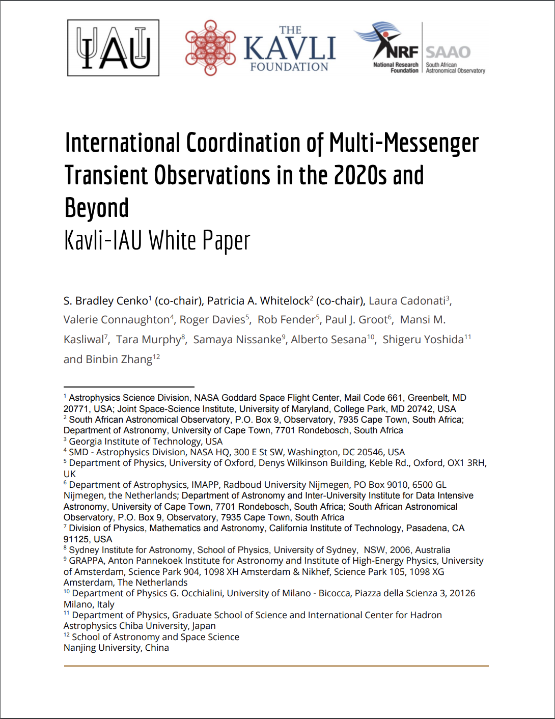
ObsLocTAP IAU endorsement proposal
Multi-messenger and Transient Astronomy White Paper
(Thanks to Ada Nebot for representing IVOA on this forum!)
https://arxiv.org/abs/2007.05546
“Telescope Coordination Recommendation 1: We recommend the IAU endorse a common format for all observatories to report previous and planned observations, namely the standard developed by the IVOA (ObsLocTAP).”
Proposal to endorse this white paper recommendations by IAU during next XXXI IAU General Assembly (Busan, South Korea, August 2021)

Slide 12
ObsLocTAP community dissemination
Two hands-on workshops organized by ESA to promote the implementation of ObsLocTAP and ObjVisSAP (focused on implementation)
Friday 18 September 12UT, Monday ​​​​​​​28 September 12UT
Around 20 participants each
https://www.cosmos.esa.int/web/vovisobs_protocols/demonstrator-workshop
AGENDA
Welcome, short update of latest developments (20 minutes)
ObjVisSAP (1 hour)
Demonstration of implementing ObjVisSAP for NuSTAR (30 minutes)
Discussion (30 minutes)
ObsLocTAP (1 hour)
Demonstration of implementing ObsLocTAP for NuSTAR (30 minutes)
Discussion (30 minutes)
General discussion (40 minutes)

Slide 13
ObsLocTAP presentation (30 min)
Short description of the exercise purpose
https://www.cosmos.esa.int/web/vovisobs_protocols/implementation-guides
Architectural diagram of the elements needed
PostgreSQL
PgSphere
TAP instance
ObsLocTAP DM
ADQL concepts
TAP toolkit
Taptuto used. All known toolkits also mentioned
Database preparation
Docker option
NuSTAR feedback
General discussion

Slide 14
ObsLocTAP architecture
INGEST
ivoa.obsplan

Slide 15
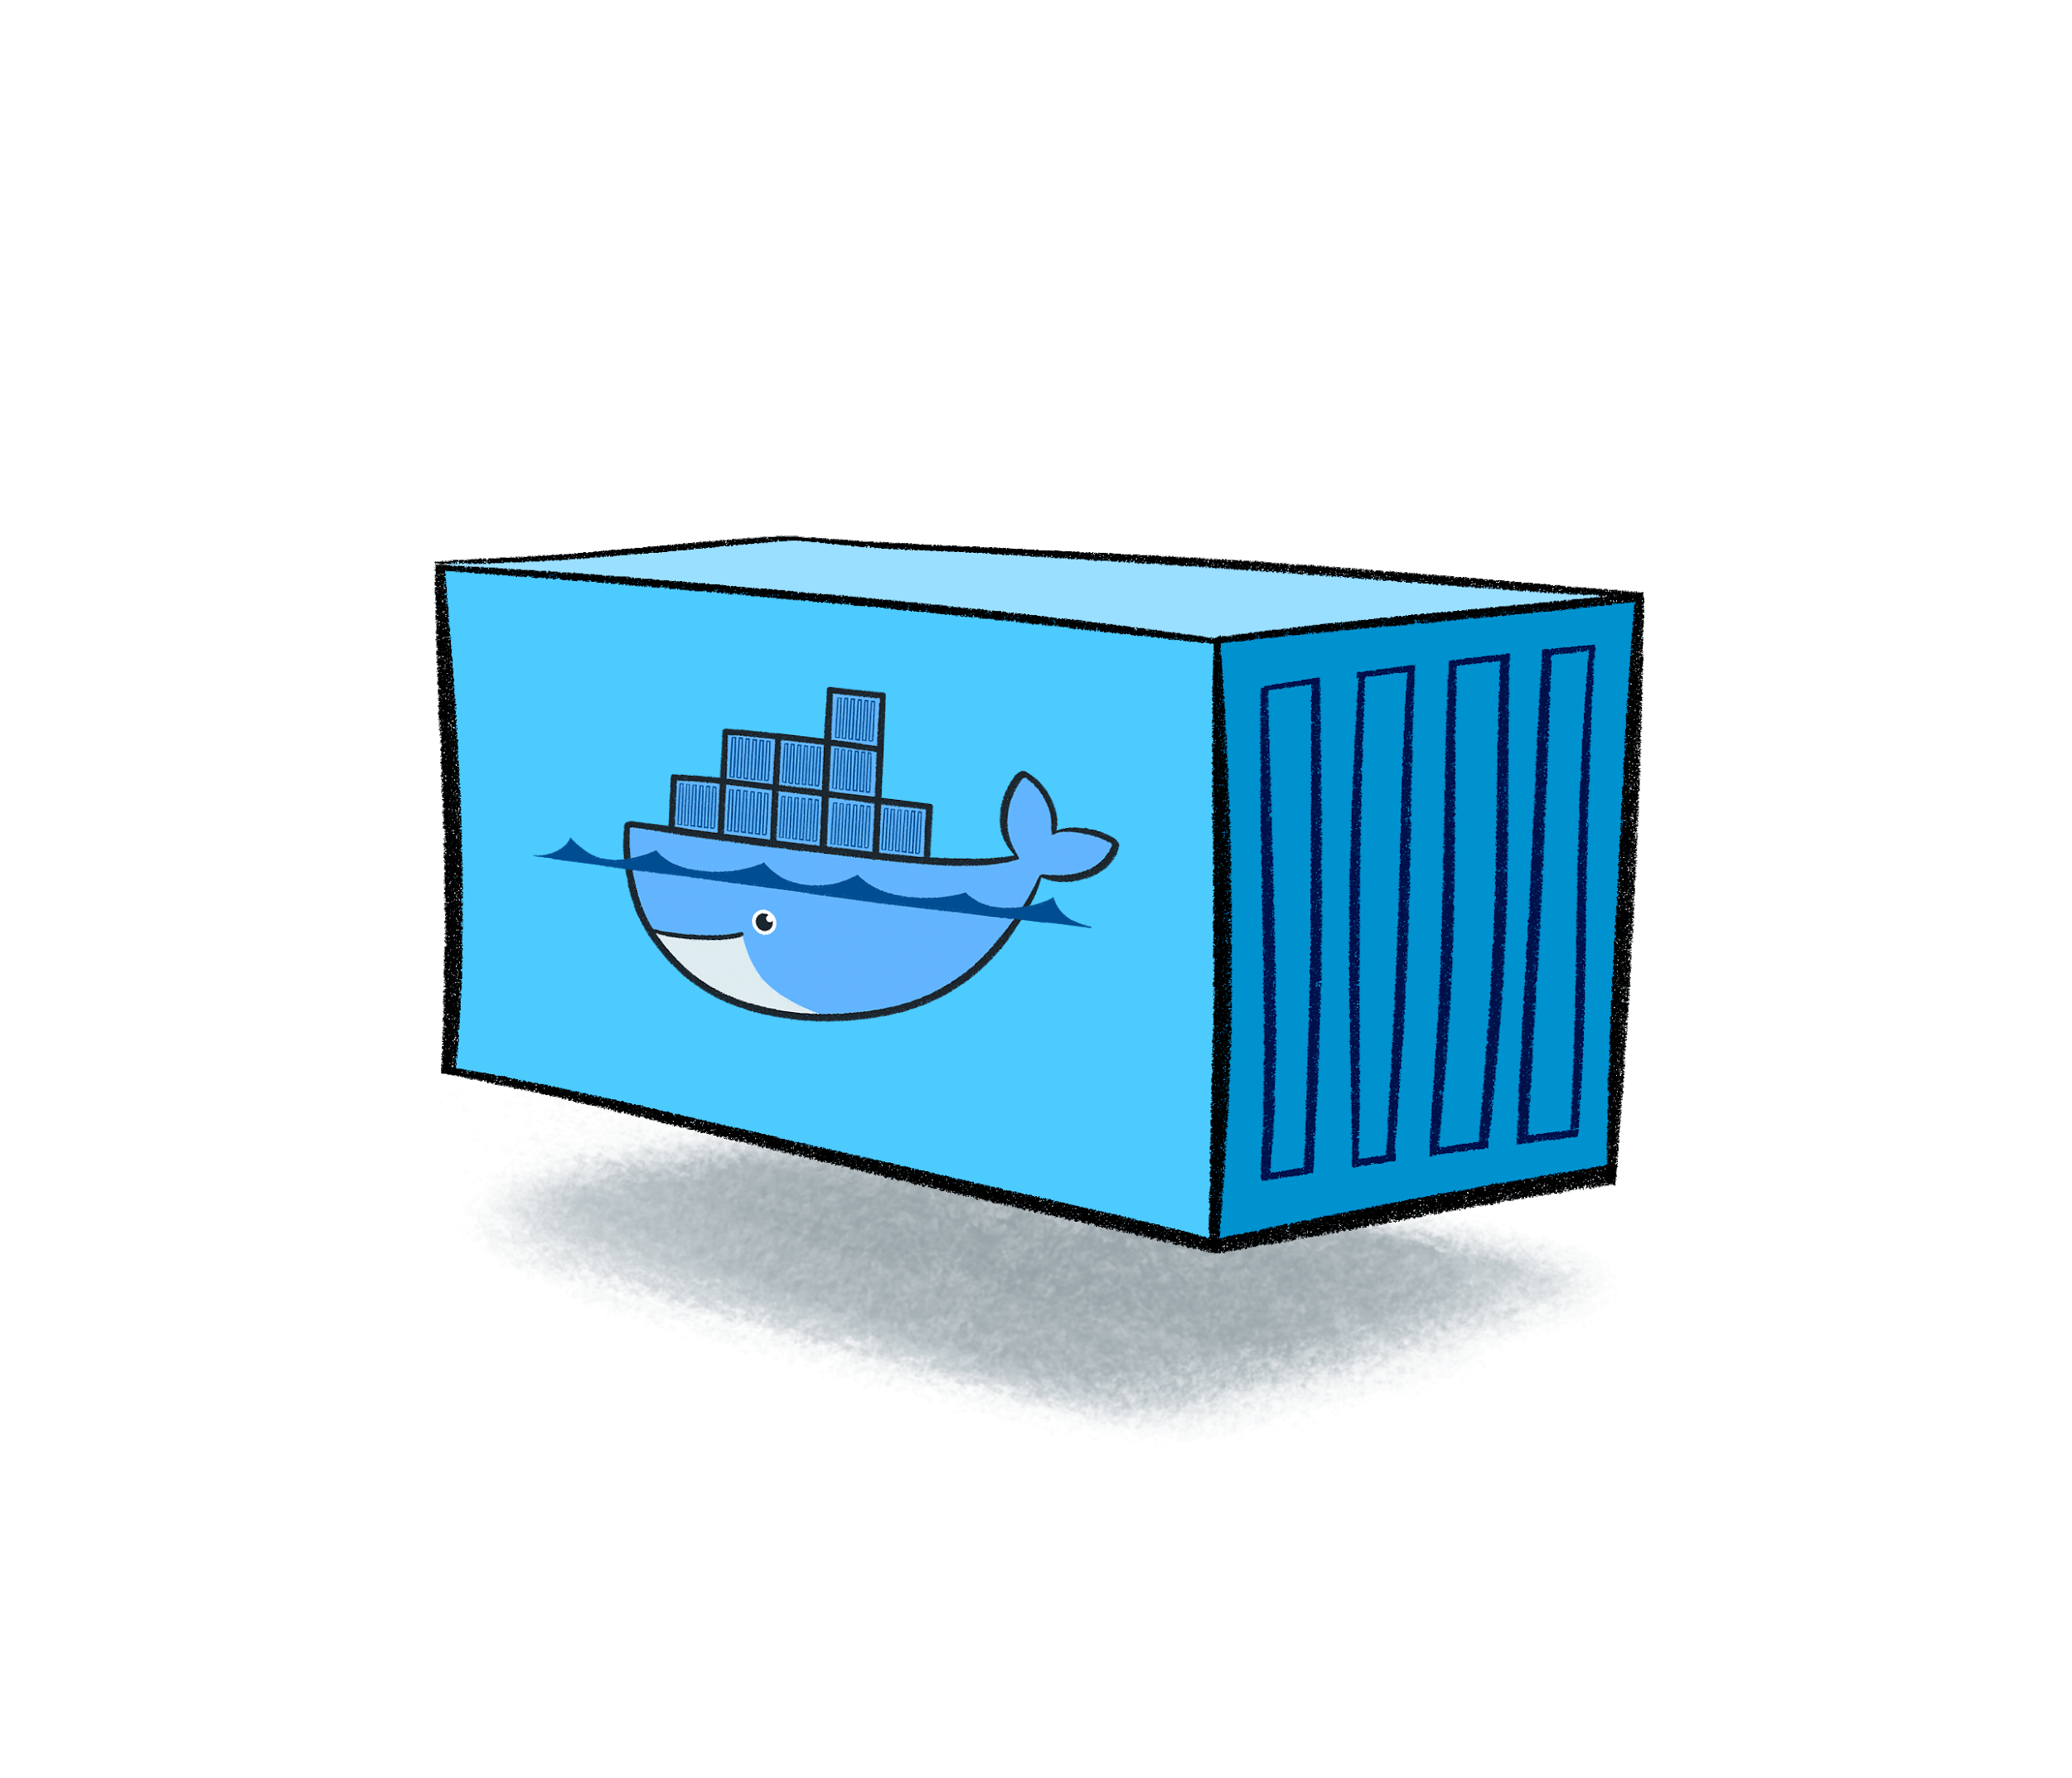
ObsLocTAP by Docker start-up
network bridge
postgreSQL - pgsphere-obsplan
tapserver (taptuto)
Database
Port 5432
Tomcat
Port 8080
docker pull jsalgadodocker/pgsphere-obsplan:latest
docker pull jsalgadodocker/tapserver:latest
docker network create --driver=bridge db-network
docker run -p 8080:8080 --net=db-network --name tap jsalgadodocker/tapserver:latest
docker run -p 5432:5432 --net=db-network --name db jsalgadodocker/pgsphere-obsplan:latest

Slide 16
ObsLocTAP implementation problems
Technical background
Not all the observatories have the resources or expertise to implement a TAP server
Answer: Toolkits, Dockers, support (IVOA members could help)
Not good knowledge of future observations
Answer: Even a short term knowledge is quite relevant for the community for, e.g. ToO follow-up
Proprietary metadata
Answer: Even to know that one time slot is reserved (or not) and to know if this is a must-done observations or something that could be done is quite relevant for multi-messenger astronomy
Summary
Most (all?) the community considers that this effort has a strong positive impact
Question: Why this has not been done before?

Slide 17
Next RFC Steps
Wait for comments on PR 1.0 version from TCG members (community comments are also welcome)
End of November!
If everything is OK or can be corrected without major changes, promote as IVOA Recommendation
Chase for IAU endorsement in August 2021
Of course continue with dissemination and implementation support of the protocol for other observatories
Thanks!

