Slide 1
Supporting observatory coordination with new standards: current status
Aitor Ibarra¹
on behalf of VOVisObs group
Special thanks to Karl Forster (NuSTAR)
1 Quasar Science Resources for ESA

Slide 2
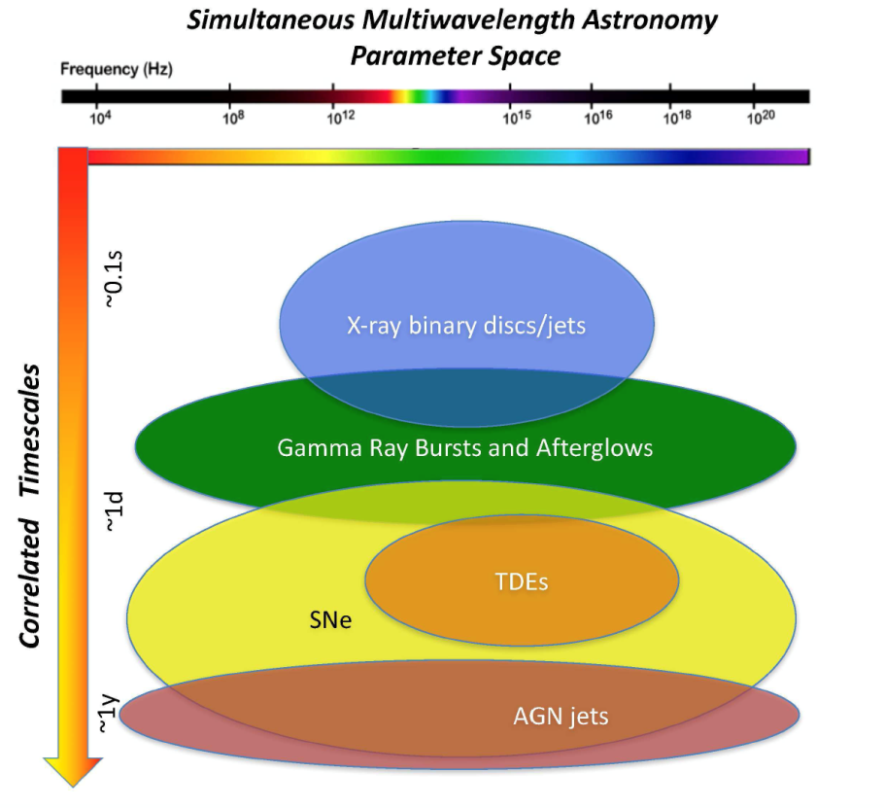
Introduction
Multi-messenger astronomy is here:
  Scientists require, more and more, coordinated multi-wavelength observations.
    Increasing interest to simultaneously observe the same target at different wavelengths. Example use cases:
      X-ray binary ToOs
      Gaia transients
      Optical & radio transients
      TDEs
      GW & neutrino follow-up
Middelton et al. 2017

Slide 3
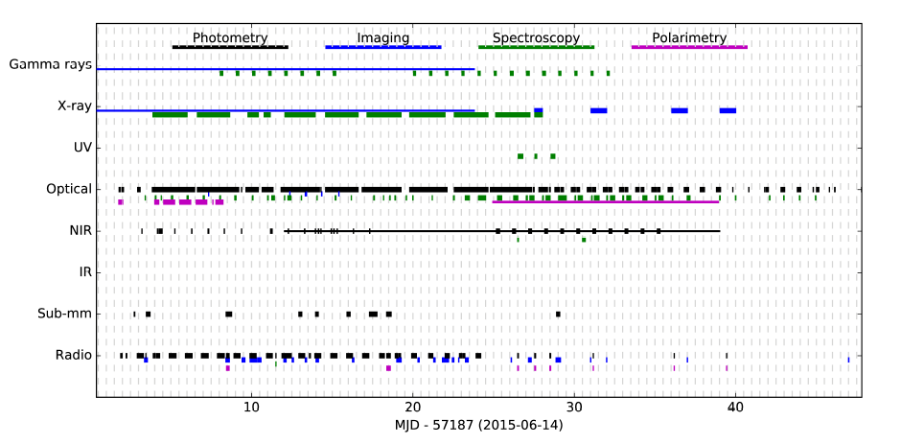
Multi-wavelength campaigns can be large and complex
Real Multi-wavelength campaign during the 2015 outburst of V404 Cygni (Credit: Tom Marsh)

Slide 4
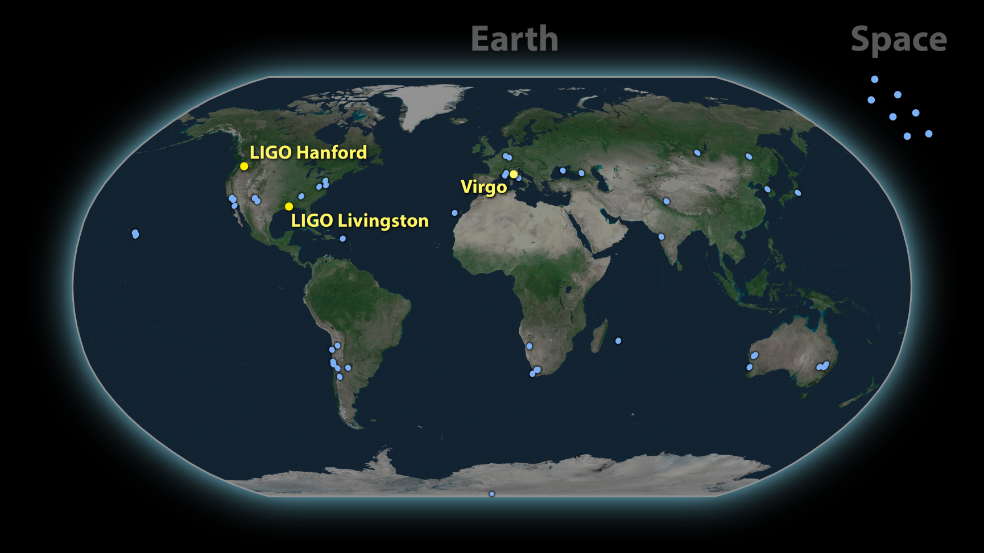
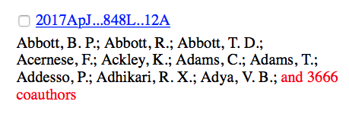
Worse: 3676 scientists working together…
~70 ground- and space-based observatories

Slide 5
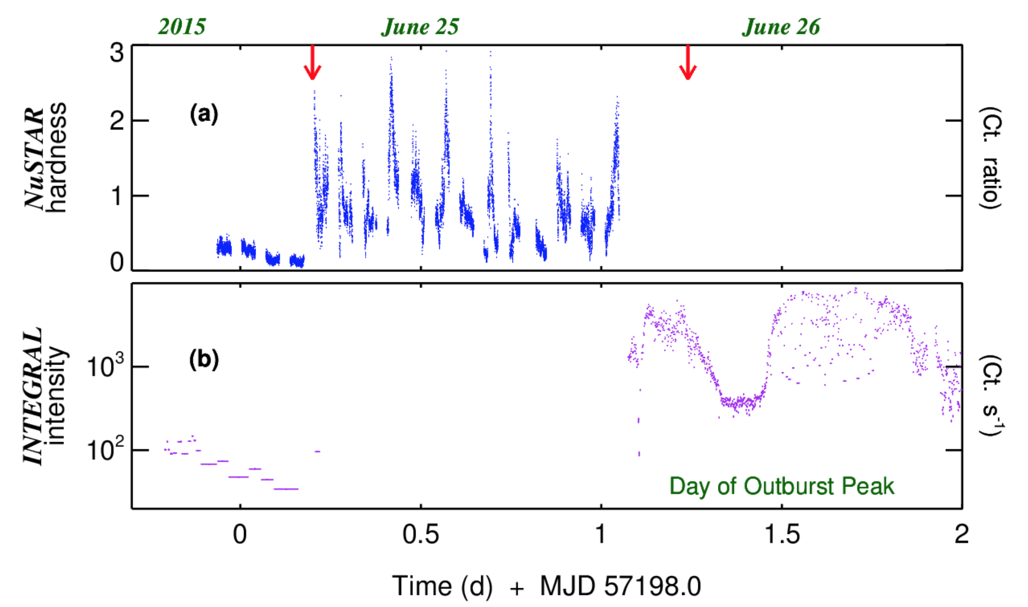
What if you do not it correctly….
X-ray evolution of V404 Cygni leading to outburst peak.
Uh-oh…
Gandhi et al. 2017, Nature Astronomy
Notes:
https://www.nature.com/articles/s41550-017-0273-3?WT.feed_name=subjects_astrophysical-plasmas
An elevation of 0.1 light-seconds for the optical jet base in an accreting Galactic black hole system

Slide 6
XMM-Newton coordinated observations
Demand for coordinated observations is increasing…
Some observatory numbers:
  NuSTAR: 30% of the observations are coordinated with other observatories.
  XMM-Newton: ~12% coordinated observations (NuSTAR, HST, Chandra, VLT, Swift).
  INTEGRAL: ~10% of the observations are coordinated with other observatories.
Courtesy J.-U. Ness

Slide 7
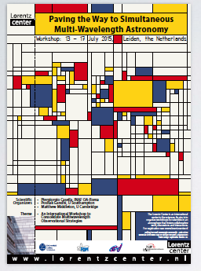
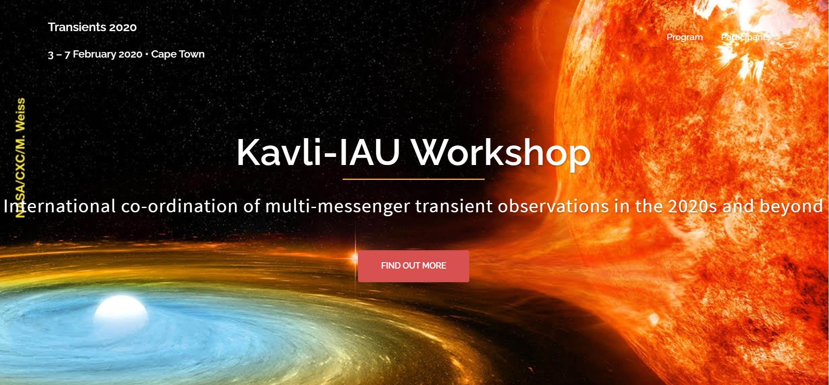
Need For Improved Methods
Recent workshops have discussed this issue:
  Paving the Way to Simultaneous Multi-Wavelength Astronomy (Leiden: July 13, 2015)
    White paper: (arXiv/1709.03520v3)
  Astrophysics Mission Synergy Workshop (Caltech: March 31, 2017)
  Planning ESO observations of future gravitational wave events (Garching: January 31 2018)
  Kavli-IAU Workshop: International co-ordination of multi-messenger transient observations in the 2020s and beyond
    International Coordination of Multi-Messenger Transient Observations in the 2020s and Beyond: Kavli-IAU White Paper

Slide 8
Observations Life cycle
Planned
Scheduled
Performed
Archived
Aborted
Check target visibility
Check performed or planned observations of same target

Slide 9
The information is out there
All information needed to plan an observation (via AO or ToO) is currently in facilities own web pages.
BUT
This information is usually shown in a web page statically and is only accessible trough forms that have to be manually filled in.
Target Visibility
Constraints
Observations info
Instrument info
Short-term schedule
Long-term schedule

Slide 10

Observations Life cycle
Planned
Scheduled
Performed
Archived
Aborted
Check target visibility
Check performed or planned observations of same target
Services common terminology?

Slide 11
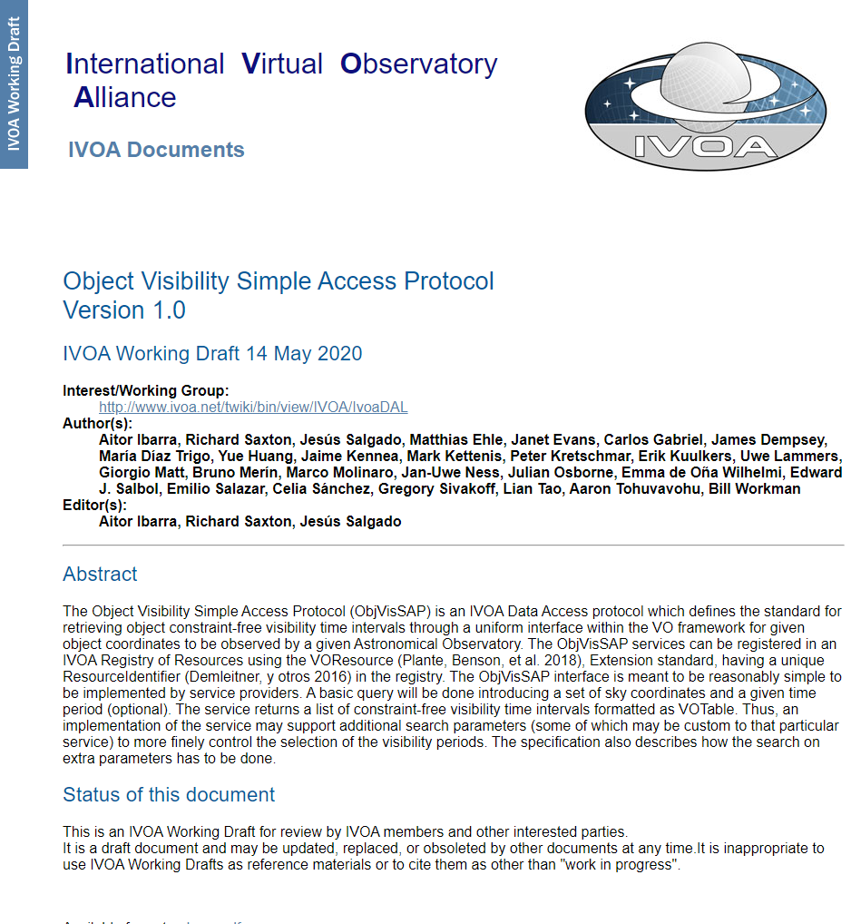
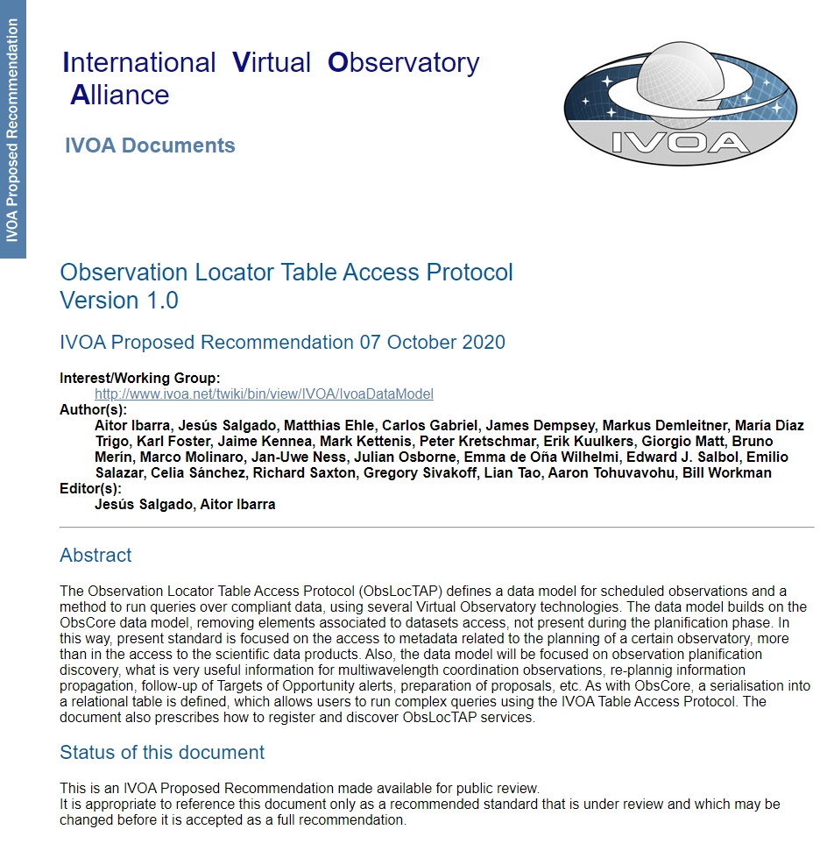
Minimum common information
Object Visibility periods
  Object Visibility protocol:
    ObjVisSAP to standardize the retrieval of the well known visibility periods that all facilities have.
Observation Locator
  Observation Locator Protocol:
    ObsLocTAP to simplify the acquisition of previous and planned observations.

Slide 12
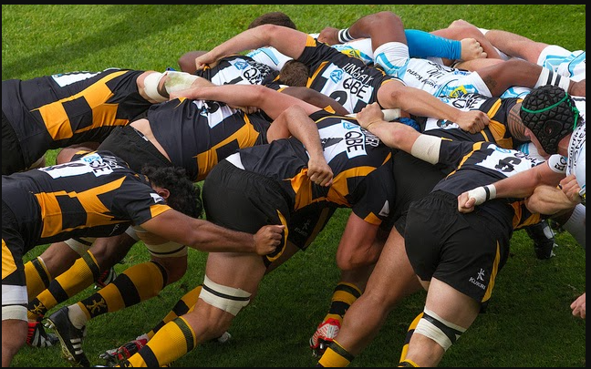
Engaging the community

Slide 13
Engaging the community
Observatory protocols workshop @ ESAC/ESA (21st September 2018)
  More than 50 participants
  More than 40 observatories represented
  Comments and suggestions implemented in the IVOA documents
Several facilities implements the current version of the protocols:
  XMM-Newton, Integral, Gaia, Chandra, NuSTAR
Demonstrator workshop @ Videocon (18th & 28th September 2020)
  Two sessions with more than 20 participants each
  Goal:
    To report about the status of the VO protocols and to receive feedback on the proposed standards
    To report about the implementation of these two protocols carried out by NuSTAR mission.

Slide 14
The NuSTAR and the NOT real-time case
Karl Foster (NuSTAR) reported during the demonstrator workshop his experience during the ObjVisSAP and the ObsLocTAP implementation.
  Both protocols were implemented following the implementation guides from:
  https://www.cosmos.esa.int/web/vovisobs_protocols/home
  Summary:
  “It is complex but not complicated”
Peter Sorensen (Nordic Optical Telescope) implemented the ObjVisSAP protocol right after the first session of the demonstrator workshop!!

Slide 15
Implementation guides
Object Visibility Service
  Emilio Salazar has developed a basic ObjVisSAP web service (REST) compliant using python+Django that can be downloaded from the following github repository
  https://github.com/emiliosalazardonate/visibility-service/blob/master/README.md
Observation Locator Service
  Detailed instructions of how to install a TAP (Table Access Protocol) server and configure it.
  In case you are familiar with Docker technologies, Jesus Salgado has created a dockerized instance with two Docker containers: One with a PosgresSQL/pgsphere with the ivoa.obsplan table and a second one with TAP server. They can be downloaded from:
  https://hub.docker.com/r/jsalgadodocker/postgres9.5-pgsphere-obsplan
  https://hub.docker.com/r/jsalgadodocker/tapserver﻿

Slide 16
Kavli-IAU White Paper
The workshop was focused on the importance of international coordination in the multi-messenger area.
The outcome of this workshop was a White Paper with a summary of the discussions that took place and the resulting recommendations for how to fulfil the full scientific potential in the 2020s and beyond.
In particular, in section Telescope Coordination says:
  Telescope Coordination Recommendation 1:
We recommend the IAU endorse a common format for all observatories to report previous and planned observations, namely the standard developed by the IVOA (ObsLocTAP)

Slide 17
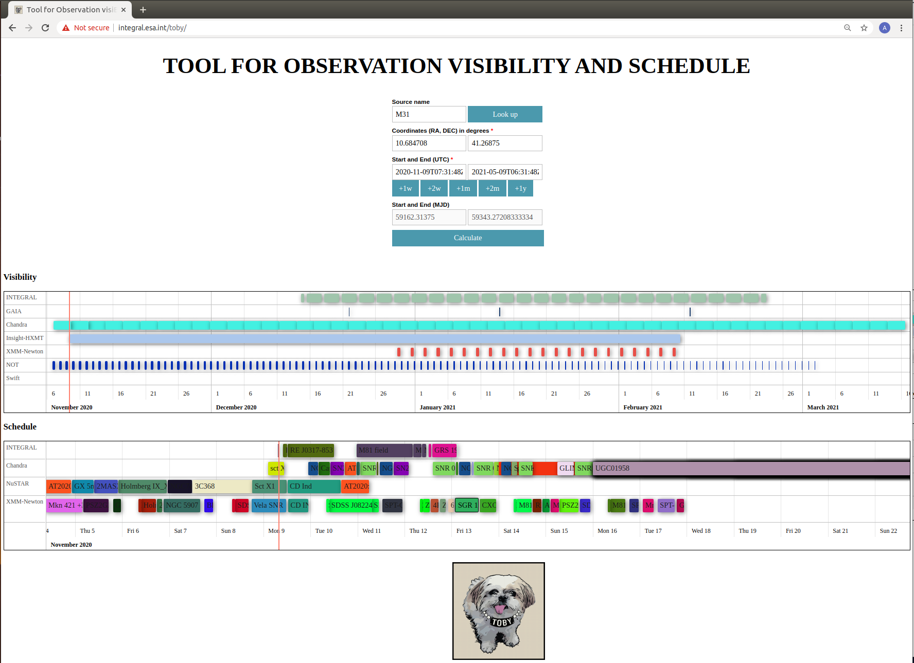
Client implementation example
ESAC (Emilio Salazar) has developed a web application where we can visualize all the astronomy facilities that currently implements the ObjVisSAP and ObsLocTAP protocols.
http://integral.esa.int/toby/

Slide 18
Conclusions
ObsLocTAP has been proposed for recommendation to the IVOA
ObjVisSAP is in working draft state and it will be proposed for recommendation to the IVOA soon.
Implementation guides and code examples can be found at:
https://www.cosmos.esa.int/web/vovisobs_protocols/implementation-guides
Do not hesitate to contact me (aibarra@sciops.esa.int) or Jan-Uwe Ness (juness@sciops.esa.int) if you have any question or doubt about the protocols.

