Slide 1
Study on Analysis of Large Datasets with Apache Spark
S. Nieto on behalf of ESDC Team

Slide 2
Outline
Motivation
Apache Spark
Data sources and connectors
Scientific use cases
Exploring catalogues with SparkSQL
Analysis on images
JupyterHub connection
Conclusions and future work
References and links

Slide 3
Motivation
SAS storage estimation (6 years mission)
10PB
Data heterogeneity
Metadata tables
Images
Spectra
Science Use Cases:
Big catalogue analysis
Source extraction on images
Machine learning

Slide 4
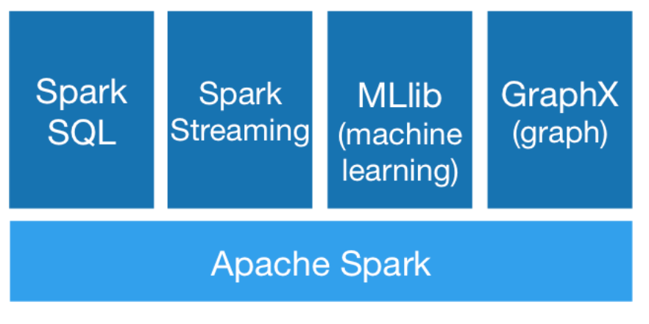
Apache Spark
Framework for large scale cluster computing in Big Data contexts
Open source platform with big and active community
Written in Scala with multilanguage API support for Python, Java and R
Platform of platforms:
Machine Learning, SQL-like, Streaming and Graphs

Slide 5
Spark Transformations and Actions

Slide 6
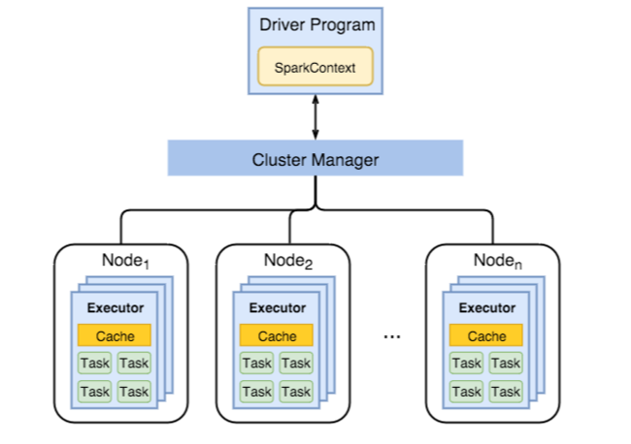
Spark cluster
Spark v2.3.1
Spark infrastructure:
Master: 24GB and 8 Cores
6 Workers: 48 Cores 180 GB RAM
Standalone mode
No YARN, MESOS
NetApp NFS instead HDFS
JupyterHub server
PySpark kernel

Slide 7
Datasets
Simulated catalogue of 2.9TB spited in CSV chunks
2.7 billion rows aprox. and 119 columns
Simulated NIR stacked images
12GB each
FITS format
Simulated FITS Catalogue
300K rows aprox.
FITS format

Slide 8
Spark Data Formats: Parquet
Spark accepts: CSV, JSON, XML, Parquet, ORC, Avro and external data sources at https://spark-packages.org/.
Parquet, format by default in Spark v2.x.
Compression
snappy is the default Parquet codec
Data Partitioning by columns
Predicate pushdown “where the data lives”
.filter("ra_gal > 48”).select(“galaxy_id”)

Slide 9
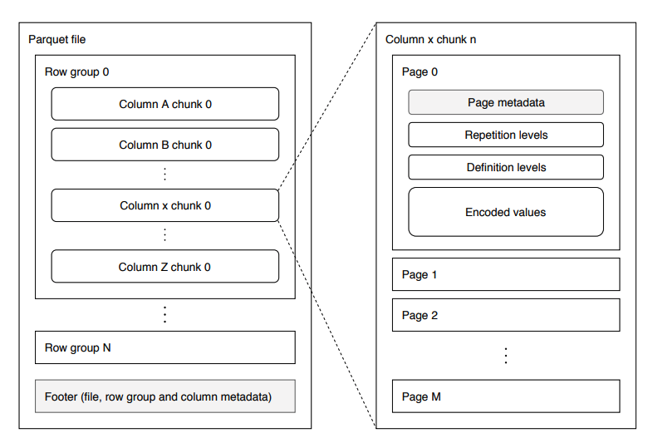
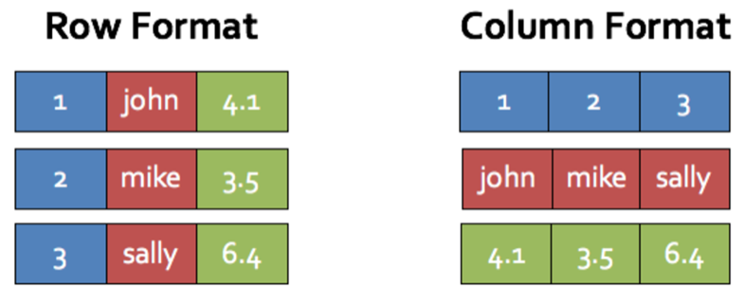
Parquet
Is column oriented data serialization standard for efficient data analytics.
Compression: SNAPPY
Parquet block size to 134217728 (128MB)
Parquet page size to 1048576
Parquet dictionary page size to 1048576
Dictionary is on
Validation is off
Writer version is: PARQUET_1_0

Slide 10
CSV2Parquet Java Tool
java –jar SparkCSV2Parc-1.0.jar
-i <source-csv-folder>
-o <output-parquet-folder>
-p <page-size>
-b <block-size>
-pb <partition-bytes>
-c <compression-codec>
Reads all CSV files under the source folder and writes them as parquet files
Schema is not in CSV chunks -> Infer Schema is set to False (faster)
Notes:
Programmatically Specifying the Schema

Slide 11
CSV2Parquet
Each CSV chunk (10.5GB) contains 10M rows
10.5GB/128MB = 85 partitions by default (maxPartitionBytes)
Snappy compression: size savings 26%
* If page size is too small, the compression will deteriorate.
Page Size | Block Size | Size (GB) | Partitions
1048576 (1MB) | 134217728 | 7.8 | 85
8192 (8K) | 134217728 | 8.2 | 85
1048576 | 134217728 | 7.8 | 44
8192 | 134217728 | 8.2 | 44

Slide 12
Parquet File Tuning
parquet.block.size: The block size is the size of a row group being buffered in memory. This limits the memory usage when writing. Larger values will improve the I/O when reading but consume more memory when writing. Default size is 134217728 bytes (= 128 * 1024 * 1024).
parquet.page.size: The page size is for compression. When reading, each page can be decompressed independently. A block is composed of pages. The page is the smallest unit that must be read fully to access a single record. If this value is too small, the compression will deteriorate. Default size is 1048576 bytes (= 1 * 1024 * 1024).
parquet.compression: The compression algorithm used to compress pages. It should be one of uncompressed, snappy, gzip, lzo. Default is uncompressed.
parquet.enable.dictionary: The boolean value is to enable/disable dictionary encoding. It should be one of either true or false. Default is true.
spark.default.parallelism - sets up the number of partitions to use for HashPartitioner (can be overridden when creating SparkContext object),
spark.sql.shuffle.partitions - controls the number of partitions for operations on DataFrames (default is 200)
spark.sql.files.maxPartitionBytes - splits a large parquet with snappy file into multiple partition with the size of

Slide 13
Compression comparison
Trade off: CPU vs IO
By default, Spark v2.3.1 provides:
Snappy (selected) - the default codec in Spark 2.0.0.
Gzip – Better compression ratio
Lzo – less popular format
Bulk migration #1 of 1.1TB into 778GB in ~2.5h
Bulk migration #2 of 2.9TB into 2.1TB in ~7h
Codec | Size | Compression Ratio
gzip | 6.3GB | 1.66 (40%)
snappy | 7.8 GB | 1.34 (26%)
Notes:
GZIP compression uses more CPU resources than Snappy or LZO, but provides a higher compression ratio. GZip is often a good choice for cold data, which is accessed infrequently. Snappy or LZO are a better choice for hot data, which is accessed frequently.

Slide 14
SparkSQL Test #1: Count
# Create a DataFrame from Parquet source path
# So only part of the file will be loaded into memory
dfp = sqlContext.read.parquet('/shared_spark_jupy/flagship_range12.parquet/')\
.select("ra_gal","dec_gal","euclid_vis","euclid_nisp_y","euclid_nisp_j","euclid_nisp_h","observed_redshift_gal")
# Count is an action that triggers queued transformations
dfp.count()
Test #1A on 1 Billion rows
elapsedTime => 25264 (25 s)
Test #1B on 2.7 Billion rows
elapsedTime => 80086 (1.3 min)
I/O amounts to ~90%
CPU time is ~10%

Slide 15
SparkSQL Test #2: Box Seach
#SQL Query selection
q1 = sqlContext.sql("SELECT * \
FROM TABLE \
WHERE ra_gal > 48 AND ra_gal < 52 AND dec_gal > 8 AND dec_gal < 12");
q1.count()
Test #2A on 1 Billion rows
elapsedTime => 49215 (49 s)
Test #2B on 2.7 Billion rows
elapsedTime => 142417 (2.4 min)

Slide 16
SparkSQL Test #3: Box Seach +Color query
#SQL Query selection
q1 = sqlContext.sql("SELECT * \
FROM TABLE \
WHERE ra_gal > 48 AND ra_gal < 52 AND dec_gal > 8 AND dec_gal < 12 AND (euclid_nisp_y - euclid_nisp_h) < 2");
q1.count()
Test #3A on 1 Billion rows
Output rows 3134628
elapsedTime => 78152 (1.3 min)
Test #3B on 2.7 Billion rows
Output rows 8599000
elapsedTime => 204043 (3.4 min)
PostgresXL (10-node) -> 1508s (25min)
GreenPlum (6-node) -> 1719s (28min)
Notes:
GP-6_columnar:Time: 149627.439 ms: optimizer=off: 86242.515 ms
Different execution plans: GP takes 1 index, while PostgresXL uses two

Slide 17
SparkSQL Test #4: Parametric search +OrderBy
#SQL Query selection
sqlContext.sql("SELECT * \
FROM TABLE \
WHERE ra_gal > 48 AND ra_gal < 52 AND dec_gal > 8 AND dec_gal < 12 AND (euclid_nisp_y - euclid_nisp_h) < 2”).orderBy("galaxy_id”)
Test #4A on 2.7 Billion rows
elapsedTime => 141883 (2.4 min)
Test #4B on 2.7 Billion rows
elapsedTime => 471366 (7.9 min)
Order by in XL: 29.5min

Slide 18
SparkSQL Test #5: Parametric search
#SQL Query selection
q1 = sqlContext.sql("SELECT * FROM TABLE WHERE galaxy_id = 2 AND gr_cosmos > 1");
q1.count()
Test #5 on 2.7 Billion rows
Output rows: 24899604
ElapsedTime => 34754 (35 s)
PostgresXL 10-nodes database takes 4h 27m to complete the query !

Slide 19
Results summary
Test | Query | Inputs (rows) | Total Time | PostgresXL | Results (rows)
#1A | Count | 1 Billion | 25s | -
#2A | Box search | 1B | 49s | - | 3134628
#3A | Box search +color query | 1B | 1.3 min | - | 2961957
#4A | Box search +color query +OrderBy | 1B | 2.4 min | - | 2961957
#1B | Count | 2.7B | 1.3 min | 1.6 min
#2B | Box search | 2.7B | 2.4 min | - | 8599002
#3B | Box search +color query | 2.7B | 3.4 min | 25 min | 8599000
#4B | Box search +color query +OrderBy | 2.7B | 7.9 min | 29.5 min | 8599000
#5 | Parametric search | 2.7B | 35s | 4h27min | 24899604

Slide 20
SparkSQL Generic Workflow
Filter parquet dataset based on predicates (WHERE clause)
Perform selection of columns, count rows
Store in cache
Perform any other operation
Store results in Notebook area if further ops are required

Slide 21
Spark-fits connector
Spark use in the astronomical community still remains limited.
Spark-fits by AstroLab for
Tables and images
"PYSPARK_SUBMIT_ARGS":
"--master spark://<spark-master-ip>:7077
--driver-memory 24G
--executor-cores 8
--executor-memory 24G
--total-executor-cores 48
--packages com.github.astrolabsoftware:spark-fits_2.11:0.6.0 pyspark-shell”

Slide 22
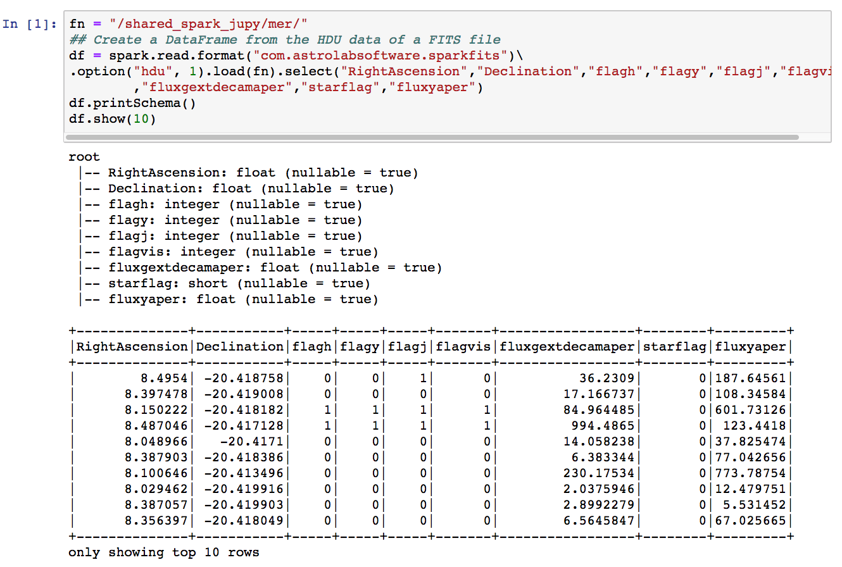
FITS Catalogue Use Case

Slide 23
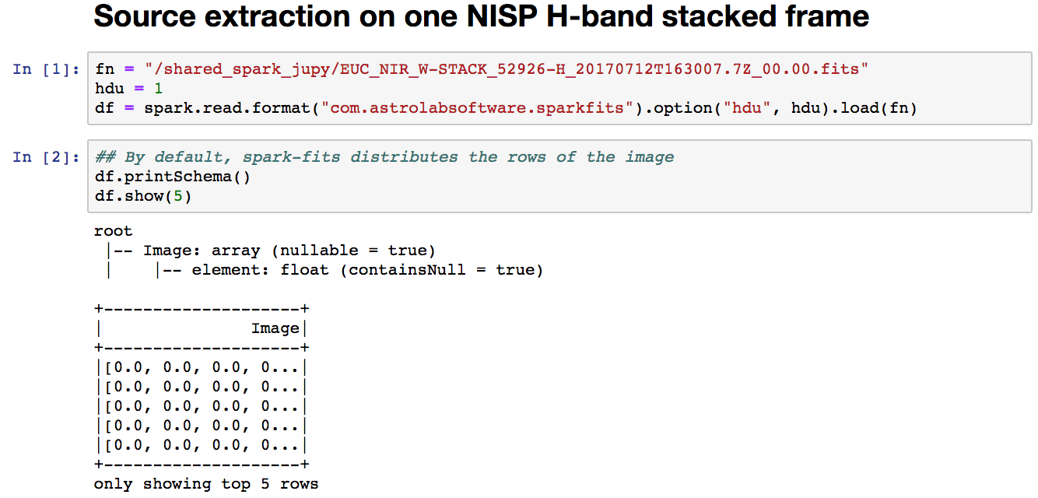
Image Use Case

Slide 24
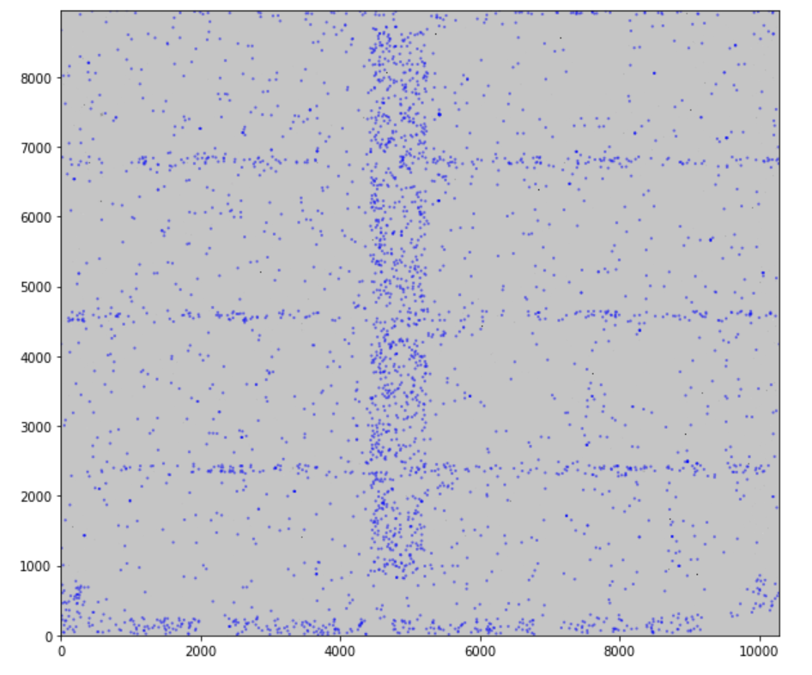
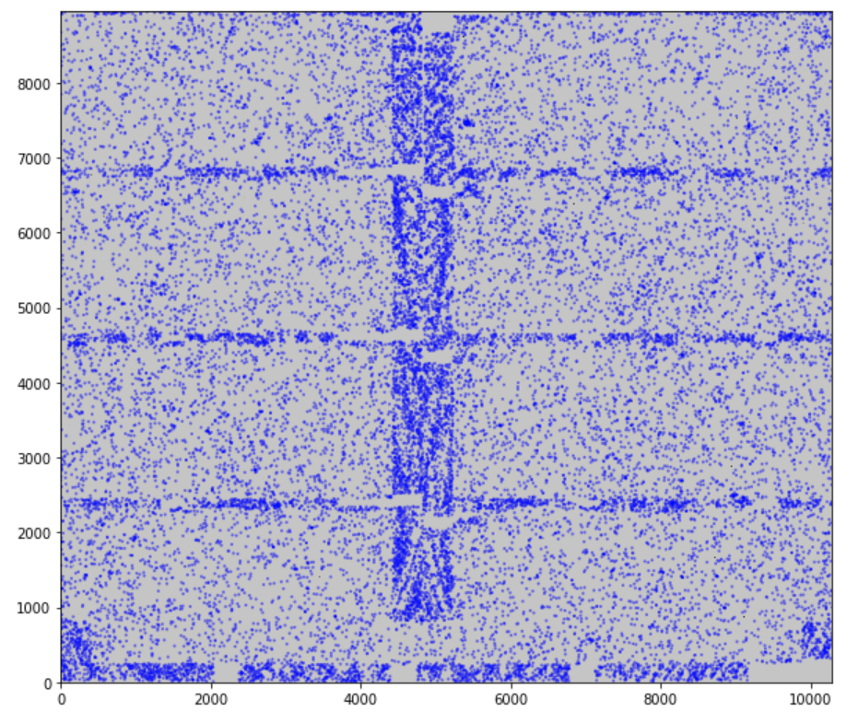
Source extraction with DAOStarFinder
FITS simulated images of 12GB ea.
3000 sources 15000 sources

Slide 25
JupyterLab connection

Slide 26
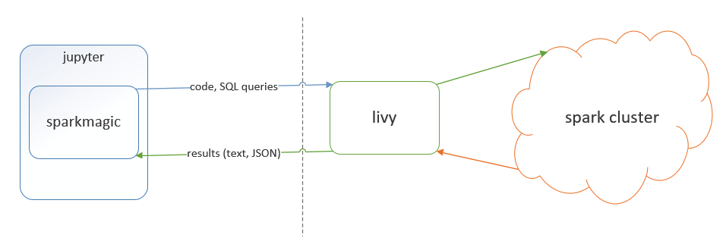
JupyterLab connection
Interactive analysis through JupyterLab
PySpark kernel - tested
Apache Toree
Dynamic resource allocation is needed
spark.dynamicAllocation.enabled
Livy – a REST based Spark interface to run statements, jobs and applications
Using programmatic API
Running interactive statements through REST API
Submitting batch applications with REST API
Notes:
https://anaconda.org/conda-forge/sparkmagic

Slide 27
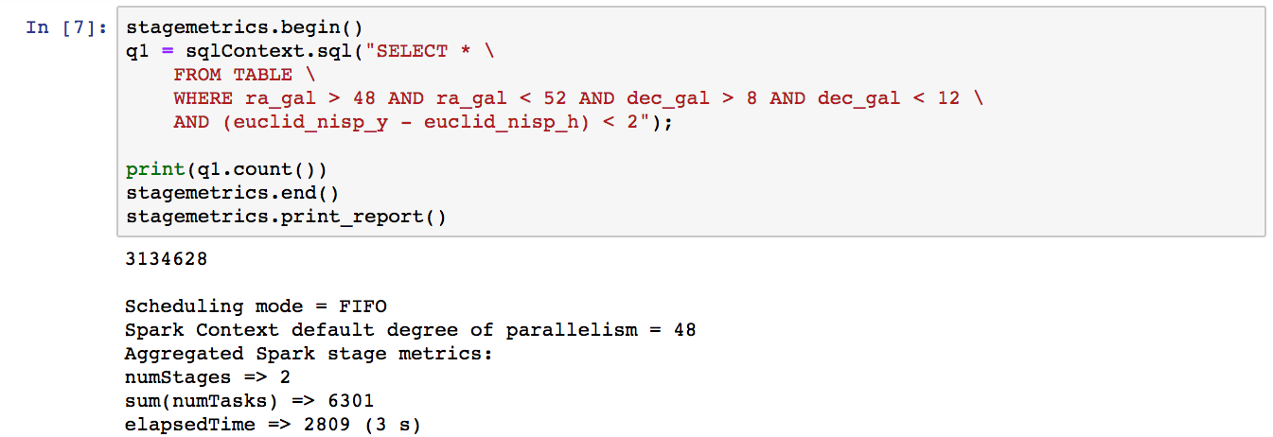
Performance metrics

Slide 28
Conclusions
Generate an optimum number of parquet files to optimize the NetApp usage.
The overhead of decompression contributes to the query execution time, while transferring compressed data results in less I/O.
Less overall IO to do, meaning jobs run faster
NFS storage is a bottleneck
Filter pushdown reduce the data loaded and improves query performance
Cache (in memory) results after filtering to continue working boosts performance
Difficult to debug errors from Jupyter
Interactive monitoring: spark job progress

Slide 29
Future work
Test with HDFS which implies to change the infrastructure
Scale-out the the cluster (k8s)
Data partitioning by columns
Heapix index
Livy
From JupyterHub sessions
Test interactive monitoring
Machine Learning API

Slide 30
Questions
Thanks for your attention

Slide 31
References & Links
Spark monitor
https://krishnan-r.github.io/sparkmonitor/
https://dlab.epfl.ch/2017-09-30-what-i-learned-from-processing-big-data-with-spark/
Spark-fits
https://astrolabsoftware.github.io/
Spark measure
https://github.com/LucaCanali/sparkMeasure
Compression
http://java-performance.info/performance-general-compression/

