Slide 1
Visibility Service and Observation Locator:
Planning future observations
Jesús Salgado¹ - ESAC Science Data Center (ESDC)
Aitor Ibarra¹, Richard Saxton², Jan-Uwe Ness⁴, Erik Kuulkers⁴, Carlos Gabriel⁴, Bruno Merin⁴, Peter Kretschmar⁴,Matthias Ehle⁴, Emilio Salazar³, Celia Sánchez³
^{1 Quasar for ESA}
^{2 TPZ-VEGA for ESA}
^{3 ATG for ESA}
^{4 ESA}

Slide 2
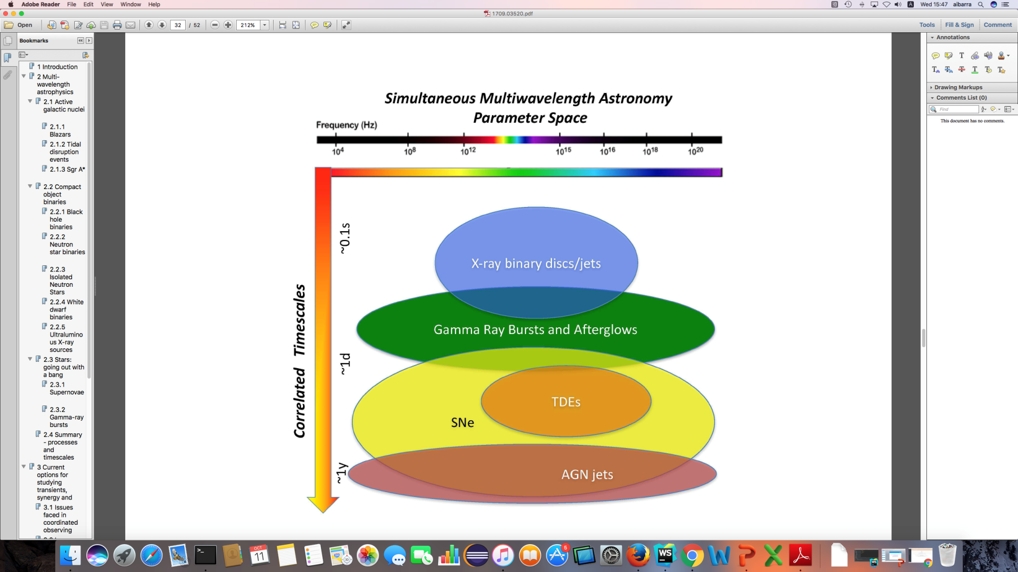
Scientists Require Coordinated
Multi-wavelength Observations
Increasing interest to simultaneously observe the same target at different wavelengths. Example use cases:
  X-ray binary ToOs
  Gaia transients
  Optical & radio transients
  TDEs, GRBs
  GW & neutrino follow-up
Some observatory numbers:
  NuSTAR: 30% of the observations are coordinated with other observatories.
  XMM-Newton: ~12% coordinated observations (NuSTAR, HST, Chandra, VLT, Swift).
  INTEGRAL: ~10% of the observations are coordinated with other observatories.
  Chandra has expanded the time available via joint programs.
Middelton et al. 2017

Slide 3
Information is out there
All information needed to plan an observation (via AO or ToO) is currently in facilities own web pages.
BUT
This information is usually shown in a web page statically and is only accessible trough forms that have to be manually filled in.
Target Visibility
Constraints
Observations info
Instrument characteristics
Short-term schedule
Long-term schedule

Slide 4
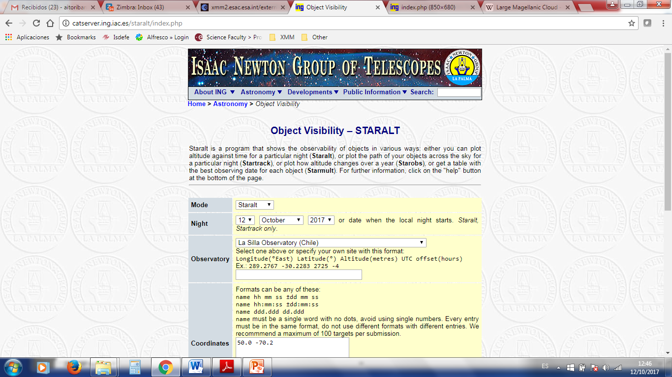
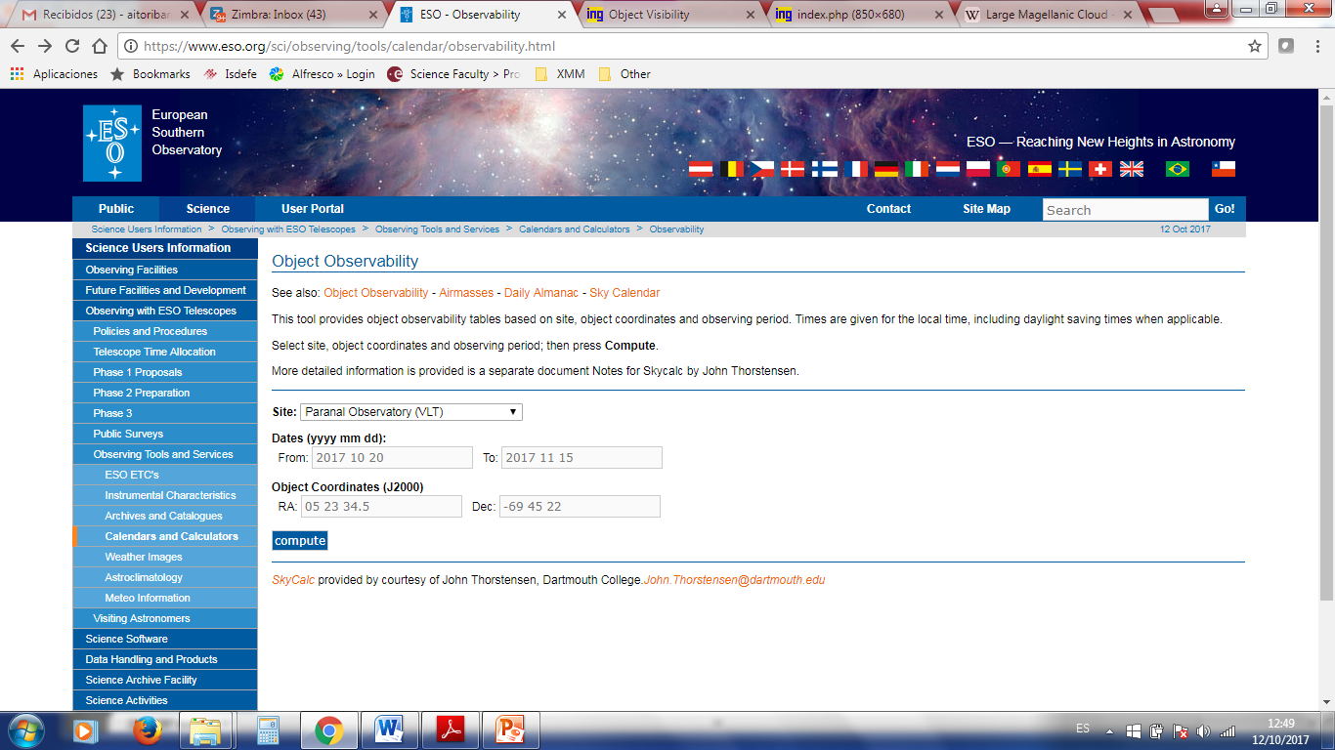
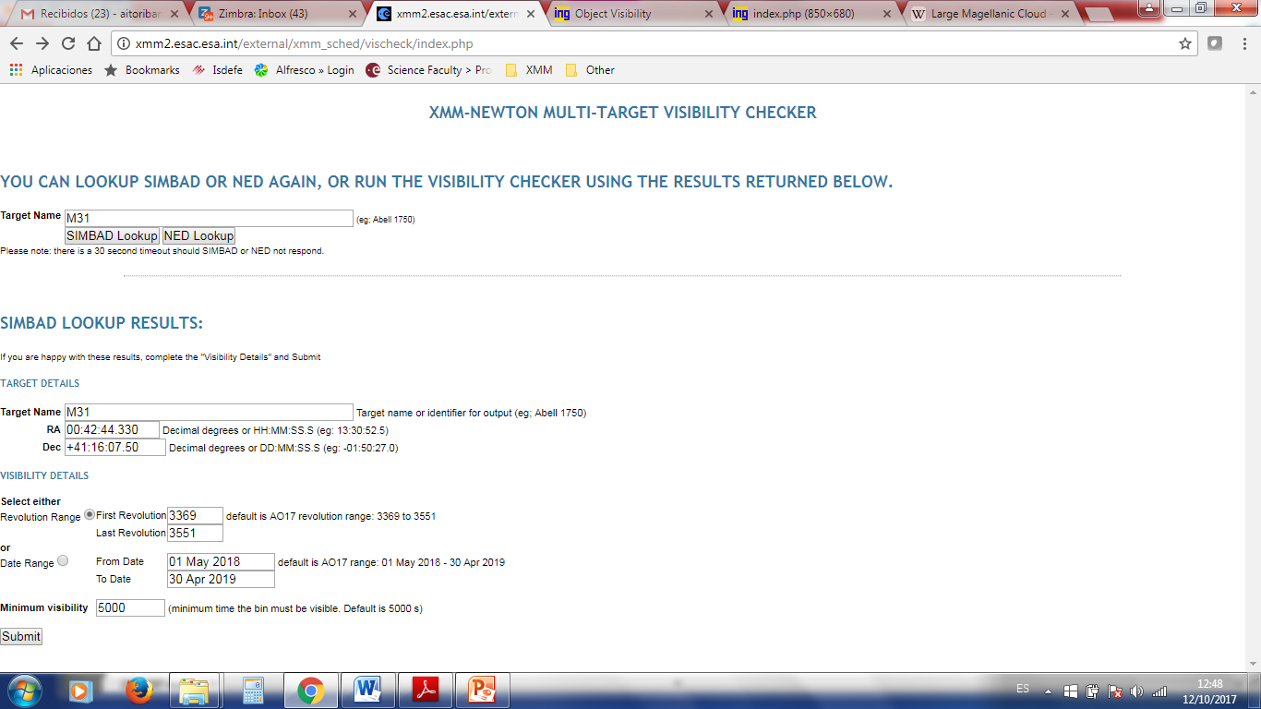
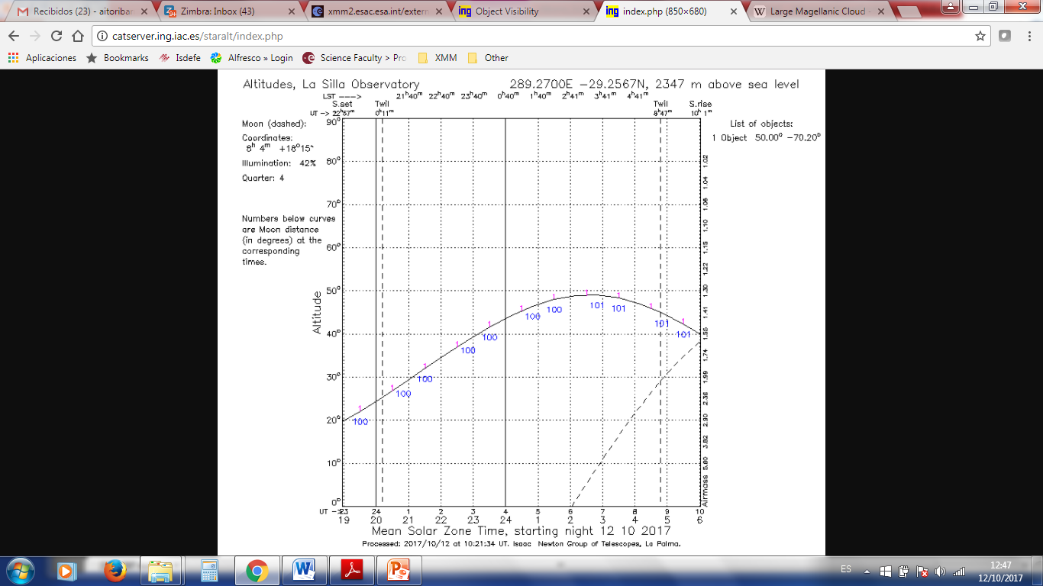
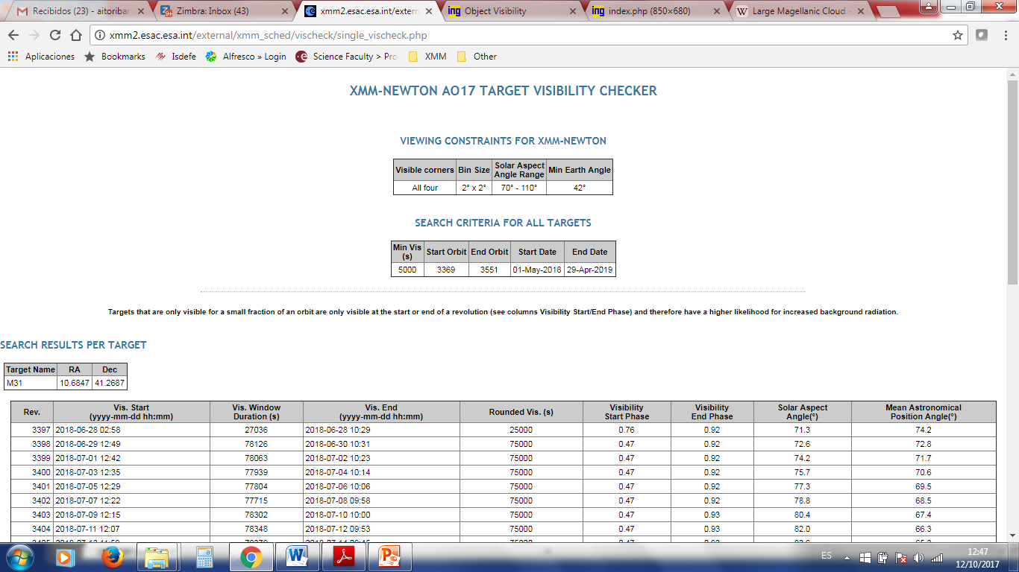
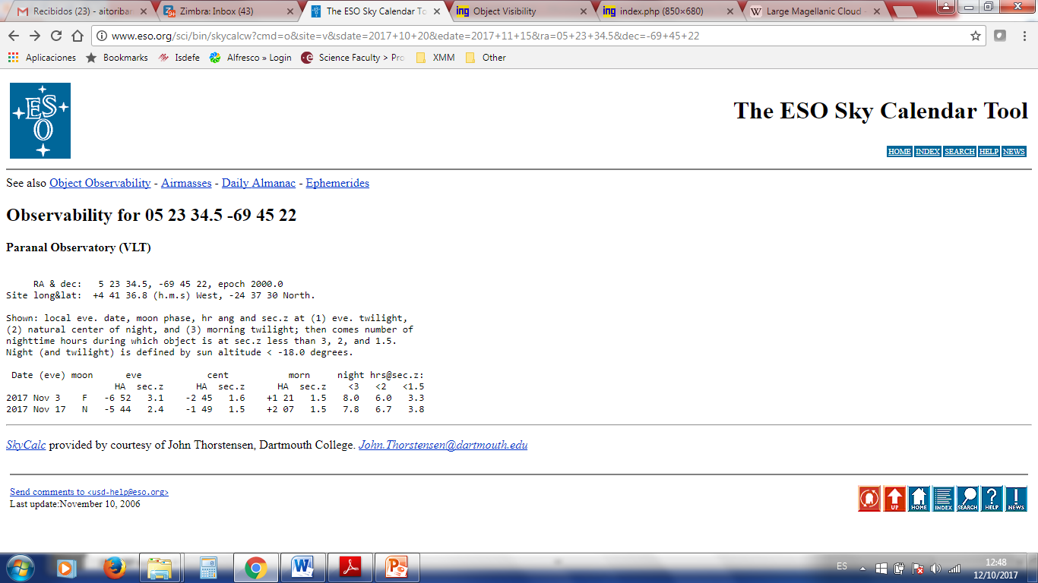
Visibility services

Slide 5
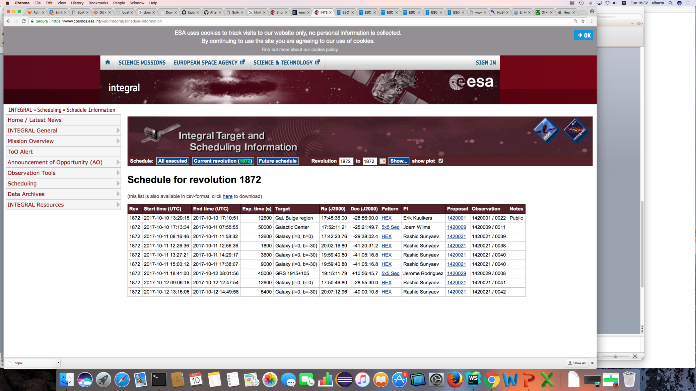
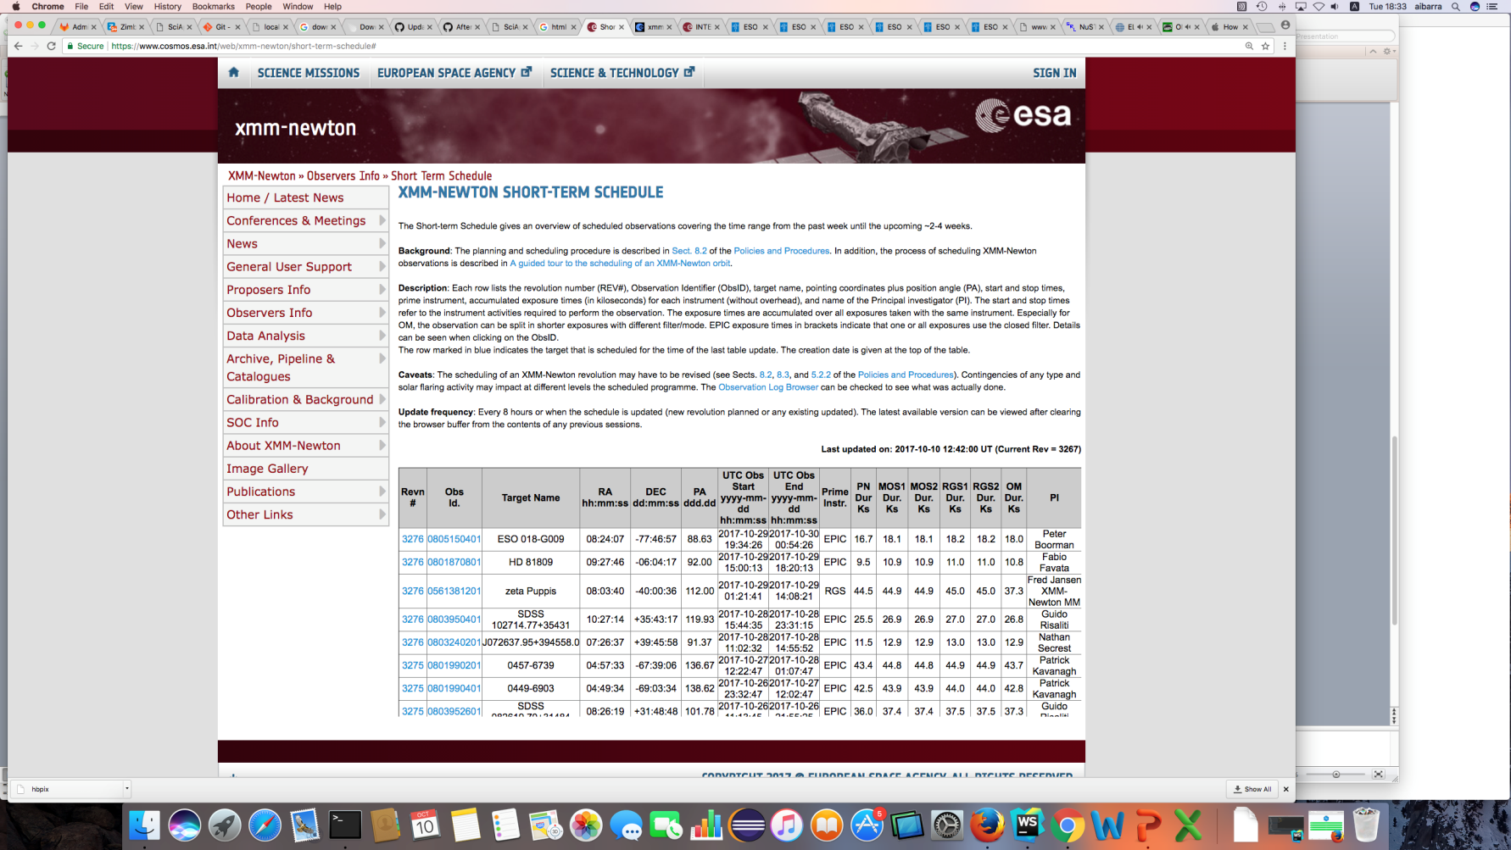
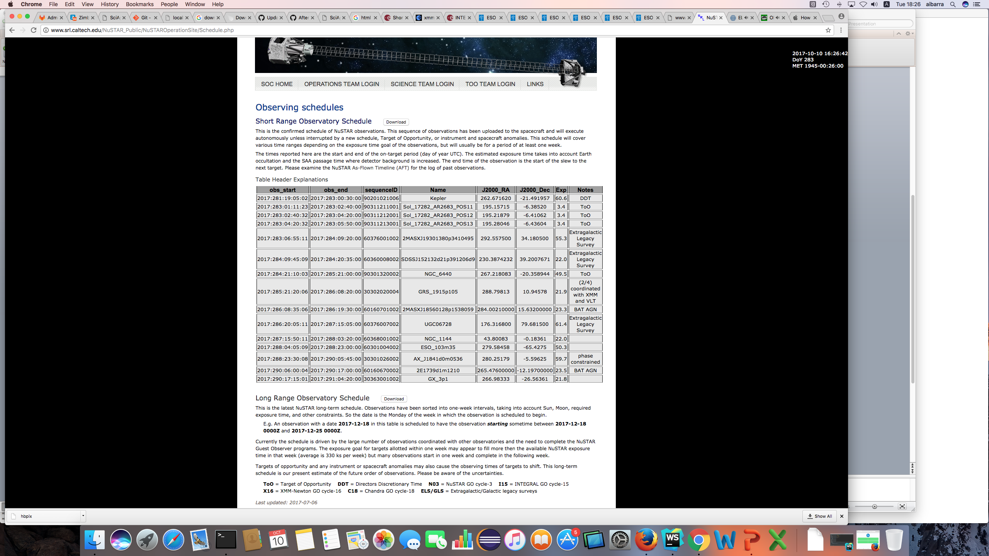
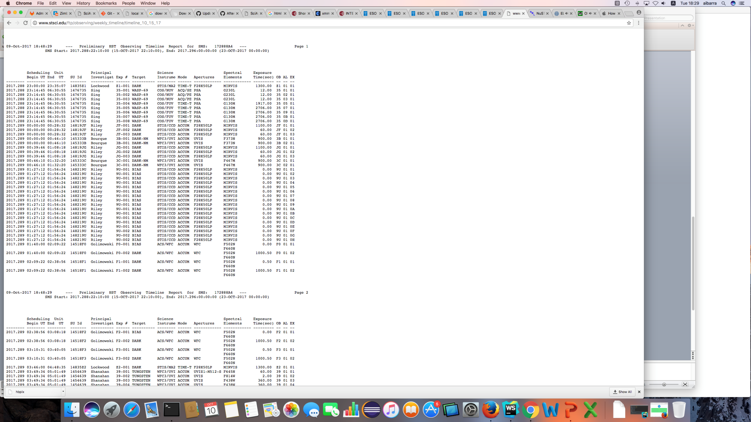
Planned Observations Services

Slide 6
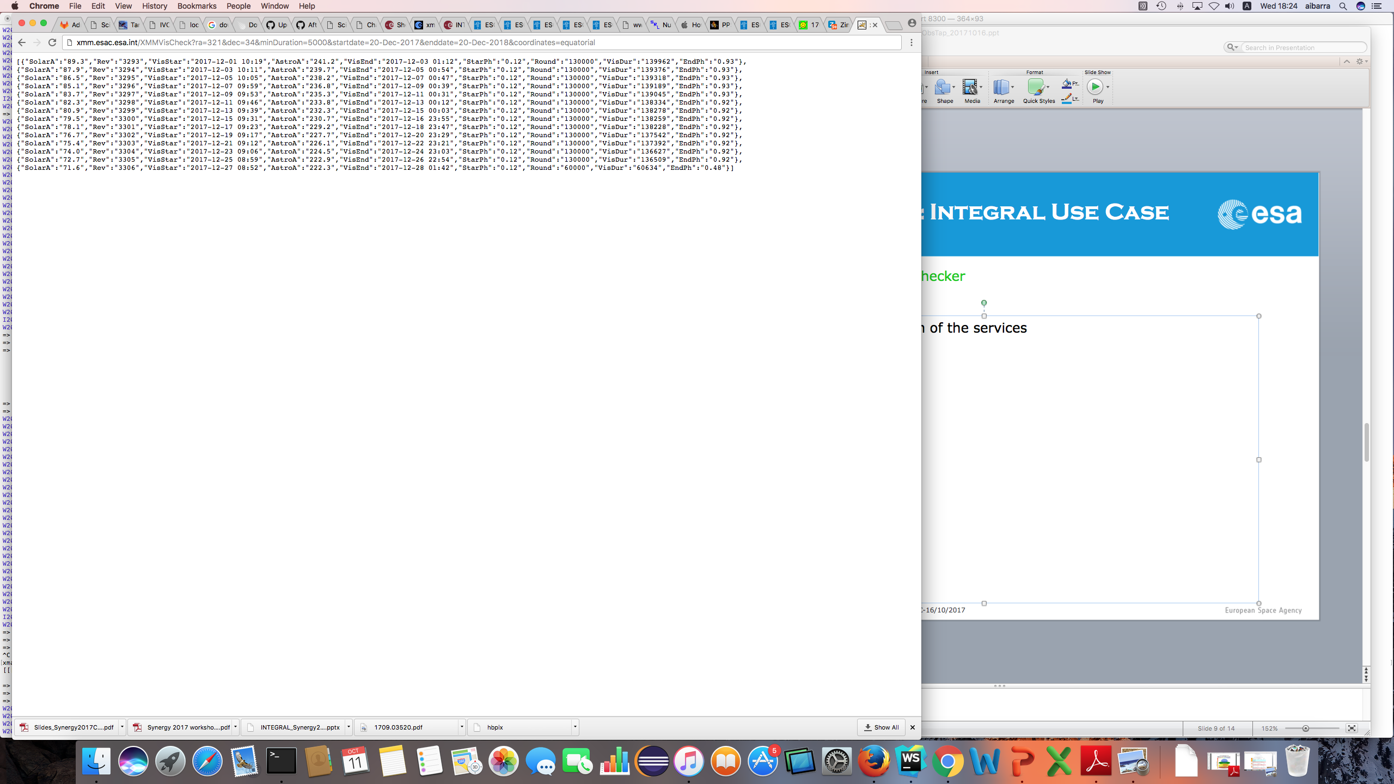
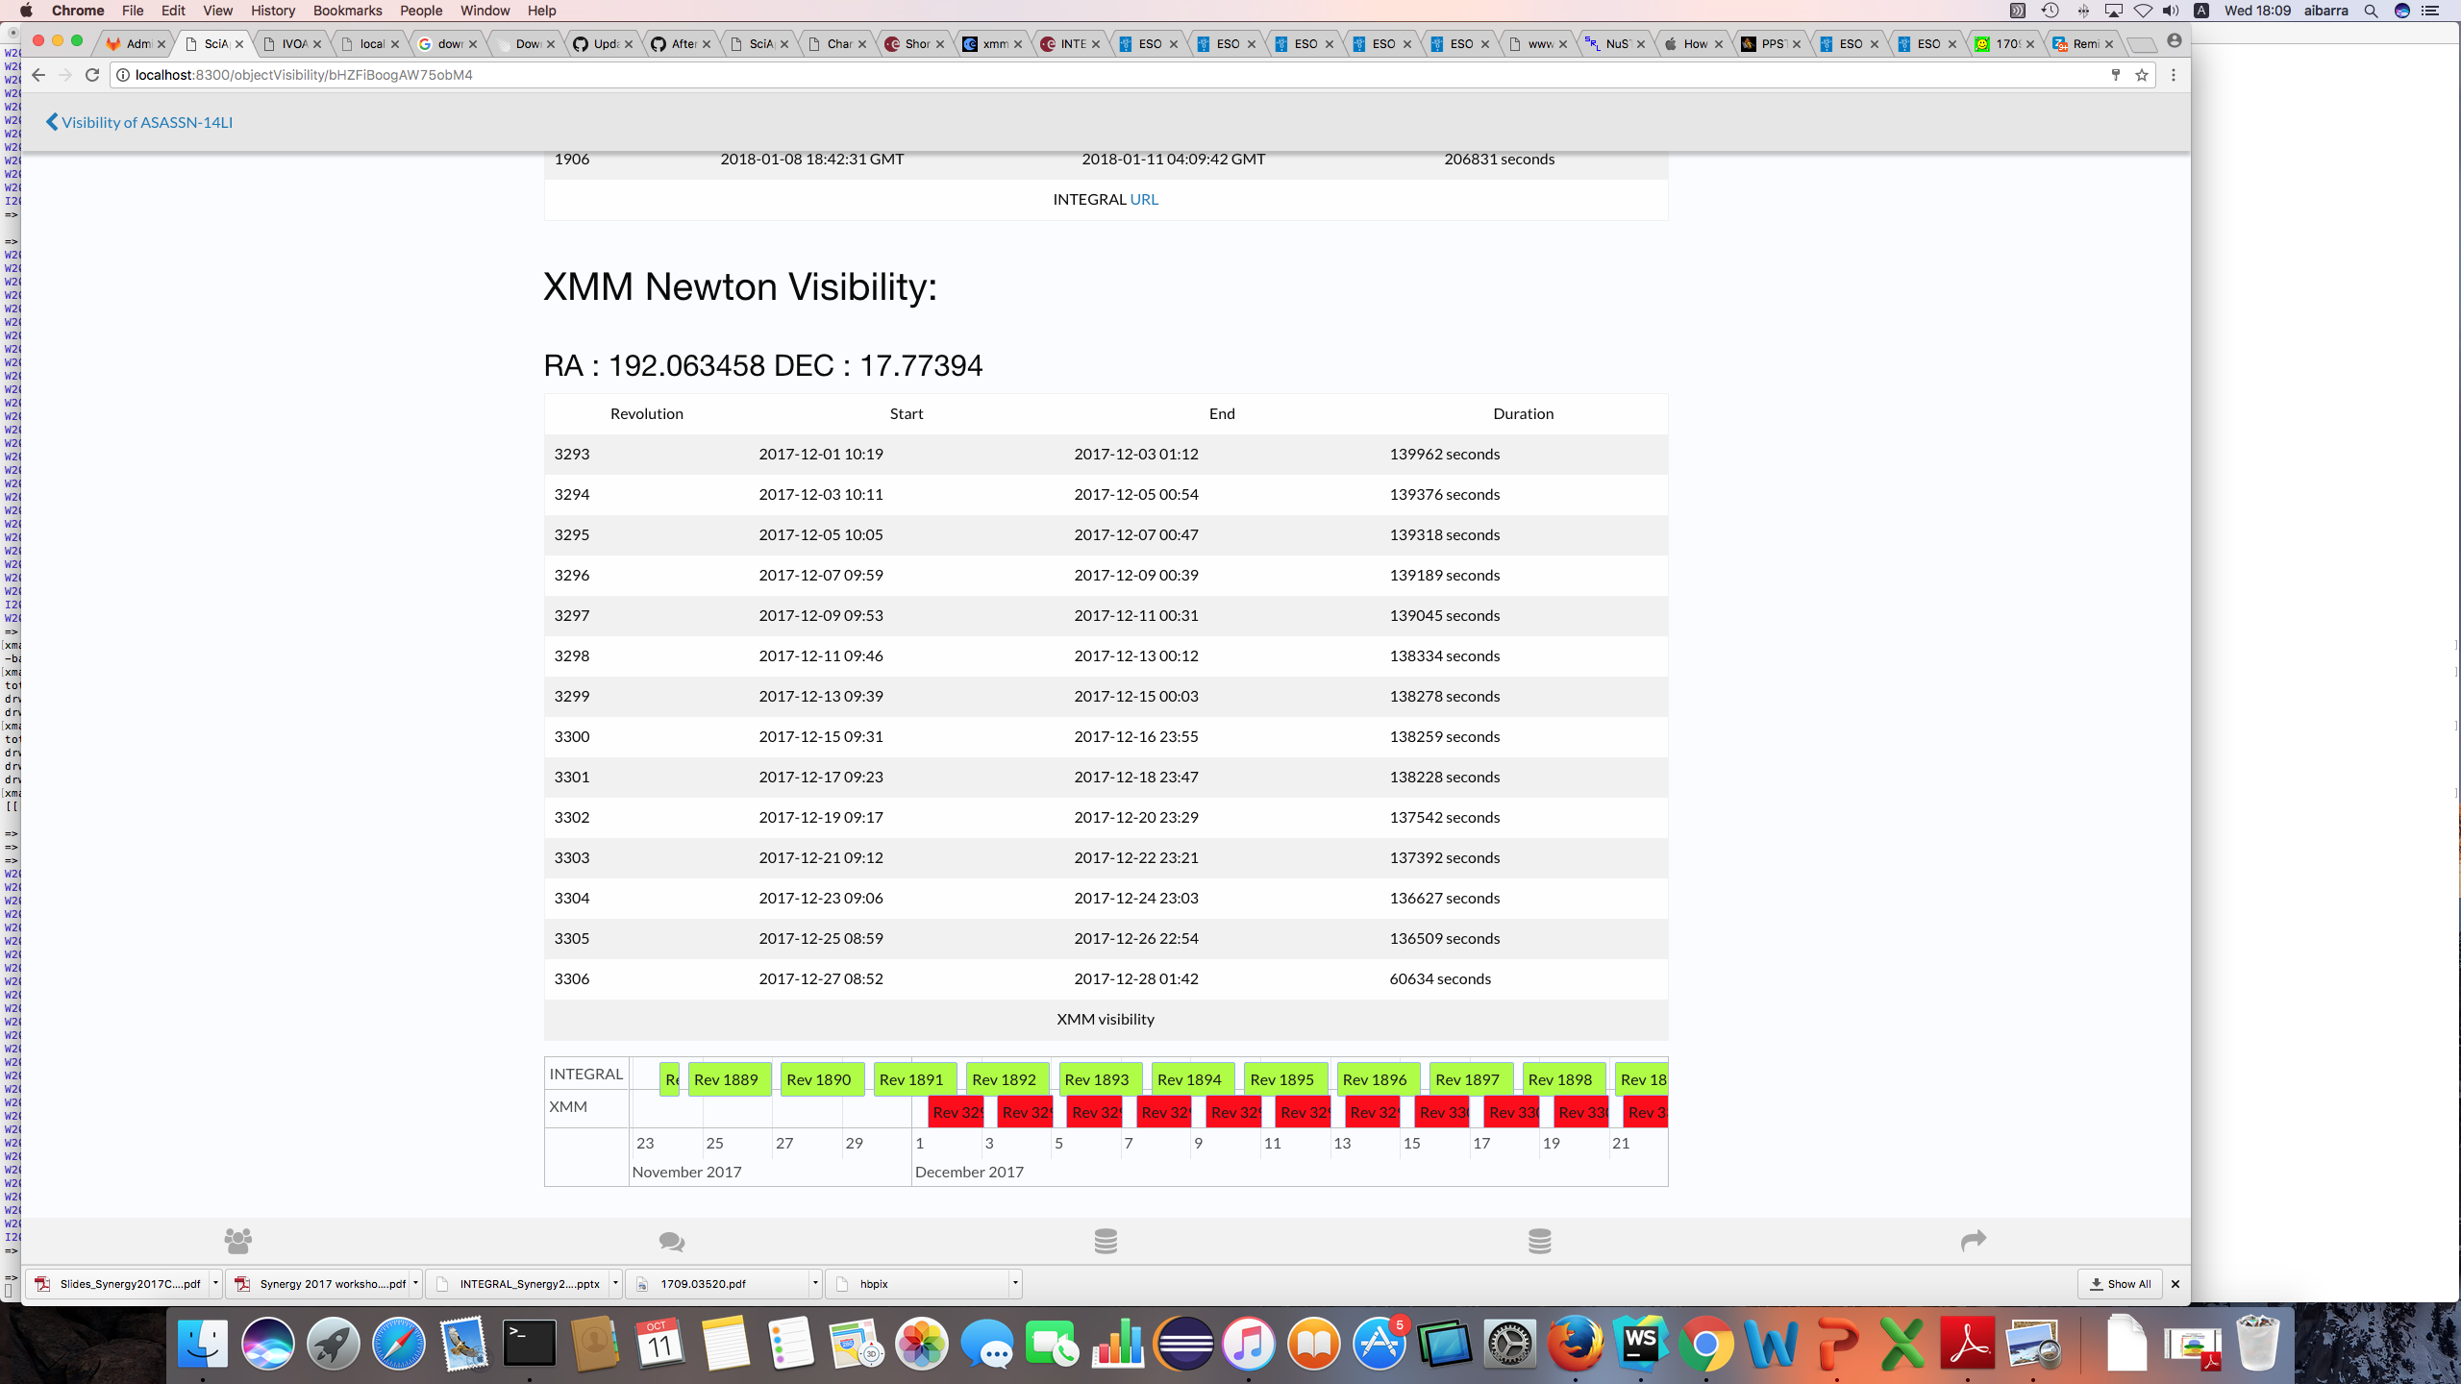
Use Case: XMM-Newton – Integral
XMM-Newton
http://xmm.esac.esa.int/XMMVisCheck?
startDate=11-10-2017&
minduration=12.000&
coordinates=equatorial&
ra=192.063458&
dec=17.77394
INTEGRAL
http://integral.esac.esa.int//IntegralVisCheck?
startDate=11-10-2017&
minduration=12.000&
coordinates=equatorial&
ra=192.063458&
dec=17.77394

Slide 7
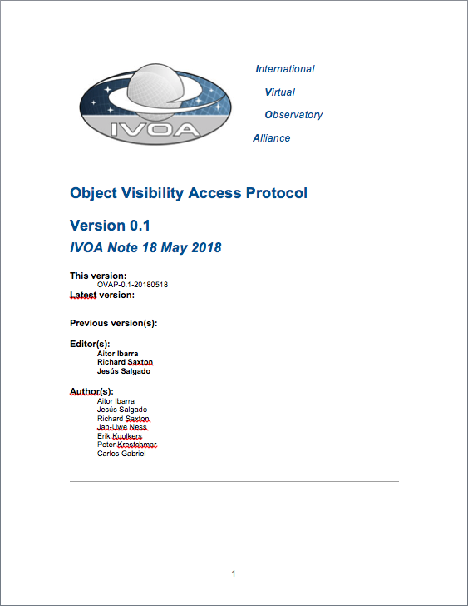
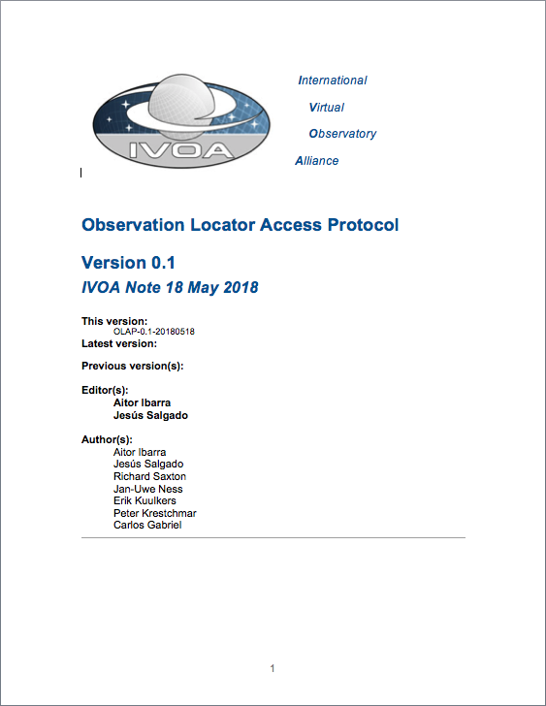
Two protocols
OVAP IVOA Note
SOVAP (?)
OLAP IVOA Note
PlanObsTAP (?)

Slide 8
Object Visibility Access Protocol
Simple Access Protocol
Easy to implement for the different observatories
Already available in a non-standard way in many cases
Based on “parameter=value” approach
VOTable response
Analyzed to be done as a TAP protocol but it was not so easy to implement

Slide 9
OVAP protocol: Input parameters
Compulsory:
RA: Right Ascension - Equatorial J2000
DEC: Declination – Equatorial J2000
START_TIME: Time period start time - UTC Time (IVOA format) or MJD
END_TIME: Time period end time - UTC Time (IVOA format) or MJD
Optional:
MIN_VIS: Minimum visibility check - Double between 0-1 (min/max)
MAX_VIS: Maximum visibility check - Double between 0-1 (min/max)

Slide 10
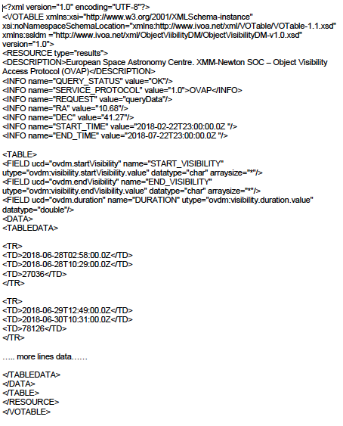
OVAP protocol: Output
Visibility period start:
UTC Time (IVOA format) or MJD (utype=”ovdm:Visibility.startVisibility.value”)
Visibility period end:
UTC Time (IVOA format) or MJD (utype=”ovdm:Visibility.endVisibility.value”)
Visibility period duration:
seconds (utype=”ovdm:Visibility.duration.value”)

Slide 11
OLAP – Observation Locator Access Protocol
Retrieve information of planned observations
Protocol based on TAP
Allow the discovery of planned observations
Based on discovery of planned observation periods (not in data discovery)
Non-applicable ObsDataSet elements have been removed as there is not data associated yet
Some new fields added to support planning and to make the distinction between performed and scheduled
Some metadata is private for some observatories but it is important to reserve these time blocks into the schedule
Compulsory metadata should be, only, the start and end times (in this case of the scheduled time)

Slide 12
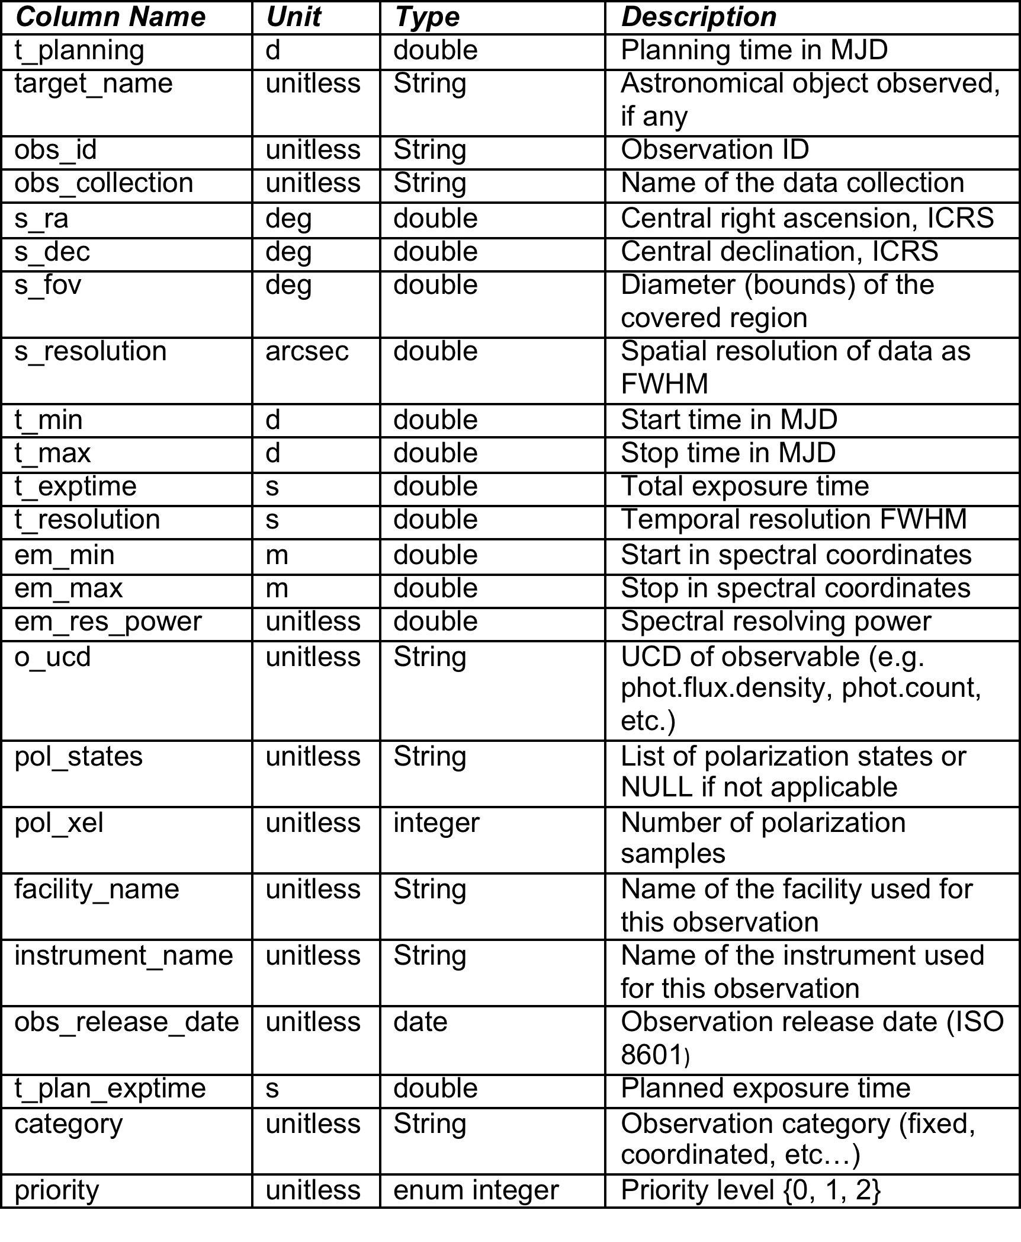
Observation Locator Data Model

Slide 13
Data Model new elements
t_planning time when the plan has been generated (to support more optimal queries to the system)
obs_release_date Time when this observation has entered into the plan
t_plan_exptime Planned time and executed time can be different due to different reasons (e.g. problems with the observation or instrumental configuration overheads)
Category Values are “fixed” or “coordinated” (can be reused from other IVOA DMs?)
Priority Value are 0, 1, 2. It helps to understand the priority of the planned observation providing also the possible chance of changing

Slide 14
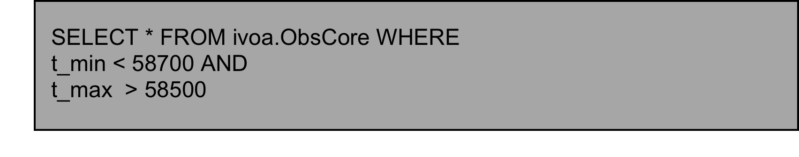
OLAP Use Case I
Discovery of observations planned for a certain observatory
The observatory receives observatory proposals by the scientists
Proposals are ranked
Proposals are inserted into the observation planning system
Observation planners schedule short-medium plan trying to maximize the relevance of a certain observation period (e.g. per night or orbit revolution) and taking into account the constrains of the observatory (e.g. visibility of the object, geometrical constrains like the Sun or the Earth for space based observatories, etc)
In case of unexpected events like, e.g. targets of opportunity, scheduled plan could be replaced by another one modifying the short or medium plans.

Slide 15
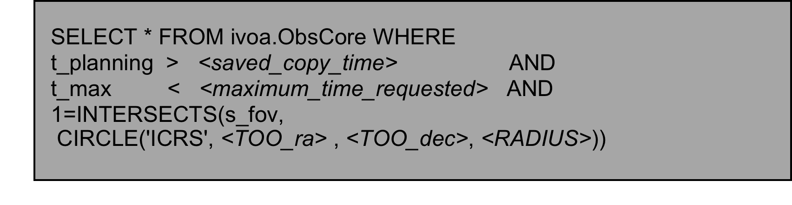
OLAP Use Case II
Follow-up of Target of Opportunities
Two types of ToOs in astronomy:
  Unpredictable ToOs: Astronomical events that require immediate or almost immediate observations and that, generally, require also coordination between different observatories.
  Predictable ToOs: These astronomical events are related (not always) to known transient phenomena or due to coordinated observations of targets special interest.
For the first type, short-term plan can be affected in a very short time scale as per triggering of follow-up observations of a certain astronomical event.

Slide 16
Looking for partners
ESA groups already involved
  XMM-Newton Science Operations Centre
  INTEGRAL Science Operations Centre
  ESDC – ESAC Science Data Centre
Teams Contacted
  NuStar (Caltech)
  CfA (Chandra)
  ESO
  Astron (ASTERICS)
Plan to create a multi-project prototype as a reference implementation
(XMM-Newton, INTEGRAL, others (?))

Slide 17
Summary
Two technical notes in process
  Visibility protocol
  Planned observation access
Interest from observatories on this kind of services
Some relevant use cases already identified
Not existing standards for this.
  IVOA will help on that
XMM-SOC members in contact with other institutions to produce prototypes
Working prototype for next ADASS/Interop

Slide 18
Thanks!

