Slide 1
Questions on how to publish mock data in the VO
Vandana Desai
Caltech/IPAC-IRSA
09 May 2023

Slide 2
Simulations are an integral part of the cosmological survey infrastructure
Stress-testing data analysis pipelines
Mocks provide invaluable proving grounds for modern cosmological data processing pipelines
A common synthetic data set creates an opportunity for survey-wide collaboration
Validating analysis robustness
Synthetic data provide “truth table” to validate a complex analysis pipeline
Especially powerful when mock data are tailored to intentionally violate analysis assumptions in a physically realistic way
Pipeline and algorithm development
Estimation of the magnitude of systematic errors
Tests of schemes to marginalize over residual uncertainty
Exploring cross-survey cross-correlation science
Next-generation cosmological data characterized by overlapping multi-λ surveys
Qualitatively new in character: new analysis tools sorely needed!
Realistically complex multi-λ synthetic data essential to develop tools for new era of cosmology
Euclid, Roman, and Rubin share many common needs!

Slide 3
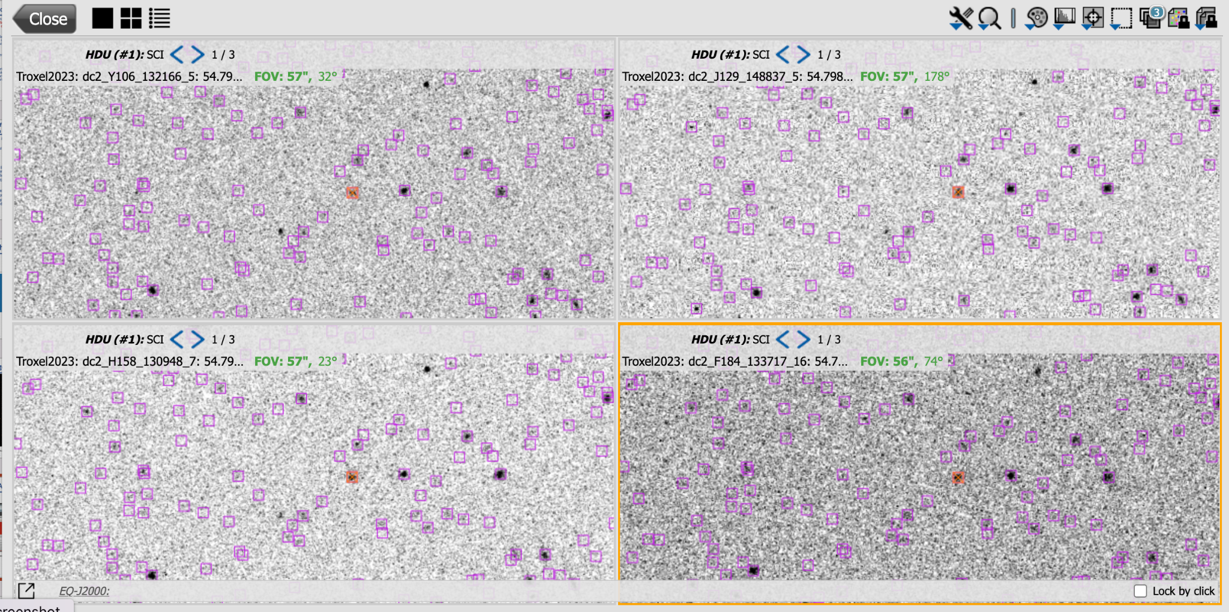
Simulated Images
Roman and Rubin synthetic images across 20 sq deg observing the DC2 universe
Troxel et al. (2023)
NASA Press release
The Roman synthetic images, representing the full depth of the High-Latitude Imaging Survey, are publicly available at IRSA
User-friendly web UI for search and visualization
Program-friendly VO API
https://irsa.ipac.caltech.edu/data/theory/Roman/Troxel2023/overview.
Above: IRSA Visualization of 4 simulated Roman bands
Left: Lensing visualization from NASA Press Release

Slide 4
Simulated Images in CAOM?
Observation.algorithm.name = "simulation" [Pat Dowler]
to distinguish from "exposure".
most TAP queries wouldn’t use this as a constraint
Extension with new ObservationIntentType & ProductType [Brian McLean]
Facilitates exclusion by “normal” queries
Still discoverable with TAP
Separate CAOM Tables [Brian McLean]
No mistaking simulated data with real data
facility_name = Roman & instrument_name = WFI-simulated [Gregory Dubois-Felsmann]
SIAv2 doesn't support "LIKE Roman%”
targetPosition.coordsys = "SICRS” & targetPosition.equinox = "S2000” [Justin Howell]
No mistaking simulated data with real data
What is the best practice?

