Slide 1
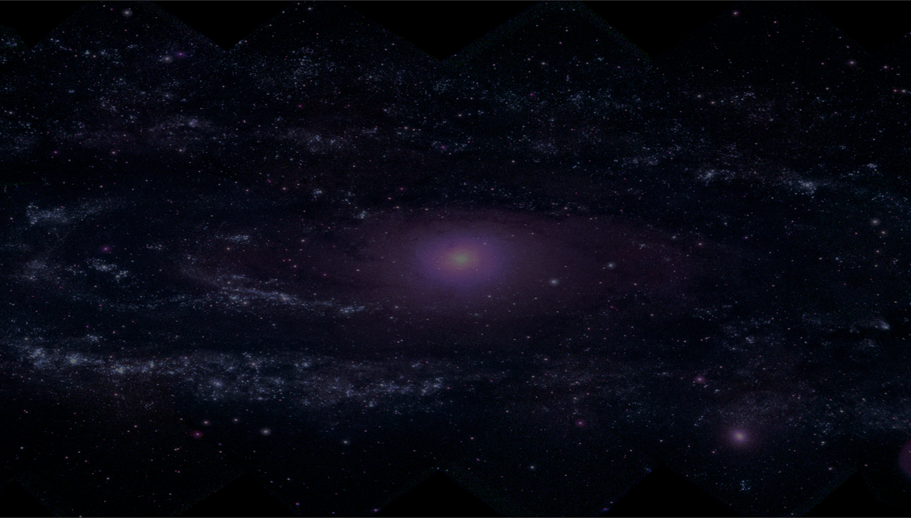
NEO services @SSDC
Angelo Zinzi
angelo.zinzi@asi.it
Marco Giardino (ASI), Alessio Giunta (ASI), Ettore Perozzi (ASI), Ilaria Di Pietro (ASI) Martina Vicinanza (INAF, SSDC), Gianluca Polenta (ASI), Elisabetta Dotto (INAF)
and the NEOROCKS team
May 2023 IVOA Interop Meeting
Solar System Interest Group Session

Slide 2
Horizon 2020
Grant Agreement No 870403
NEOROCKS will address the challenge of improving our knowledge on the physical characterization of the Near Earth Objects (NEOs) population
and of the implications for their origin and evolution as well as for planetary defense
E. Dotto, M. Banaszkiewicz, S. Banchi, M.A. Barucci, F. Bernardi, M. Birlan, B. Carry, A. Cellino, J. De Leon, M. Lazzarin, E. Mazzotta Epifani, A. Mediavilla, J. Nomen Torres, D. Perna, E. Perozzi, P. Pravec, C. Snodgrass,
C. Teodorescu, S. Anghel, N. Ariani, A. Bertolucci, F. Calderini, F. Colas, A. Del Vigna, A. Dell’Oro, A. Di Cecco, L. Dimare, P. Fatka, S. Fornasier, E. Frattin, P. Frosini, M. Fulchignoni, R. Gabryszewski, M. Giardino, A. Giunta,
T. Hromakina, J. Huntingford, S. Ieva, J.P. Kotlarz, F. La Forgia, J. Licandro, H. Medeiros, F. Merlin, F. Pinna, G. Polenta, M. Popescu, A. Rozek, P. Scheirich, A. Sergeyev, A. Sonka, G.B. Valsecchi, P. Wajer, A. Zinzi.
IVOA Interop meeting 2023– Solar System IG

Slide 3
NEOROCKS: data management
Only 20% of the known NEO population has been characterized
Direct link between orbital and physical characterization
Physical characterization requires availability of large aperture telescopes
Continuously analyzing the detections
For each object identified, the astrometric follow-up and the associated orbit improvements are activated
Long-term archiving, maintenance and evolution of the corresponding data products
Ground-based and space-based data to be made available through a centralized access
IVOA Interop meeting 2023– Solar System IG

Slide 4
EpnCore derivation
Mandatory params
target_name
Optional params
alternative_target_name
External serv. params
Additional params
Thematic ext. params
semi_major_axis (Solar System Obj)
north_pole_position (APIS)
target_class
….
file_name
…
id_mpc (DynastVO)
observer_lat (PVOL)
beam_linear_polarization (LOFAR_ Jupiter)
primary_body
perihelion
…
31
EpnCore
6
20
8
27
IVOA Interop meeting 2023– Solar System IG
Notes:
The partitioning among EpnCore, external services and unmapped parameters is here shown. Many parameters were matched by using also the thematic extension of APIS and Solar System Obj. Among unmapped parameters, there is the polarization group, while several other pars are derived from other pars.

Slide 5
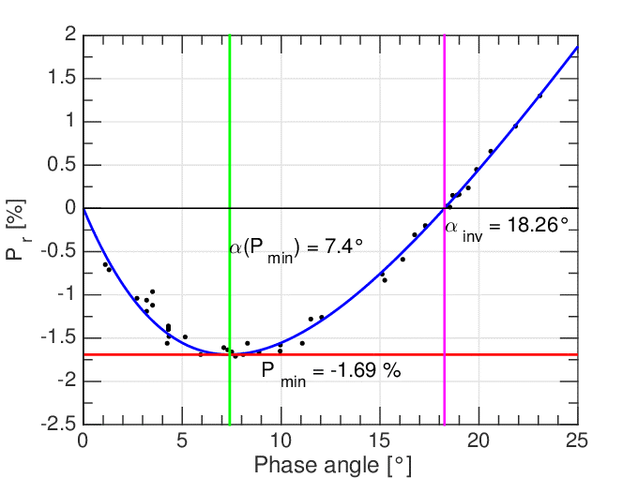
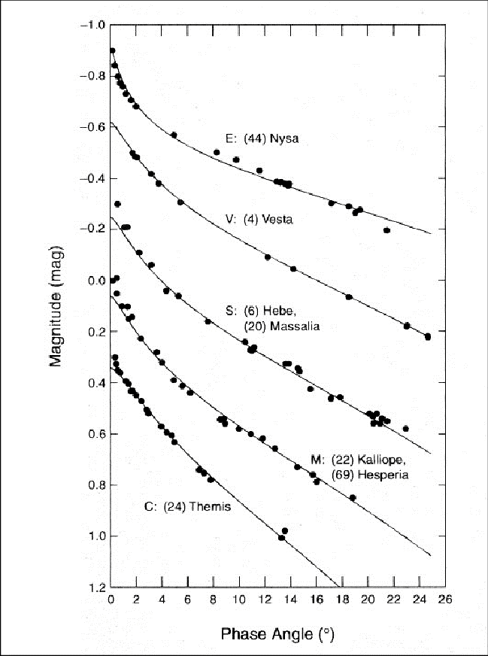
Open Questions – New data products
Phase curve
dataproduct_type= ts (time_series)?
processing_level= 5 (derived)
Polarization curve
dataproduct_type= ts (time_series)?
processing_level= 5 (derived)
Possible implementation:
Combine UCD into measurement_type
phot.mag#pos.phaseAng (phase curve)
phys.polarization#pos.phase (polarization curve)
Single observation file having two axes
Y:phot.mag, X:pos.phaseAng (phase curve)
Y:phys.polarization, X:pos.phase (polarization curve)
Photometric band can be specified in Y with
phot.mag;em.opt.<possibly filter>
A new dataproduct_type can be evaluated
IVOA Interop meeting 2023– Solar System IG

Slide 6
NEOROCKS (or "My FAIR Planetary Defense")
EARN
NEO
Domain
ESA
NEOCC
Observers
Science
&
Services
Other (NEOSTEL?)
upload
use
analysis
NEOROCKS
Portal
query
use
definition
import
NEOROCKS
ConceptualModel
insert
Data Modelling
NEOROCKS
Physical Properties
DB
VO Services
NEOROCKS
Data Model
query
derivation
EpnCore
development
VO
Tools
IVOA Interop meeting 2023– Solar System IG
Notes:
The general overview of PPDB and its role for the NEOROCKS project is given here. A major role is of course the initial data ingestion from the ESA NEO CC, thanks also to a fruitful collaboration established so far.
Once imported, the accessibility of the physical properties will be enriched by adopting the VO protocols. On the other way, astronomers will collaborate and use the Technical Web Portal to upload observational data and to improve the NEO physical characterization.
The long term preservation will be guaranteed by the Italian space agency involvement through SSDC and its infrastructure.

Slide 7
NEOROCKS future heritage
New datasets
Applications
IVOA Interop meeting 2023– Solar System IG

Slide 8
New datasets
Adding new datasets to the already standardizes NEOROCKS database it would be possible to obtain important physical information (e.g. orbital period, taxonomy) of the detected NEOs in a rapid and efficient way
IVOA Interop meeting 2023– Solar System IG

Slide 9
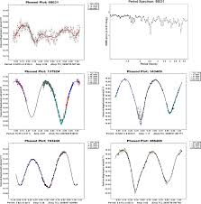
NEOSTEL
The Near Earth Object Survey TELescope (NEOSTEL) is a 1-metre class telescope with a 6.7°x6.7° field of view able to perform a complete scan of the observable sky down to V=21.5 every 2-3 nights in order to detect NEO sized 40 metres and above a few weeks before they impact Earth.
LIGHT CURVES
PHASE CURVES
Shadow Hiding ̴ 1/Albedo α>5°
Coherent Backscatter ̴ Albedo α<5°
[offset for clarity]
Orbital Period
Binary System Identification
Taxonomy Classification
Surface Features
IVOA Interop meeting 2023– Solar System IG

Slide 10
Applications
The FAIR-based NEOROCKS database, eventually enlarged with new datasets, would be ready for some useful and innovative applications
IVOA Interop meeting 2023– Solar System IG

Slide 11
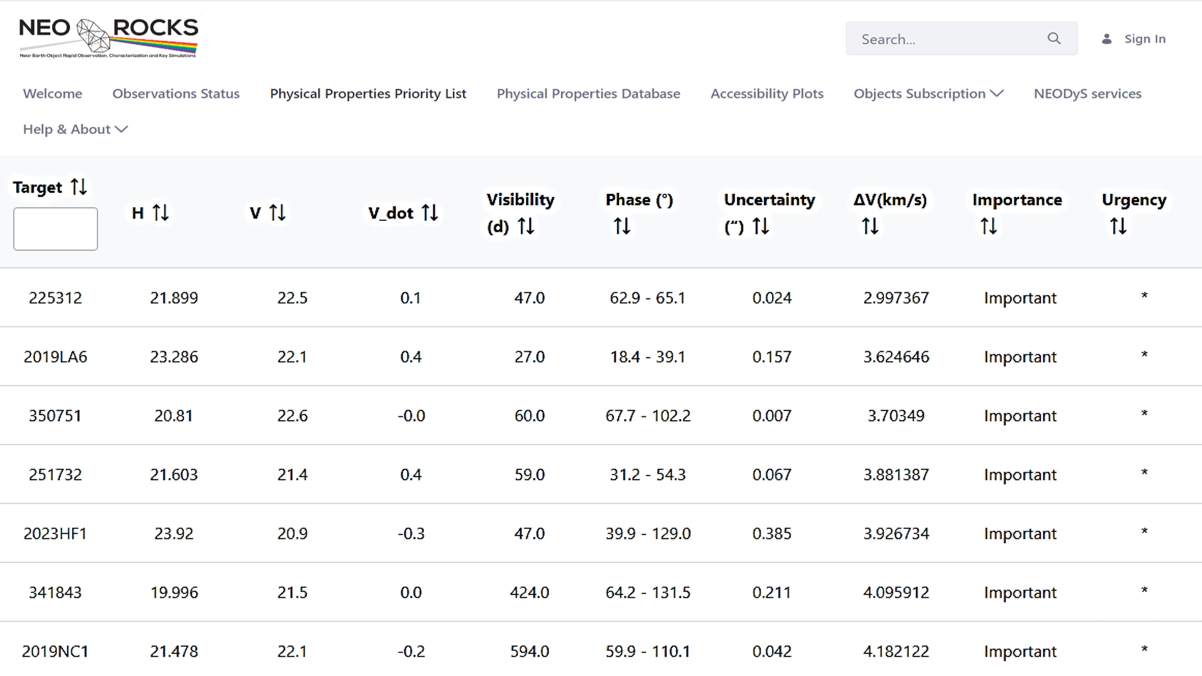
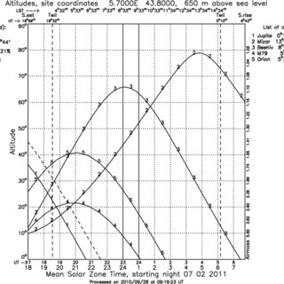
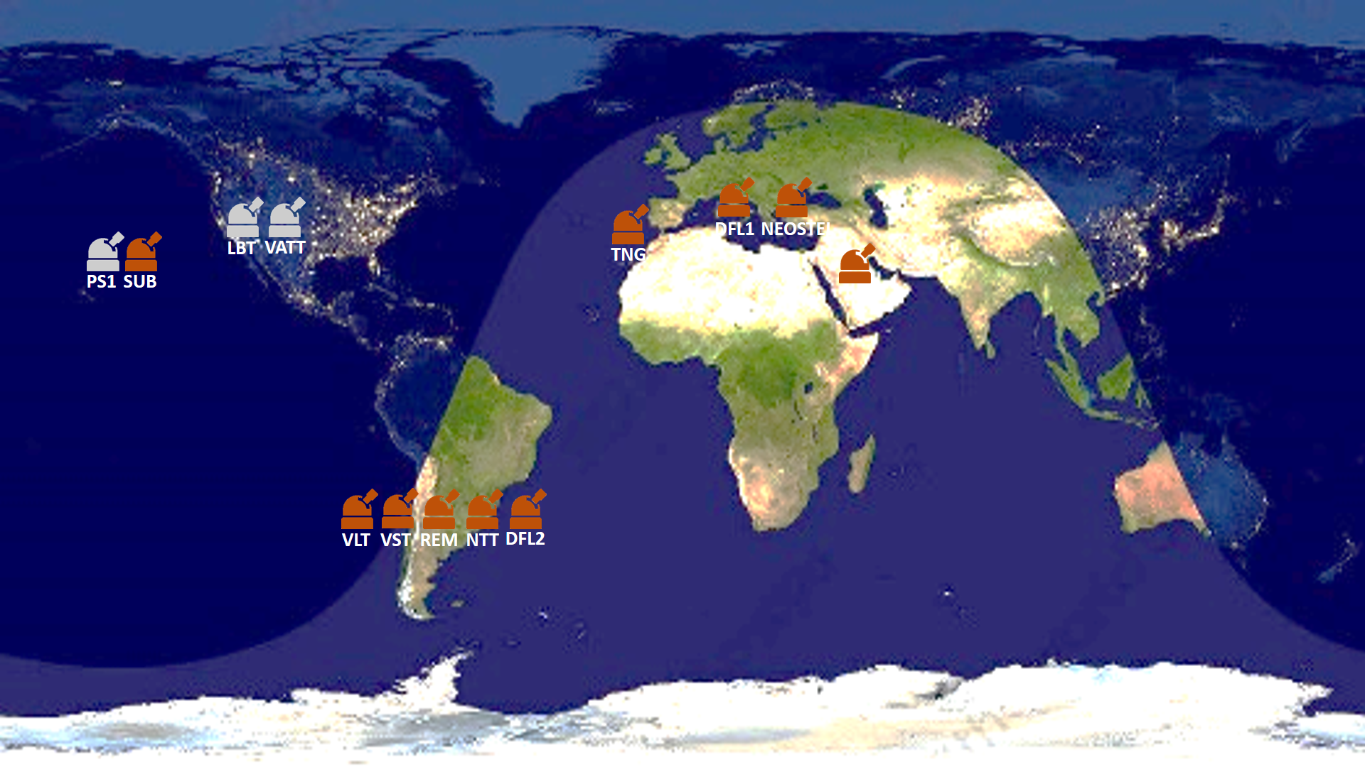
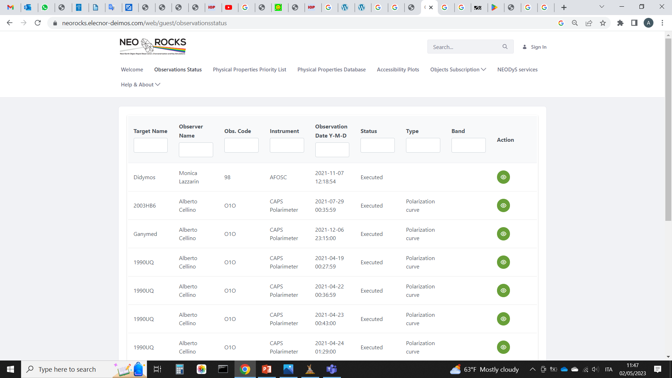
Observation planner
Priority List
(taking into account data already present in the db)
Visibility Plot
Telescope Status
Observation Planner
IVOA Interop meeting 2023– Solar System IG

Slide 12
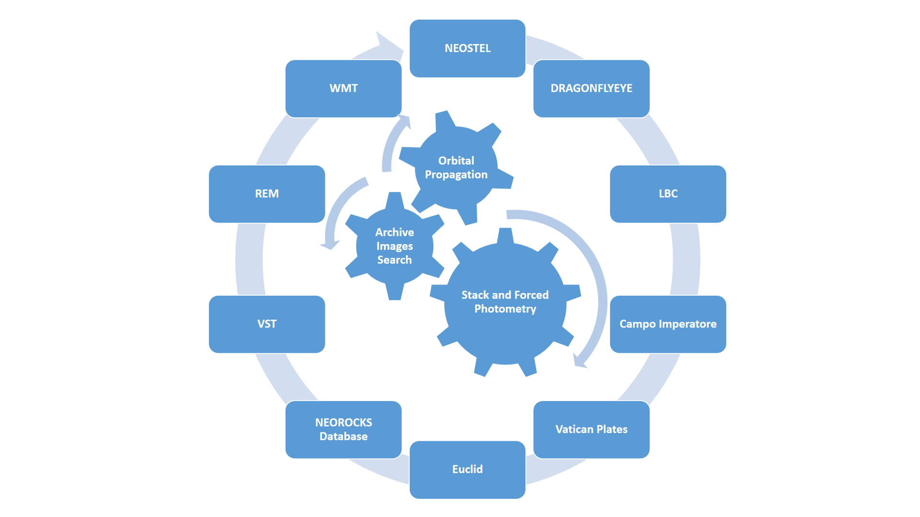
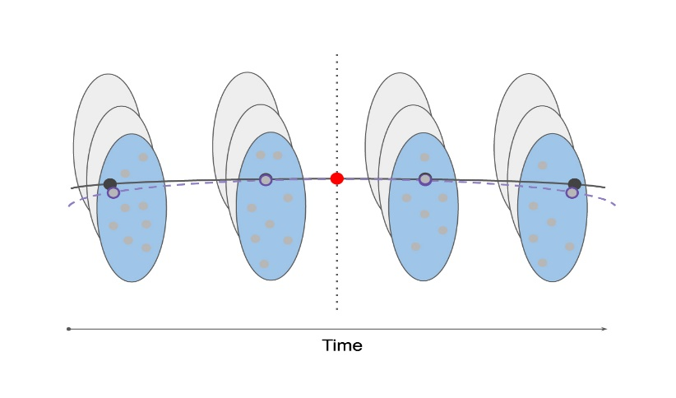
Precovery
Precovery is the process of searching for observations in images taken before the object was discovered
It’s useful for extending the observational arc of discovered objects by improving their orbit as well as providing important physical information
A method for precovery is to propagate the orbit to all times, check the position against all available observations and perform a forced photometry to find the object and define its coordinates
IVOA Interop meeting 2023– Solar System IG

Slide 13
Other NEO projects
IVOA Interop meeting 2023– Solar System IG

Slide 14
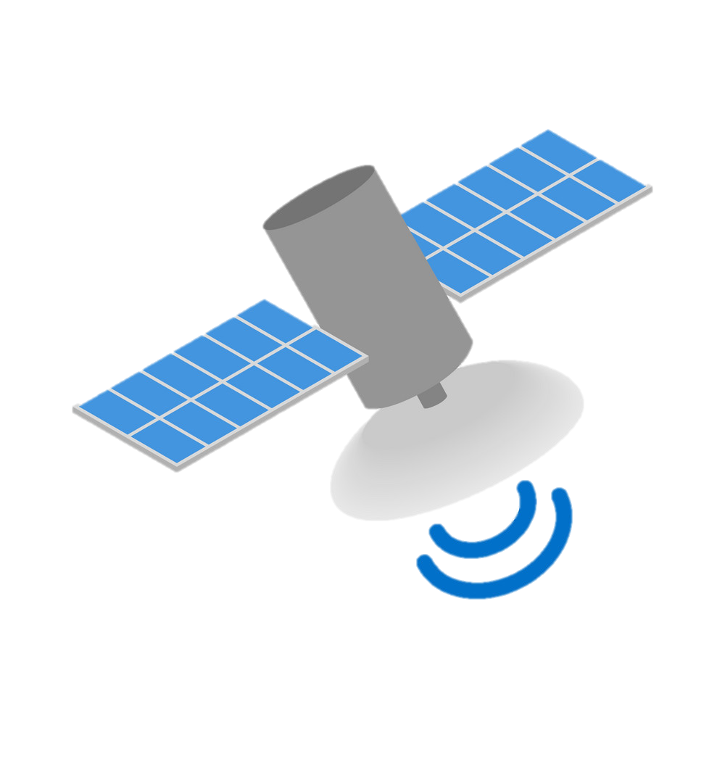
LICIACube
LICIACube
Team
Mission Control Center
(Argotec)
Scientific Operations Center
(ASI-SSDC)
Public
DSN
SSDC is responsible for the Scientific Operations Center (SOC) and for all that regards data formatting, processing and dissemination
IVOA Interop meeting 2023– Solar System IG

Slide 15
The archive has been designed and built as PDS4 compliant and we are willing to collaborate with the DM WG for PDS
IVOA Interop meeting 2023– Solar System IG

Slide 16
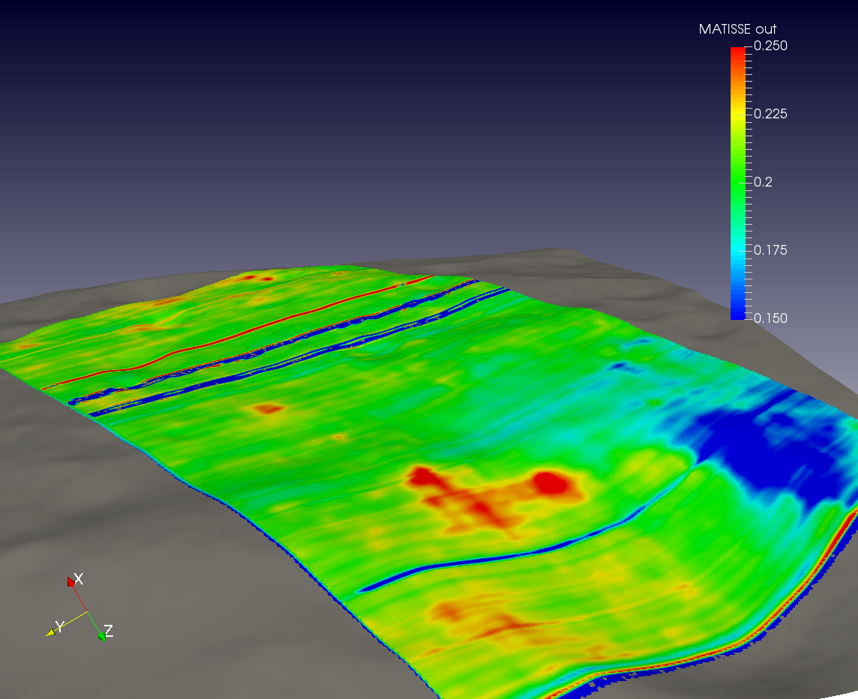
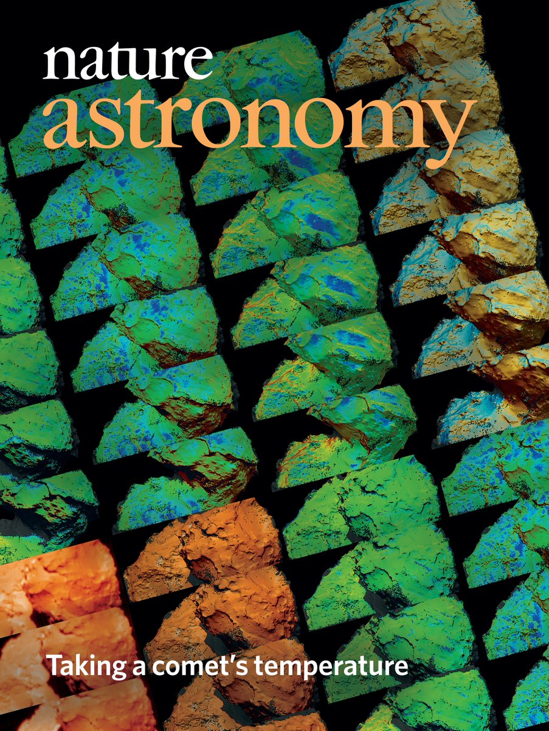
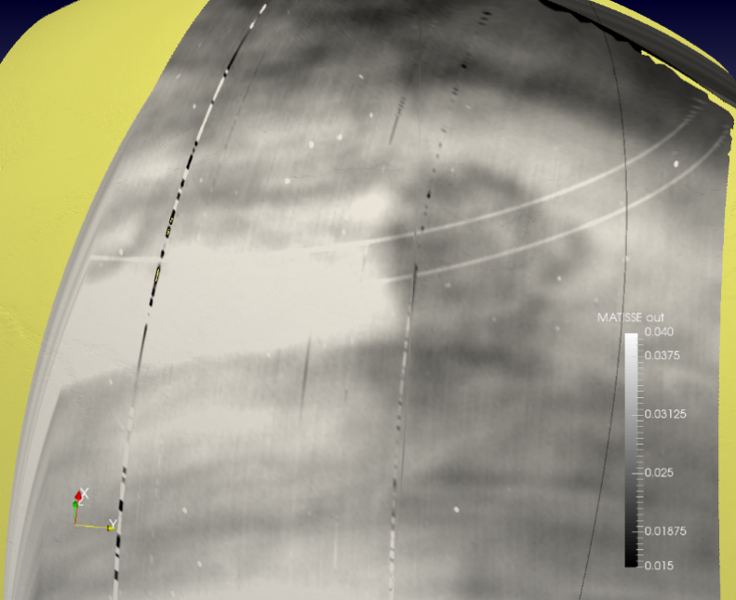
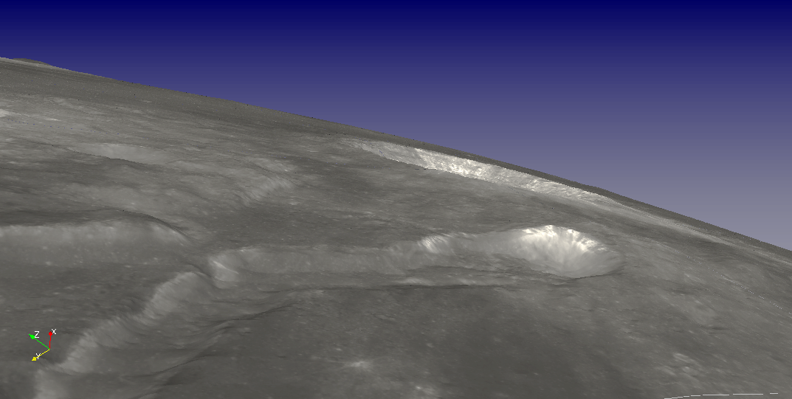
MATISSE
Vesta, Ceres
Since its first version in 2013 the tool has grown, improving its scientific capabilities and including new targets, missions and instruments
CRISM & MARSIS Mars, VIRTIS Venus, MDIS Mercury called by external services
(EPN-TAP, PlanetServer, NASA ODE REST)
Moon
July 2019 Nature Astronomy cover!
Venus
IVOA Interop meeting 2023– Solar System IG

Slide 17
Thank you
angelo.zinzi@asi.it

