Slide 1
Recent planetary activity at CDS: Mars MRO CTX HiPS, Aladin Lite planets explorer, planetary features name resolver service,
Sesame extension for solar system objects
Thomas Boch (CDS),
CDS team IVOA Bologna 2023 - SSIG

Slide 2
Mars MRO CTX HiPS
MRO CTX images
« The Context Camera, called CTX, provides a big-picture, background view of the terrain around smaller rock and mineral targets that are studied by other cameras on the Mars Reconnaissance Orbiter »
5 meters/pixel resolution
Mosaics from Murray Lab (V00)
3960 4°x4° tiles
HiPS generation process
Conversion from TIFF to FITS
Adding WCS headers
Hipsgen
HiPS generated (order 11) and published - 16 TB
Better V01 mosaics available from Murray Lab, will update HiPS in the future
Standard: how to properly describe Mars frame
Credit: Murray Lab
IVOA 2023 Bologna - SSIG

Slide 3
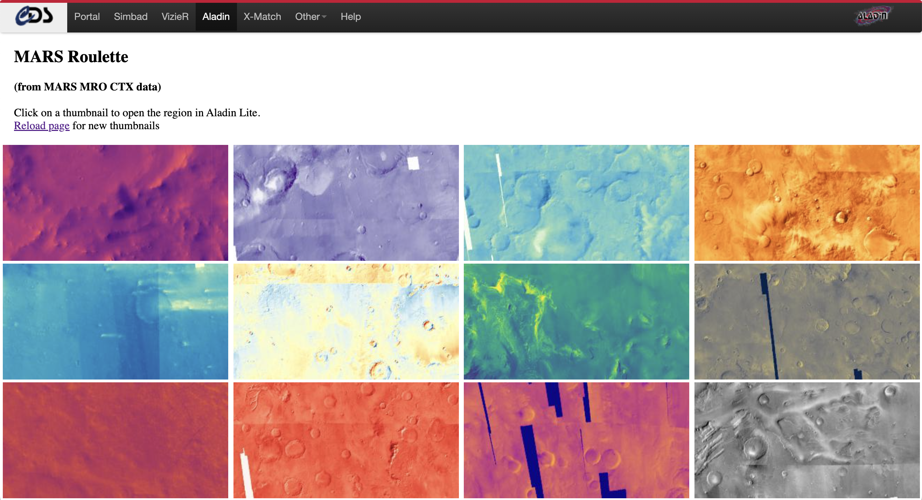
Mars roulette
https://aladin.cds.unistra.fr/AladinLite/showcase/mars-roulette/
IVOA 2023 Bologna - SSIG

Slide 4
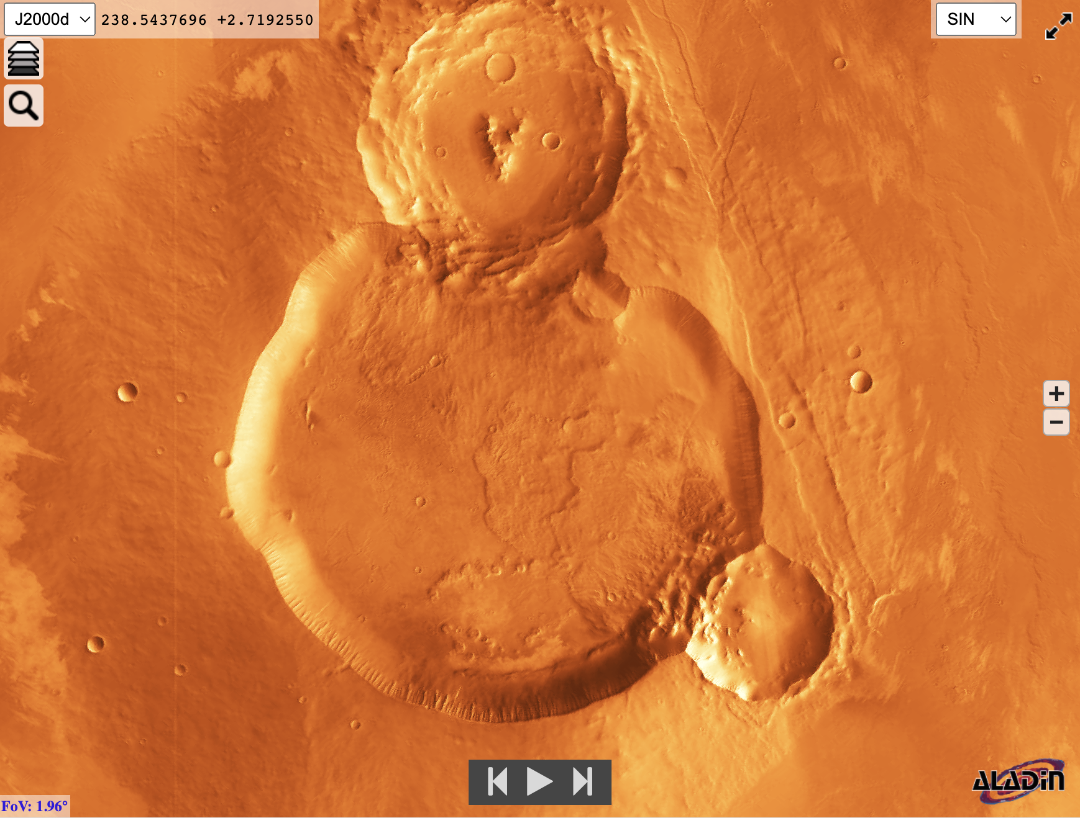
Animation "favorite Mars locations"
https://aladin.cds.unistra.fr/AladinLite/showcase/mars-favorite-locations/
IVOA 2023 Bologna - SSIG

Slide 5
Mirroring China-VO Chang'e2 HiPS
Chang'e2
chinese lunar probe launched in 2010
7 meters/pixel resolution
HiPS created by China-VO
HiPS order 9 1.5 TB
Mirrored at CDS
Allow for faster access from Europe
IVOA 2023 Bologna - SSIG

Slide 6
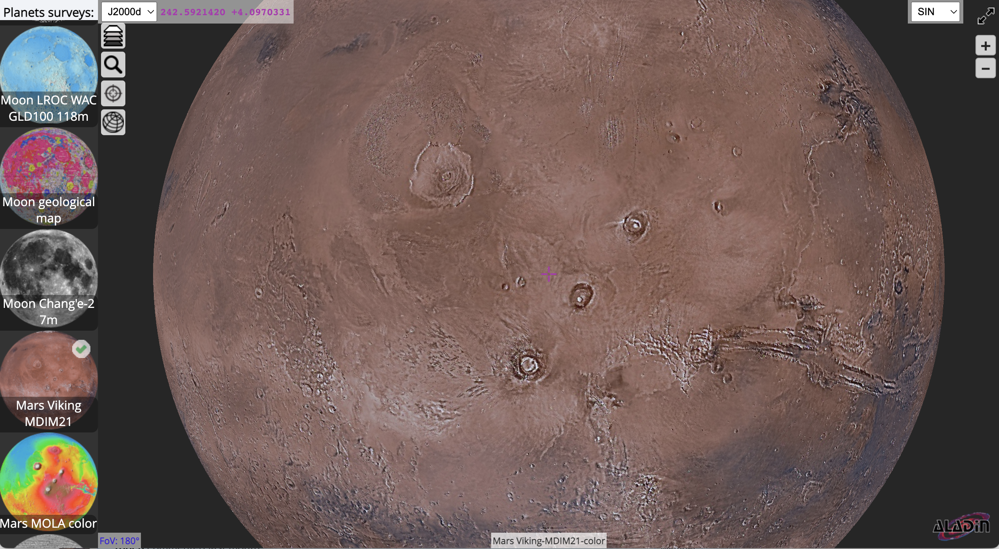
Aladin Lite planets explorer page
Aim: promoting available planetary surfaces HiPS datasets
Curated list of planetary surfaces HiPS
https://aladin.cds.unistra.fr/AladinLite/planets-explorer/
IVOA 2023 Bologna - SSIG

Slide 7
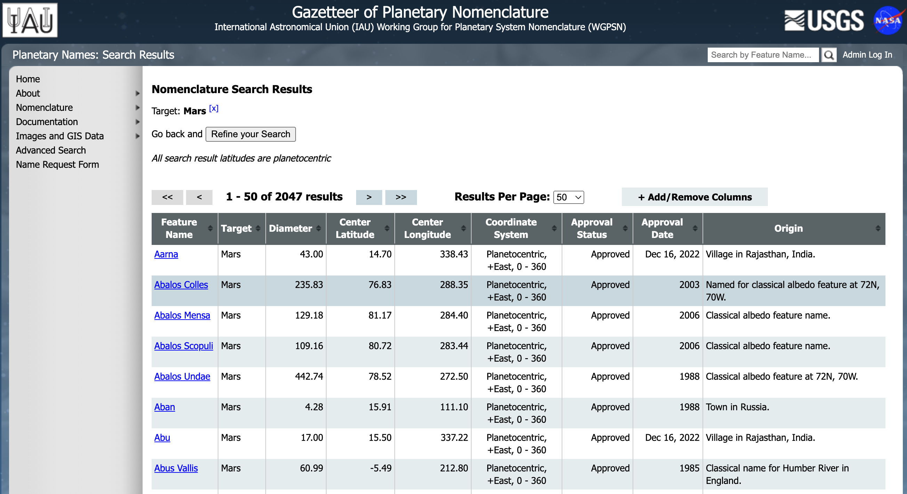
Name resolver for planetary features
USGS planetary features page
List of IAU-approved names for solar system planetary features
46 different bodies (planets, asteroids, satellites)
16k features, 18 columns
No existing usable API (to my knowledge)
IVOA 2023 Bologna - SSIG

Slide 8
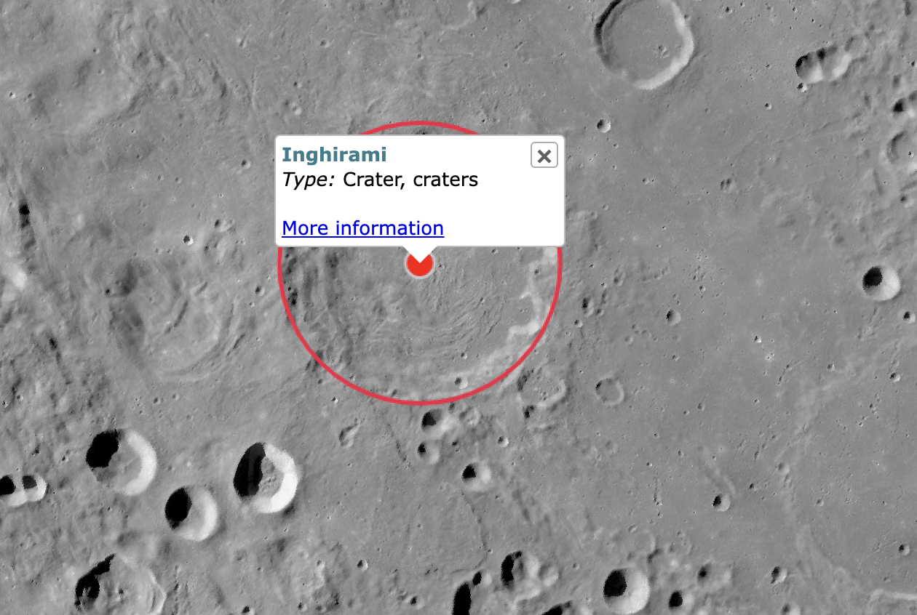
Dedicated service
2 endpoints
"Cone search"
LON, LAT, Search Radius
https://alasky.cds.unistra.fr/planetary-features/cs?
Name resolver
Feature name, body
https://alasky.cds.unistra.fr/planetary-features/resolve?
Powered by Falcon Python application
Used by Aladin Lite v3
demo
Standard: add keyword to HiPS properties in order to describe if longitude is increasing towards East or West?
IVOA 2023 Bologna - SSIG

Slide 9
Sesame extension to solar system objects
Sesame: name resolver gathering results from SIMBAD, VizieR and NED
Input: object name
Output: ICRS coordinates
Experiment by G. Landais (CDS) with help from J.Berthier and J.Normand (IMCCE)
Extension to results from IMCCE for solar system objects
Example: https://cds.unistra.fr/cgi-bin/nph-sesame/SNVI/?Saturn
Query to IMCCE resolver
Result not cacheable
Available in latest Aladin Desktop beta version
IVOA 2023 Bologna - SSIG

