Slide 1
Recent HiPS activities at CDS
Thomas Boch,
Caroline Bot, Pierre Fernique, Matthieu Baumann, Mihaela Buga (CDS), Daniel Durand
and the CDS team IVOA Bologna 2023 - Apps I

Slide 2
Outline
New and updated HiPS datasets
PNG cuts by region
Hipsgen new features
Experiments
WebP compression tests
Services over HiPS cubes
CORS issues for WebGL clients
IVOA 2023 Bologna - Apps1

Slide 3
New and updated HiPS datasets (1/2)
Extended coverage: 2730 deg2 (DR1: 1460 deg2)
5 bands + color HiPS
Planck R3
DECaPS DR2
DESI Legacy Survey
DES DR2
MzLS, DECaLS, BASS
20,000+ deg2 at 0.26arcsec/pixel
3 bands
color and g band HiPS available
Same coverage as DR1
Deeper coadds
5 bands + color HiPS available
IVOA 2023 Bologna - Apps1

Slide 4
New and updated HiPS datasets (2/2)
HST
Covers HST observations until early 2023
Images retrieved from MAST
Astrometric correction
24 HiPS updated (observations grouped by sets of filters)
Links to progenitors
PNG tiles take advantage of cuts by region
Thanks to Daniel Durand for this work!
JWST observations until early 2023
8 HiPS published (filters F115W, F150W, F200W, F210M, F212N, F444W, F480M, OPEN)
In beta while we learn about these data products
Thanks to Daniel Durand
Planetary surfaces HiPS
See talk in SSIG session
HiPS from ESO/HST outreach images
See talk in Edu session
IVOA 2023 Bologna - Apps1

Slide 5
PNG cuts by regions
Global cut on pointed observations is difficult
Cuts by region
Consider disjoint regions of the HiPS coverage (MOC)
For each region
Get a sample of pixels in the region
Compute a sensible cut based on percentiles
Apply this cut to generate PNG tiles
Implemented in latest Hipsgen version
Too bright
Too faint
IVOA 2023 Bologna - Apps1

Slide 6
Global cut vs cuts by region
IVOA 2023 Bologna - Apps1

Slide 7
Hipsgen new features
Hipsgen: CDS tool to generate HiPS
>95% available HiPS produced with Hipsgen
Recent improvements (April 2023)
Code redesign
Non-regression tests
Documentation
User manual in english and french
Updated « Make your HiPS in 10 steps » instructions
New features
Checksum code facilities (basic-fast check method or full DATASUM)
Full FITS RICE support (CFITSIO4.2.0 compatibility)
8 bits cut by region (adapted for pointed surveys - preview mode)
Support for "no XMP" AVM tags (outreach JPEG or PNG images)
FITS trimmed tile support (R&D)
STMOC generation
RGB HiPS with Lupton method
IVOA 2023 Bologna - Apps1

Slide 8
WebP compression tests
WebP: new open format for lossy compressed true-color graphics on the web, producing files that were smaller than JPEG files for comparable image quality (Wikipedia)
Test on DSS2 color HiPS
Total size: 277GB (JPEG) vs 85GB (WebP)
well suited for low-bandwidth situations (smartphones)
Standard update?
minor change to existing document: add webp to the list of allowed values for FORMAT
IVOA 2023 Bologna - Apps1

Slide 9
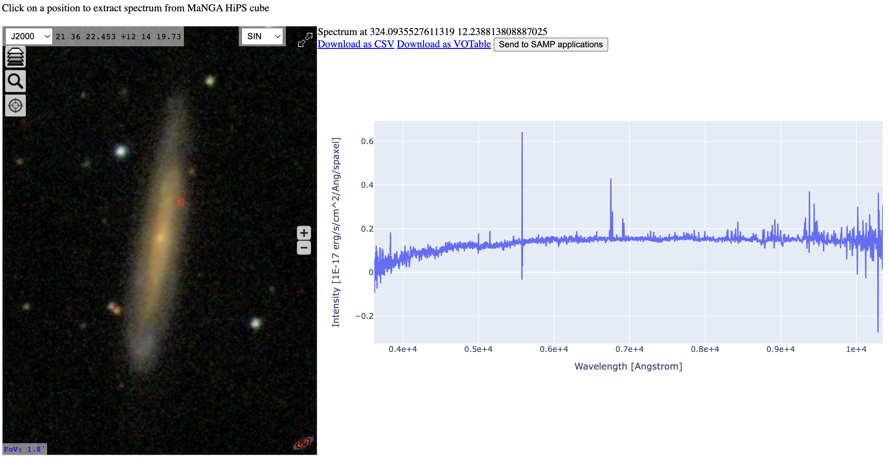
Services over HiPS cubes
Experimental services
Generation of RGB 2D HiPS
Moment maps HiPS generation on the fly
Spectrum extraction
Current format not well suited for operations involving all slices
Too many files to open ==> can be quite slow
Experimenting with « cubic » tiles: each tile is a FITS cube
Reduces number of files to open
Much faster
Pointed observations
HiPS tiles are mostly empty
Wasted disk space
IVOA 2023 Bologna - Apps1

Slide 10
CORS issues
CORS: set of HTTP headers allowing to give permission to give access to selected resources to web clients running from a different origin
WebGL clients (World Wide Telescope, Aladin Lite v3, …)
Need to be able to read HiPS tiles to display them
Must go through a proxy if CORS headers missing
2016 talk in Trieste
https://wiki.ivoa.net/internal/IVOA/InteropOct2016GWS/GWS1-TBoch-CORS.pdf
16/22 HiPS nodes set CORS headers
Not only HiPS related, also relevant to Cone Search, TAP, SIA, SSA, …
Topic for DALI?
IVOA 2023 Bologna - Apps1

