Slide 1
International WorldWide Telescope Guided Tour Contest
Shanshan Li
2021.5

Slide 2
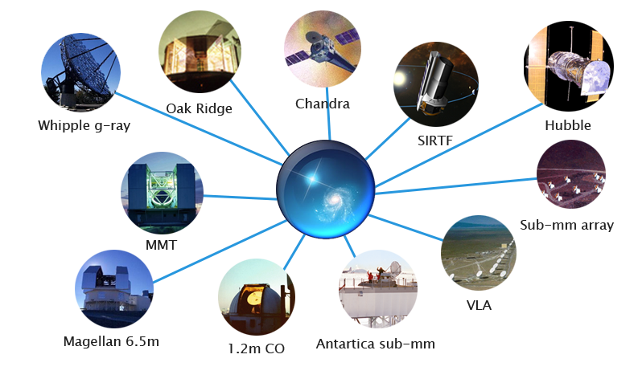
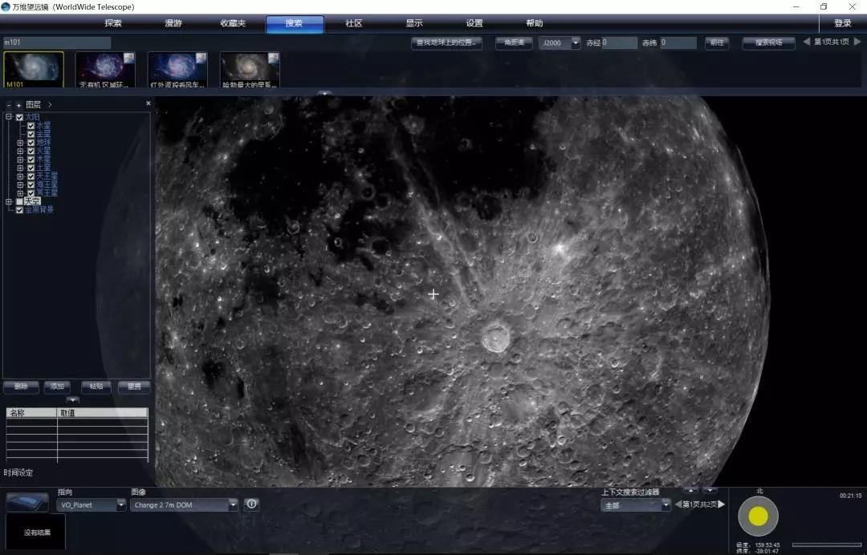
WorldWide Telescope（WWT）
WorldWide Telescope (WWT) was first designed as a tool for astrophysical data exploration and discovery in the era of large and disparate data. It is a scientific data visualization platform.
Launched in 2008 by Microsoft Research, WWT was open-sourced (under the MIT license) Seven years later with copyrights transferred to the .NET Foundation and project direction and management taken up by the American Astronomical Society (AAS).

Slide 3
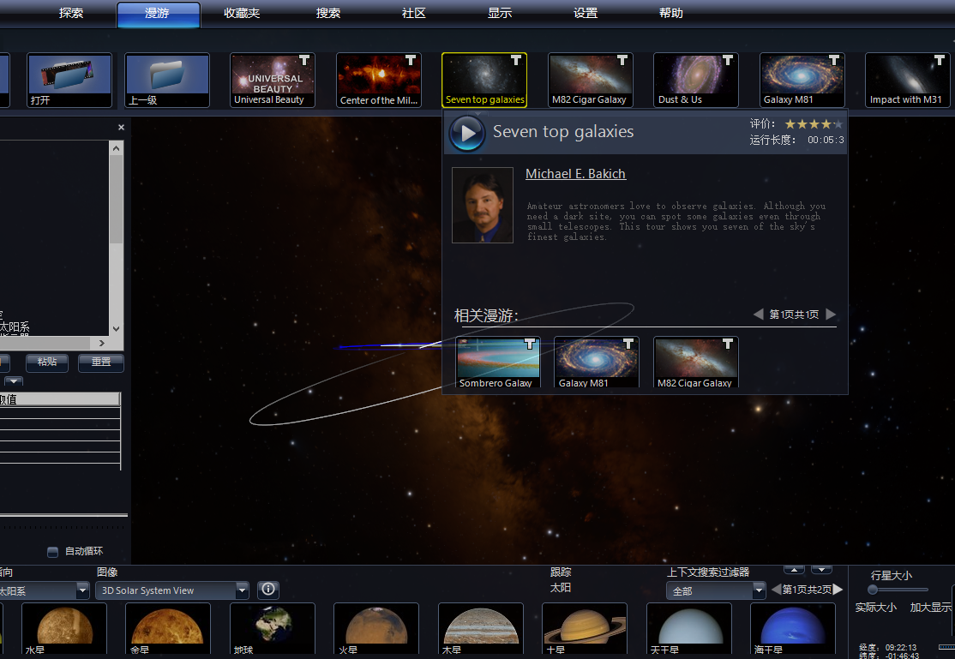
WWT Tours
"Tours" are interactive paths through the night sky, designed to tell a story or teach a particular astronomy concept.
They look like movies, but when viewed in WWT, you can pause the tour to explore regions of the sky that catch your interest, and you can click on hyperlinks throughout the tour to learn more about an object or phenomenon.

Slide 4
Brief Introduction of WWT Tour Contest
WWT Tour Contest is a contest encourage students, amateur astronomer and who ever interested in astronomy, geography and other science to use astronomical data and the platform provided by WorldWide Telescope (WWT) to create WWT tour.
A WWT tour can cover all topics related to astronomy and other science, Including concept teaching, interpret of science knowledge, data analysis and display, story telling, science fiction and so on.
Concept and purpose:
Push the social influence of astronomy and astronomical data;
Stimulate the scientific interest and technological innovation of students;
Cultivate the cooperate and team-work spirit of teenagers;

Slide 5
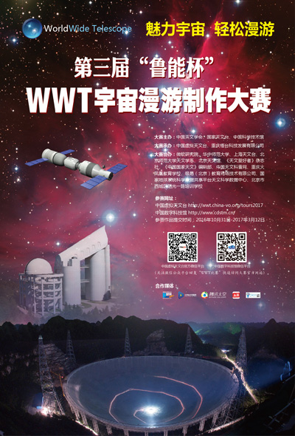
History of WWT Tour Contest in China
1st WWT Tour Contest (August 2010 - November 2010)
2nd WWT Tour Contest (January 2015 - July 2015)
3rd WWT Tour Contest (October 2016 - June 2017 )
4th WWT Tour Contest (October 2019 - August 2020)
Notes:
比赛时长增加，给参赛者更多准备时间。

Slide 6
Statistics - Tours

Slide 7
Statistics - Participants

Slide 8
Exhibition of tours

Slide 9
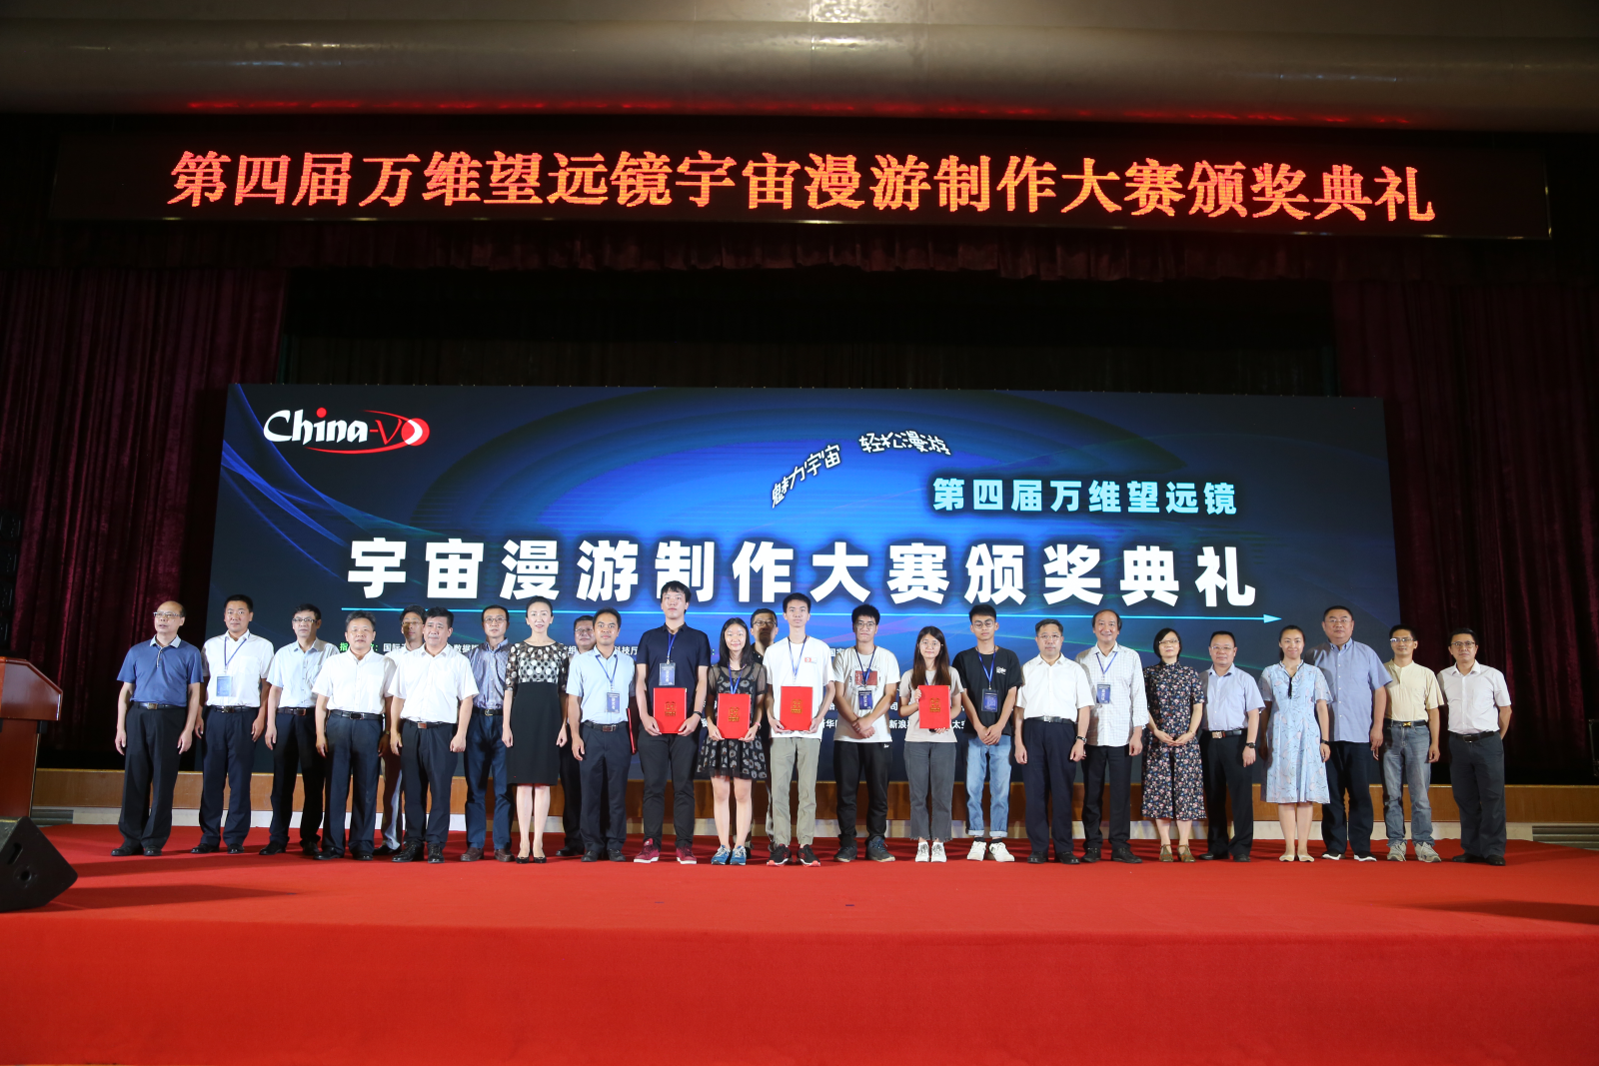
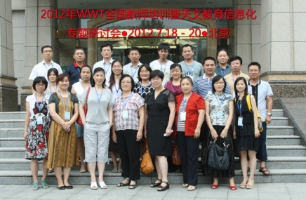
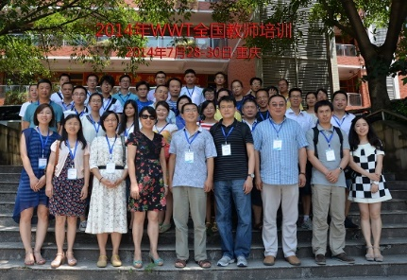
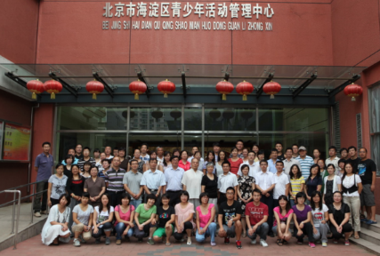
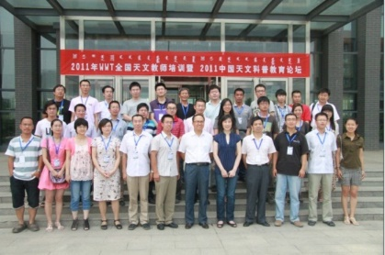
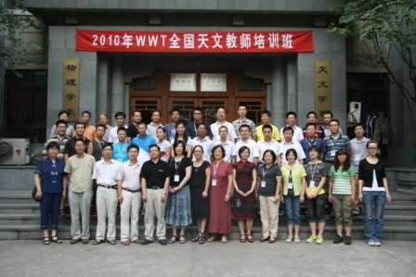
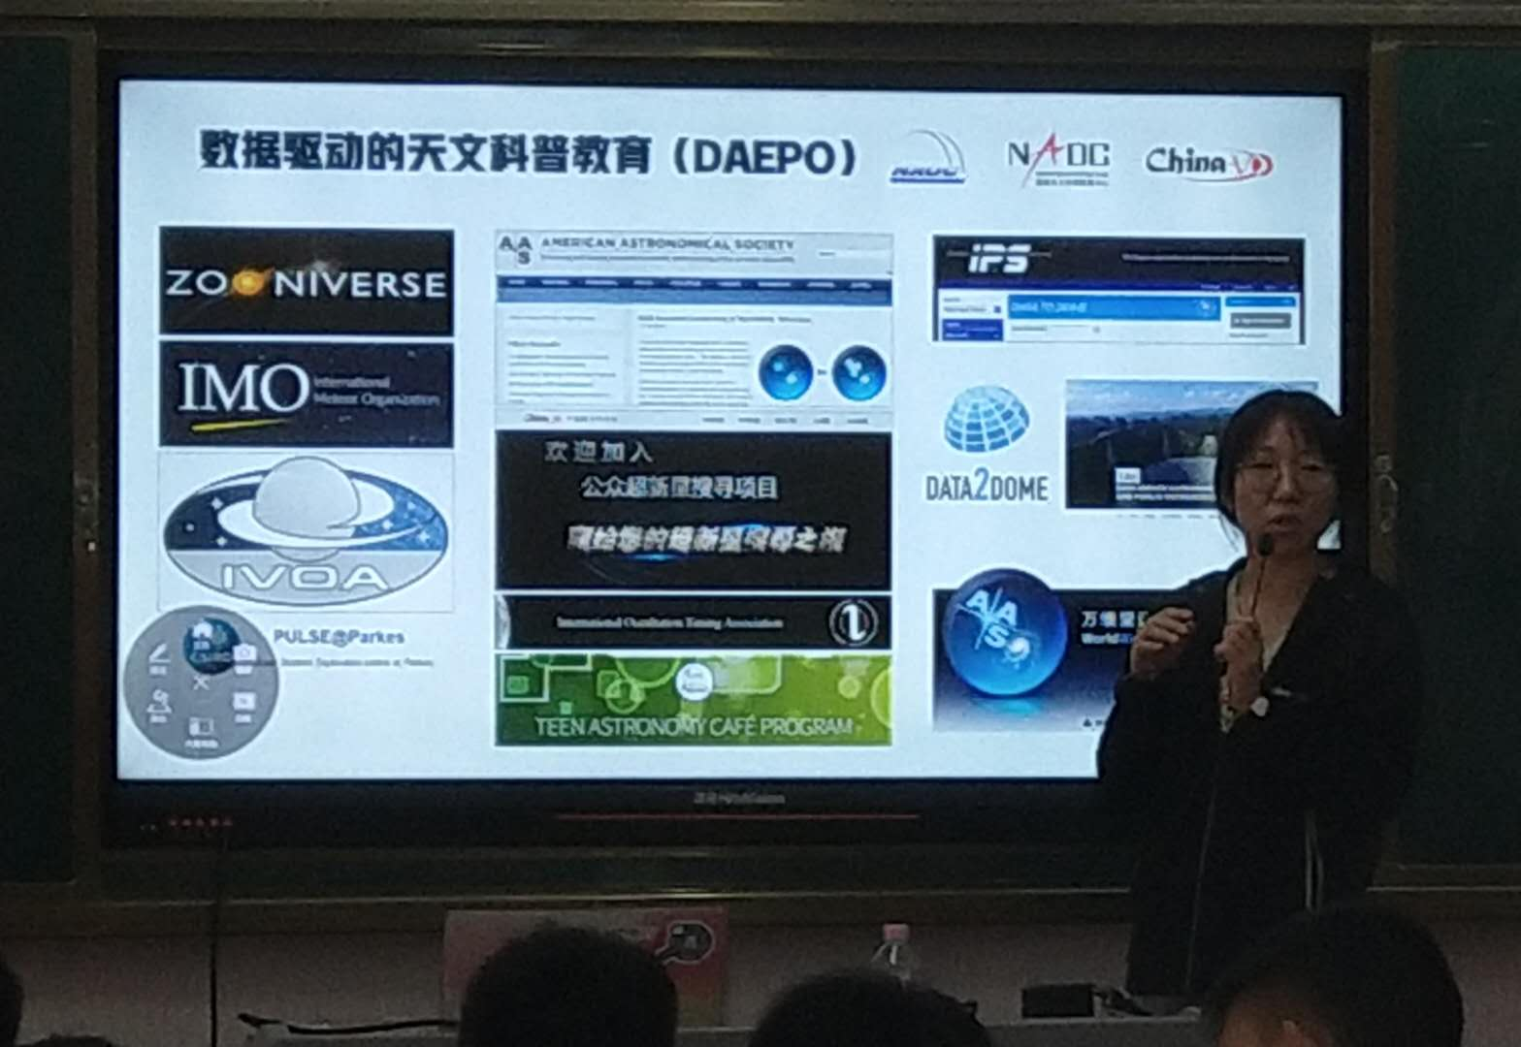
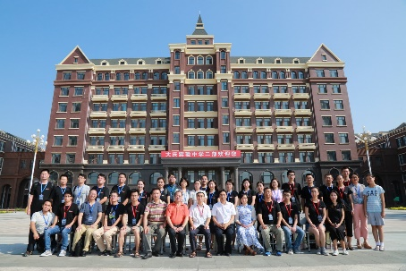
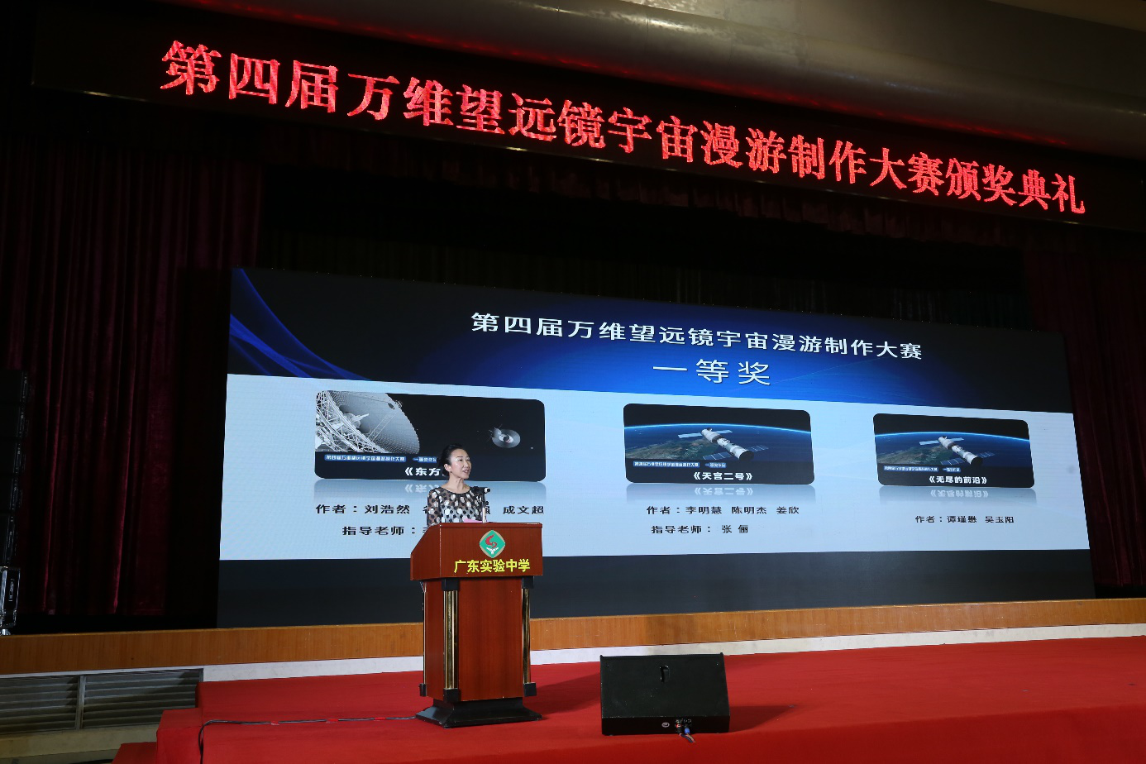
Related Activities
WWT Teacher Training
MOOCs
Online Question Answer
Guidance Course in School
Social Media Promotion
Tour Review
Award Ceremony

Slide 10
MoU between IVOA and OAD
Both the OAD and IVOA have ongoing projects of astronomical education and public outreach and realize that astronomical data and technology have the potential to be applied in various fields to benefit society.
Purpose of the collaboration
Both the OAD and IVOA are motivated to use astronomical data for education, development and public outreach. The purpose of this collaboration is to bring together the complementary resources and expertise of IVOA and of the OAD to advance the application of astronomical data and technology use in different areas of society.
Initial pilot activities
The development of a blended-learning Masters course in Astrophysics for universities based in Southern Africa. This pilot initiative could later be expanded to other regions.
Astronomy for development and education activities, for example the Shristi Astronomy Project , run virtually from India, which trains students on using archival astronomy data for discoveries.
Data driven citizen science projects, for example Worldwide Telescope (WWT) guided tour contest.
Notes:
The purpose of this collaboration is to bring together the global resources and expertise to advance the application of astronomical data and technology use in different areas of society.

Slide 11
International WWT Tour Contest - Organization
✸
Organization: IVOA, OAD, AAS, CAS
✸
Sponsor: (if any)
✸
International Organizing Committee establish In May 2021
✸
LOCAL organization sign up: countries and areas (before Oct 2021)

Slide 12
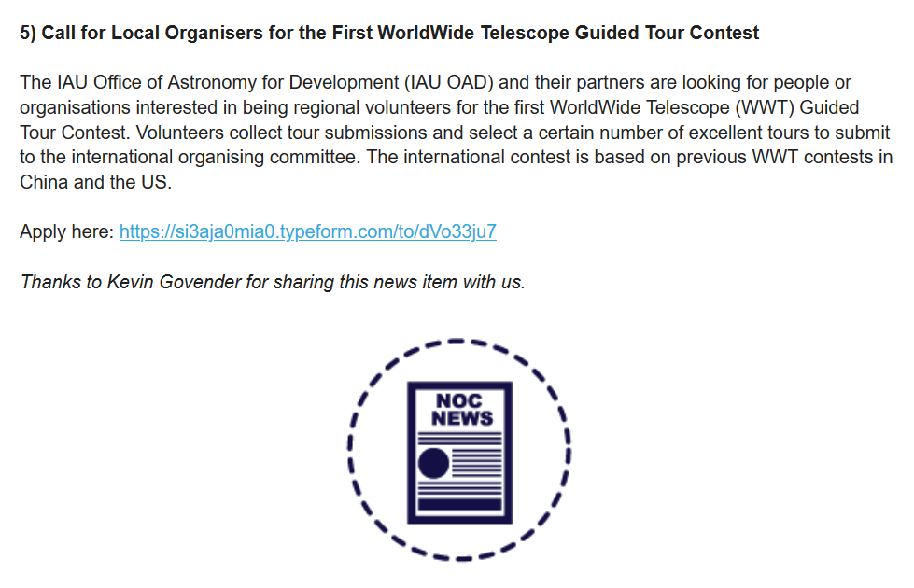
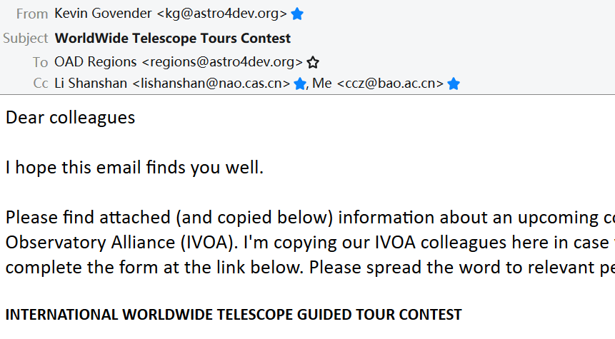
IAU Astronomy Outreach newsletter
45 feedback
27 of them from different Organizations
From 19 different Countries or Areas
Notes:
IAU OAD Kevin send email to all ragion office
The WWT Guided Tour Contest is another pilot project for the collaboration. The news about the contest was officially announced by the IAU outreach newsletter and OAD network.

Slide 13
From Local to International
International
Contest
China
Organization
Local
Organization
Local
Organization
Local
Organization
5th WWT Tour
Contest in China
Local Contest
Local Tour Collect
Local Promotion or ceremony

Slide 14
International WWT Tour Contest - timeline
2021
May Pre-organizing meeting
Oct Contest Start (Local and International)
Oct 2021 - Apr 2022 Promotion and training
2022
Apr - May Tours review in local contest
May - June Tours recommendation to international contest
Jun - July Tours review in international contest
July Results announcement
Aug Award Ceremony

Slide 15
THANK YOU
China-VO WeChat

Slide 16
International WWT Tour Contest - Works
May 2021 - Oct 2021
Poster design
Contest theme (if any)
Official website
Regulation of tours: language, script, introduction, length,...
Number of tours (from local to international contest) and Award setting
Software platform (any update?)
Tutorials or manuals guidance (can push to Jan 2022)
Oct 2021 - Apr 2022
Promotion (IVOA twitter? in China Wechat)
Invite Judges (Local and International)
Certificates design (Local and International)

