Slide 1
A Python TAP Server at the NASA Exoplanet Science Institute (NExScI).
G. Bruce Berriman, John Good, Mihseh Kong
(Caltech/IPAC-NExScI)
Notes:
Challenges for KOA
-

Slide 2
A Python TAP Server - Goals
Deploy an Open Source TAP Server in Python.
Includes ADQL to SQL translation module and generic spatial indexing packages.
Enable support for all databases in common use in Astronomy.
Support data access policy at KOA
Data are protected for at least 18 months.

Slide 3
The NExScI Context
The Keck Observatory Archive (KOA) and NASA Exoplanet Archive at NExScI are modernizing their query infrastructure to make it API-based.
A new archive to support the NEID EPRV instrument is using the TAP server on its first release.

Slide 4
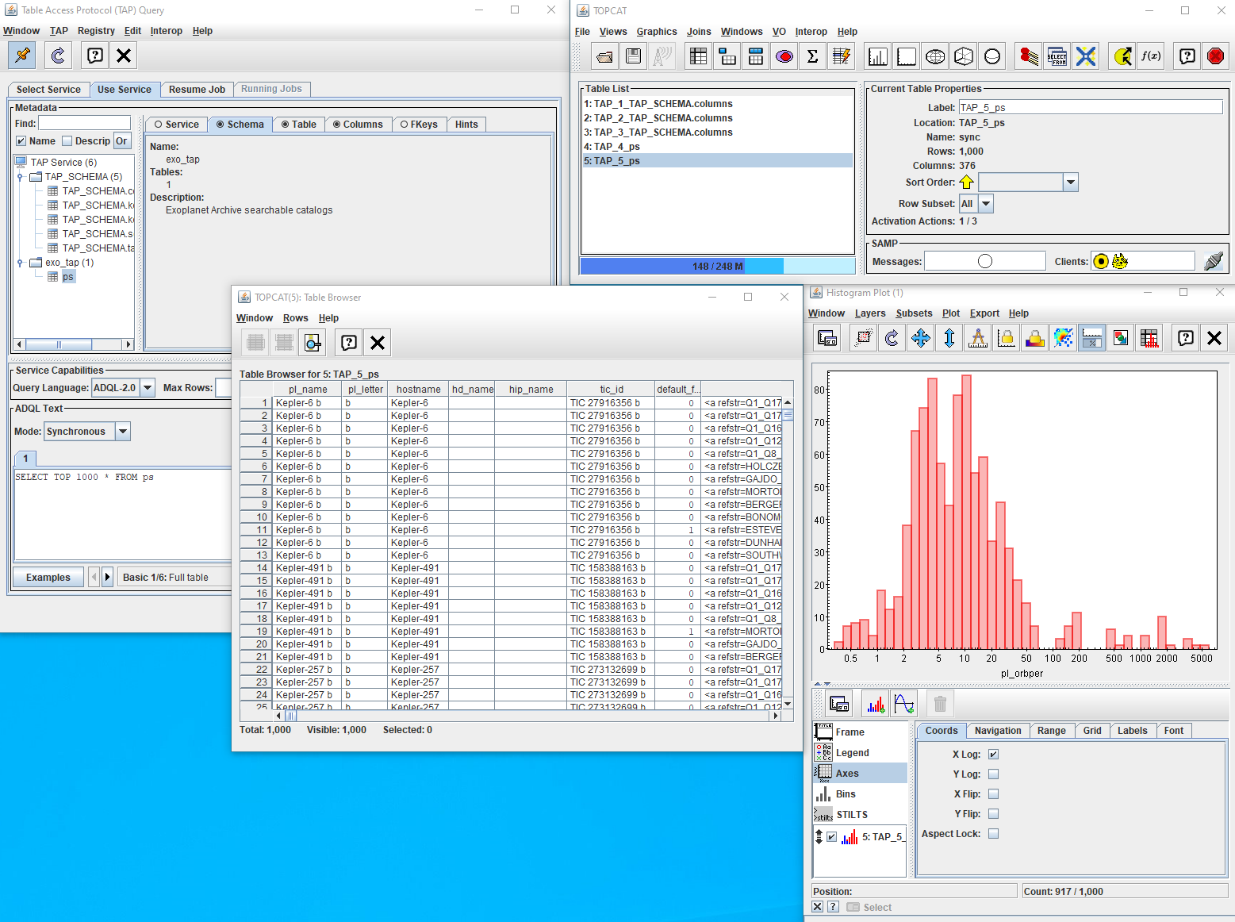
NASA Exoplanet Archive TAP Service
NASA Exoplanet Science Institute maintains the NASA Exoplanet Archive
Curation of all known exoplanet systems … and more
Mission data from Kepler, K2, TESS … and more
TAP service released with new Planetary Systems table
Contains all solutions for all known confirmed planets
All future tables will be released against TAP service and all older tables will be converted.
TOPCAT Access to the Planetary Systems Table at Exoplanet Archive via the Archive TAP service
https://exoplanetarchive.ipac.caltech.edu/TAP/

Slide 5
Future KOA End User Services
New architecture API based - VO Table Access Protocol
Flexibility for archive.
Data discovery through VO.
Synchronous and asynchronous queries.
Proprietary authentication.
VOTable, CSV, etc. output formats.
Python
(incl. PyKOA)
Web forms
Custom
TAP Server

Slide 6
Python-based TAP Server
Client
TAP SERVER
Convert ADQL to SQL
Retrieve table
schema
Add optional proprietary
filtering
Query DBMS
Format output
May require minor DBMS-specific tweaks.
Approximately 10 KLOC of Python code and 15 KLOC of C spatial indexing code (Python binary extension package).
Notes:
Lightweight Python implementation (install via pip).
DBMS agnostic (we use Oracle and SQLite).
Require no DBMS extensions.
The hard work in making the service simple is not TAP itself, but in supporting ADQL.
Keep the complexity away from the DBMS.
Instead translate the ADQL into SQL in a way an DBMS can handle
Only supports HTM and HPX indexing (any others would have to be added).
We don't have any databases that contain geometric objects so haven't implemented INTERSECTS().
We do have an R-Tree implementation external to the DBMSs that could be folded in.
Since we place no constraints on the DBMS, we could support uploads and joins but do not have plans to do so.

Slide 7
Proprietary Access to KOA Data
Augment the database with table of users, programs, and relationships between them.
Include proprietary period information in data records.
Login/cookie-based user identification.
Modify queries on the fly to include joins, filtering of the above so that only legally-accessible records are shown.
Data download also applies the same constraints.

Slide 8
Current Status
NEID, NASA Exoplanet Archive archive and KOA have supported extensive testing of the TAP server.
Tested CGI calls
Testing through PyVO, TAP+, and TOPCAT clients.
These clients support access to public KOA data.
TAP Server will underpin an astroquery-compliant interface to KOA data.
Testing underway, including access to proprietary data.

Slide 9
TAP Server Release Plans
The TAP Server has been placed in a GitHub repository.
Version 1 will support Oracle.
We will add documentation and tests before release.
Persons wishing to use it are requested to contact Bruce Berriman.

Slide 10
TAP Server Future Expansion
Support multiple DBMSs
Version 1: Oracle (cx_Oracle package; Python Database API 2.0)
Implementations for PostgreSQL, SQLite, etc. This involves pointing to different DB API 2.0 packages and tweaking the ADQL module.
New environments:
Version 1: CGI program connects to Oracle via Apache
Test under NGINX and add WSGI (Web Services Gateway Interface) support.

Slide 11
Comments on TAP and AQDL
TAP spec says explicitly the ExecutionDuration must be in integer seconds.
We have data that have sub-second timing, so output them as a decimal value.
An observation on POLYGON searches in ADQL.
Simple solution is to treat as a convex hull: if there are no checks for convexity, wrong results will be returned.
In the best case, everyone would support general polygons in a common fashion (e.g. by "triangulation" of the polygon) or would return an error if the polygon is not convex.

