Slide 1
State of the IVOA
Virtual IVOA Interop Meeting, May 2020
Chenzhou Cui
Chair of the IVOA Executive Committee
Chinese Virtual Observatory
NAOC, CAS

Slide 2
Participation
185

Slide 3
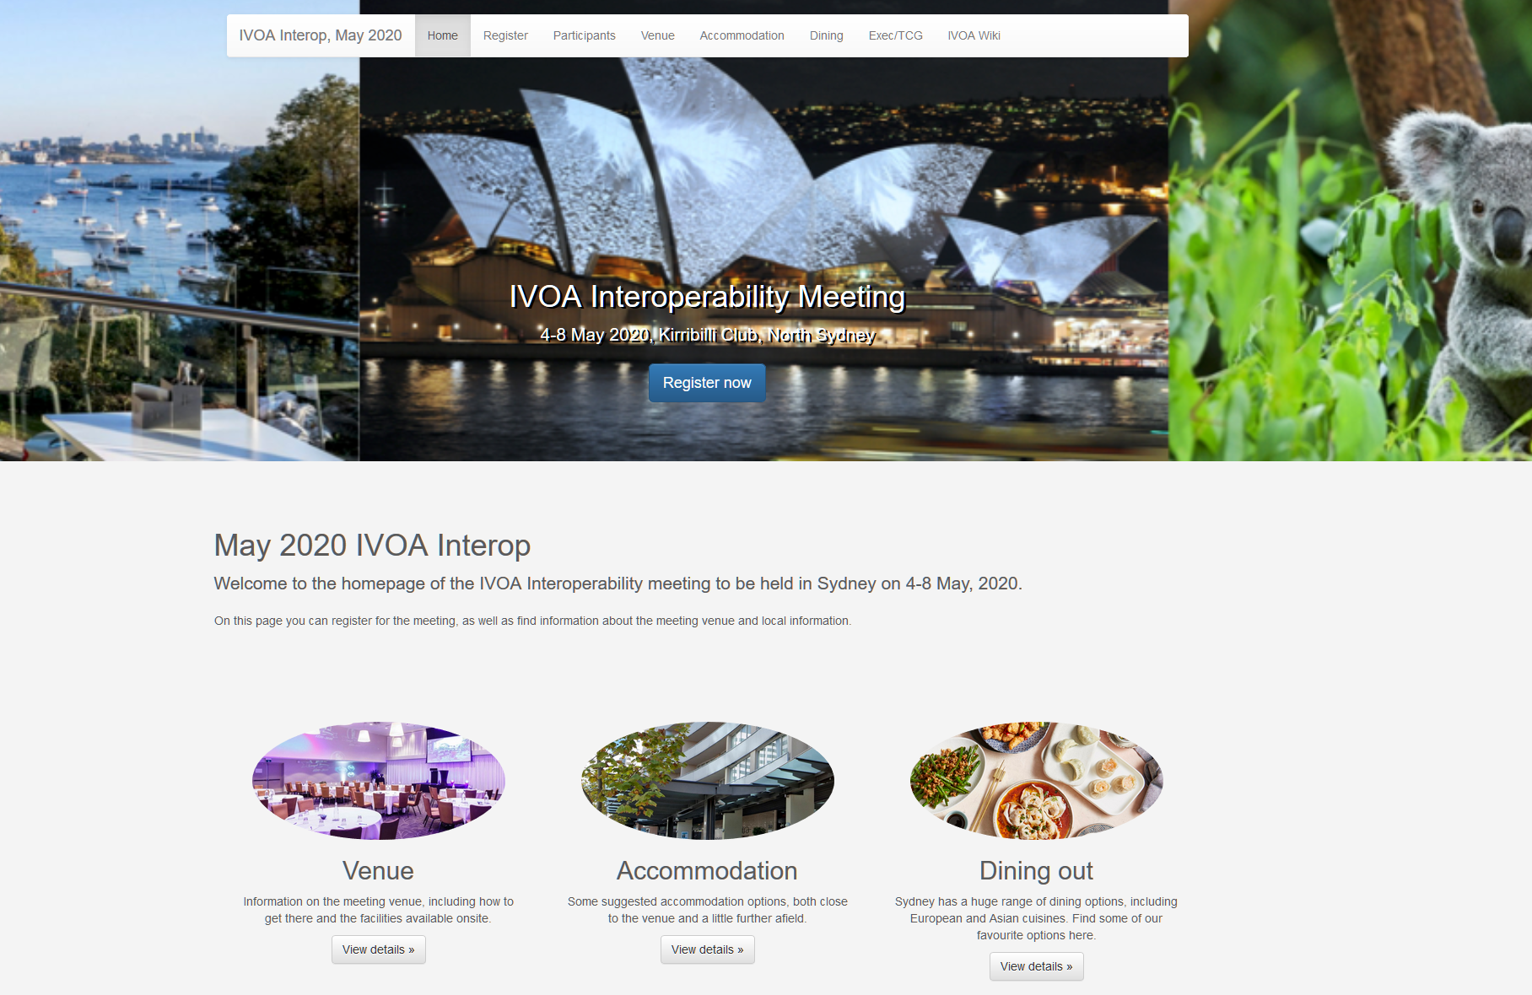
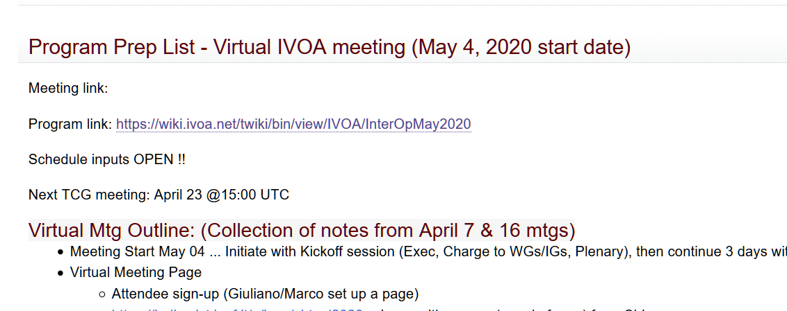
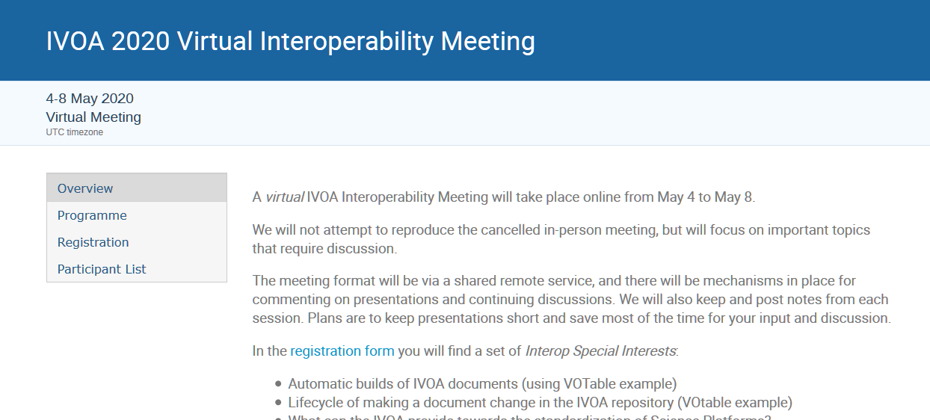
Special Acknowledgements
Technical Coordination Group (TCG)
  Janet Evans, Patrick Dowler
  Giuliano Taffoni, Marco Molinaro
  WG/IG Chairs and Vice Chairs
Originally Planned Sydney Meeting OC
  Simon O'Toole, ASVO
  OC Sponsors
Exec members
The whole IVOA community

Slide 4
The Idea of VO
Vision of the VO:
The Web is transparent. The goal of the Virtual Observatory is to achieve the same feeling for astronomical data - that it is all available to explore in a single transparent system.
Like the World Wide Web, the VO is not a fixed system, but rather a way of doing things.
Astronomical datasets, tools, services should work seamlessly together.
The VO allows astronomers to interrogate multiple data centers in a seamless and transparent way, provides new powerful analysis and visualization tools within that system, and gives data centers a standard framework for publishing and delivering services using their data.

Slide 5
International Virtual Observatory Alliance
VO’s vision is made possible by standardization of data and metadata, by standardization of data exchange methods, and by the use of a registry, which lists available services and what can be done with them.
IVOA:
An organisation that debates and agrees the technical standards that are needed to make the VO possible
A focal point for VO aspirations, a framework for discussing and sharing VO ideas and technology
Promoting and publicising the VO

Slide 6
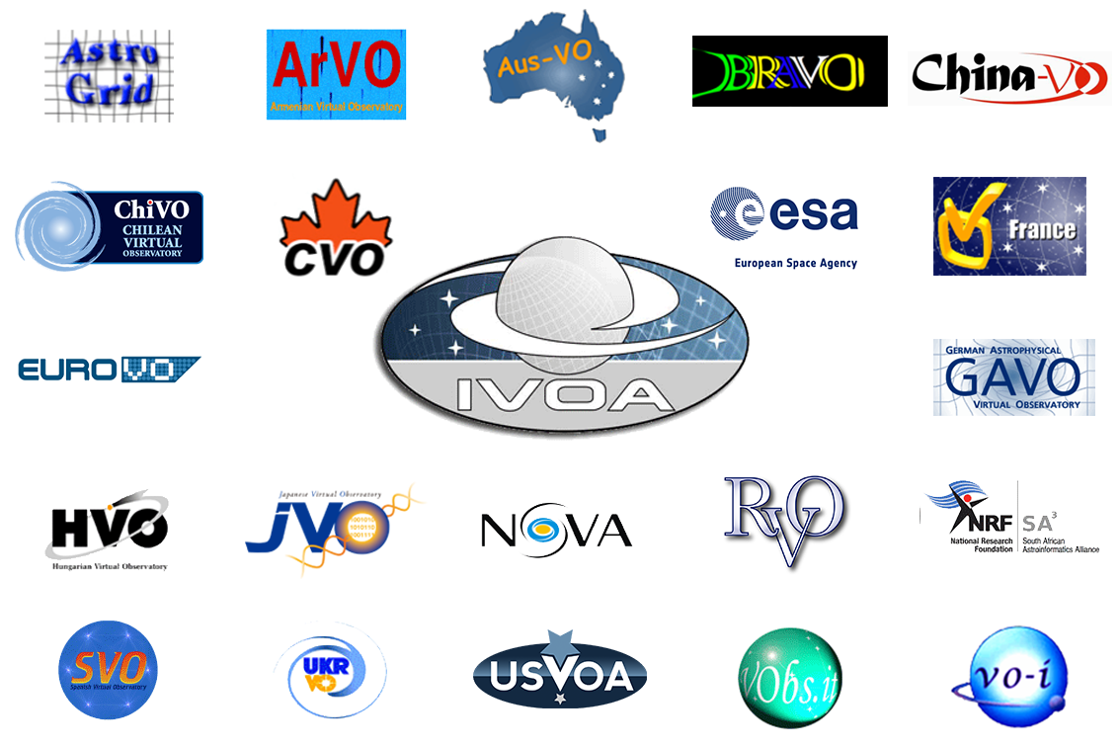
Basic Information about IVOA
Created in 2002
21 member VO projects
  Netherlands shows strong interests
6 Working Groups, 8 Interest Groups
2 Interoperability meetings per year
  May (Virtual meeting this time)
  Oct/Nov with ADASS
~ 46 interoperability standards

Slide 7
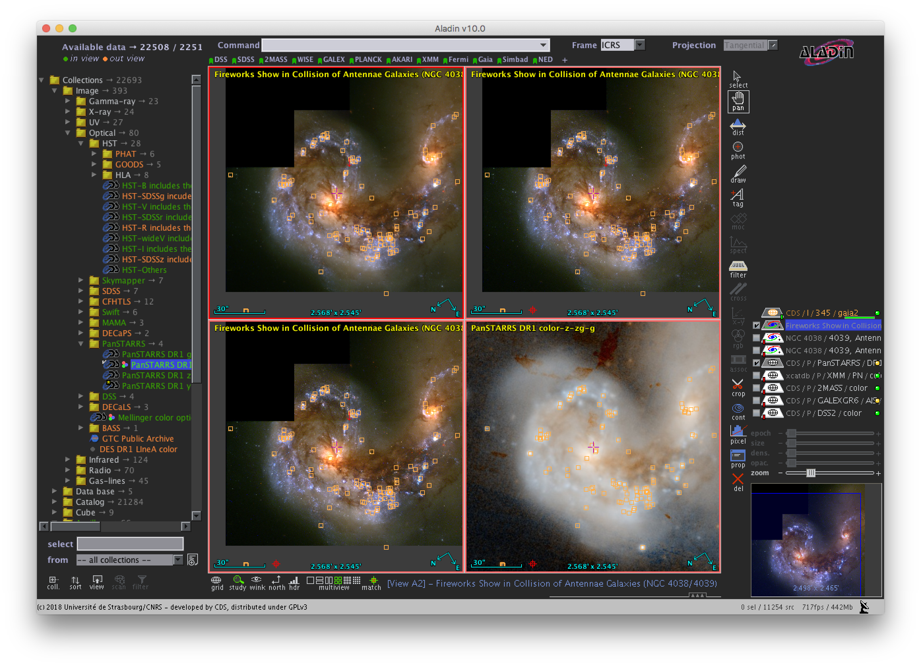
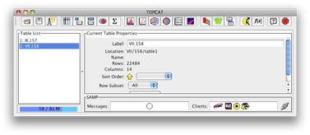
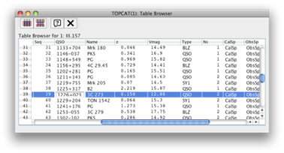
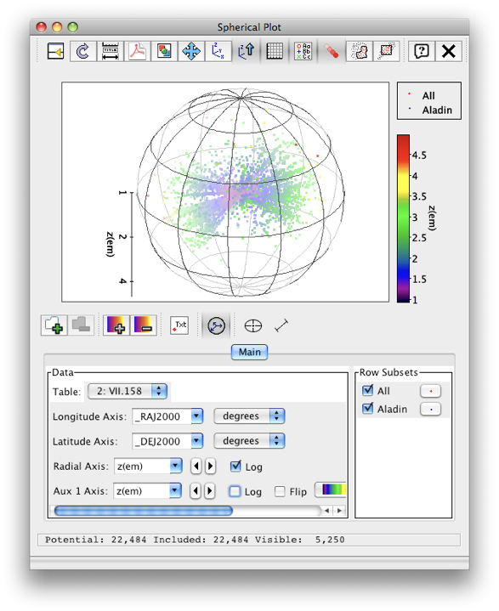


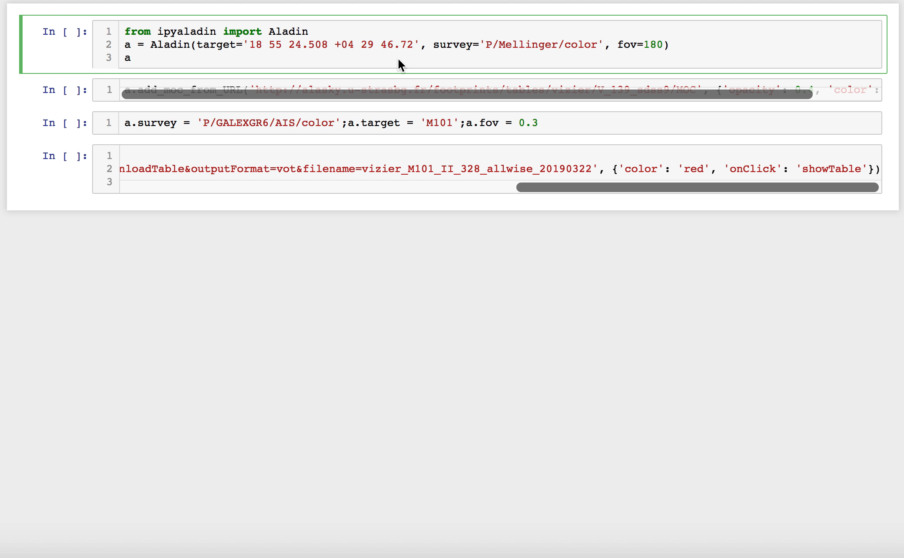
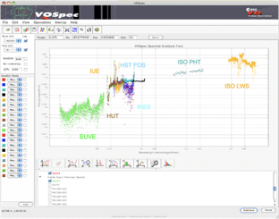

Interoperable applications and services
Aladin
Your apps
& programs
TOPCAT
Notebooks
Spectral tools

Slide 8
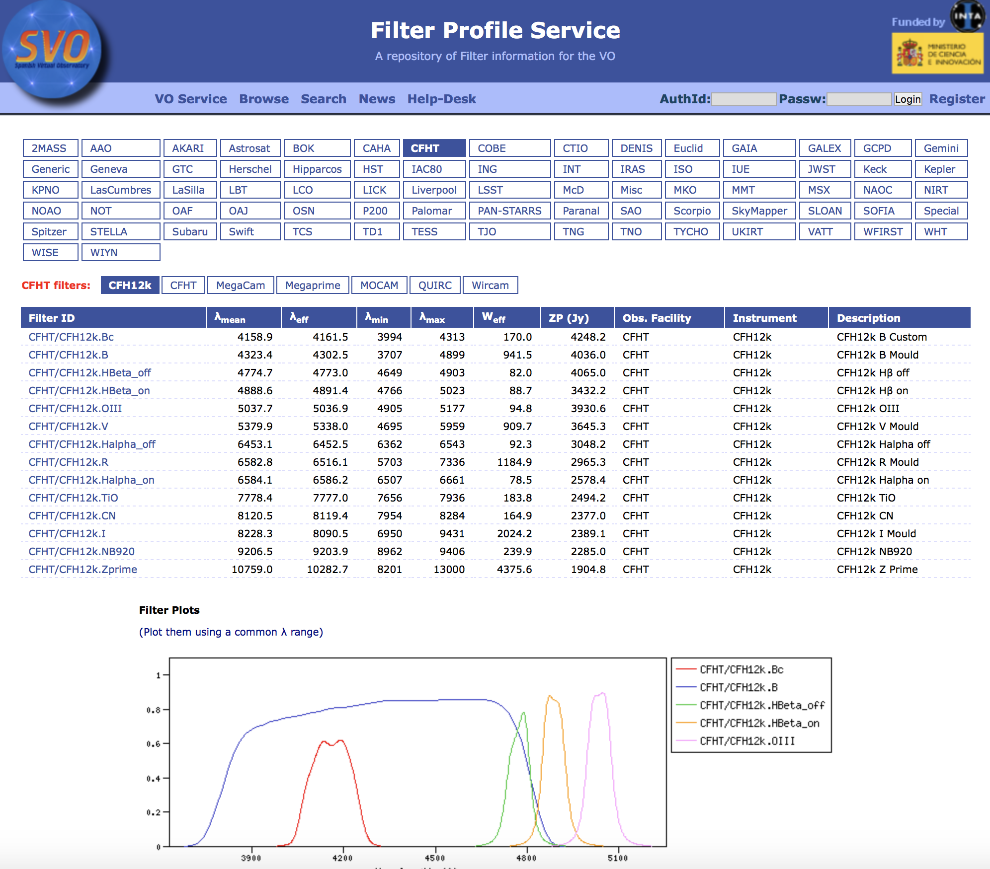
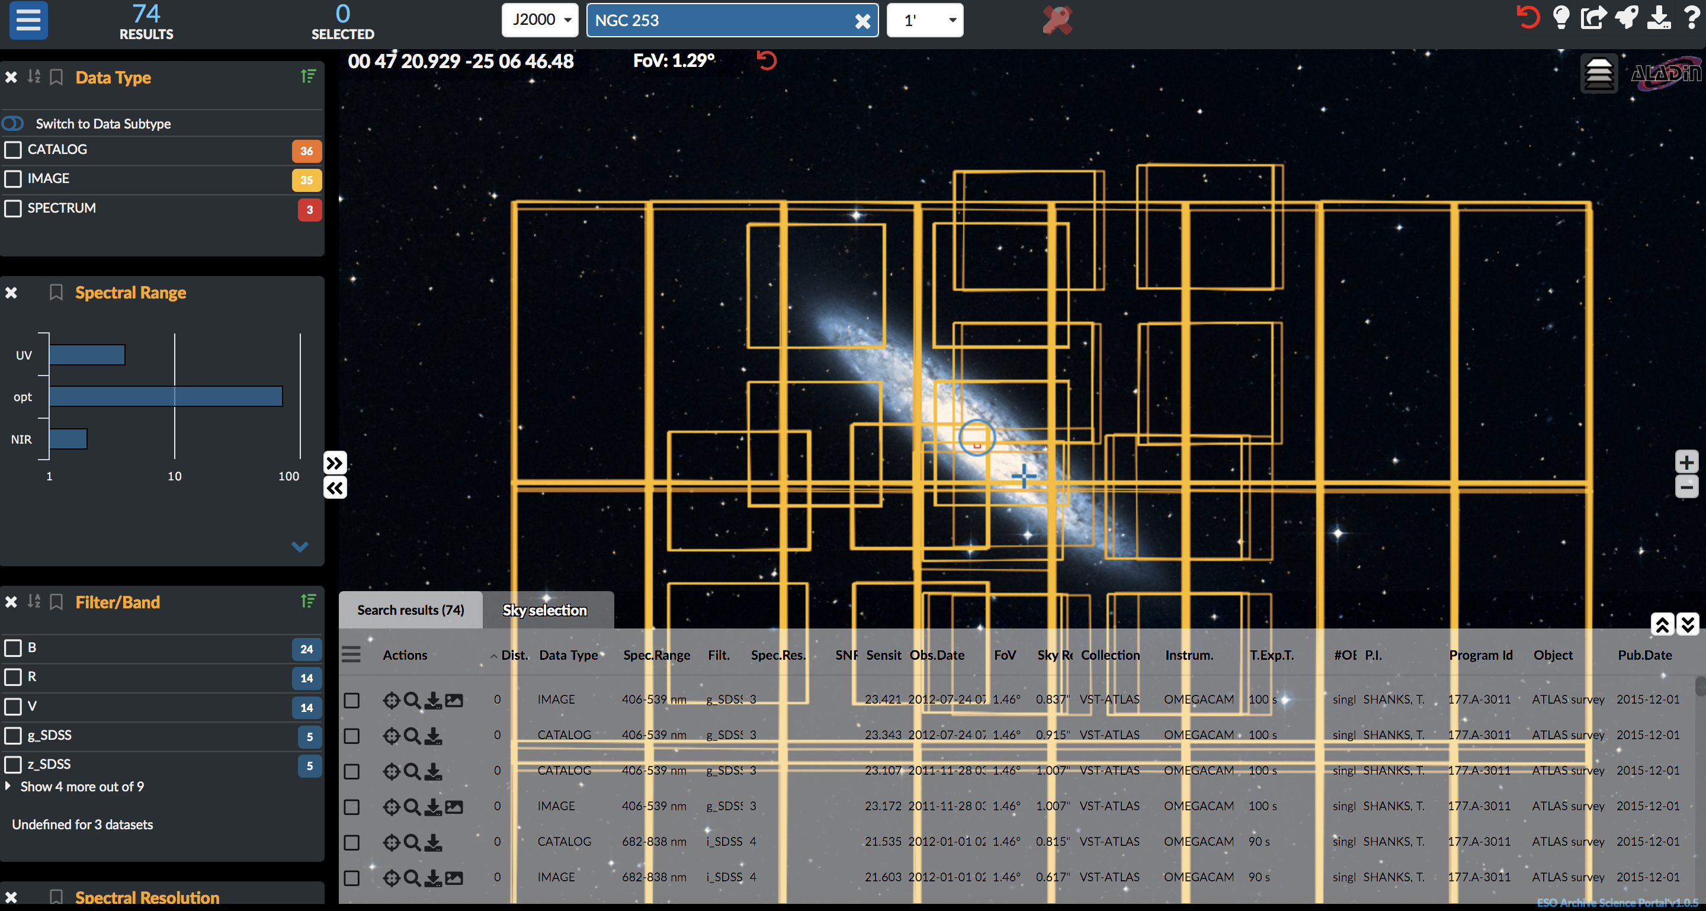
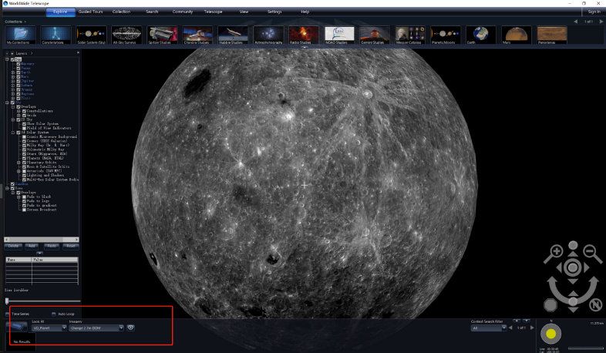

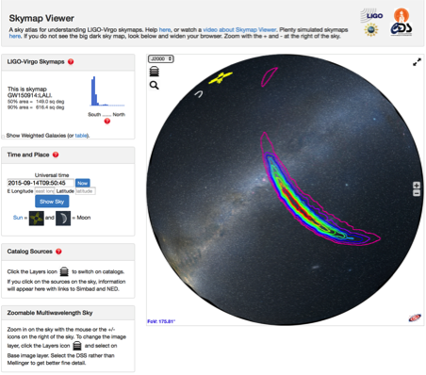
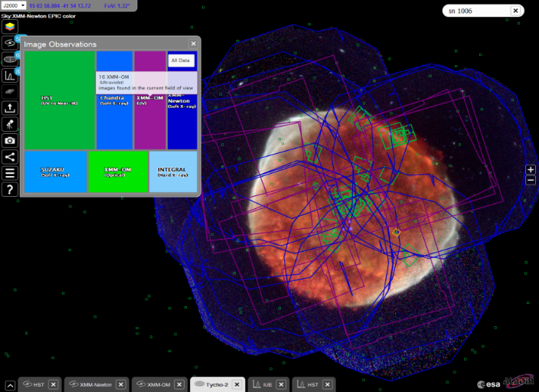
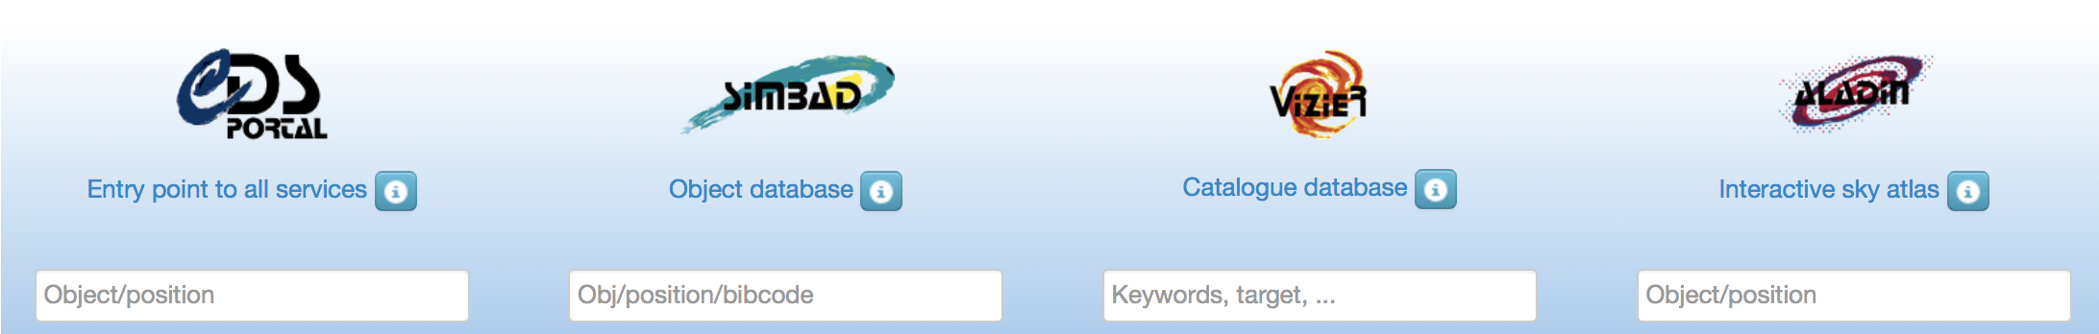
VO embedded in astronomy services
WWT
ESO Science Portal
SVO Filter Profile service
ESA Sky
Grav. waves
CDS reference data services

Slide 9

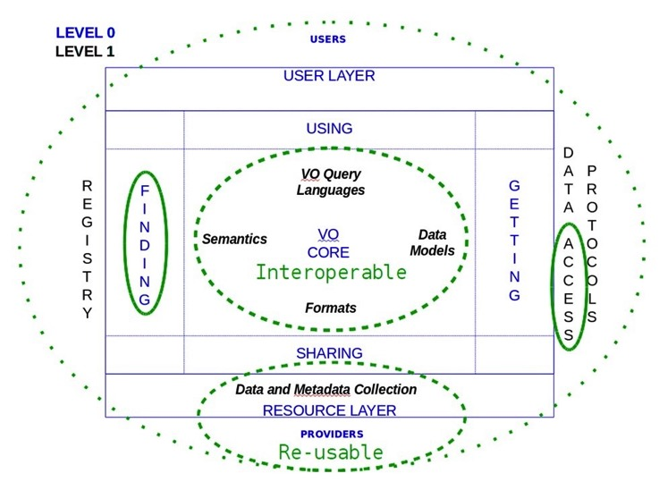
VO is FAIR
Making data:
Findable
Accessible
Interoperable
Reusable
International Virtual Observatory Alliance
Credit: X-ray: NASA/CXC/CfA/R. Tullmann et al.; Optical: NASA/AURA/STScI

Slide 10
IVOA Organization Chart
Executive
Committee
Committee on Science Priorities
Media Group
Technical Coordination Group
Standards & Processes Committee
Working Groups
Interest Groups
Applications
Data Access
Layer
Data
Model
Data Curation
& Preservation
Education
Theory
Radio Astronomy
Grid & Web Services
Registry
Semantics
Time Domain
Knowledge Discovery in Databases
Solar
System
Operations

Slide 11
Radio Astronomy Interest Group
Radio Astronomy Interest Group approved
  define requirements for the representation of radio astronomy data in the VO through:
    development of use cases for data discovery, access and visualization
    identification of metadata concepts needed by radio astronomy
  provide a well identified point of contact for radio projects with IVOA, and actively encourage their use of VO standards and protocols
  The group will organize sessions focused on radio astronomy data at IVOA meetings
  ALMA,NRAO,ASKAP,MWA,CIRADA,FAST,SKA,ASTRON,ESCAPE,MeerKAT,IDIA,INAF involved actively
Chair: Mark Lacy (NRAO)
Vice Chair: François Bonnarel (CDS)
  See the CSP presentation!

Slide 12
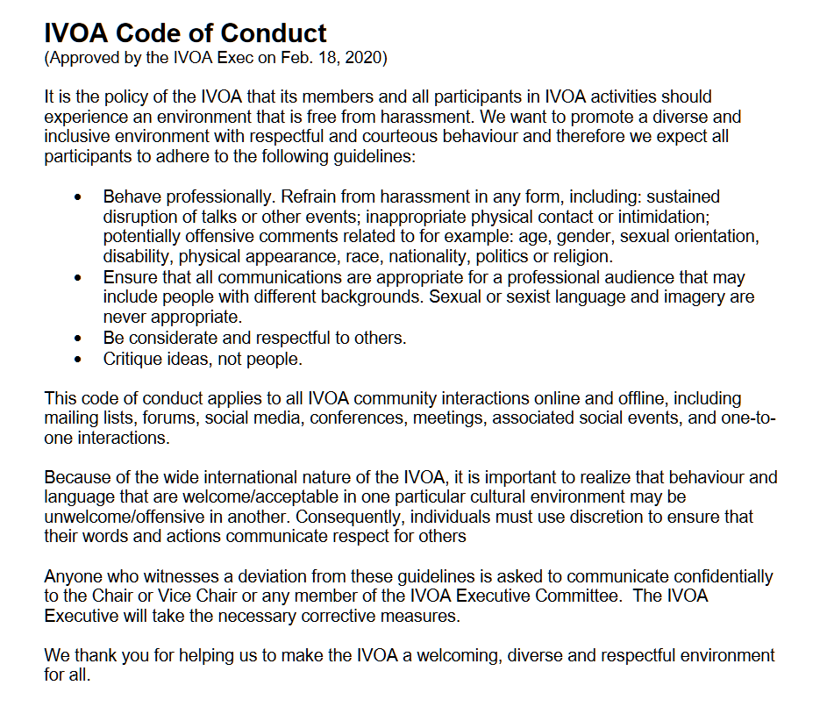
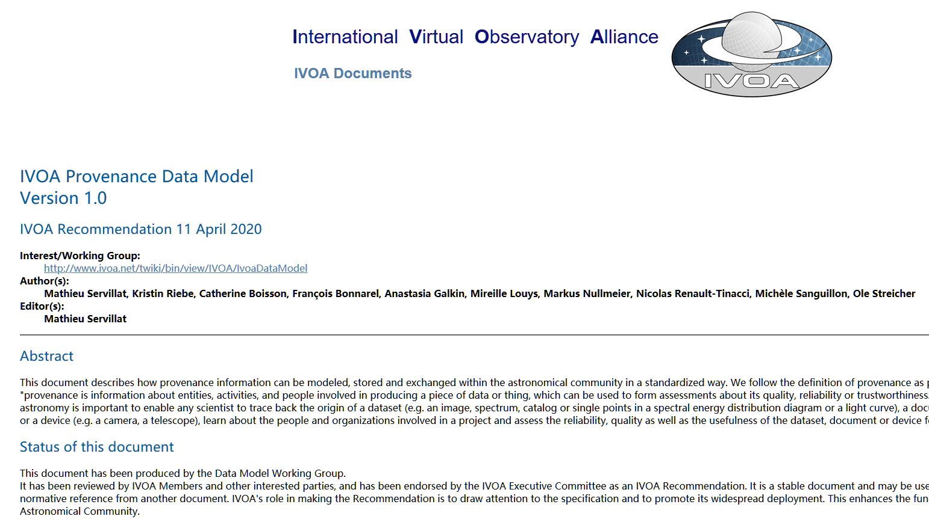
Endorsed documents
Code of Conduct (1.0)
Provenance Data Model (1.0)

Slide 13
IVOA Web and Wiki pages
Web assets and wiki pages are all hosted in Trieste, Italy (Vobs.it) now.
Thank IUCAA for the support in the last years
Plans for new web site design have been made by the IVOA Media Group
  Progress now dependent on resources

Slide 14
WG/IG Chair and Vice Chair renew
KDD IG
  Chair: Matthew Graham
  Vice Chair: Open
Theory IG
  Chair: Gerard Lemson
  Vice Chair: Open
Education IG
  Chair: Chenzhou Cui (1 yr ext.)
  Vice Chair: Hendrik Heinl (1 yr ext.)
Time Domain IG
  Chair: Ada Nebot (1 yr ext.)
  Vice Chair: Open
An enormous thanks to the Chairs and Vice Chairs at the end of their terms:
Kai Polsterer (KDD IG)
Carlos Rodrigov (Theory IG)
Dave Morris (Time Domain IG)

Slide 15
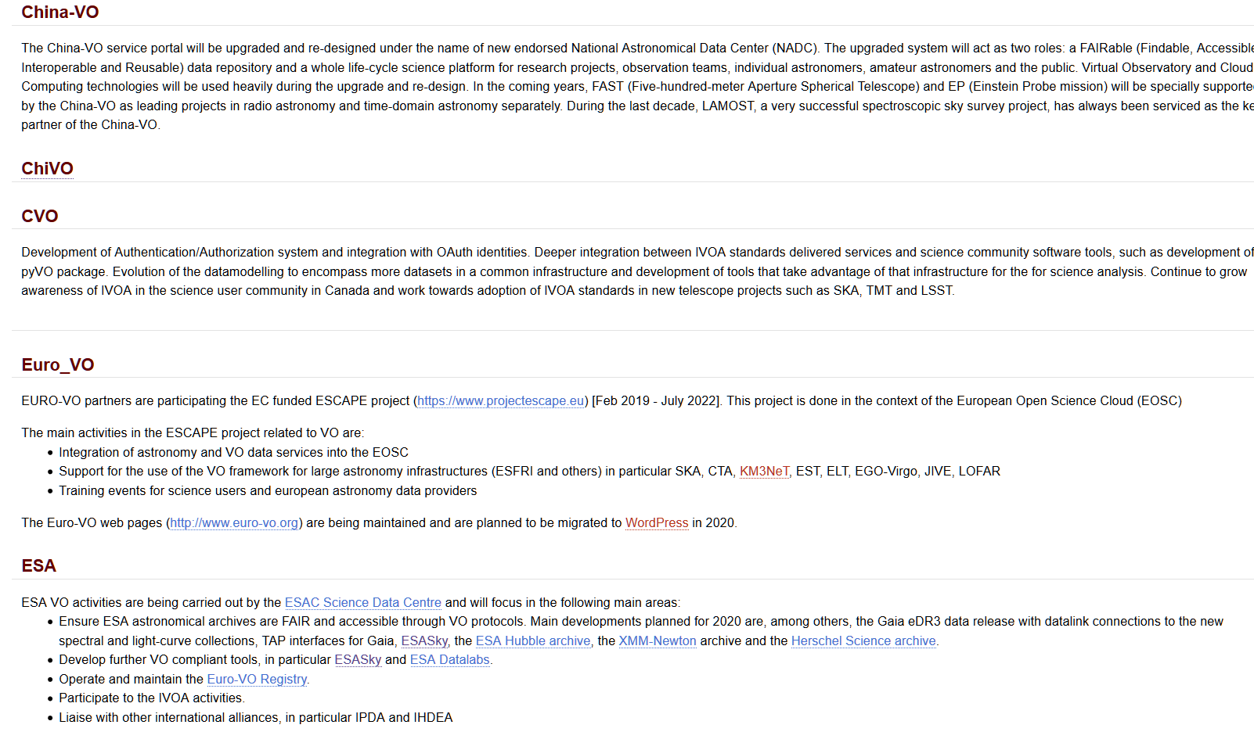
IVOA Roadmap - 2020
China-VO
CVO
Euro-VO
ESA
https://wiki.ivoa.net/twiki/bin/view/IVOA/RoadMap

Slide 16
Highlights from IVOA Members

Slide 17

USVOA/NAVO
Submitted renewal proposal to NASA on Feb 3 2020.
Oral defense on March 12 2020
Awaiting final results from NASA

Slide 18













Euro-VO Activities
Activities being pursued within the EC funded ESCAPE Project
  In the work package: CEVO "Connecting ESFRI to the EOSC via VO”
Euro-VO partners working with large Astronomy, Astroparticle Physics and Solar Physics partners
ESCAPE is bringing VO into the European Open Science Cloud (EOSC)

Slide 19
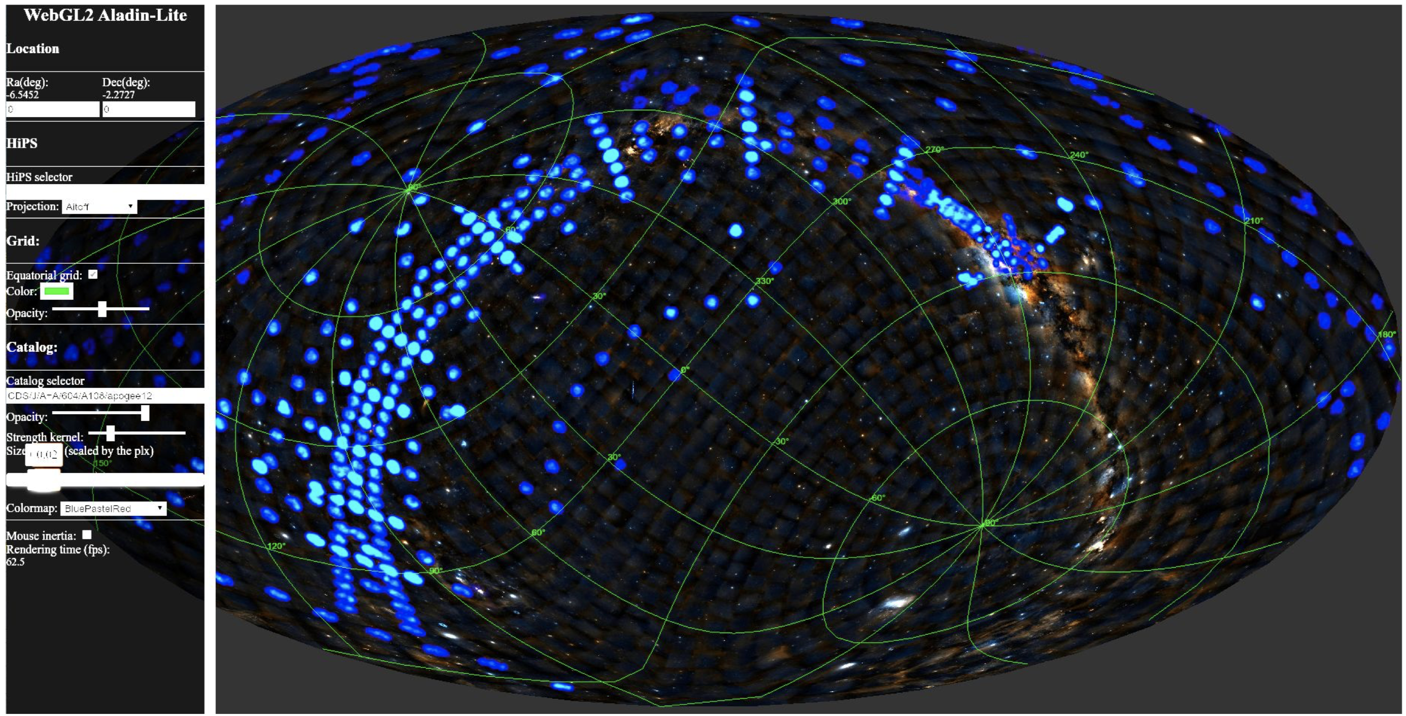
Euro-VO ESCAPE Status and Highlights
ESCAPE project 2019-2022 – coming up for mid-term review in 2020
  Defined VO priorities for European Astronomy/Astroparticle/Solar/GW IRs
  VO registry in EUDAT B2FIND re-implemented and improved
  Input provided to RDA FAIR Data Maturity Model Working Group
  Progress on Deep Learning applied to ESO Science Archives data/services (with WP3 ESCAPE)
  Tools/services; e.g: ASTRON services registered, WebGL Aladin Lite prototype, mocpy, +…
  VO in Science Platforms (coordinated with WP5 ESCAPE)
  AAI (coordinated with WP2/3/5 ESCAPE)
Recent Activities:
  Provenance meeting – CTA & KM3NeT synergies (Nov 2019)
  ESA/ESO SCIOPS Conference – presentation of ESCAPE (Nov 2019)
  EOSC Symposium (Nov 2019)
  WP4 Technology Forum 1 (Feb 2020)
Upcoming: VO school (postponed), Data Provider Forum (2021), EOSC events

Slide 20

Canadian Virtual Observatory
Actively developing / contributing to pyVO
Adopting astroquery.alma to utilize pyVO
Deploying new ‘Science Portal’ components – ARCADE
Migrating collections to CAOM 2.4
File system based VOSpace (cavern) operational.
User upload of proprietary catalog data into CADC TAP 1.1 service – process has stabilized and in use – YouCat
Authentication and GMS standards development.

Slide 21
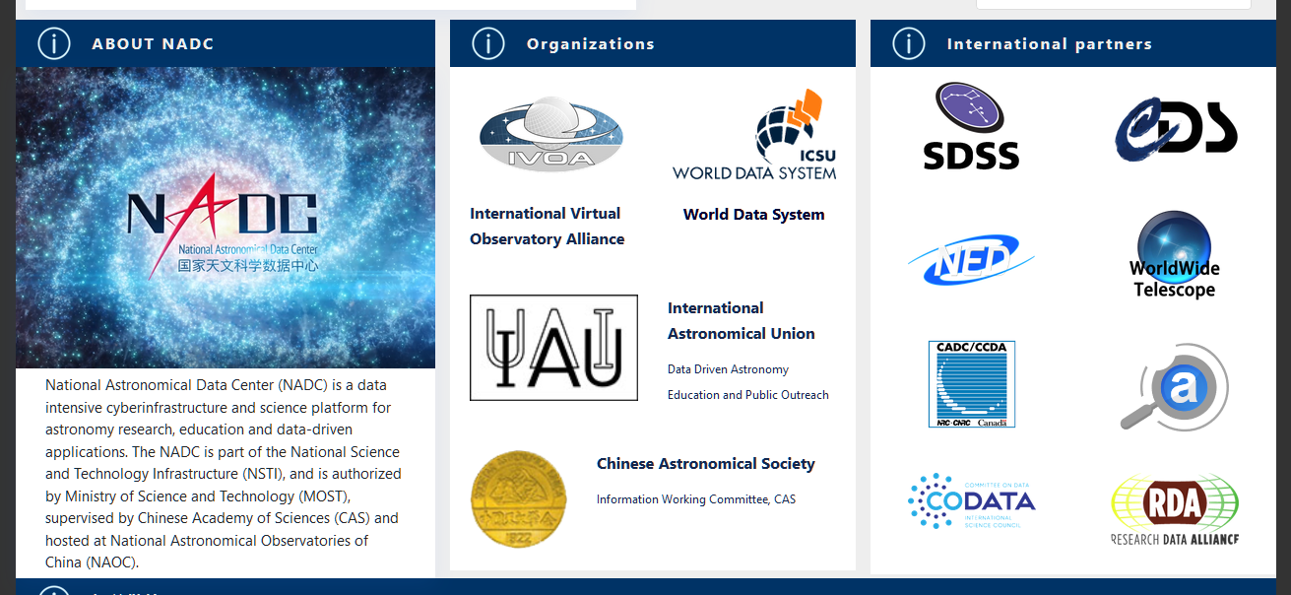
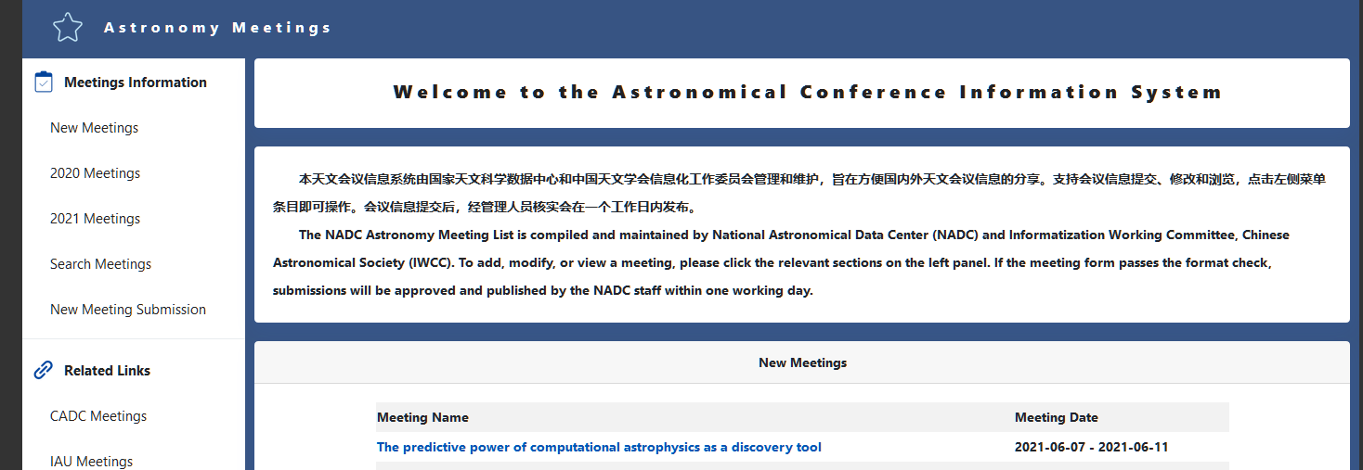
China-VO Status
NAOC – Alibaba Cloud Collaboration Agreement (II, 2020-2022) was signed
Three papers submitted to Astronomy and Computing (ASCOM)
  IVOA HiPS Implementation in the Framework of WorldWide Telescope. Y Xu, et al. Accepted.
  Towards an Astronomical Science Platform: Experiences and Lessons Learned from China-VO. C Cui, et al. Submitted to Science Platform Special Issue.
  A Redistribution Tool for Long-Term Archive of Astronomical Observation Data. C Yu, et al.
National Astronomical Data Center (NADC) web portal is under upgrading
  NADC Meetings was online on April 29, 2020

Slide 22
And now – to work !!
Notes:
我的介绍就到这里，请各位专家评委指正！

