Slide 1
MAST VO Operations IVOA Interop, Paris, May 2019 Operations Interest Group Theresa Dower MAST / STScI / NAVO

Slide 2
MAST VO Operations: no metrics.
This is not a talk about metrics.
This is a talk about MAST’s VO-related architecture, which is a moving target.
And about why.

Slide 3
MAST VO Operations history
Early VO participation:
experiment with standards themselves in research mode
However most comfortable for individual developers
or the architecture where the data lived

Slide 4
MAST VO Operations history
Meanwhile MAST has expanded
32 people
Astronomers, engineers, web designer, management
Missions from tiny to Pan-STARRS
Heterogenously collected from High Level Science Products to CAOM

Slide 5
MAST VO Data Service Early Architecture
MSSQL Databases (with HTM spatial libraries)
PHP Spectral Services
PHP Cone Services
C#/IIS Cone Services
C#/IIS Registry
C#/IIS Image Services

Slide 6
MAST VO Data Service Architecture
MSSQL Databases
PHP Spectral Services
PHP Cone Services
C#/IIS Image Services
C#/IIS Cone Services
C# & Java IIS TAP Services
Registry

Slide 7
MAST Registry Architecture
MSSQL Database
Apache SOLR
RofR Harvester
Keyword Search Portal
RegTAP
OAI-PMH
Local Registry Harvester
Legacy Search Interfaces

Slide 8
MAST Total Data Service Architecture
MSSQL Databases
PHP Spectral Services
PHP Cone Services
C#/IIS Image Services
C#/IIS Cone Services
C#/IIS TAP Services
File Distribution
MAST API
Python on nginx Misc Services
CASJOBS
Registry
Java Name Resolver
…and logging (IIS & Apache to ELK)
…and authentication (MAST SSO)

Slide 9
MAST Total Data Service Architecture
MSSQL Databases
PHP Spectral Services
PHP Cone Services
C#/IIS Image Services
C#/IIS Cone Services
C#/IIS TAP Services
File Distribution
Python on nginx MAST API
Python on nginx Misc Services
CASJOBS
Registry
Java Name Resolver

Slide 10
MAST VO Operations Roadmap
Building up TAP support for bigger and bigger catalogs
Consolidating metadata master copy
TAP or Python microservice layer for legacy services

Slide 11
MAST VO Operations Roadmap
We are probably going to always have more than one way to do things
The point is to have fewer, more consistent, and more integrated stacks for doing them

Slide 12
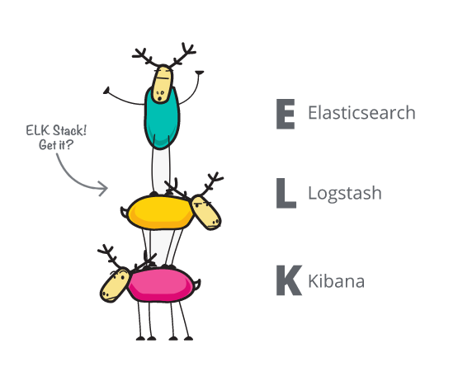
MAST VO Operations Roadmap
From this, more integrated metrics
Next time?

