Slide 1
IVOA EduIG and Media Session
IVOA EduIG & Media Group

Slide 2
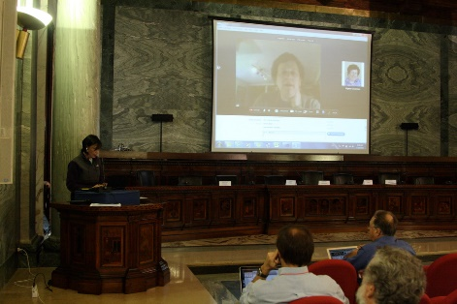
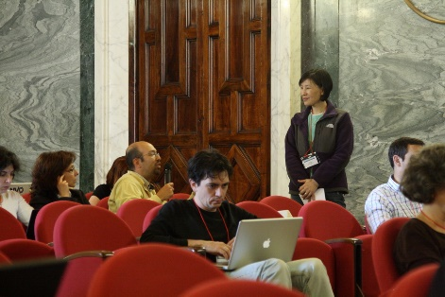
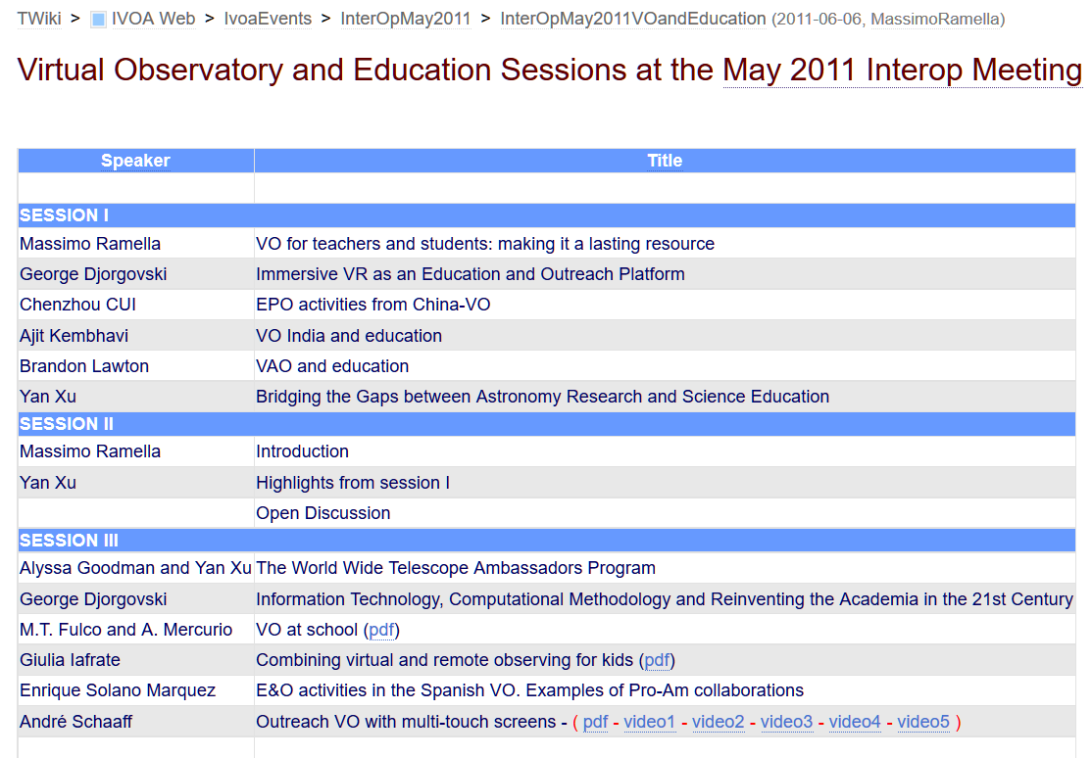
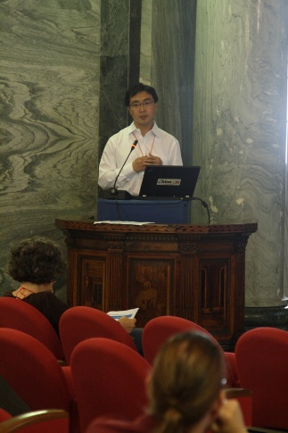
A brief review of IVOA EduIG
First Edu Session at IVOA Interop, May 16-20, 2011 hosted by University of Naples
  Yan XU, Chenzhou CUI and Massimo Ramella
Massimo Ramella presented the proposal for the interest group, and approved by the Exec on Oct 24, 2012
  Based on experiences from projects including EuroVO-AIDA, EuroVO-ICE, WWT, Aladin, …
  Chair: Chenzhou Cui; Vice Chair: Hendrikl Heinl
  Previous Chair: Massimo Ramella; Previous Vice Chair: Sudhashu Barway
Long term goal
  widest global distribution of VO tools, data and practices in support of astronomy teaching in schools and universities.

Slide 3
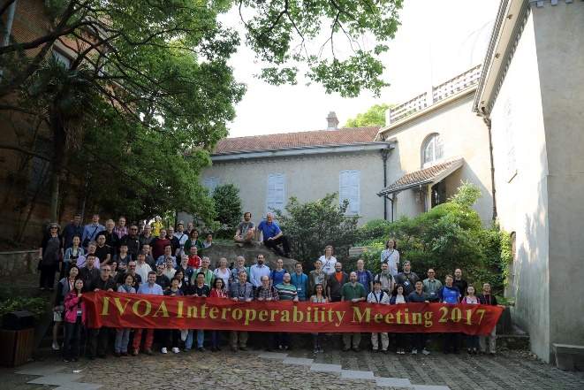
IVOA Organization Chart, Media Group Created
Executive
Committee
Committee on Science Priorities
Media Group
Technical Coordination Group
Standards & Processes Committee
Working Groups
Interest Groups
Applications
Data Access
Layer
Data
Model
Data Curation
& Preservation
Education
Theory
Knowledge Discovery in Databases
Solar System
Grid & Web Services
Registry
Semantics
Time Domain
Operations

Slide 4
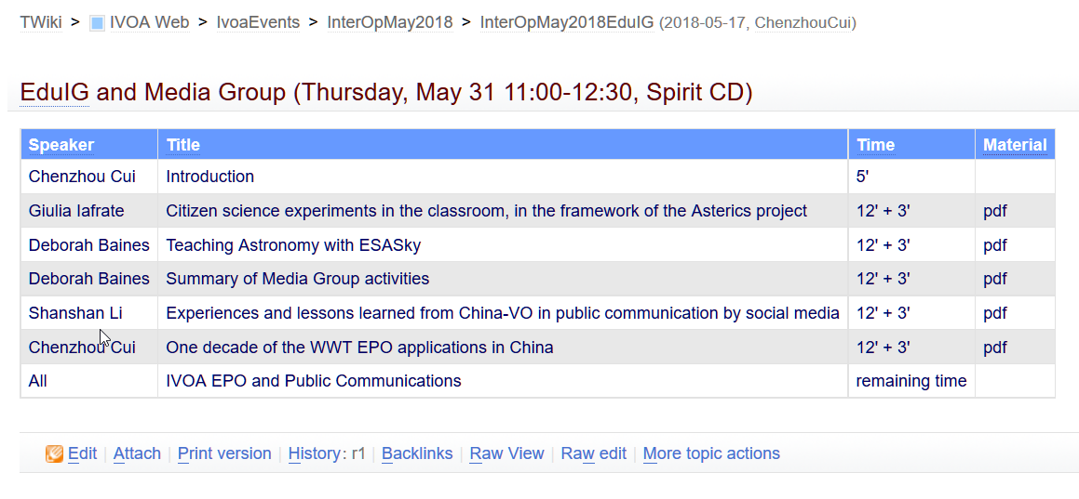
Education and Media Session

Slide 5
Discussion Topics
From loose Interest Group to close collaborations
  Now, mainly contributed from Chair and Vice Chair
  We hope to be crowd efforts
Improve the visibility of IVOA and VO projects in both astronomers and the general public
  VO training for developers at the Washington ADASS by Hendrik Heinl
  Press releases by public and social medias (together with Media group)
  Revamping IVOA website for the general astronomer (Media group)
Better contributions to big events and initiates
  IAU GA booth
  UN Open Universe
  AAS meetings

