Slide 1
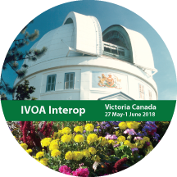
State of the IVOA Victoria, Canada 27 May – 1 June 2018
Pepi Fabbiano
Harvard-Smithsonian Center for Astrophysics
Chair of the IVOA Executive Committee
IVOA Interoperability Meeting Opening Session
Victoria, Canada, 27/May/2018

Slide 2
A Bit of History

Slide 3
Timeline of data access and interoperability
1960 1970 1980 1990 2000 2010
Beginning of computer connectivity
ARPANET
Internet
e-mail
1973 ARPANET standards for encoding messages
WorldWideWeb @ CERN
Global hyperlinked information system
Web Browsers
CERN, SLAC
Concept of Data Access and Inter-operability
Growth in societal Data Interoperability projects
FAIR data principle
Findable
Accessible
Interoperable
Reusable

Slide 4
1960 1970 1980 1990 2000 2010
Beginning of computer connectivity
ARPANET
Internet
e-mail
1973 ARPANET standards for encoding messages
WorldWideWeb @ CERN
Global hyperlinked information system
Web Browsers
CERN, SLAC
Concept of Data Access and Inter-operability
Growth in societal Data Interoperability projects
FAIR
Astronomers have been early adopters of these developments
e-mail
Data Services
NED
SIMBAD
NASA Data Infrastructure
Archives
Mission Centers
ADS at SAO
Literature access
Data-literature links
Virtual Observatory
Easy access to data, reuse
and inter-operability
National Projects
IVOA
European VO initiatives
UN Open Universe
Yes!!
Yes!!
Yes!!

Slide 5
Beginning – ESO conference of 2002 International Virtual Observatory Alliance

Slide 6
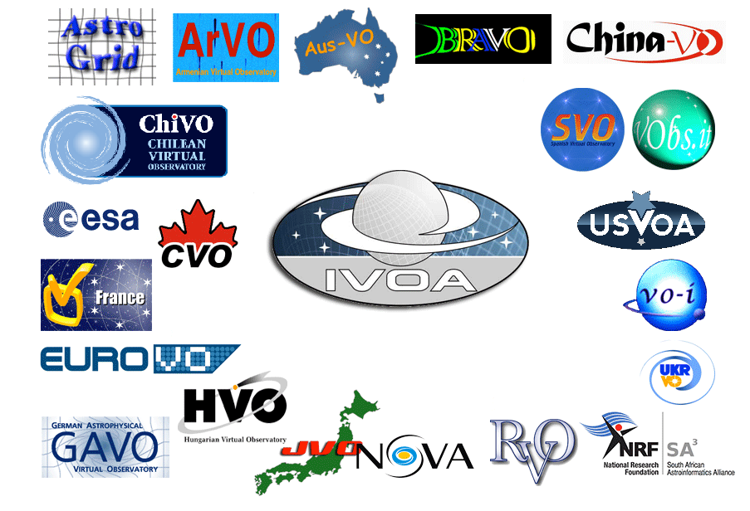
IVOA Today www.ivoa.net
Created in 2002, the International Virtual Observatory Alliance (IVOA) today has 21 member projects
The IVOA has no direct funding
Affiliated projects seek funding from their national agencies

Slide 8
Now – IVOA @ the IAU and United Nations
The IVOA has been promoted by the International Astronomical Union as the standards organization for FAIR data in astrophysics
The United Nations Committee on the Peaceful Uses of Outer Space (COPUOS) is recognizing the role of the IVOA
The Open Universe UN initiative (under approval) will be based on IVOA standards and collaboration with the IVOA

Slide 9
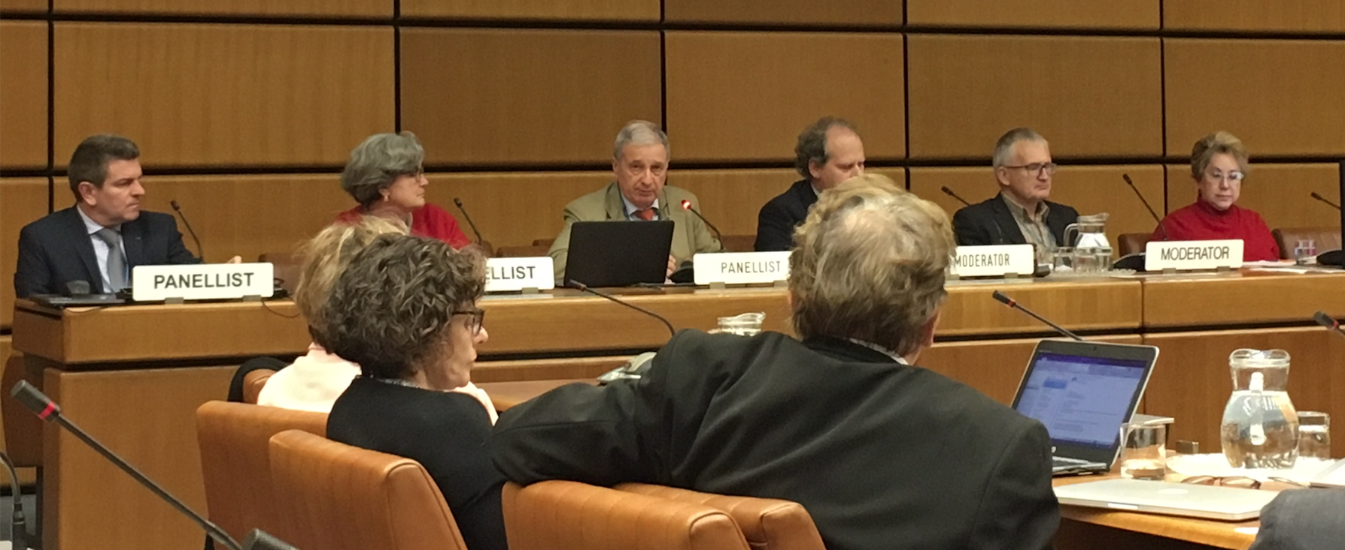
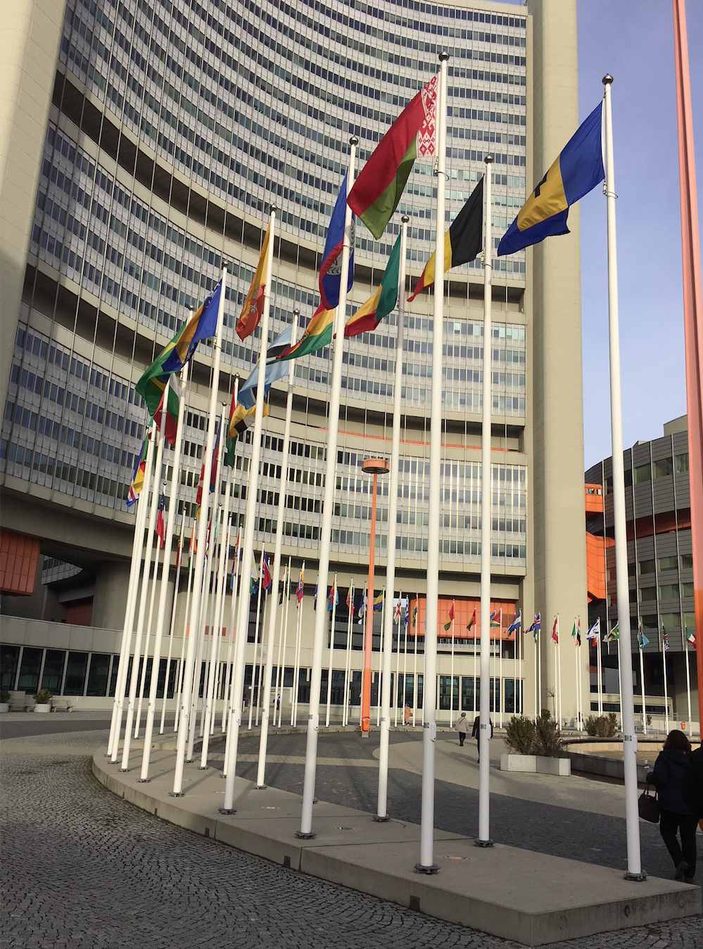
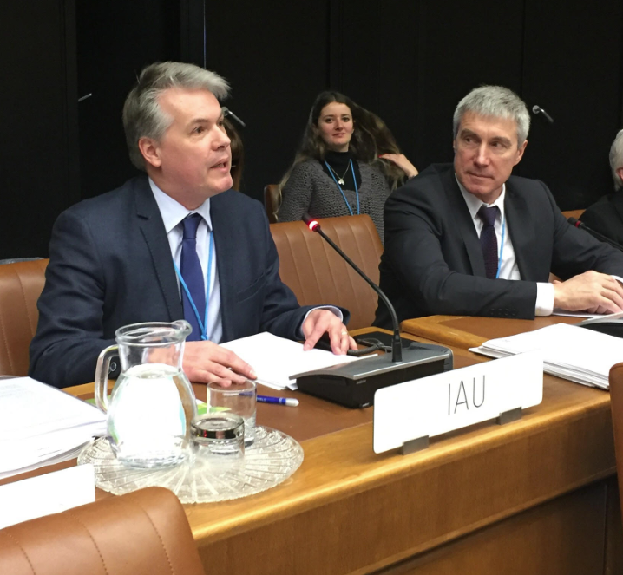
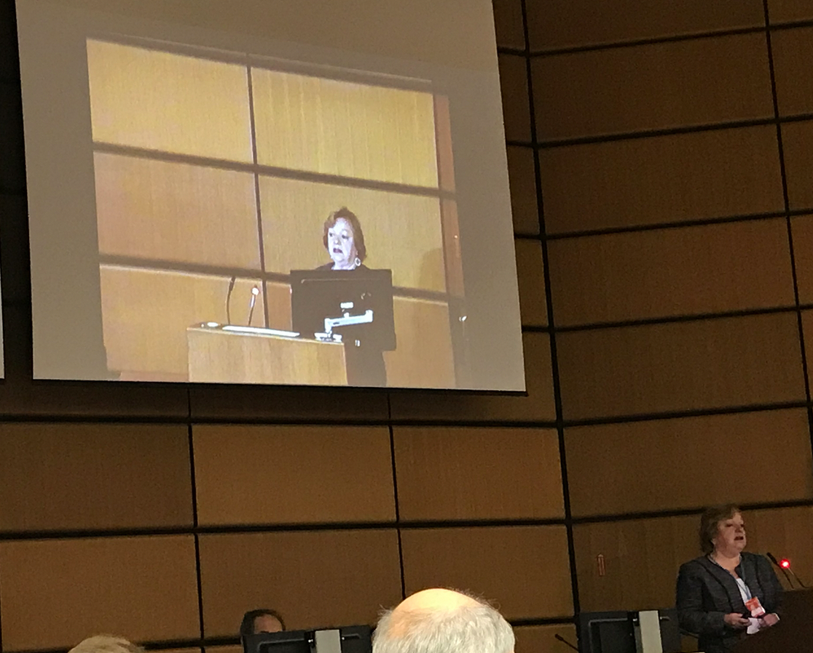
IVOA & IAU@ UN

Slide 10
Perception Reality Evolution

Slide 11
The Virtual Observatory
Perception
Failed experiment
No progress
No benefit to astronomers

Slide 12
The Virtual Observatory
Perception
Failed experiment
No progress
No benefit to astronomers
Reality
Overall successful
IVOA infrastructure implemented in major data centers and being adopted by new major projects
Hidden benefit to astronomers
…also visible but not recognized benefit

Slide 13
The Hidden VO & the User Community
Every time you access a major astronomy archive you are using the VO
More and more new data products and databases are produced by VO-native pipelines (e.g. GAIA)
Use of VO standards fosters archival data reuse
The archive/data user community is not just the old expert community
Use of NASA archives has risen after implementation of these interfaces
….fosters interoperability
Data-literature-tools links increasingly common (use of SAMP)
….reduces costs
…so more money for financing your science project

Slide 14
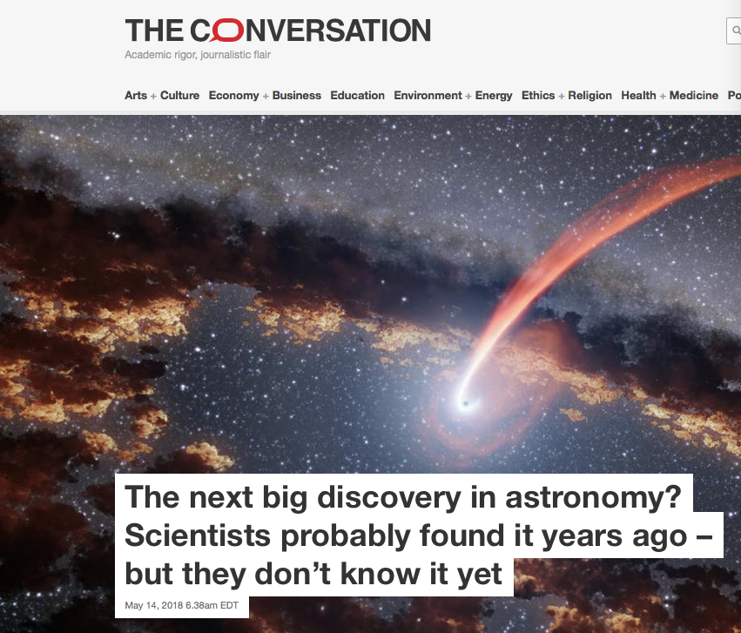
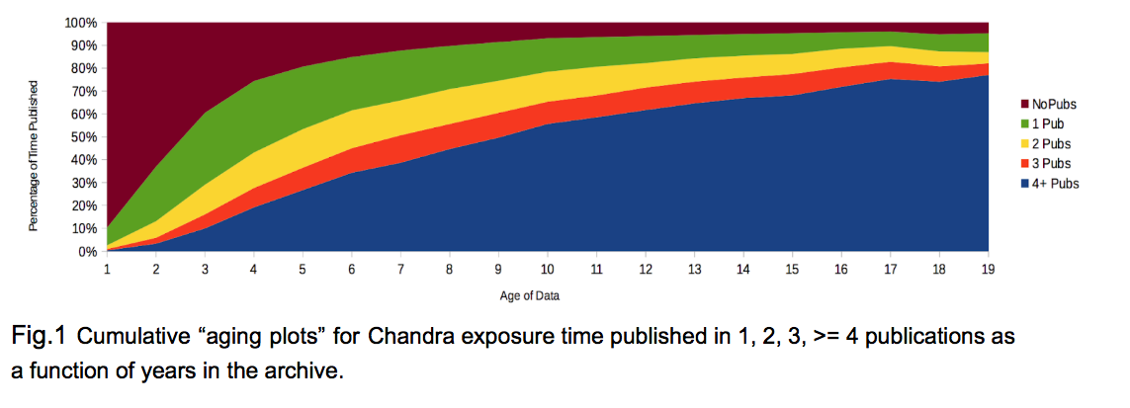
Awareness and Use of archival data are increasing

Slide 15
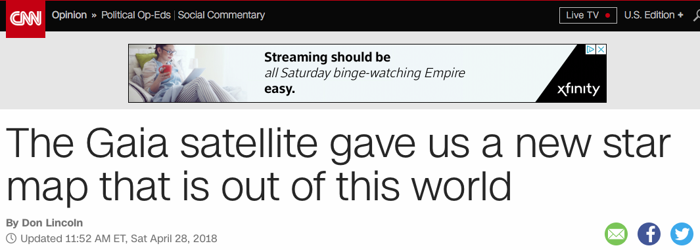
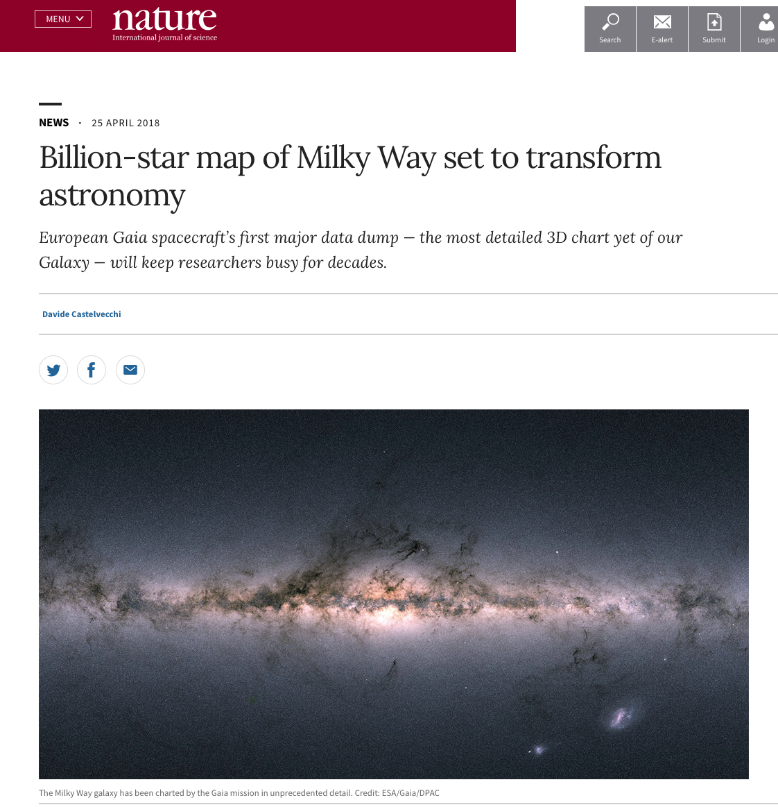
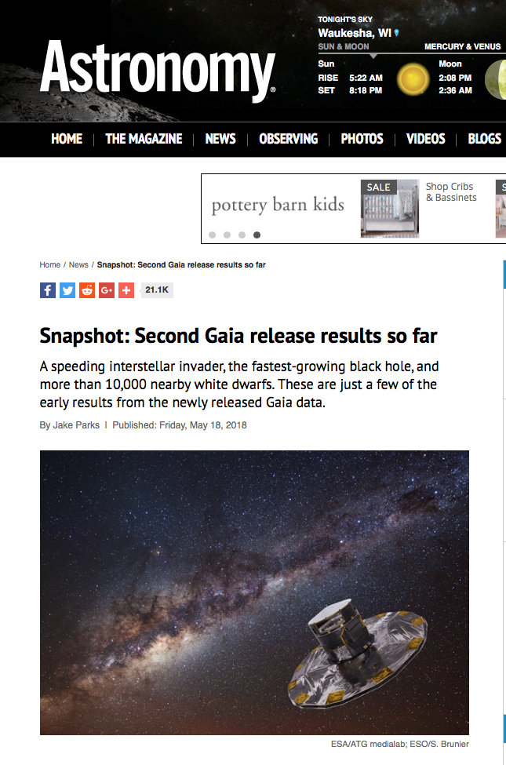
ESA’s Gaia is a tremendous world-wide success

Slide 16
All of this is based on the concept of the VO and on the use of IVOA standards …..but our colleagues and funding agencies need to be reminded

Slide 17
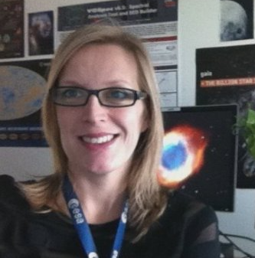
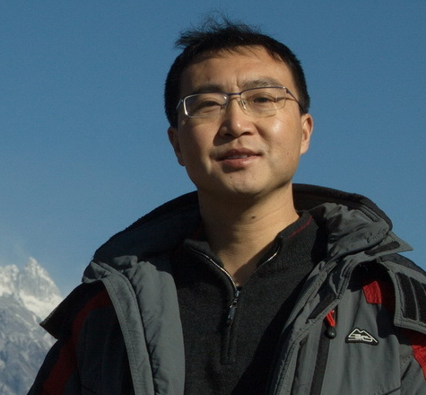
Increasing IVOA Recognition Media, Data, and Community Presence
The IVOA Media Group – chair Debbie Baines (ESA)
Two Newletters per year, following each Interop
Establishing Media presence
The IVOA Media Group and the Committee on Science Priorities [CSP – Chair Bruno Merin (ESA)]) working on an IVOA Data Portal
IAU Inter-Commission B2-C1-C2 WG Data Driven Astronomy Education and Public Outreach (DAEPO) was launched – chair Chenzhou Cui (IVOA EPO chair)
The IVOA Exec will have an IVOA booth – Mark Allen organizing

Slide 18
IVOA Standards and Community Needs
Commonly heard, even from IVOA members
The standard development process is
Top-down
Glacially slow
Standards are difficult to implement
Do we need to revise the TCG process and/or formalize successful practices?
E.g., HiPS and MOC standards development paradigm
Developed by Data Center to address pressing needs
Introduced to the IVOA for general acceptance
Parallel paths for ‘big’ and ‘small’ standards?
Process revision (see Sidney) / flexibility will be needed to respond to evolving project needs and adapt to changing s/w environment/culture
More hands-on ‘hackathons’ at astronomy meetings and ADASS on standards implementation? (e.g. VODML at this meeting)

Slide 19
Bridging the Divide with Astropy
Python is commonly used in astrophysics
The Astropy is a large grassroots community
We want to embrace this community and find a common ground
Escape the [unfair] ‘top-down-obsolete’ label
The CSP has begun IVOA outreach to Astropy
Individual data centers and national projects are also collaborating

Slide 20
How do we become more relevant for the astronomical user community?
Some ideas to start the discussion
Can Astropy and IVOA complement each other?
Critically assess Data Model work against data models already developed by the Astropy community?
Upgrade some of these to IVOA status?
Work with the Data Centers (i. e. ourselves) to produce general use IVOA standards libraries in Python?
FITS i/o was a main reason of FITS success
IVOA community based GIT repository?
Continue working for an increased tool / services/ data interoperability
Astronomers like interoperability (e.g. SAMP, TopCat, etc.) and use what is available (without relating it to the IVOA)

Slide 21
In summary….
The IVOA is a fruitful collaboration
We need to continue evolving
Challenges are opportunities
Compromising is sometimes winning
(….these are not platitudes)

Slide 22
Member News

Slide 23
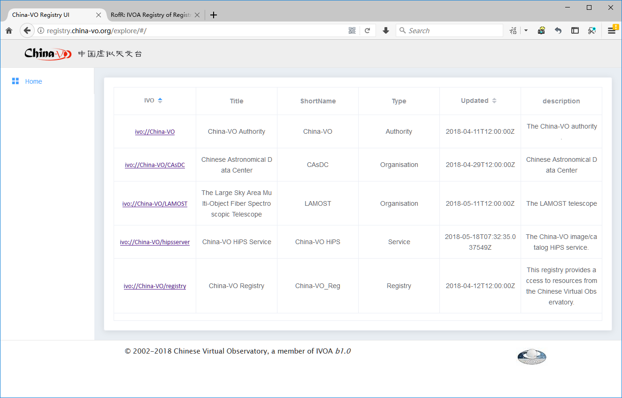
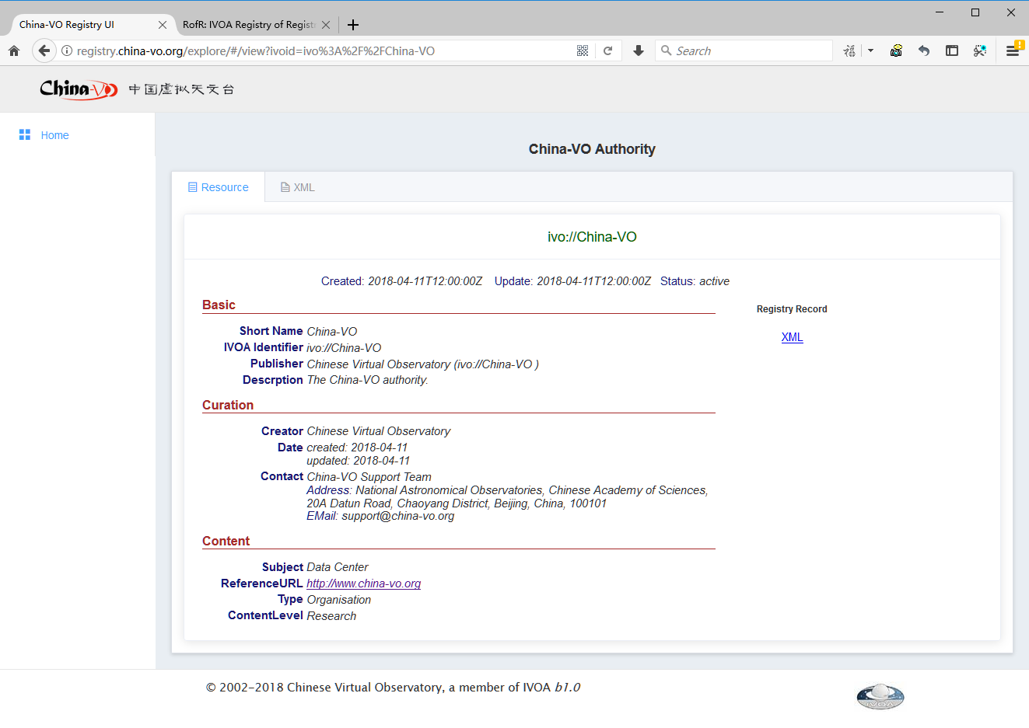
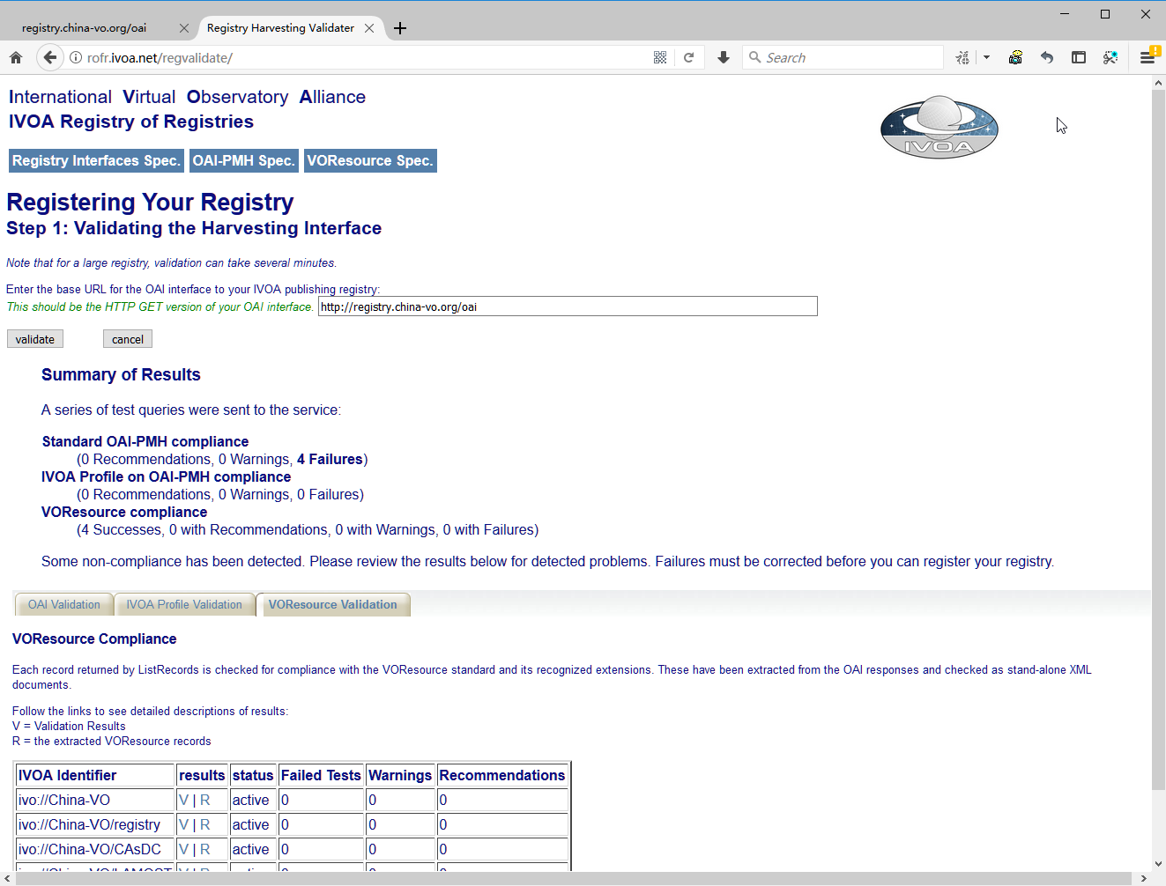
China-VO Registry gets online
Following the specifications of the IVOA, a China-VO Publish Registry (http://registry.china-vo.org) with extended backend metadata database has been developed in the last months. The system passed Validation of http://rofr.ivoa.net/ on May 17, 2018.

Slide 24
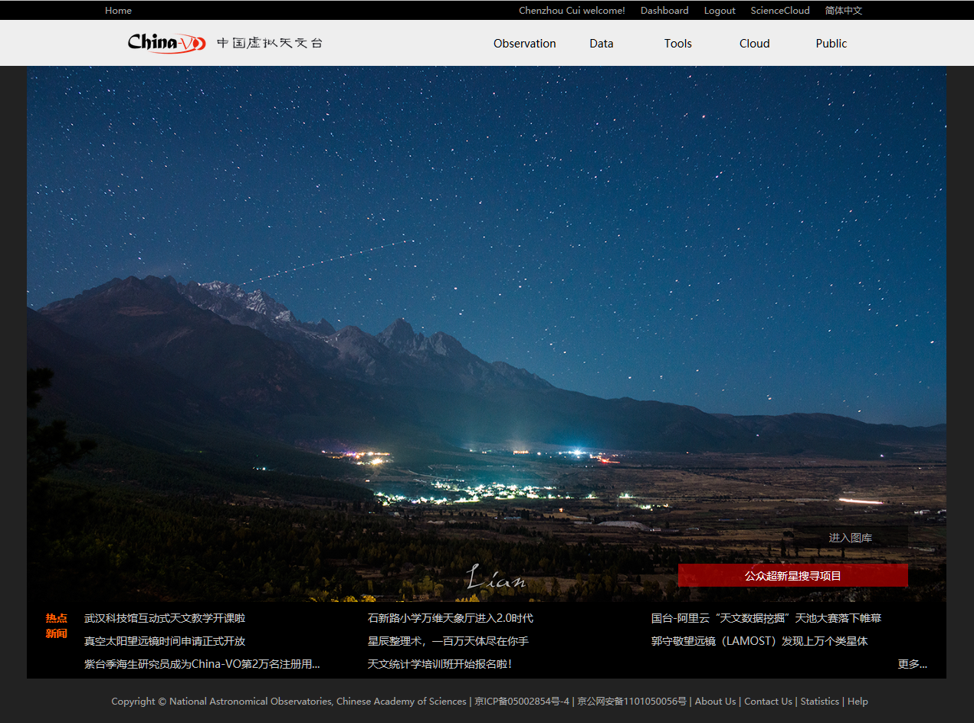
China-VO registered users reached 20,000
On April 25, 2018, Professor Haisheng JI from China Purple Mountain Observatory became the 20,000 registered user.

Slide 25
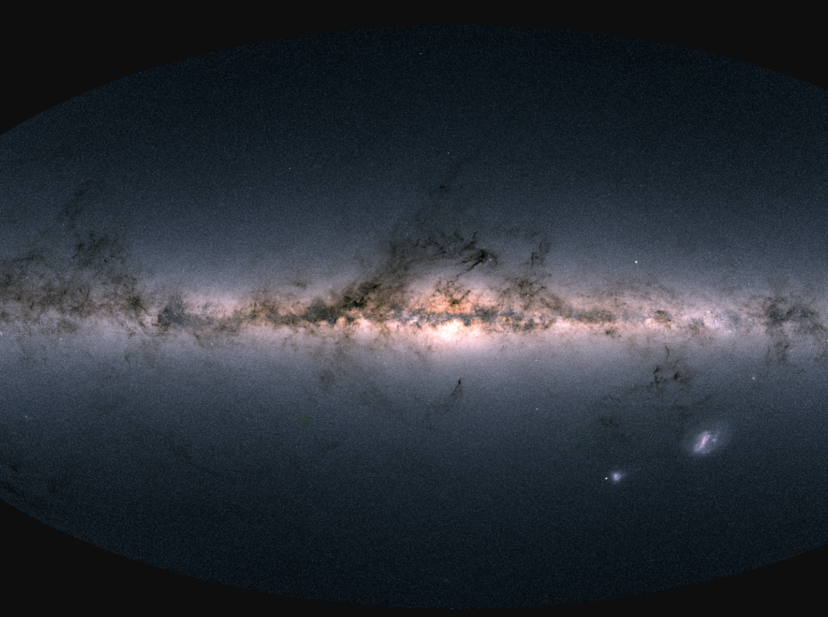
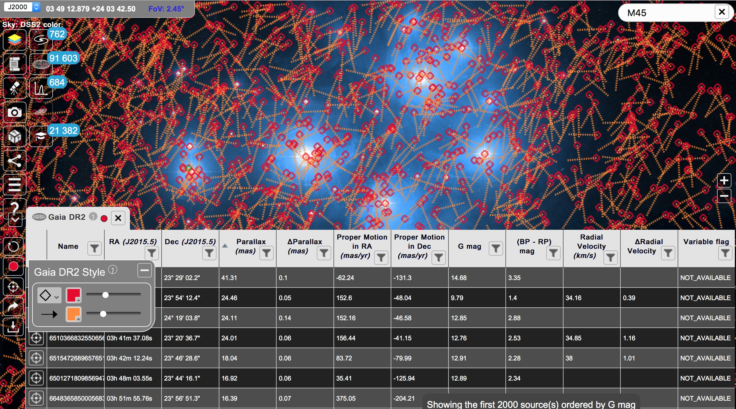
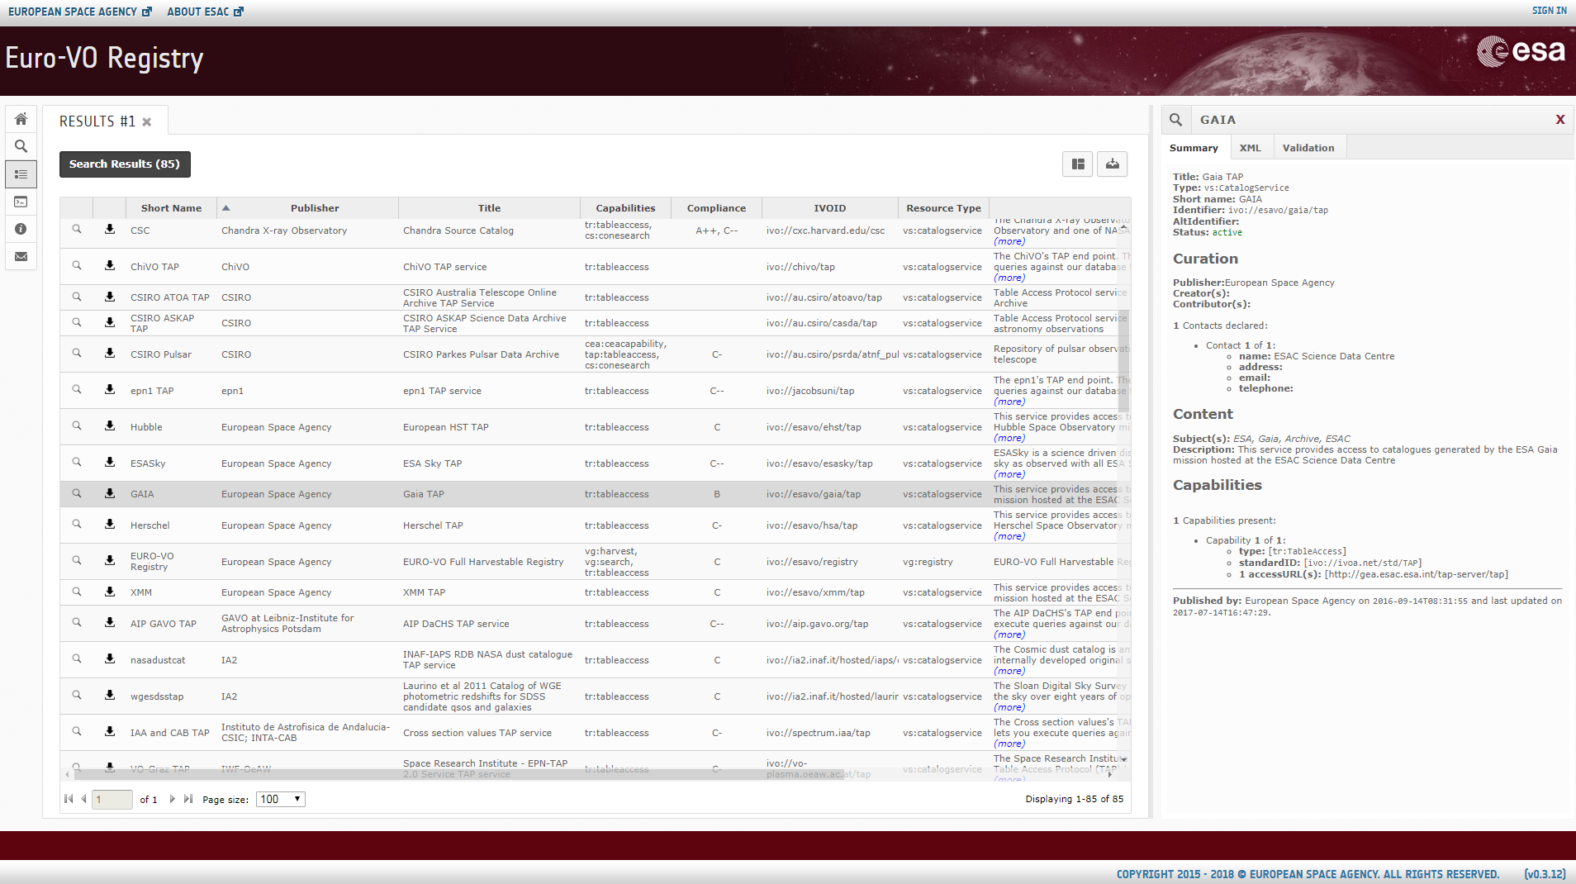
VO recent activities at ESA
Gaia DR2 released on April 25th
VO-built in ESA Gaia Archive
Big VO success behind the scene
ADQL, TAP, UWS, DataLink, VOSpace, SAMP
ESASky v2.2 released same day
Euro-VO Registry new GUI (on-going)
1st beta release by end 2018
More ESA TAP servers
EPN-TAP for Planetary Science Archive

Slide 26
Euro-VO activities within ASTERICS project (May 2015 – May 2019) - ASTERICS project web-site renewed - Many events directed at large European astronomy and astro-particle infrastructures (ESFRI*) - Technical forums – supporting coordination of VO development - VO Schools aimed at early career astronomers (tutorials on-line) - participation in RDA
*ESFRI – European Strategy Forum for Research Infrastructures

Slide 27
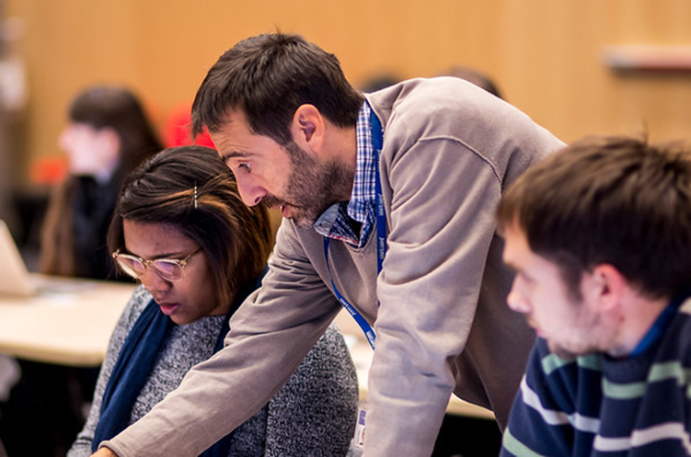
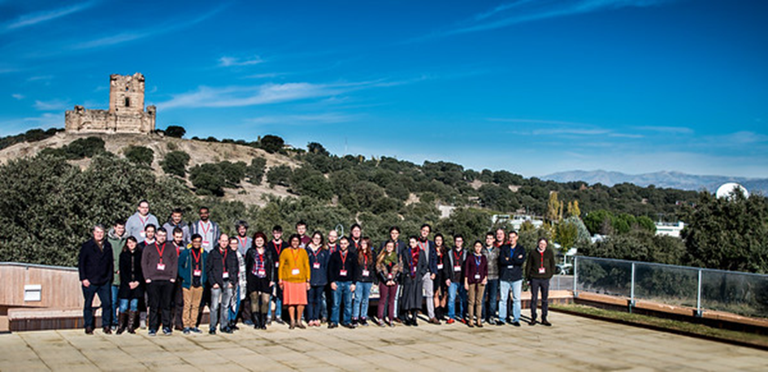
Third DADI VO School
14-16 November 2017, Madrid
23 participants, 10 tutors
Learn enough about the VO to be able to use it in one’s own research
Intro to VO
“Hands-on” tutorials
Participants’ projects
+ Gravitational wave tutorial
“EM follow-up of GW event”
http://www.euro-vo.org/?q=science/scientific-tutorials

Slide 28
Second ESFRI Forum & Training Event
13-14 December 2017, Trieste (+ New-comer Session 12 Dec.)
29 participants
Contributions by the ESFRI projects and VO projects
Topics: Time Domain, Radio interferometry data in the VO, EST (European solar Telescope) Polarimetry
Fourth Technology Forum
16-17 April 2018
21 participants
Topics: Registry, Science Platforms, python, time Series, Data link, SODA
Hack-a-thon

Slide 29
ASTERICS ”Data Access Discovery & Interoperability” – VO School
Strasbourg, France, Nov 20-22, 2018

Slide 30
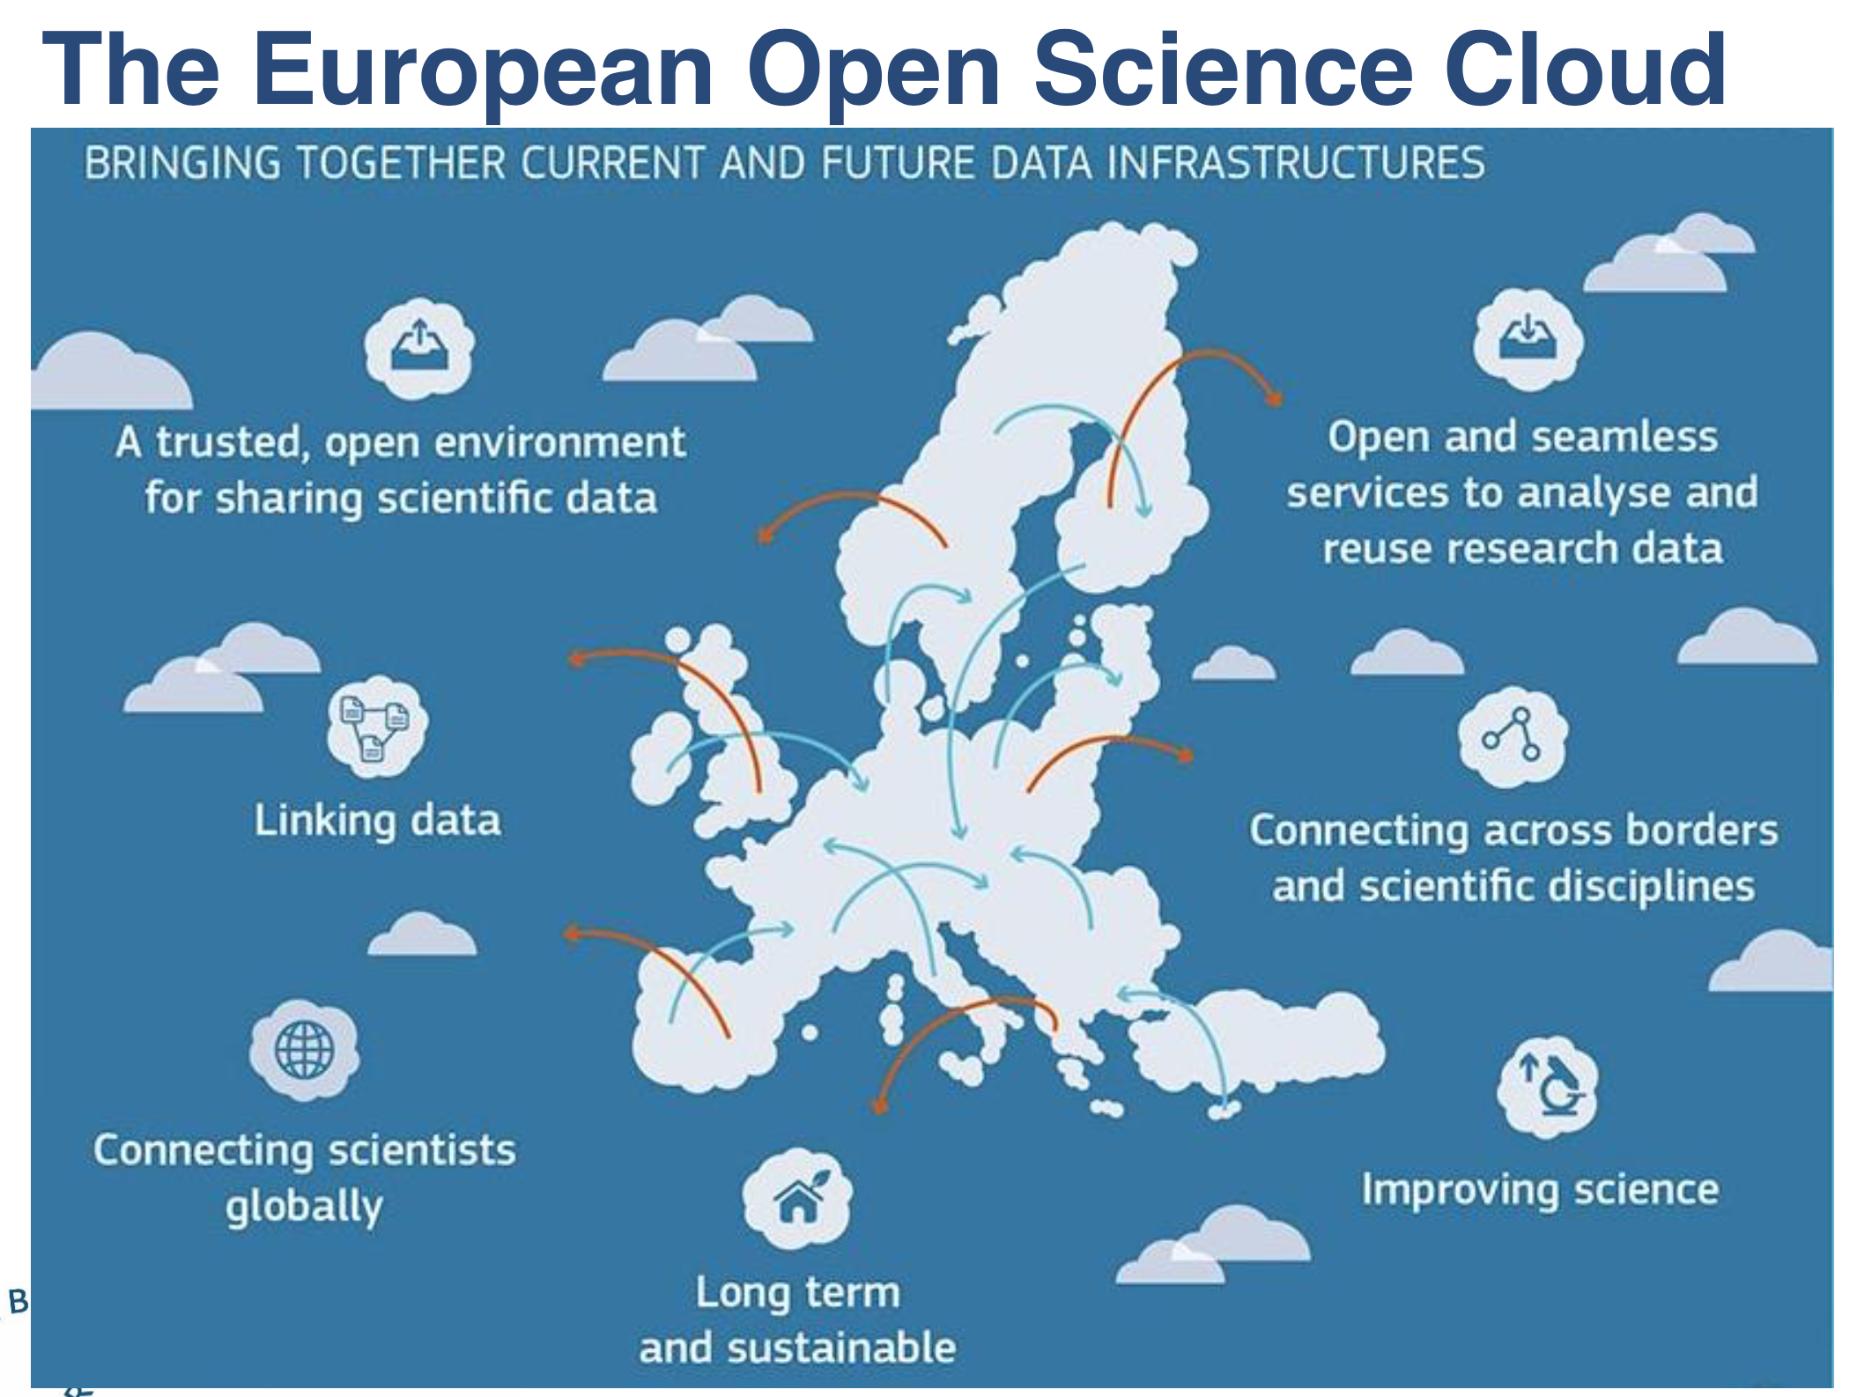
European Open Science Cloud - EOSC
European funding calls have been opened in the context of EOSC – proposal submitted (including Euro-VO partners)
VO to be mapped onto EOSC, & VO make use of EOSC resources
EOSC declaration – ESO, SKA, RDA-Europe, JIVE among first signatories
Opportunity to be involved in definition of EOSC

Slide 31
IVOA exhibit booth
August 20-31, Vienna, Austria
Inform international community about IVOA
Participation of all IVOA member projects encouraged
Demonstrations of VO services/tools
Standard booth
Table, 2 chairs, banners, poster
Video display – connect laptop/computer
Booth to be staffed 8-17h each day

Slide 32
Your help needed !!
IVOA member projects
Identify people attending IAU GA who can help at the booth
Coming soon – a sign-up schedule (organized into morning and afternoon blocks)
Prepare a flyer on your project using a template (expect deadline at end of June)
Prepare “demos” for the booth
Contribute IVOA promotional “goodies”
Media Group
IVOA flyer
Template for member project flyers
Contact M. Allen

Slide 33
German Astrophysical Virtual Observatory news
GAVO's DaCHS publishing suite has reached version 1.1 last November, with support for TAP 1.1
DaCHS version 1.2 with an almost all of ADQL 2.1, including the optional parts, will be released shortly after the interop
GAVO maintains blog at https://blog.g-vo.org
Posts on topics of more general VO interest (e.g., Gaia time series, STC in the registry, RegTAP hints).
If other VO projects would do similar things, we could have a "planet VO" atom feed that more people would subscribe to...
Something to consider……
Media Group?

Slide 34
US Virtual Observatory Alliance news
USVOA held annual face-to-face meeting at Jan 2018 AAS
NAVO
Annual review technical plans and budget review by NASA was successful
Actively developing Python interfaces to our VO Services
NAVO will hold a workshop on access to NAVO holdings at AAS in June
All the NAVO centers now have instances of TAP, SSA, SIA, and cone search protocols
LSST
Committed to using the VO
Working on ADQL/TAP and SIAv2 data access implementations
Adopting VOSpace in science platform
Extending the Firefly tool to support HiPS

Slide 35
US Virtual Observatory Alliance news
NOAO Data Lab IVOA implementation status
TAP - primary DB/catalog access
SIA - Multiple services for entire Science Archive and individual survey collections (v1 and v2)
SCS - Cone Search for each DB table w/ positional data
SSA - Implemented but not yet deployed
ObsCore DM - ObsCore tables available in TAP for data discovery
VOSpace - Basis of 'virtual storage' system. Intermediate Storage Manager interface to access large file collections (e.g. SDSS, brick/tile-based data releases from Legacy Survey/DES, etc)
UWS - Basis for upcoming Job Manager / Compute Service
VOSI - standard on all services
ADQL - for TAP queries
VOTable - service responses + supported table format in code
HiPS - used in web-based discovery tool, plans to deploy additional HiPS data and register as server
MOC - Not yet used but plans to provide coverage tools
Registry: Not yet deployed but plans to run a Publishing Registry of services following upcoming (June AAS) release
Will investigate how DataLink and SODA would fit into our compute service framework.
On the client side, a variety of custom code, AstroPy modules and packages from e.g. GAVO (for TAP clients). TOPCAT and Aladin are also part of the standard toolkit and science examples with accompanying SAMP functionality when appropriate.

Slide 36
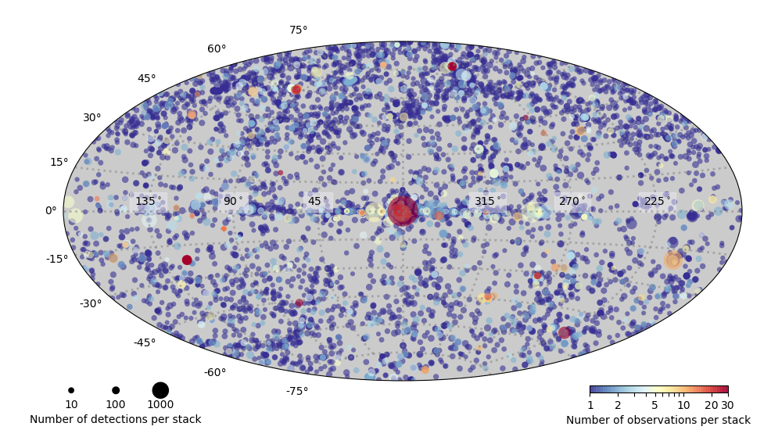
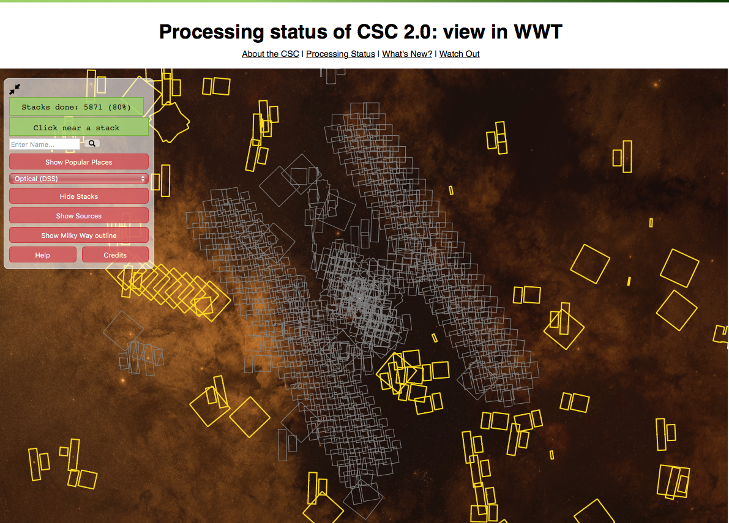
US Virtual Observatory Alliance news
CfA - CXC
Chandra Source Catalog (CSC 1.1) released in ESASky – HiPS & MOC
Implemented MOC interface for Chandra archival data
CSC 2.0 opened to public at Jan 2018 AAS
http://cxc.cfa.harvard.edu/csc2/
~370,000 sources from stacked observations
Tabular source properties
Per stack, field , and source data products for further analysis
Datacubes, images, spectra, light curves
CSC2.0 Processing status view in WWT
http://cxc.cfa.harvard.edu/csc2/wwt.html
New CSCview released (with SAMP)
The CXC Archive and Catalog make use of SIAP, ObsCore, SCS, TAP, ADQL, MOC, SAMP (and soon HiPS)
Maintaining the Registry of Registries

Slide 39
This Meeting

Slide 40
Attendance a focused working meeting
82

Slide 41
IVOA Organization Chart
Executive
Committee
Committee on Science Priorities
Media Group
Technical Coordination Group
Standards & Processes Committee
Working Groups
Interest Groups
Applications
Data Access
Layer
Data
Model
Data Curation
& Preservation
Education
Theory
Knowledge Discovery in Databases
Solar System
Grid & Web Services
Registry
Semantics
Time Domain
Operations

Slide 42
Exec Membership Changes
Lets welcome the new members of the IVOA Exec
Rafael Santos is the new BraVO representative
Tim Jenness is a new member of the USVOA representation
Thanks to Paula Coelho (BraVO) and Adam Bolton (USVOA) for their past service in the IVOA Exec

Slide 43
IVOA Term Expirations in May 2018
Working Groups
Applications: Pierre Fernique - Ch, Tom Donaldson - V Ch
Data Access: Francois Bonnarel - Ch, Marco Molinaro - V Ch
Registry: Markus Demleitner - Ch, Theresa Dower (1 year extension) - V Ch
Data Model: Mark Cresitello-Dittmar - Ch (1 year extension) , Laurent Michel (1 year extension) - V Ch
Grid & Web Services: Brian Major - Ch (1 year extension), Giuliano Taffoni (1 year extension) - V Ch
Semantics: Mireille Louys - Ch (1 year extension), Alberto Accomazzi (1 year extension) - V Ch
Interest Groups
Data Curation & Preservation: Francoise Genova – Ch
Operations: Tom McGlynn - Ch (1 year extension), Mark Taylor (1 year extension) - V Ch
TCG: Matthew Graham - Ch, Patrick Dowler - V Ch
Exec: Pepi Fabbiano - Ch, Mark Allen - V Ch
"1 year extension" means a 1 year extension is available

Slide 44
Progress in Standards (At the end of the Shanghai meeting) We now have 5 standards approved in Victoria

Slide 45
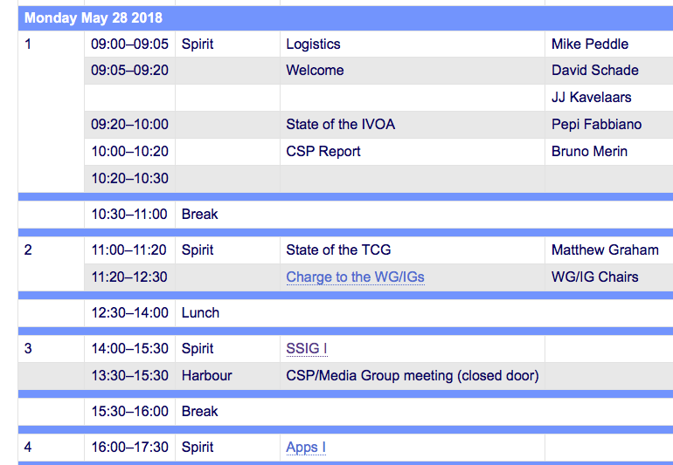
Lets go to work…
And now lets go to work…
We have a packed program
Thank you CADC
and the LOC

