Slide 1
Data Curation and Preservation
IVOA May 2017, Shanghai
Françoise Genova

Slide 2
Data Curation & Preservation Session
Tuesday, 11:00-13:30, Room E
All talks proposed deal with the Research Data Alliance
RDA activities and outputs (F. Genova)
Report on RDA P9 – Barcelona April 2017 (A. Schaaff)
Implementation of dynamic data citation/query store in VAMDC (C.-M. Zwölf)
Discussion
Disciplinary Interoperability Framework Interest Group being formed (D. Schade)
Allows participation of disciplines which do not have a formalized representation

Slide 3
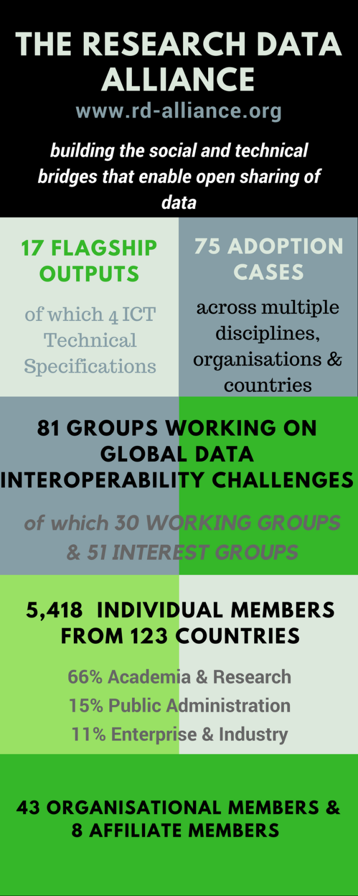
Vision
Researchers and innovators openly share data across technologies, disciplines, and countries to address the grand challenges of society.
Mission
RDA builds the social and technical bridges that enable open sharing of data.
In About RDA/Who is RDA
https://www.rd-alliance.org/sites/default/files/attachment/
RDA_in_a_nutshell_April_2017.pptx
CC BY-SA 4.0

