Slide 1
Closing Remarks
Pepi Fabbiano
Chair of the IVOA Executive Committee
IVOA Interoperability Meeting Opening Session
Shanghai, China, 14/May/2017

Slide 2
Great Attendance
116

Slide 4
10 New Standards Approved by Exec
Approved before this Interop
ObsCore1.1, SimDAL1.0, VTP2.0
Approved this meeting
HiPS 1.0
VOAI 1.1
SimpleDALRegExt 1.1
DocStd 2.0
SSO 2.0
SODA 1.0
DALI 1.1

Slide 5
IVOA Organization Chart
Executive
Committee
Committee on Science Priorities
Technical Coordination Group
Standards & Processes Committee
Working Groups
Interest Groups
Applications
Data Access
Layer
Data
Model
Data Curation
& Preservation
Education
Theory
Knowledge Discovery in Databases
Grid & Web Services
Registry
Semantics
Time Domain
Operations

Slide 6
IVOA Organization Chart
Executive
Committee
Committee on Science Priorities
Media Group
Technical Coordination Group
Standards & Processes Committee
Working Groups
Interest Groups
Applications
Data Access
Layer
Data
Model
Data Curation
& Preservation
Education
Theory
Knowledge Discovery in Databases
Solar System
Grid & Web Services
Registry
Semantics
Time Domain
Operations

Slide 7
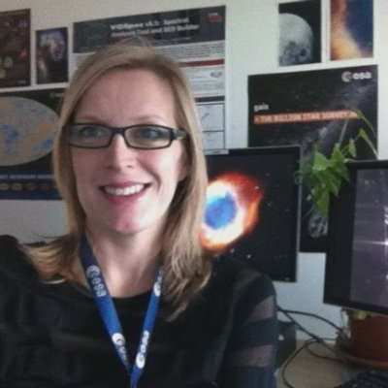
The IVOA Media Group
Welcome to the Media Group
Debbie Baines (ESA) – Lead Newsletter Editor
Simon O’Toole (Aus-VO)– Lead for other media presence
Li Shanshan (China-VO)
Yihan Hao (China-VO)
Jamie Anne Budynkiewicz (USVOA)
Teresa Dower (USVOA)
Giulia Iafrate (Italian VO)
Group in charge of assembling & producing IVOA newsletters
Also exploring a more complete media presence
If interested in helping out, ask Debbie
June 17 issue of Newsletter being prepared

Slide 8
Solar System Interest Group Chair: Baptiste Cecconi

Slide 9
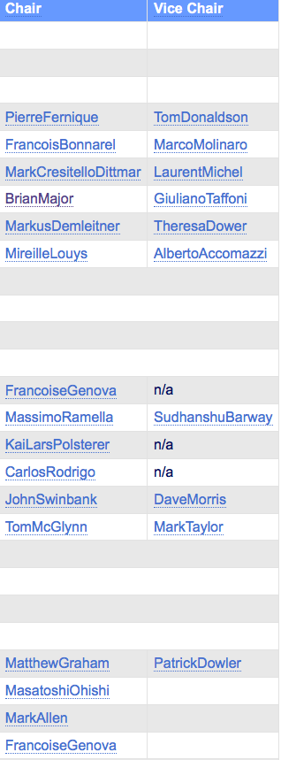
Chair & Vice-chair Rotation
Possible 1yr ext.
No ext.
Ready to move on

Slide 10
Chair & Vice-chair Rotation
Possible 1yr ext.
Chenzhou Cui
Hendrik Heinl
Chenzhou Cui
All Extended
Ada Nebot
Solar System
B. Cecconi
Media Group
Debbie Baynes
Bruno Merin
C. Arviset

Slide 11
New Outlook for the Education IG
Chair: Chenzhou Cui of China-VO
Vice-Chair: Hendrik Heinl of GAVO
Two [related] challenges ahead
Strenghten the world-wide representation by including ‘regional coordinators’
Present a strong IVOA representation in IAU and in the UNOOSA Open Universe initiative
Vienna meeting

Slide 12
New Outlook for the CSP
Chair: Bruno Merin of ESA
IG Chairs are now ex-officio members of the CSP
Need to widen the membership at large

Slide 13
Future Interops
27-29 Oct. 2017 – Santiago, Chile - after ADASS
Northern Spring 2018 – [near] Victoria, Canada
Northern Fall 2018 – [near] Washington DC, USA – after ADASS
Northern Spring 2019 – France
Northern Fall 2019 – Potsdam, Germany – after ADASS

Slide 14
Submission and Registration available from adass.cl

Slide 15
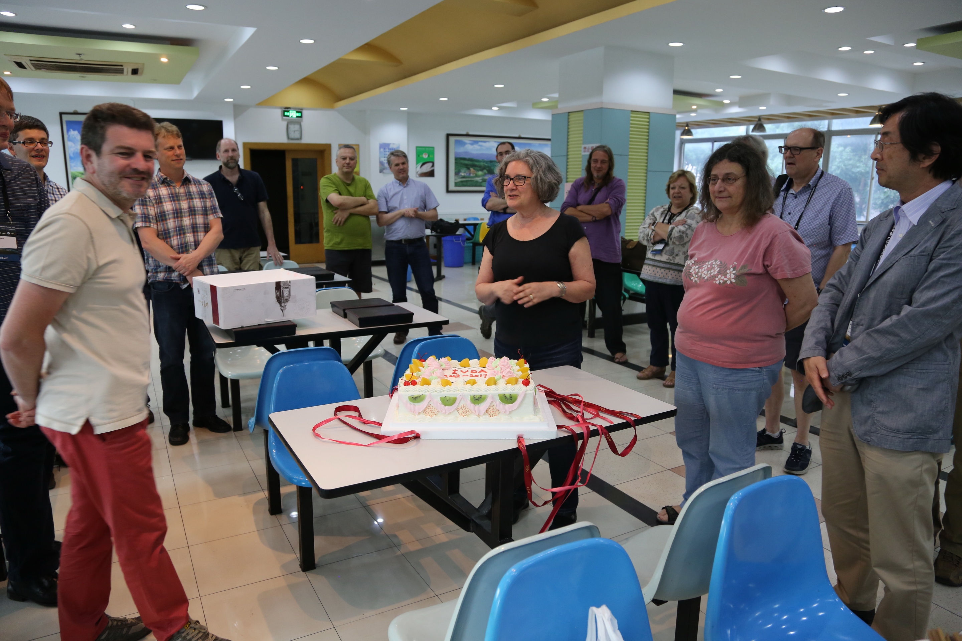
The 15 years of IVOA

Slide 16
The 15 years of IVOA

Slide 17
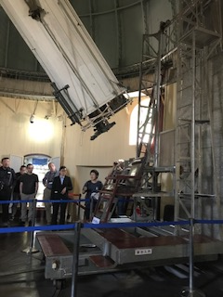
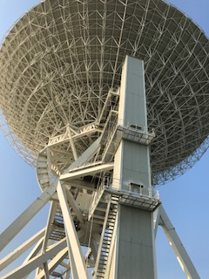
Thank you, China-VO

