Slide 1
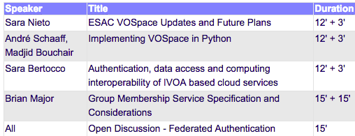
GWS II

Slide 2
VOSpace Implementations
VOSpace Host / Authority | Specification Version
ChinaVO | ??
CADC | 2.1
OATS-INAF | 2.1
ESAC | 2.0 ?
CDS | ??
NOAO | ??

Slide 3
GWS Interest Telecons
Containers
VOSpace

Slide 4
GWS Participation
Code to Data
Containers
Describing the code and parameters
Publications, reproducability
Machine learning
Mailing list
Federated Authentication
Recommendation of approach
Mailing list
GWS Specification
Mailing list
How to write a VOSpace
Simple implementation

Slide 5
Federated Authentication

