Slide 1
IVOA Provenance METAdata
Current STATuS
Mireille Louys
Kristin Riebe, MathieuServillat, Michèle Sanguillon, François Bonnarel, Markus Nullmeier

Slide 2
Working draft update
Last working draft issued :
WD-ProvenanceDM-v1.0-20170512.pdf at
http://wiki.ivoa.net/twiki/bin/view/IVOA/ObservationProvenanceDataModel
Modelio 3.6 model available
To be completed for documenting each class/ attributes/relation
VODML-Provenance.xml representation
Improved
Still a few problems in understanding the design constraints UML→ VOML

Slide 3
Draft Structure proposed
A logical path :
Use cases
Domain model : the abstract shape in UML 2.0
Conception model : the UML translation in VOML
Description of classes and relations
How to use the model : discussion section
Experience in adopting the model for various use-cases
DB tables declarations examples
Queries examples and their response in various formats : JSON, VOTable, PROV-N
VOTools for Provenance : VOPROV-Python package
Serialisation in all formats W3C and VOTable

Slide 4
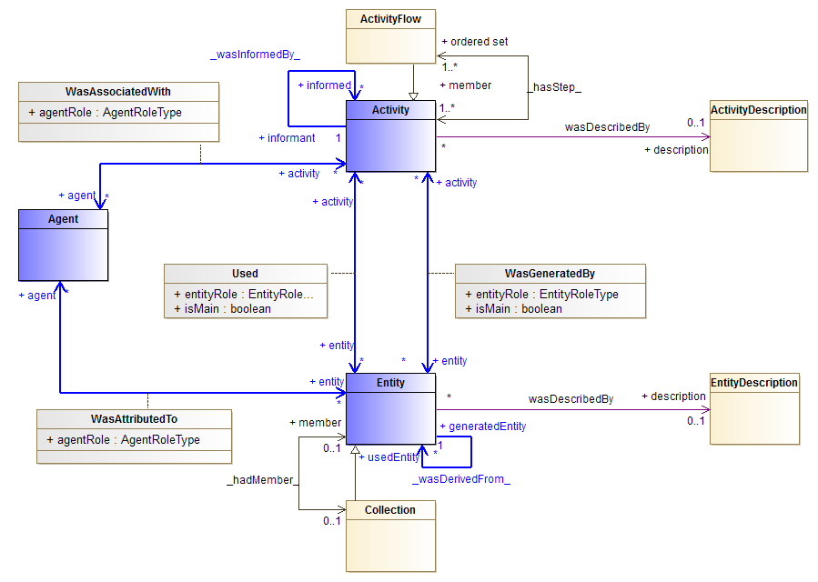
Domain Model - Provenance - 2017 May11
UML v. 2017May15

Slide 5
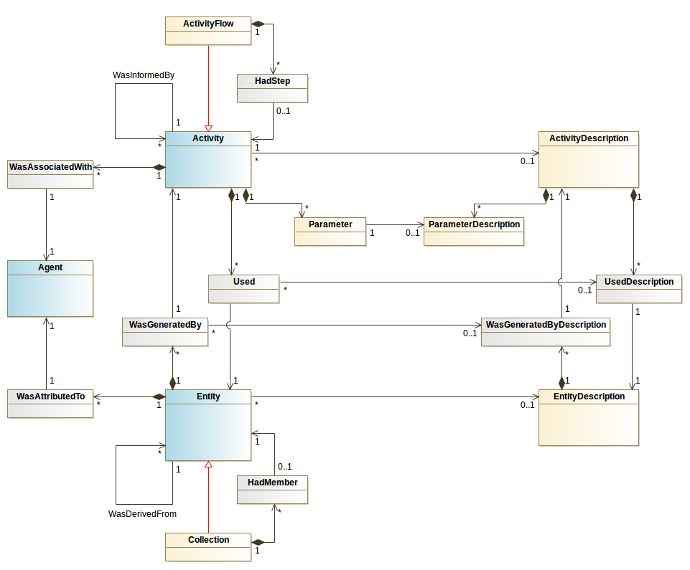
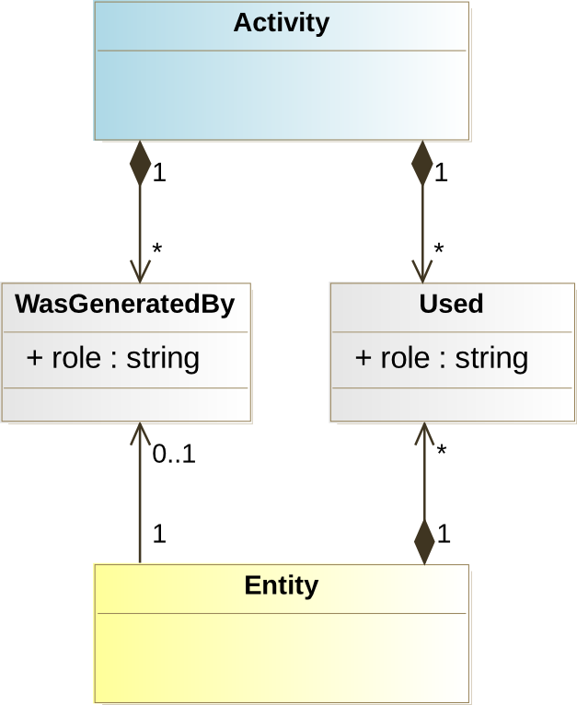
Conception Model - Provenance
Searching compliancy for VODML ingestion
DB implementation Focus
VODML
UML v. 2017May15

Slide 6
VODML compliancy
Many *< ----> * relationships in the Domain model
How to properly translate this to our conception model?
Using double aggregation/compositions:
not allowed by VO-DML, produces validation errors
Use one composition + 1-1 reference? => Still being discussed

Slide 7
Current design questions
How to bind to subsets classes of existing IVOA models and
represent ancillary data

Slide 8
Agent → ActivityDescription relation (MS)
Describe the algorithm, goals, and limits of the code used by an Activity
Bind the author of the code to the ActivityDescription class instead of Activity
Distinguish :
Realisation/execution of a task → operator Agent
Description of this task → author Agent for the code
Description classes as W3C entities
They are published , versionned, bound to authors
WasAttributedTo relation

Slide 9
Entity, Dataset,EntityDescription
Entity Vs dataset
Keep it general as w3C entities
Allow hooks for any category of data
Simulation, observation, log file, list of parameter , etc
Is the goal of Entity description to make explicit the binding to existing IVOA DMs
EntityDescription
Type :
Observation → ds:Obsdataset.dataproduct_type
Simulation → sim:Dataset.output , etc… cf mapping table in appendix
Ancillary → custom mapping //to be defined //
Notes:
Allocate precise meaning and roles for these 3 concepts

Slide 10
How to access Provenance metadata
Various scenarios to consider: on going work
2 step discovery (dataset focused)
Discover a data set (event list, image, etc.) as in ObsTAP
Select Provenance elements from a ProvTAP service using the Entity.id
Access provenance description via a datalink service
Embedded Provenance description into the Dataset serialisation ( ex: Json serialisation in FITS extension , SVOM)
Provenance TAP service
Query Provenance DM from a SimDM implementation
Cosmological simulation data mapped to ProvDM (KR)
Mapping is easy due to existing provenance concepts in SimDM
see SimDM-ProvDM mapping table in WD, table 13.

Slide 11
Prototyped Use cases on the way
Cosmological simulations (K. Riebe)
Links with SimDM
CTA pipeline (M. Servillat)
recordind of Provenance embedded in the pipeline code
Pollux data base A data product (M. Sanguillon)
Synthetic and theoretical spectra
Hips generation ( F. Bonnarel)
Tracing back the generation of HiPS surveys
SVOM provenance design (L. Michel) starting

Slide 12
Outside VO community
RDA meeting Barcelona April 2017
A plan to have a Provenance WG in RDA
Charter beeing prepared, IG→ WG launch waiting for approval
Re-use of existing work Prov W3C DM and suite
Connection to IPAW conferences and ANDS Australian librarian circle
Plan to gather Provenance use-cases across disciplines ex: Blue Brain Project (Swiss, Samuel Kerrien )
Data + prov solutions
A catalog to be maintained by the WG group

Slide 13
Conclusion
Adoption of the existing W3C provenance Model framework
Implementation tests for 4 use-cases are on the way
A variety of use-cases with different access and serialisation strategies
Coupled interaction between astronomical projects and modeling → prototypes in an Agile-like process

