Slide 1
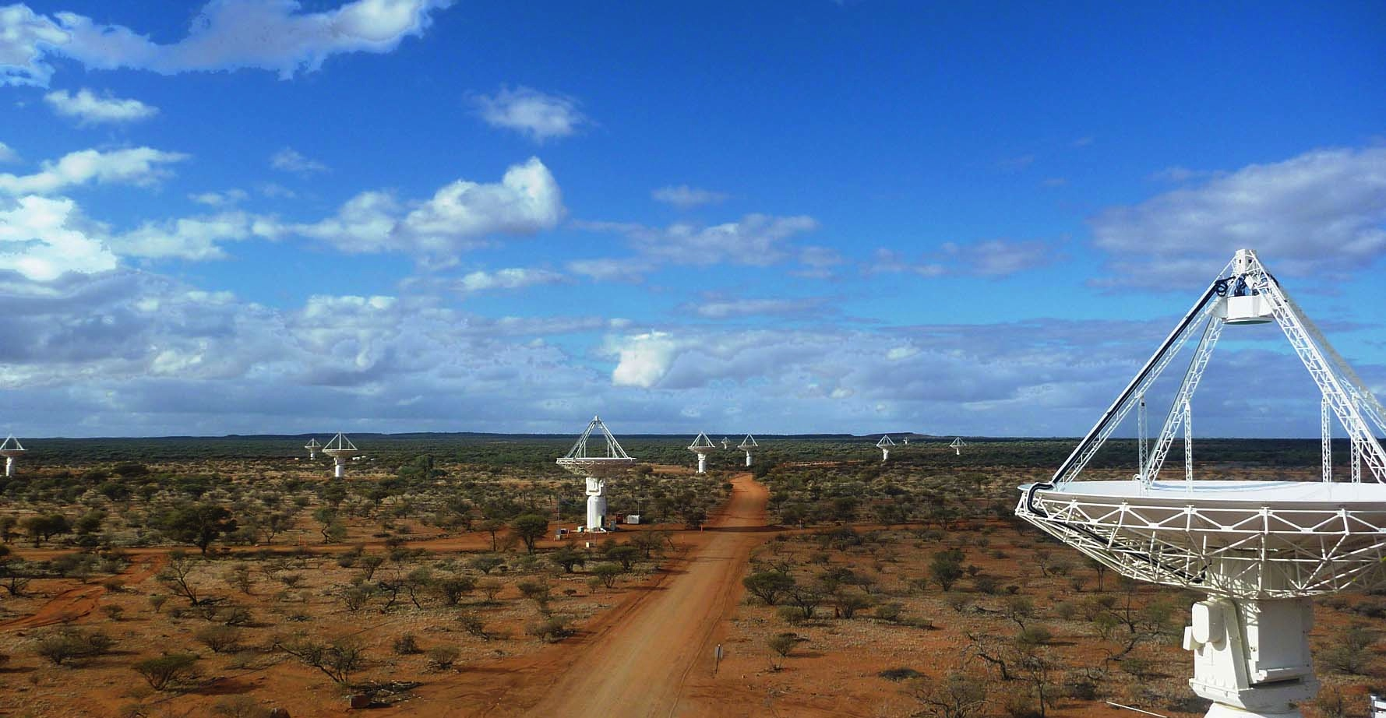
The CSIRO ASKAP Science Data Archive Progress and Plans
Jessica Chapman, CSIRO
CSIRO astronomy and space science

Slide 2
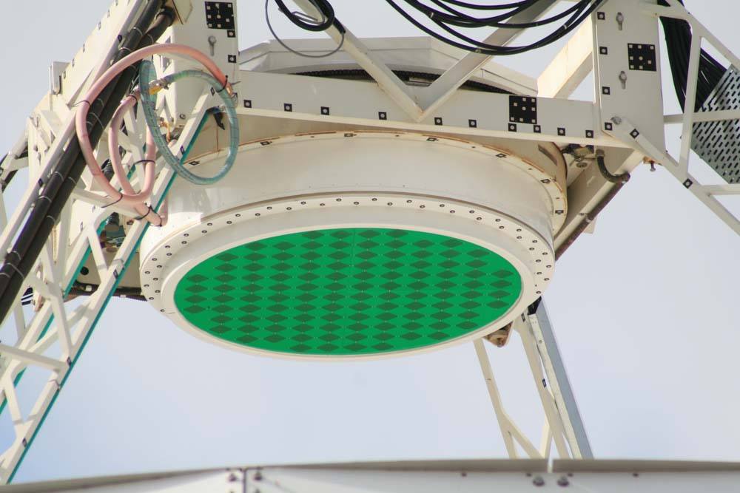
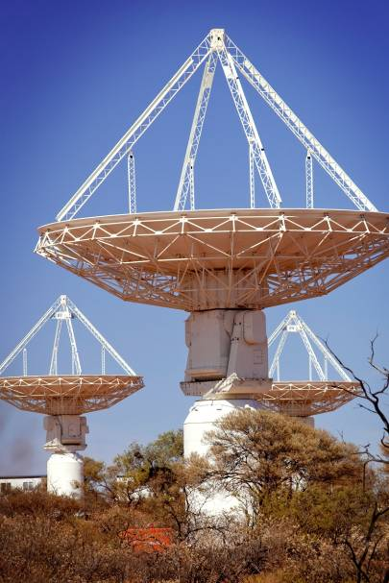
Australian SKA Pathfinder (ASKAP)
36 × 12 m dishes
Max baseline = 6 km
Phased Array Feeds – 188 elements
Up to 36 beams
30 deg² Field of View
700 – 1800 MHz
300 MHz Bandwidth
16,200 spectral channels
Early Science begins in late 2016

Slide 3
ASKAP commissioning with the BETA array (six ASKAP antennas)
Wide Field Imaging with 6 antennas
and 9 beams on each antenna
Mosaic of the Tucana region.
Some parameters
Image area = 150 square degrees
Number of pointings = 12
Total observing time for full image = 33 h
Thermal noise = 375 microJy/beam
Credit: Ian Heywood, CSIRO

Slide 4
First ASKAP image with 36 beams and MKII PAFs
Wide Field Imaging with 9 antennas and 36 beams
Some parameters
Image area = 30 square degrees
Total observing time for full image = 11h
Frequency = 939.5 MHz
Bandwidth = 48 MHz
Thermal noise = 300 microJy/beam
About 1,300 sources

Slide 5
ASKAP Data Management

Slide 6
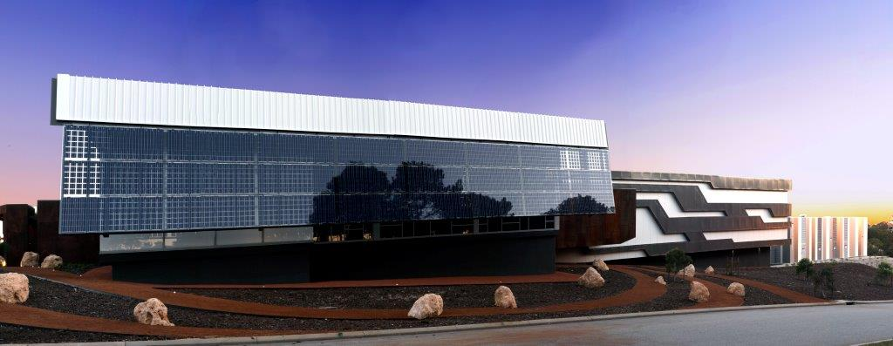
The Pawsey High Performance Computing Centre for SKA Science
AUD$80M super-computing centre
~ 25% use for radio astronomy operational use

Slide 7
ASKAP pipeline data processing: Outline work flow
Uncalibrated visibility data received from correlator
Apply corrections and calibrations → calibrated visibilities
Fourier Transform and further process the data → astronomy image and image cubes
Search images for astronomy sources → source ‘detections’
Write source detections into tables
Send finished data products to CASDA

Slide 8
ASKAP Data Products
Calibrated visibility data files
archived for all continuum data (as 300 channels x 1 MHz)
Images (2-d) and image cubes (3-d and 4-d)
continuum, spectral line, polarisation, moment maps ..
Catalogues
source detection tables (with data quality information)
project-related information
ASKAP data products from the Survey Science projects are made publically available for general use after data quality validation. (No proprietary period)
CASDA data rate for full operations: 15 TB per day, 5 PB per year.

Slide 9
The CSIRO ASKAP Science Data Archive (CASDA)
CASDA provides a ‘big data’ science archive for ASKAP Data Products. The application supports:
Long term data storage at Pawsey Centre
Searches and data access using CSIRO Data Access Portal and VO services
Data uploads of science catalogues provided by Science Teams
Tools for setting data validation flags and quality information
User authentication and tools to manage team members
Digital Object Identifiers (DOIs)
Archive administration tasks: user mgt, queue control, monitoring and reports etc.

Slide 10
CASDA web access is through the CSIRO Data Access Portal

Slide 11
CASDA Virtual Observatory (VO) Services
CASDA includes VO data services that make use of international protocols:
VO Service | Notes
Table Access Protocol | Access to source detection catalogues Cross-matching
Cone Search Protocol | Simple cone-searches around given positions.
Simple Image Access Protocol (v2) SODA, Datalink | Access to images and image cubes. 2-d, 3-d, 4-d image cut-out service
All VO services can be accessed programmatically – i.e. with python scripts

Slide 12
VO services
The CASDA VO software uses CDS libraries (ADQL, UWS and SAVOT).
CASDA VO services are provided through a CSIRO VO registry.
Users are encouraged to use TopCAT for catalogues and to develop python scripts for catalogues and images
CASDA provides its own interface for SIAPv2
CASDA VO software is now available and can be configured for use with other applications.
Promoting VO
Many radio astronomers have little experience with using VO services. Documentation and training is provided.

Slide 13
CASDA in Production
First release (Version 1.0 Nov 2015) :
Key goal: Be ready for use with start of ASKAP Early Science
and also:
Open access to science data products from BETA observations
Established three-tier service agreement
User support through helpdesk system
Provide user documentation, example python scripts and training sessions
VO TAP and cone searches and some early SIAPv2 development

Slide 14
CASDA production v1.1 (Feb 2016)
Scripted access to large data files via VO protocols, including authenticated access
SIAP v2: 3-d image cube cut-outs including spatial, spectral and polarisation filtering
Provided example python scripts for producing bulk image cut-outs based on a catalogue
Team member access to unvalidated (restricted) data products via VO protocols
Support for fast transfers within Pawsey Supercomputing Centre for users with Pawsey accounts
Team self-administration of project roles (e.g. allocation of validation rights for a project)

Slide 15
CASDA v1.2 (April 2016): Application Upgrades
Many small changes to improve usability, based on user feedback
Data Access Portal search form extended to handle multiple cone searches at a time
The search tools have improved handing for data products that are produced from more than one scheduling block.
Added information on (~40 different) image types and set up a CASDA ‘vocabulary’ for this.
SODA extended to include 4D image cubes and additional features for obtaining cut outs from 2D and 3D images and cubes.

Slide 16
CASDA v1.2: Software Release April 2016
Open release of CASDA VO tools application (with DoI) through the CSIRO Data Access Portal.
Other major CASDA application software through github.

Slide 17
CASDA Stage II Planning: Next steps
1-d spectra and time domain data products
Full CASDA support for images/cubes, spectra, time series, cross-matched catalogues etc provided by Science Survey Teams as ASKAP ‘post-archive’ data products
Extend CASDA to include legacy data products from surveys taken with the Australia Telescope Compact Array and Parkes radio telescope.
All CASDA data collections have ‘progressive’ DoIs.

Slide 18
CASDA support for ATNF legacy surveys
About 20 large-scale or ‘legacy’ surveys carried out with Parkes and/or Australia Telescope Compact Array
Science teams have produced high quality data products (images, spectra, catalogues)
Their results are published and data products are stored but with limited access
Archive services for these ATNF data products will significantly extend their ‘re-use’ for science research.

Slide 19
Other CSIRO VO Services
Facility | What it is | Notes
Australia Telescope Online Archive | Unprocessed ATNF radio data from the ATCA, Parkes, Mopra and Long Baseline Array. 200 TB data with 372,000 files 6.2 million scans 1.1 million sources | Makes use of CASDA VO software for TAP and Cone Search Some complexities in the ‘translation’ between the ATOA data model and a easy-to-use TAP service. Status: At test stage
Pulsar catalogue | Catalogue of pulsar properties for all published pulsars | VO TAP/cone search Status: Initial planning
Pulsar VO archive | 400 TB Parkes pulsar data | Older TAP implementation Status: To be upgraded

Slide 20
A few comments
We have been able to implement the protocols to a ‘good state’ for end-users.
A few issues have merged. These include:
UCDs – we would like some additions for radio astronomy
SODA: Cube coordinates – would like pixel values added
Obscore – suggest adding data product types for catalogues and for single dish radio astronomy data
But overall – good progress and users seem happy!

Slide 21
To get started with using CASDA see the CASDA Users Guide
www.atnf.csiro.au/observers/data/casdaguide.html

Slide 22
CASS Senior Data Scientist in Astrophysics
Position available!
If interested – please contact Jessica Chapman or Simon Johnston
Jessica.Chapman@csiro.au
Simon.Johnston@csiro.au

Slide 23
CSIRO Astronomy and Space Science
Jessica Chapman
Data Management Leader
t +61 2 9372 4196
e Jessica.Chapman@csiro.au
w atnf.csiro.au
CSIRO astronomy and space science

