Slide 1
Data Based Astronomical Education and Citizen Science
Chenzhou Cui
Shanshan Li, Dongwei Fan, with the whole China-VO team

Slide 2
A brief survey
Please rise your hand if you are under 35+
Both VO and IVOA need more young individuals involved

Slide 3
Contents
Data in the classroom and Citizen Science
Popular Supernova Project
Worldwide Telescope

Slide 4
Data

Slide 5
Why Teach with Data?
To teach with data usually requires curricular revision and a willingness to give up some control of the classroom. So, what's the upside? Below are six reasons most commonly cited by education experts:
As an active learning strategy, teaching with data increases retention
Working with data introduces students to problem-solving techniques for the messiness of real-world problems
Teaching with data supports critical quantitative reasoning capacities
Teaching with data can teach modeling skills
Working with real data raises questions of ethical research
Hands on research shifts attitudes toward science and quantitative analysis
http://serc.carleton.edu/sp/library/twd/why_teach_data.html

Slide 6
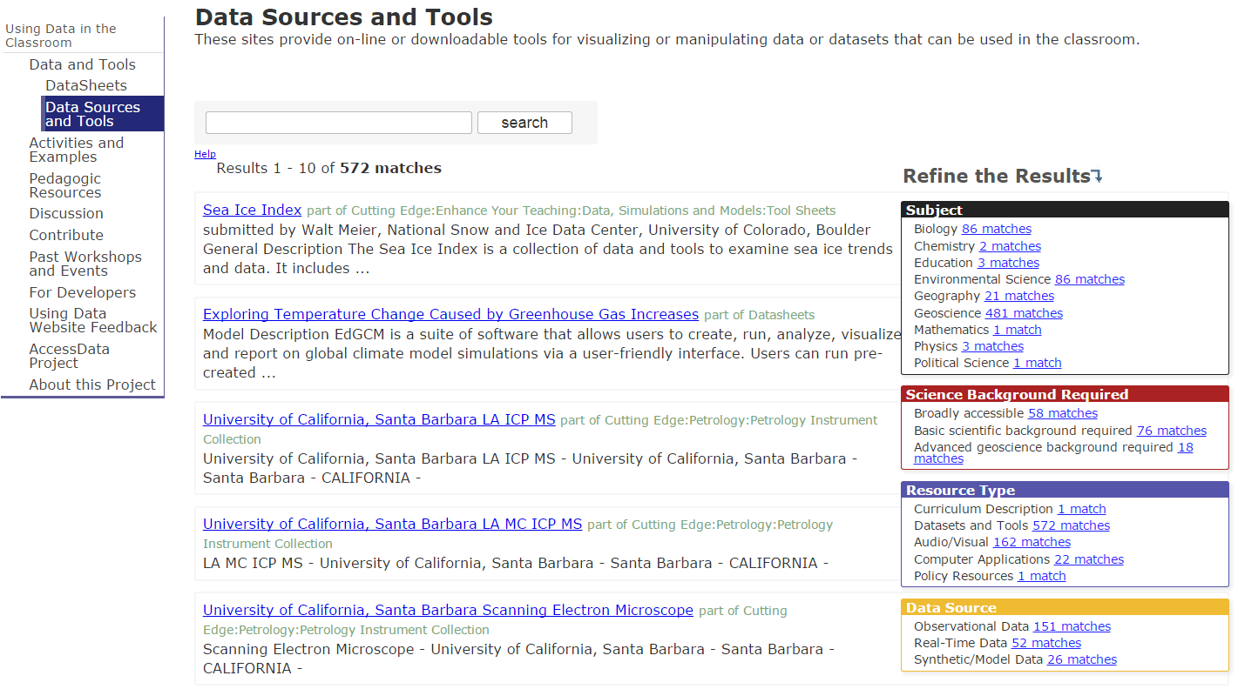
Carleton College Science Education Resource Center：Using Data in the Classroom (~2002-2005)
Engaging students in using data to address scientific questions has long been an integral aspect of science education. Today's information technology provides many new mechanisms for collecting, manipulating, and aggregating data. In addition, large on-line data repositories provide the opportunity for totally new kinds of student experiences. This site provides information and discussion for educators and resource developers interested in effective teaching methods and pedagogical approaches for using data in the classroom.
For Resource Developers
For Educators
Resources
http://serc.carleton.edu/usingdata/index.html

Slide 7
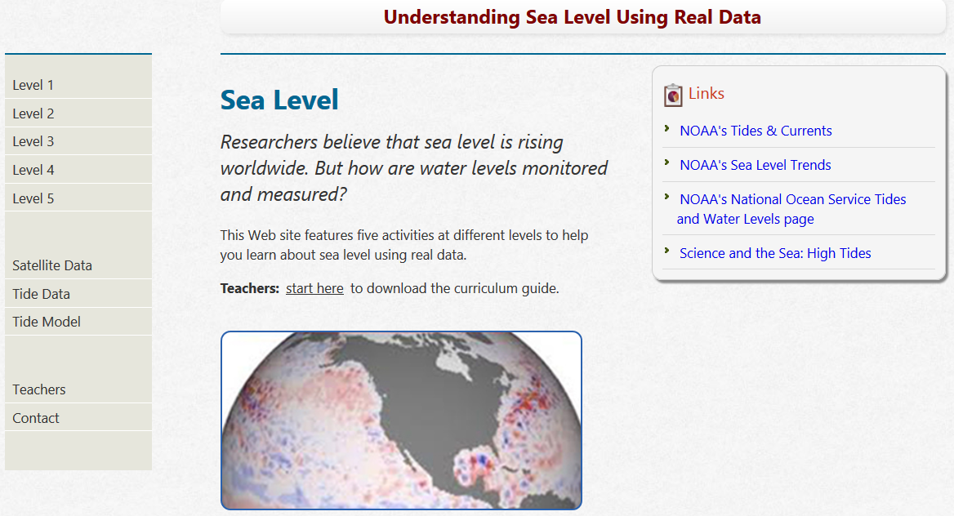
http://dataintheclassroom.noaa.gov/DataInTheClassRoom/

Slide 8
Great Reasons to Use Citizen Science in Class
Sense of Community and Place
Recognition of Self Importance
Understanding that Research isn’t Just for Scientists
Reaching Different Types of Learners
Development of Critical Thinking Skills
Use of Multiple Skill Sets
Application of the Scientific Method
Meeting Next Generation and Common Core Teaching Standards
By Karen McDonald at “http://scistarter.com/blog/2014/03/benefits-citizen-science-classroom/#sthash.6q51Eqja.dpbs”

Slide 10
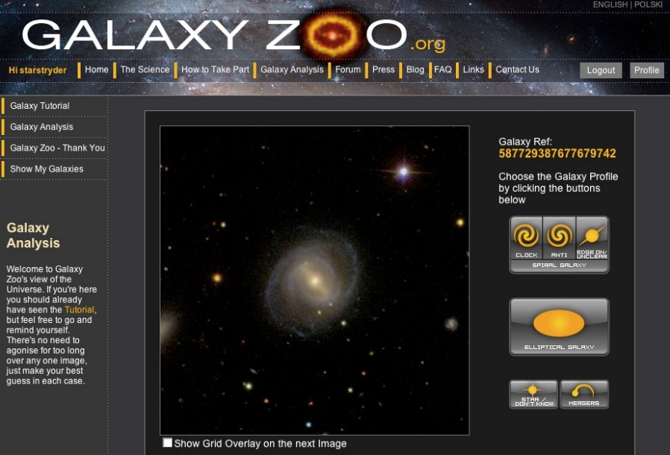
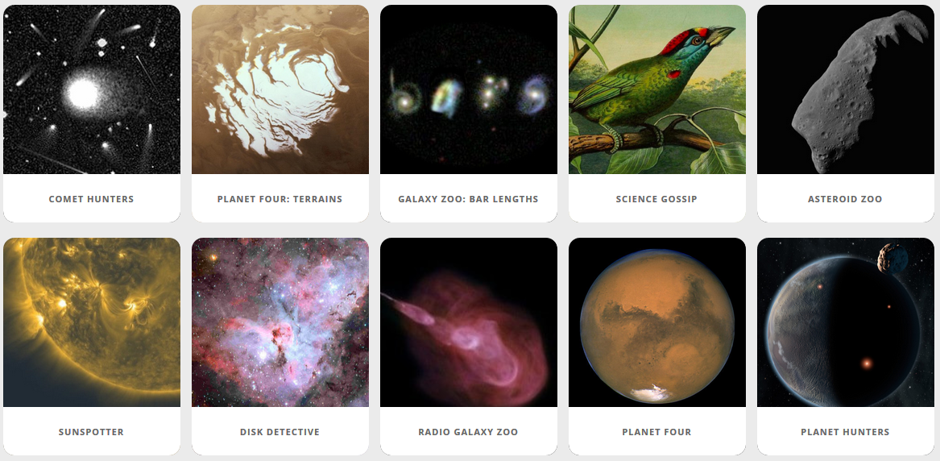

Slide 11
PSP INTRODUCTION
Popular Supernova Project，PSP, designed by Xingming Observatory and Chinese Virtual Observatory (China-VO) provides a platform for the public to make real astronomical discoveries. PSP is based on data from amateur astronomy observatory. It provides a new way of public education and citizen sciences, which effectively combine web technologies and astronomical learning together.

Slide 12
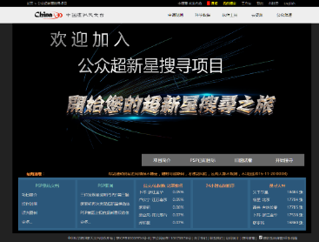
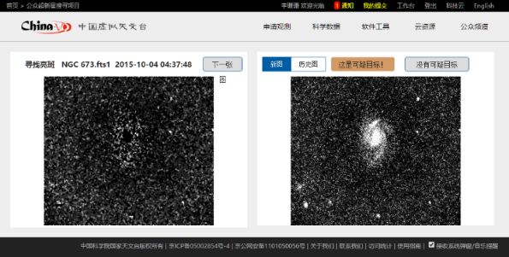
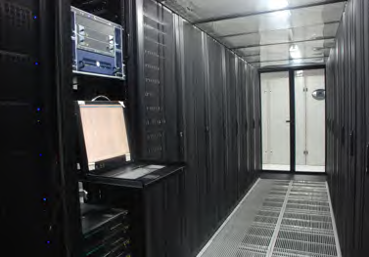
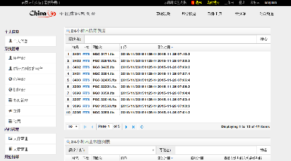
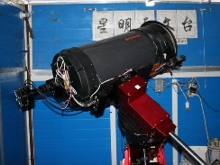
Website platform
psp.china-vo.org
Amateur astronomer
browse online
China-VO
Data Center
SUPERNOVA
Advanced user
review
Professional
Observation
And confirm
Xingming
Observatory
In Xinjiang
Report to IAU/CBAT
TOCP
Check the
suspected target
Notes:
PSP发现的超新星侯选体上报及确认流程 1、PSP普通用户在PSP平台内上报给高级用户 2、PSP高级用户经过判断确认为疑似目标等待补拍（排除噪点、鬼影、已知恒星，已知超新星，已知小行星，已知变星，并根据经验确定值得补拍） 3、星明台望远镜当晚补拍确认或者第二晚补拍确认是疑似超新星目标 4、由高级用户负责写发现报告并上报IAU\CBAT，在TOCP网页贴出疑似坐标。并抄送超新星权威网页站长 IAU ：dwe_green@eps.harvard.edu CBAT ：cbatiau@eps.harvard.edu TOCP：http://www.cbat.eps.harvard.edu/unconf/tocp.html 站长http://www.rochesterastronomy.org/snimages/；David Bishop (dbishop@vhdl.org) 5、等待专业台拍摄光谱确认，一般专业台拍摄光谱后会发布ATEL，目前IAU已经基本不给超新星发公报发布正式编号了，但在这之前大家都公认以拍摄到光谱确定的了类型作为是否是真实超新星的依据，所以目前只要有ATEL发布光谱就作为确认是一颗真实的超新星。
目前服役设备：
赤道仪：Paramount ME
CCD： QHY9
望远镜： Celestron C14（口径356毫米，焦距3916毫米）+F6.9减焦镜
视场：19分（Dec)*25分(RA)
拍摄参数：曝光60秒，FITS格式，BIN=2,像素1792*1284
拍摄极限星等：约19.5等

Slide 13
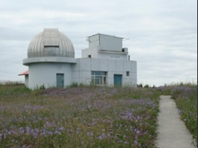
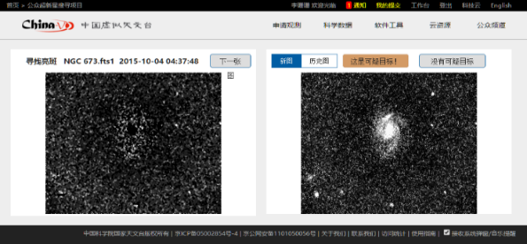
DATA
(1) Amateur astronomer and observation.
(2) Integrated and supported by professional astronomy technology team.
(3) Public participate.
(4) Scientists confirm.
Notes:
首页
简介等文档
看图界面
通知界面

Slide 14
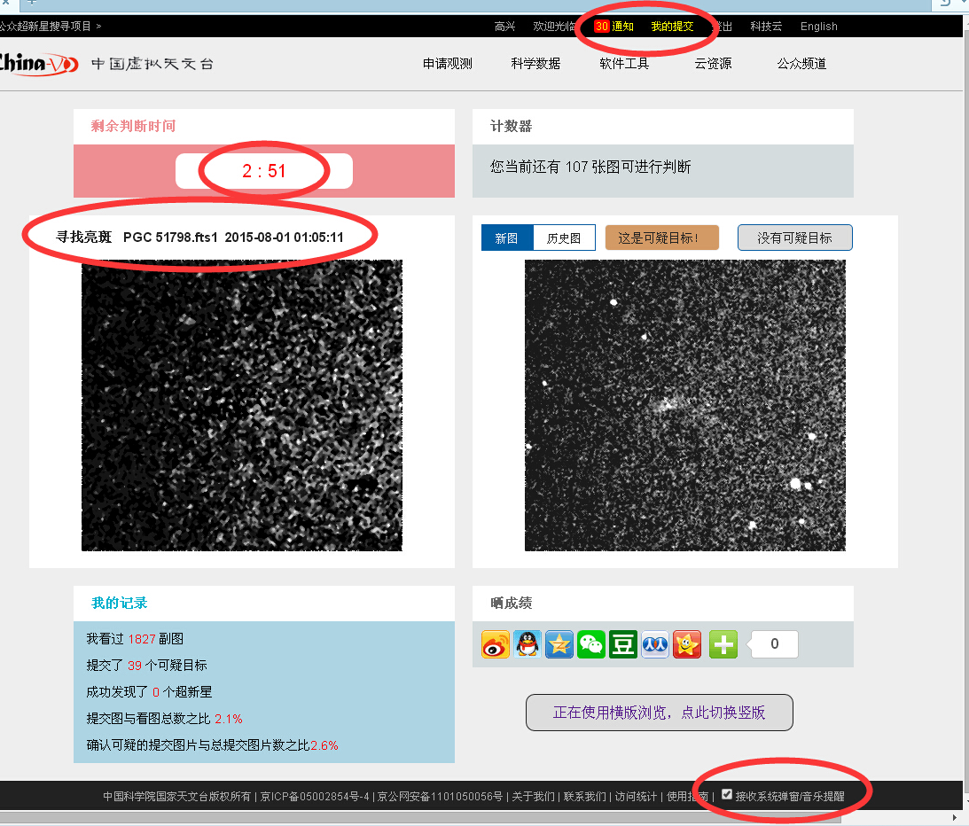
USER
(1) Register China-VO website.
(2) Read the introduction, instructions and examples misjudgement. Pass a basic test online.
(3) Begin to browse pictures.
(4) Submit judgments.
(5) Waiting for professional result.
Notes:
首页
简介等文档
看图界面
通知界面

Slide 15
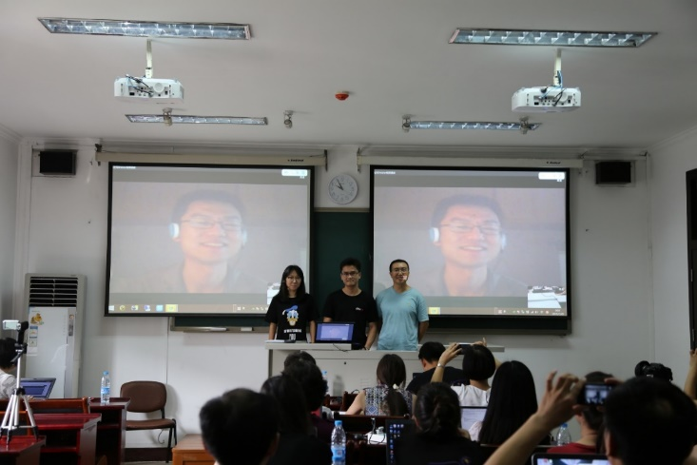
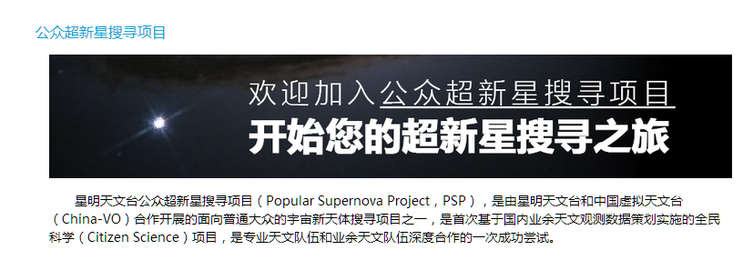
LAUNCH 2015.7.29
First figure uploaded on 2015.5.25
Website: http://psp.china-vo.org/
Notes:
也有一些人在这段时间内加入看图。
系统第一张图上传时间 2015年5月25日。
梳理改进流程，阅览图片。
2015年7月14日凌晨，PSP计划正处于测试期间，庞立凤于5:20，卫申权于6:43各自独立上报了一颗可疑的超新星目标。后由金彰伟验证为一颗3天前刚发现的已知超新星。

Slide 16
OVER 160 NEW REGISTERED USER ON THE FIRST DAY
Notes:
如此大规模的用户爆发，对于系统的稳定性和承载能力是一次较大考验。
系统运行稳定
AUGUST 1ST, NEW REGISTERED USERS EXCEEDED 300.

Slide 17
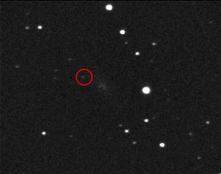
FIRST SUSPECTED TARGET
September 12, 2015, Jiaming Liao submit a suspected target. Advanced user Jiangao Ruan verified and reported the target.
FAILED TO CONFIRM
DUE TO WEATHER
Notes:
2015年9月12日上午，阮建高查验PSP项目可疑目标时，发现在廖家铭上报的目标非常可疑，后经排查，为真实目标，由徐智坚测量，阮建高上报。
可惜由于天气原因，没能及时有专业天文台进行观测确认。

Slide 18
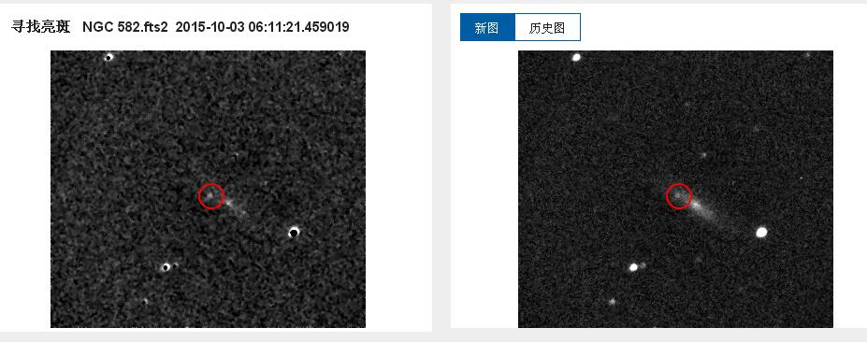
FIRST SUPERNOVA CONFIRMED
SUPERNOVA CONFIRMED!
In the morning of Oct. 3rd, jiaming Liao found another suspected object and this time it was confirm only 2 days later by astronomer from Yunnan Observatories and Tsinghua University.

Slide 19
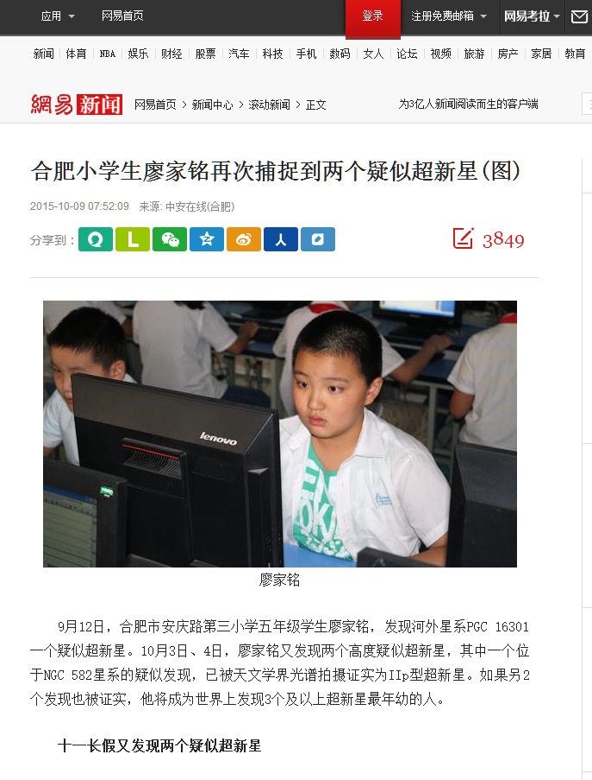
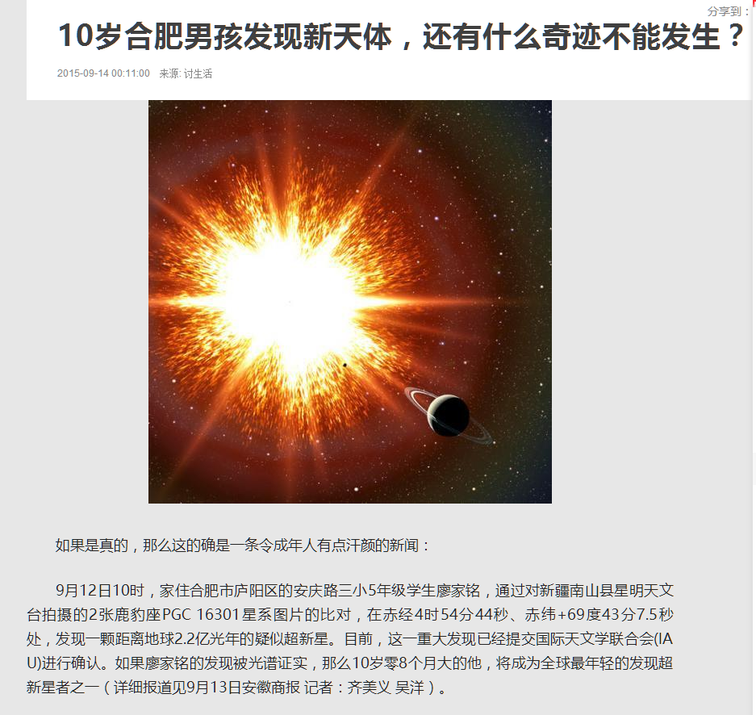
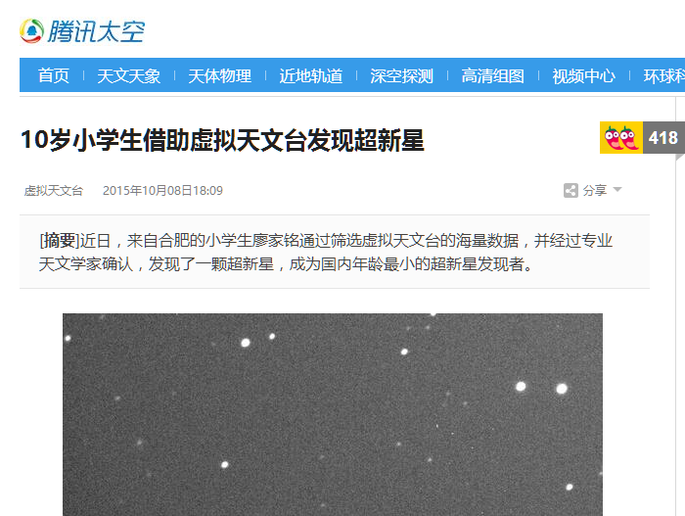
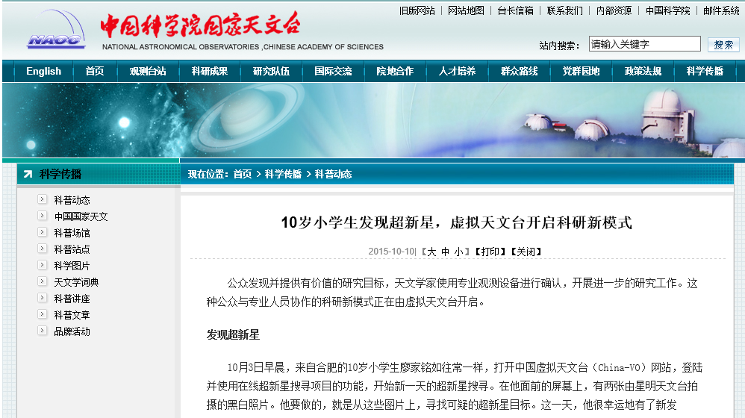
TRADITIONAL MEDIA AND WEB PORTALS REPORT
Notes:
再次进行媒体宣传，腾讯新闻弹窗
Tencent Technology , Netease News and so on…

Slide 20
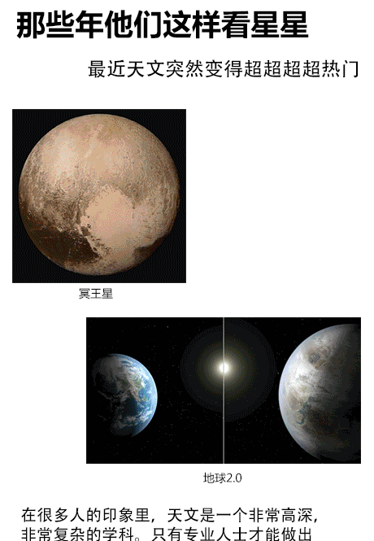
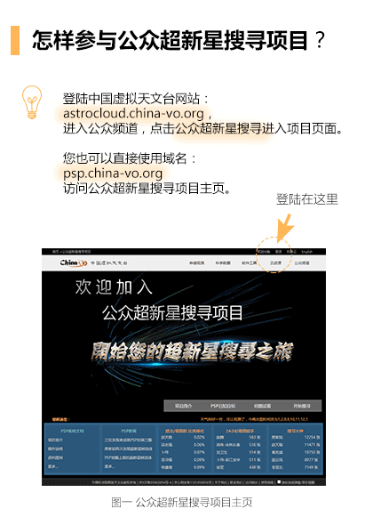
SOCIAL MEDIA PROMOTION
Notes:
中国虚拟天文台平台主要提供专业观测服务，所以很多为了公众天文台注册的用户
找不到PSP入口。
米琳莹 用户支持

Slide 21
9.13 2218 9.14 4993 9.15 798 (Single day registration) 9.19 TOTAL USER NUMBER EXCEEDED 10,000
9.14
new user 4993
7.29
launch
Notes:
到9月19日为止，每天都有上百人注册；
之后每天都有两位数的注册量。
我们出于谨慎，本身并没有对这一次的疑似发现进行宣传，耐心等待第一颗确认。
PSP系统经历了注册浪潮的考验，一天注册用户2000多人，至今已经注册用户上万，可喜的事，他们中有很多热爱科学，热情严谨的学生爱好者，这也是PSP项目的初衷，让更多的爱好天文爱好科学的年轻下一代能通过PSP平台参与到天文发现和天文研究中来，相信PSP项目会发展的更好~

Slide 22
11 SUSPECTED TARGET REPORTED
6 SUSPECTED SUPERNOVA TARGET CONFIRMED
1 SUSPECTED NOVA TARGET CONFIRMED
16000 REGISTER USERS
OVER 7151 PEOPLE TOOK TEST
DATA CREATED BY BROWSING WEBSITE OVER 1TB
YOUNGEST PERSON FOUND SUPERNOVA IS 10-YEAR-OLD
NUMBERS
OF POPULAR SUPERNOVA PROJECT
Notes:
总计图片数量52164
总计看图次数948087
注册用户14178，考试用户5934，通过用户3986，看图至少一次的用户1422提交至少一次的用户1102
看图时间的有趣统计，比如图片发布之后，最快多久看完，最慢多久看完

Slide 23
COLLABORATION
Collaboration between amateur astronomer and professional astronomy team.
REAL DATA FOR PUBLIC
SIMPLE
NEWEST
EDUCATION
REAL SCIENCE RESULT
Find a supernova event
Study supernova spectrum
INSPIRATION AND INNOVATION
OF POPULAR SUPERNOVA PROJECT
Notes:
简单：平台操作，发现方式。不需要了解复杂背景，产生原理。
最新的，具有时效性。专业稳定的平台使其成为可能。
教育：随着使用平台，开始对超新星和发现超新星有更多了解。（noise、ghost）
研究超新星，光谱可以告诉我们很多事。距离、超新星类型等……

Slide 24
MORE PEOPLE
Public (normal people, students, etc.)
Amateur astronomer
Professional astronomy team
IMPROVE TECHNOLOGIES
Including more telescopes
Improve data quality
Improve the platform (English UI)
GLOBAL COLLABORATION
Public user and students
Telescopes
Projects
OUTLOOK
OF POPULAR SUPERNOVA PROJECT
Notes:
Expand by including more people and telescopes
deepen professional cooperation
发现的超新星大部分距离较近

Slide 25
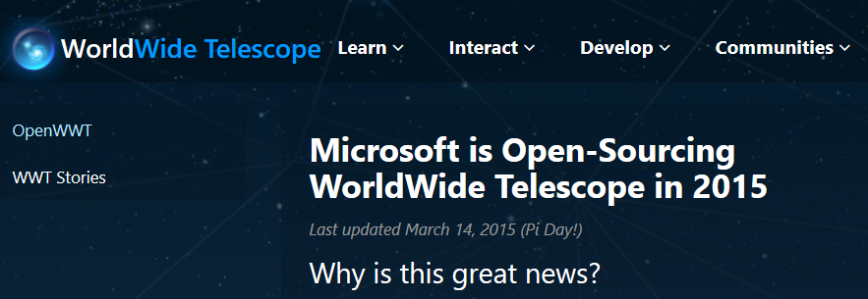
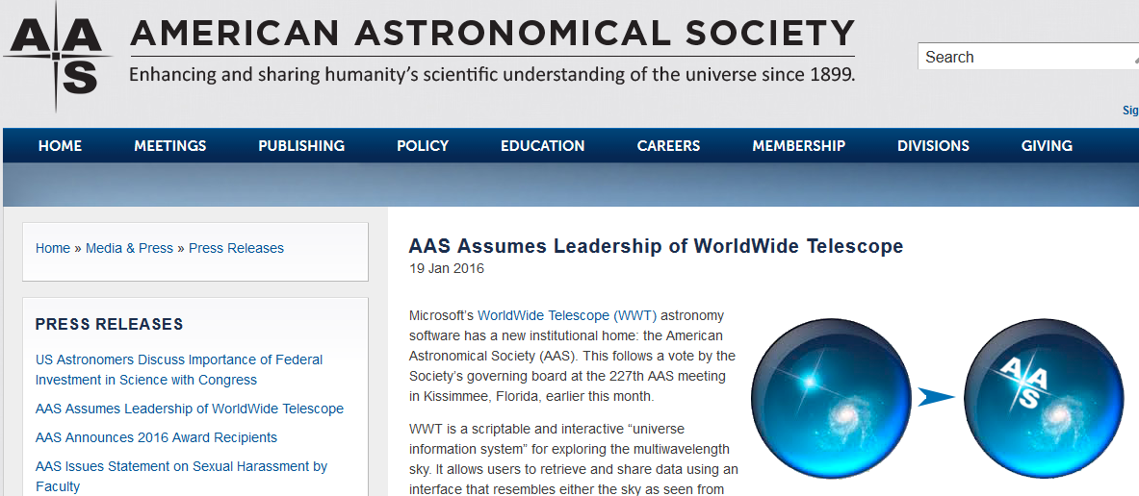
Worldwide Telescope

Slide 26
WWT at China-VO
Real demo

Slide 27
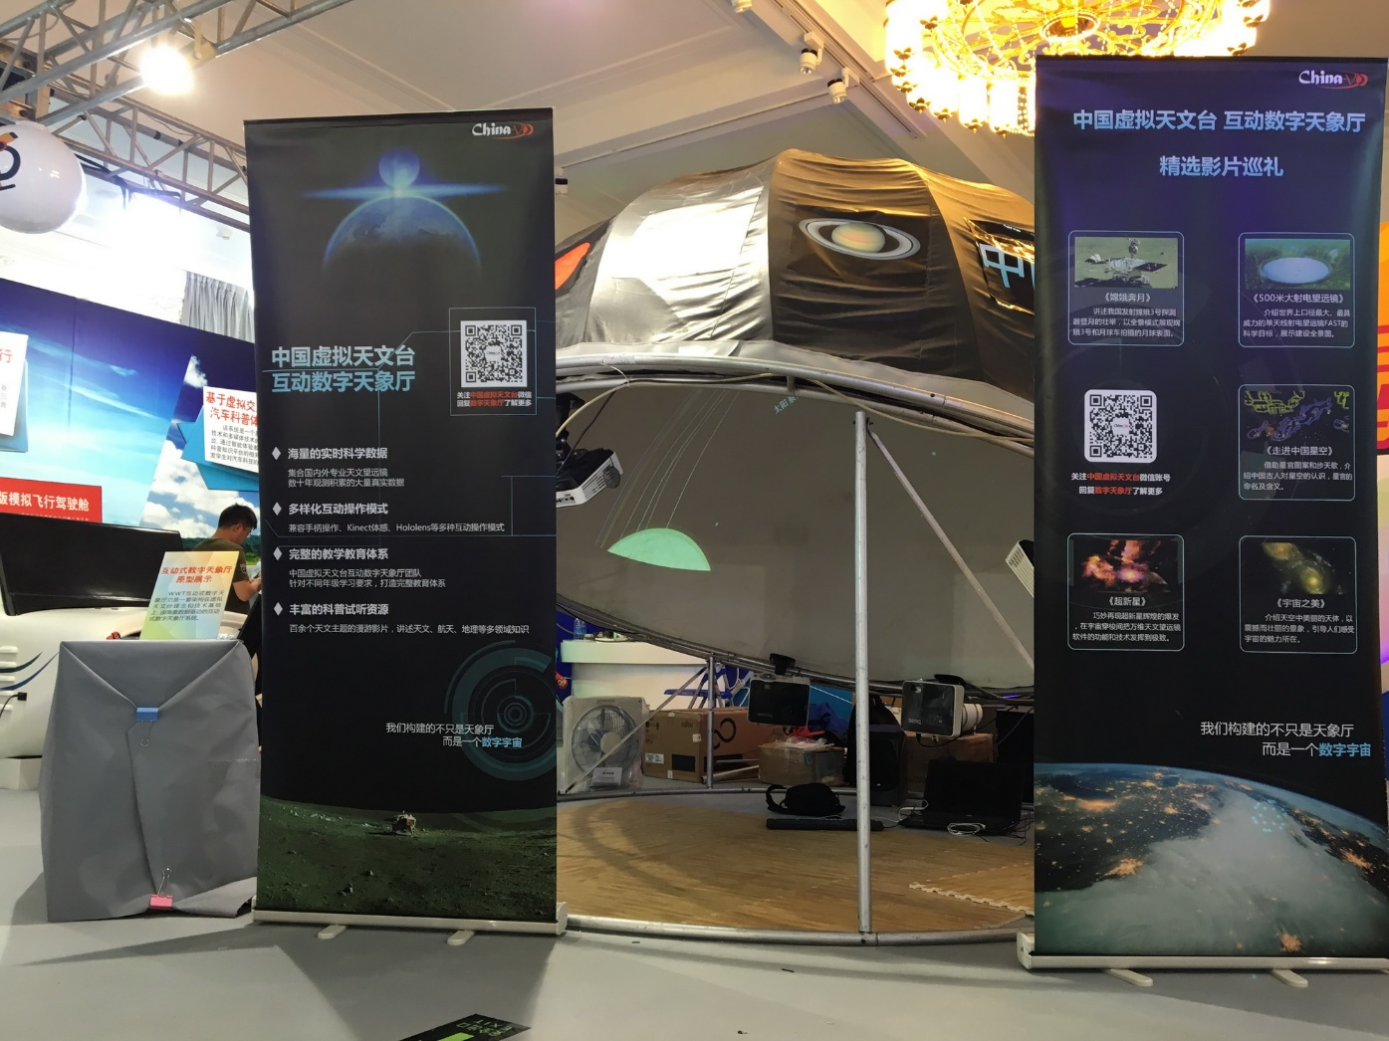
National Science and Technology Week, 2016
May 14-21, 2016

Slide 28
Deep localization
Featured panoramas
Chinese constellations
Planetariums
Customized version

Slide 29
Data based, VO powered but not data and VO oriented
China-VO
WeChat
http://public.china-vo.org
Notes:
备用

