Slide 1
Chandra Bibliography: A Case Study on Benefits of Proper Data Citation
Arnold Rots SAO/CXC

Slide 2
Parties Who May Benefit
Data product authors – obvious recognition
Manuscript authors – Edwin Henneken study
The community
Observatories and data repositories
There is active interest in these matters in the RDA

Slide 3
Literature-Data Linking
Also known as Data Citation
At a fine-grained data set level (proper citation)
The key is the combination of:
Data/observation metadata
I trust we all know what that contains
Literature metadata
Keywords, authors, dates, objects, text analysis results

Slide 4
Chandra Bibliography
Started from the beginning of the mission
Complete bibliography
Complete linking of articles to data in the archive at the ObsId level
This fine-grained linkage is crucial
Labor-intensive – until authors can be convinced to take responsibility for providing all links (then we only need to check them)
We do provide tools
And need a mechanism to harvest links from ADS

Slide 5
Benefits for the Community
Data Mining and Knowledge Discovery
The sum of the two sets of metadata provides a much richer information field for data mining than the two separately – fine-grained linking is key
This allows more effective data and knowledge discovery for the astronomical community
It can be further enhanced by increased sophistication in the persistent identifier syntax

Slide 6
Observatory Metrics
Because of the fine-grained linkage, we can tell management exactly what data got published when
The Director’s Office was concerned that the number of articles published annually stopped increasing
That’s a bad metric – as became clear when we showed the amount of exposure time published annually

Slide 7
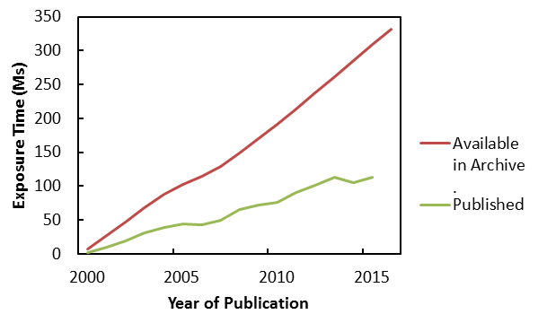
Available and Published Exposure Time

Slide 8
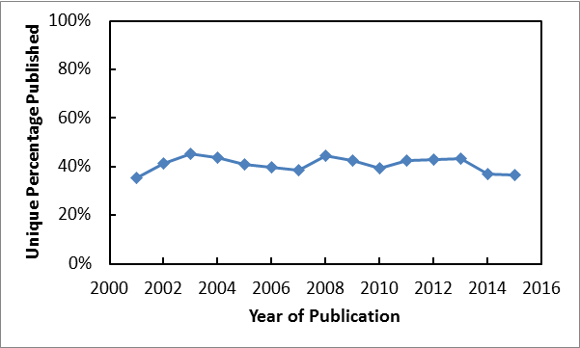
Fraction Published

Slide 9
More Useful Metrics
How much data gets published actually?
How often does it get published?
How long does it take?

Slide 10
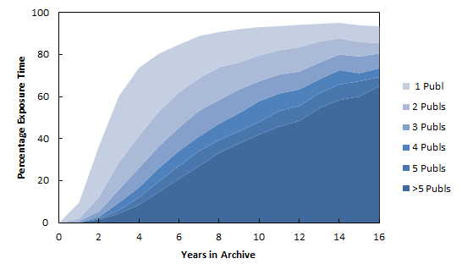
Publication History vs Data Age

Slide 11
Chandra Publication Statistics
Some publication statistics:
Median time till first publication:
2.55 years
Metrics summary:
Data Age (years) | 1+ Publications | 5+ Publications
2.5 | 48% | 4%
5 | 81% | 20%
10 | 94% | 48%
15 | 94% | 67%

Slide 12
Comments and Caveats
Fine-grained linking is key
One can construct these metrics for subsets of the data: by type of observation, by instrument, etc.
It helps making the case that we need the resources
But note that these numbers need to be interpreted in the context of the observatory or data repository! Never – ever – use them to compare observatories

