Slide 1
VAO Registry Status Spring 2014
THE INTERNATIONAL VIRTUAL OBSERVATORY ALLIANCE
Theresa Dower
Registry WG
IVOA Interoperability Meeting – Madrid 2014

Slide 2
VAO Registry History
VAO Registry at Space Telescope uses an underlying relational database.
Implementation in Microsoft Sql Server
Original schema non-standard, internally developed
Imports VOResource as XML via XSLT to SQL
Evolved to support new resource types for new standards after approval at IVOA level (Cone Search, SIA, SSA, TAP, DataService 1.0 but NOT 1.1)
Fulltext-indexed for fast keyword search of active resources
Saves all resource update history across IVOA Registries.
May 2014
IVOA Interoperability Meeting – Madrid

Slide 3
Schema Update: Almost Standard
Contributed to RegTAP standard
Lessons learned from prior implementation
Support Microsoft SQL dialect quirks
Tested speed/usability for common searches
Small name changes in RegTAP working draft can be hidden in TAP service
Internal translation hides resource history from public interface queries
Indexes retain speed for queries that have been split into multiple tables
May 2014
IVOA Interoperability Meeting -- Madrid

Slide 4
Registry Upgrade: Status
Operational registry database live & RofR listed
Harvesting full IVOA RofR
Populated from scratch: not porting history information from old VAO Registry relational schema.
Missing records only from validation or temporary OAI harvesting issues across RofR.
VOLogin support for local resource publishing
Major curation/cleanup effort regarding invalid and obsolete records
Official release with documentation summer 2014
May 2014
IVOA Interoperability Meeting -- Madrid

Slide 5
Registry Interfaces
http://vao.stsci.edu/directory/...
Legacy Interfaces
OAI Standard (Cross-registry resource harvesting)
Non-standard VOTable search (Used by several VO tools)
Web keyword search page
Backward compatibility for non-standard searches reliant on old schema.
Standard SOAP-based RI 1.0 Search Interface
Used by TOPCAT (for now)
Thanks: Menelaus Perdikeas, Mark Taylor, Ray Plante
May 2014
IVOA Interoperability Meeting -- Madrid

Slide 6
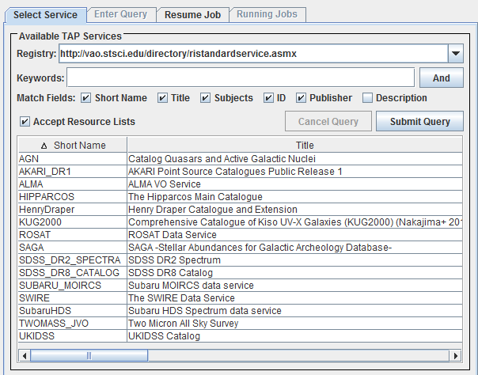
Standardized Searching
Standard SOAP-based RI 1.0 Search Interface
Used by TOPCAT (for now)
http://vao.stsci.edu/directory/RIStandardService.asmx
May 2014
IVOA Interoperability Meeting -- Madrid

Slide 7
Registry Future Work
Finalize RegTAP interface
Will update to RegTAP standard as approved
Based on prototype C# TAP service at STScI, built in collaboration with VAO TAP Server in Java at JHU.
REST interface
Based on existing VOParis work and existing non-standard VAO keyword search.
Need to decide upon output format.
Mirror site within current VAO institutions
Finalize resource publishing / user migration
May 2014
IVOA Interoperability Meeting -- Madrid

