Slide 1
Worldwide Telescope
Evolving technologies in WWT
Jonathan Fay
Microsoft Research
Presented by Ray Plante (NCSA) & Theresa Dower (STScI)

Slide 2
Pushing the limits of a web app
The WWT Web Control and the new Web Client use several new technologies to bring desktop quality app capabilities to plug-in free, JAVA-Free universal access.
Virtually all clients are supported automatically using the technology.
  Tablets, phones, laptops and desktops supported thru responsive design and graceful degradation.
  Supports Mac OS, IOS, Android, Linux, Windows/RT/Phone, XBOX, Kindle Fire, Etc.
  Transparently adapts to rendering capability of the client platform
Build with a shared code-base with our desktop application using cross compilation to allow rapid porting of new features from desktop to client, and sharing code, infrastructure, tours, etc.

Slide 3
Graphics Layer
Complete HMTL5 3D graphics layer on canvas. Allows for imagery to be displayed in a proper spherical projection with good performance over a large range of hardware.
High-level and low level abstractions support optimizing graphics performance for different target environment with maximum code re-use.
A double precision world/local/view coordinate system ensures accuracy and insulates the application layer from the limitations of the graphics implementation.
On WebGL compatible browsers, graphics can be drawn thru the WebGL layer allowing for near desktop application level performance for nearly all features.
WebGL clients can enable enhanced capabilities like large data support and GP/GPU code paths for accelerating computation of orbits, filtering data for visualization, and processing data for display.

Slide 4
Sharing code thru cross compilation
Virtually all of the rendering engine is sourced from the desktop WWT product
The render engine code is developed and compiled as c# code.
The HTML5/WebGL and browser environments are projected into the .NET C# environment thru shim assemblies that export HTML & jscript features and make them appear as .NET resources at compile time.
After compilation the binary IL code is parsed and jscript code is outputted for the WWT library. This code is minifies and optimized for the browser environment.
This system allows not only code sharing but use of type-safe code, pre-compilation, code level validation tools, and avoids pitfalls of direct jscript programing for complex code. Code reuse also accelerates the porting and leads to better stability.
Abstractions in the code at several levels allow a significant amount of common code, with specific implantations for DirectX11 on the Windows client, and HTML5 & WebGL implantations for the Web client.
The UI code is written in Native HTML5/CSS/Jscript to make the best use of the web platform, but matched to the Desktop UI to allow users to go between platforms without having to re-learn the interface.

Slide 5
The new Web Client
On-line now at http://www.worldwidetelescope.org/webclient
No plug-in required.
Match for the desktop client. About 60% feature overlap today, targeting about 85% by fall. The last 15% are exotic features that have no place in the browser.
Integrating VO & Data services deeply into the client.

Slide 6
Web Client Demo
http://www.worldwidetelescope.org/webclient

Slide 7
WWT Web Control
Meant to integrate into your own data portal, web service, etc.
Adds all-sky visualization and WWT capabilities with a few lines of HTML/jscript
Multiple abstraction levels allow either very quick implantation, or heavy customization.
Sample: http://www.spitzer.caltech.edu/glimpse360/wwt
Sample: http://goldmine.mib.infn.it/
Sample: http://optas.net/andromeda-galaxy-m31/#.U3wSC2AnKck

Slide 8
ADS All Sky Survey
On the ADS Website
  http://www.adsass.org/wwt/
Built into WorldWide Telescope Web Client
  http://www.worldwidetelescope.org/webclient?ads=true

Slide 9
We want to explore more rich integration
Traditional WWT VO tools will be integrated into the Web Client
Cloud based storage and data processing managed thru the Web Client
Integration with *YOUR* services. Please contact jfay@Microsoft.com

Slide 10
Collaborative/Immersive visualization with head-mounted displays
WorldWide Telescope 5.0 desktop client ships with Oculus VR Support today.
We are designing remove interactive visualization scenarios with Kinect V2 to allow viewing your own avatar, your collaborators avatar, and use your own hands to point out data, select data, manipulate data and navigate shared virtual spaces.

Slide 11
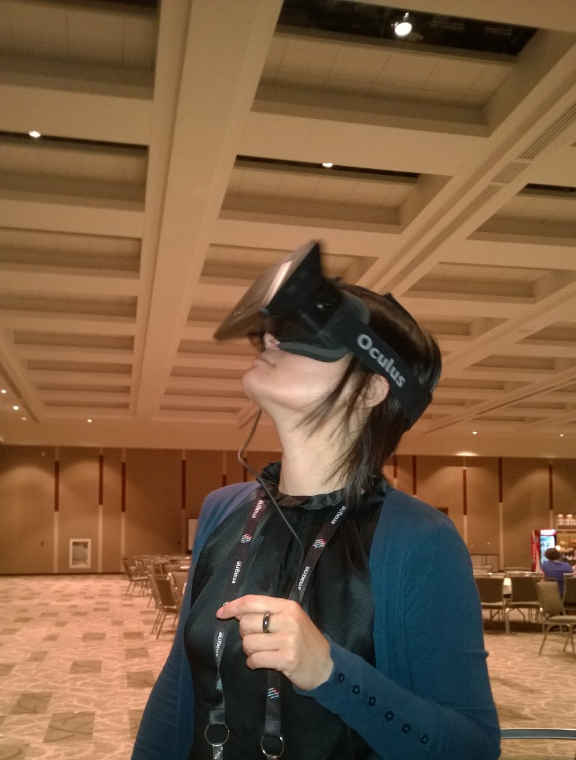
Oculus Demo

Slide 12
3d Print your universe
WorldWide Telescope 5.1 will ship shortly with integrated 3D printing support to allow planetary terrain, and other data to be exported for 3D printing.
Scenarios allow for presenting craters, mountains and other to the visually impaired, as well as deeper insight for the sighted.
Investigating a collaboration with STScI to allow visualization and printing of volumetrically enhanced Hubble images.

Slide 13
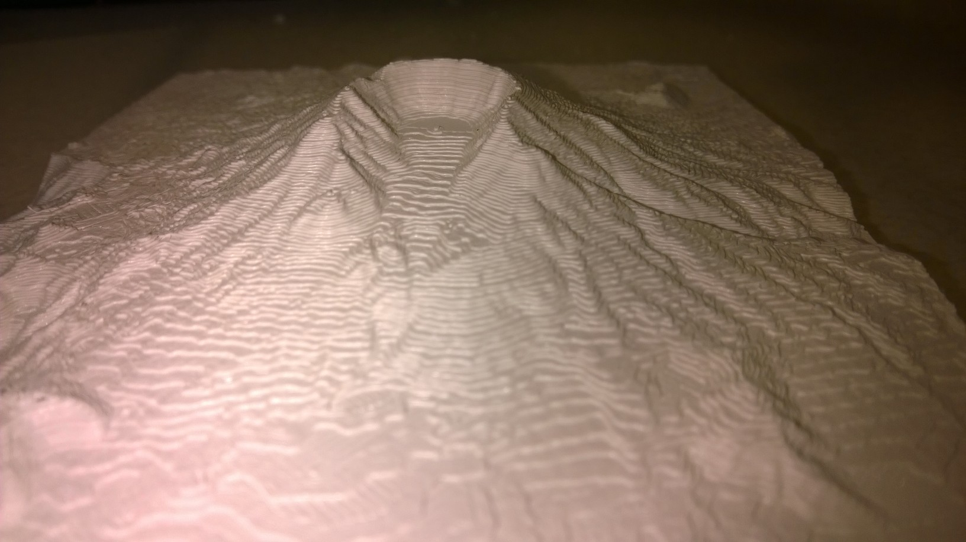
Sample Print – Mt St. Helens (Erupted 34 years ago this week) – Exported from WWT 5.1

Slide 14
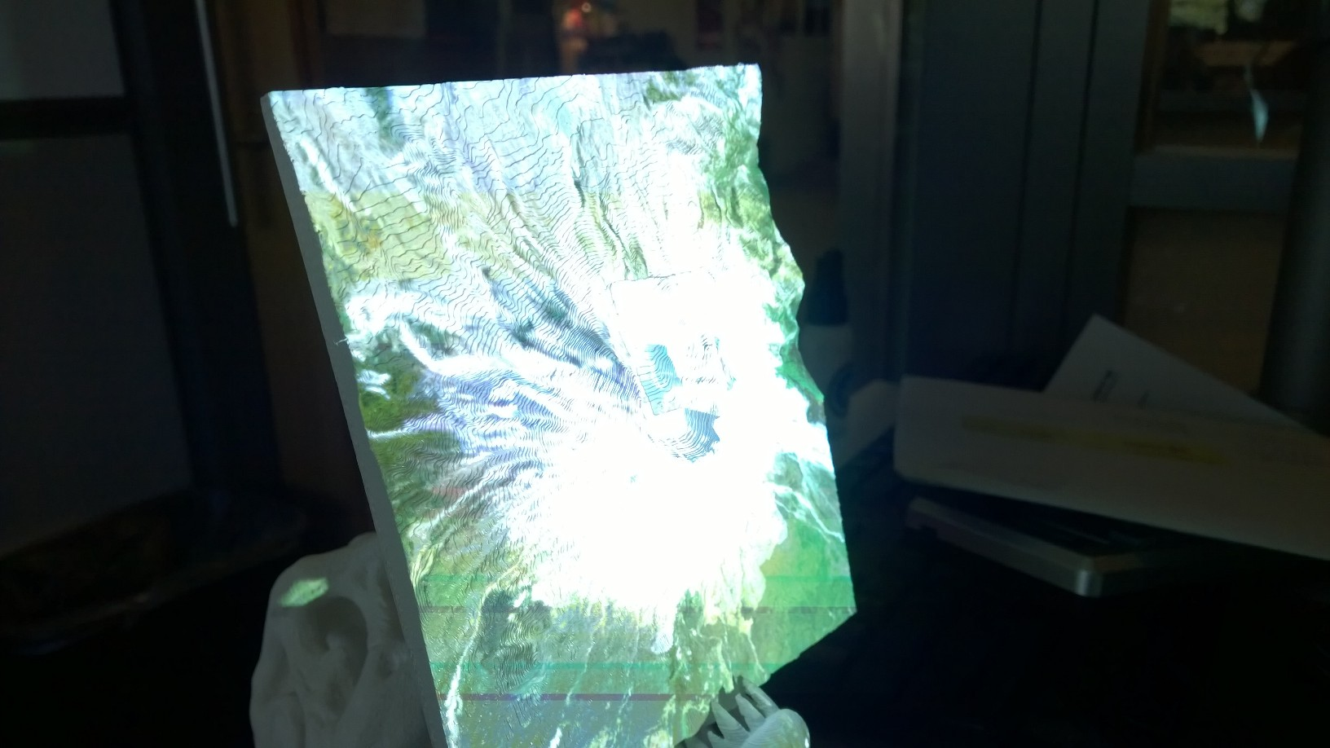
3d Printed Mt. St. Helens, held in the teeth of 3d Printed t-REX, projected with video texture

