Slide 1

EPO Activities from China-VO
Chenzhou CUI
National Astronomical Observatory of China

Slide 2

VO ABC
Virtual Observatory (VO) is a data-intensively online astronomical research and education environment, taking advantages of advanced information technologies to achieve seamless, global access to astronomical information.
The power of the VO on education and public outreach
  Professional level astronomical archives
  Up-to-date information and bibliography
  Cutting edge technologies and tools
Notes:
2

Slide 3
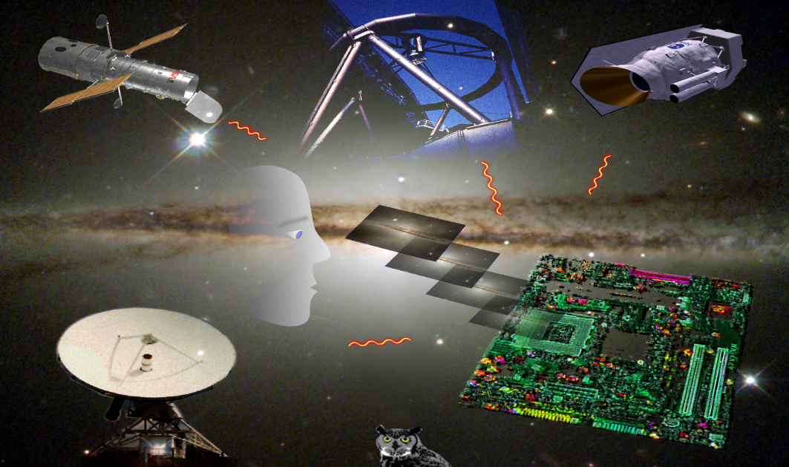
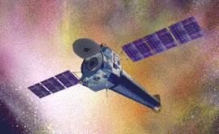
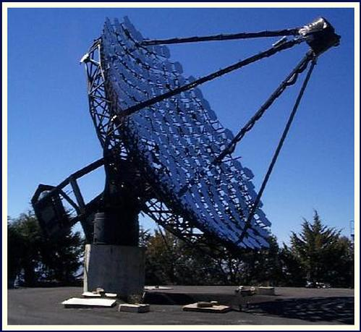

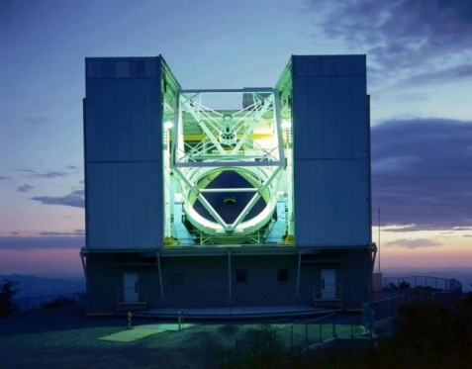
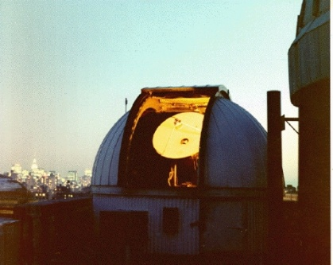
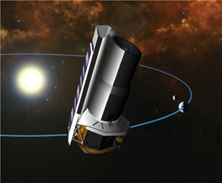
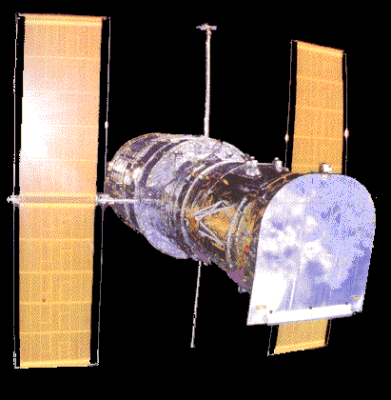
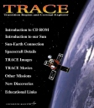
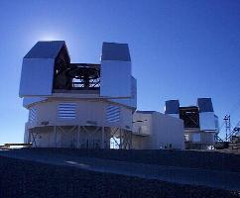
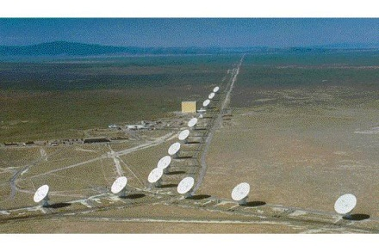
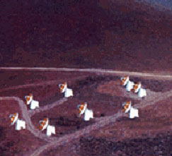
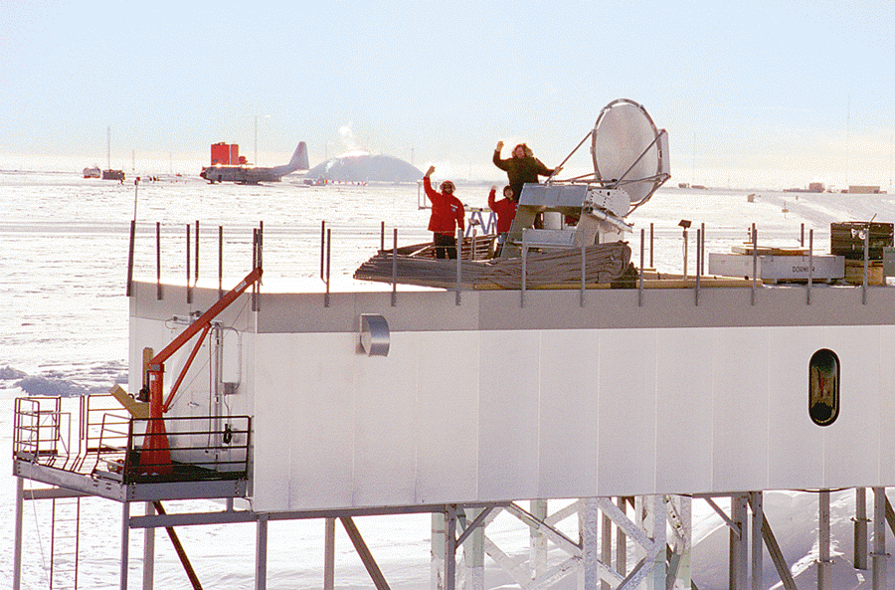
World Wide Telescope
Chandra
Whipple γ-ray
Oak Ridge
1.2m CO
MMT
SIRTF
Hubble
VLA
Sub-mm array
Antartica sub-mm
Magellan 6.5m
Courtesy of Dr. Jim Gray
Notes:
3
微软资深的研究员Jim Gray博士给虚拟天文台起了一个很形象很好听的名字，Worldwide Telescope。这张幻灯片是从Jim以前的讲稿中截取的。

Slide 4


China-VO
Chinese Virtual Observatory (China-VO) is the national VO project in China initiated in 2002 by Chinese astronomical community leading by National Astronomical Observatories, Chinese Academy of Sciences.
Dr. Jim Gray (Microsoft Research) visited the China-VO in 2002
China-VO became a member of the IVOA with the recommendation of Dr. Jim Gray

Slide 5
China-VO Team
Partners
NAOC (Beijing): Yongheng Zhao (PI), Chenzhou Cui (PM), Ganghua Lin, Yanxia Zhang, Boliang He, Wei Gao, Yue Chen, Yiming Teng, Zihuang Cao, Dongwei Fan, Wangwei Chu, Haijun Tian, Zheng Li,
TianJin Univ. (Tianjin): Jizhou Sun, Ce Yu, Jian Xiao, Qing Zhao, Xu Liu, Ao Yuan
CCNU (Wu Han): Xiaoping Zheng, Cuilan Qiao, Qin Wang, Junli Jia
Kunming Univ. of Science and Tech: Feng Wang, Kaifan Ji, Hui Deng
Collaborators:
Computer Network Information Center, CAS (Beijing): Baoping Yan, Kai Nan, Jianhui Li, Kevin Dong, Yongzheng Ma, Lianglin Hu
Purple Mountain Astro Obs (Nanjing): Ji Yang, Liang Liu, Dengrong Lu
Shanghai Astro Obs (Shanghai): Yipeng Jing, Weipeng Lin, Xiao Chen, Shuhe Wang, Jianhai Zhao, Haiming Tang
Yunnan Astro Obs: Yufeng Fan, Chuanjun Wang
Tsinghua Univ.: Jianfeng Zhou, Zhihui Du
External collaborations:
JHU, MSR, Caltech, IUCAA, CDS, ICRAR (Australia), NAOJ (Japan)…

Slide 6
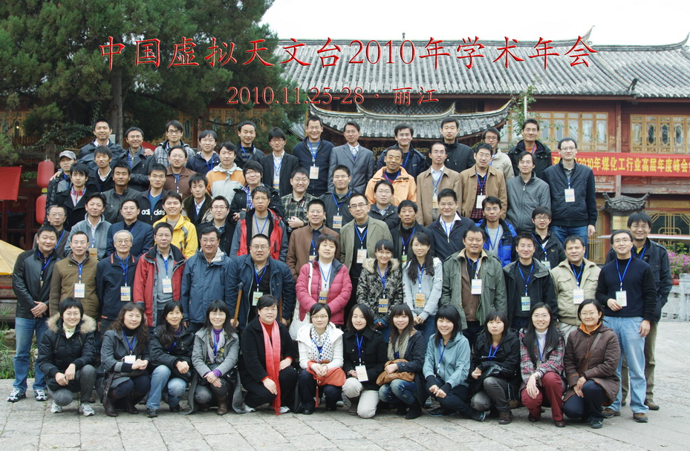
China-VO annual meeting
year | attendees
2001
2003 | 36
2004 | 30
2005 | 27
2006 | 47
2007 | 40
2008 | 57
2009 | 63
2010 | 78

Slide 7
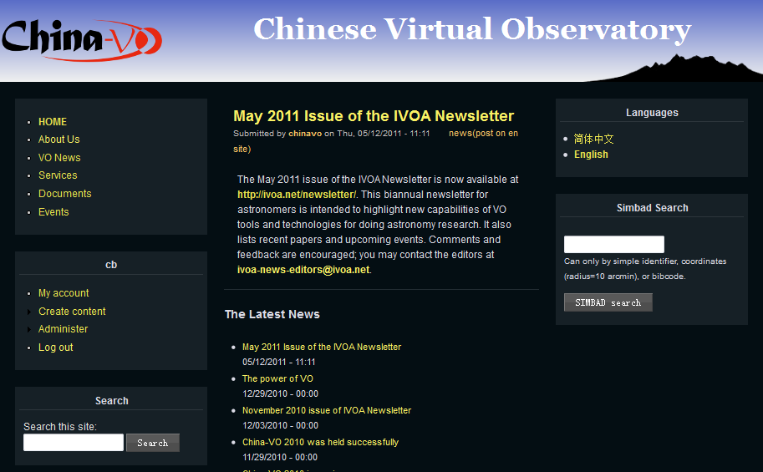

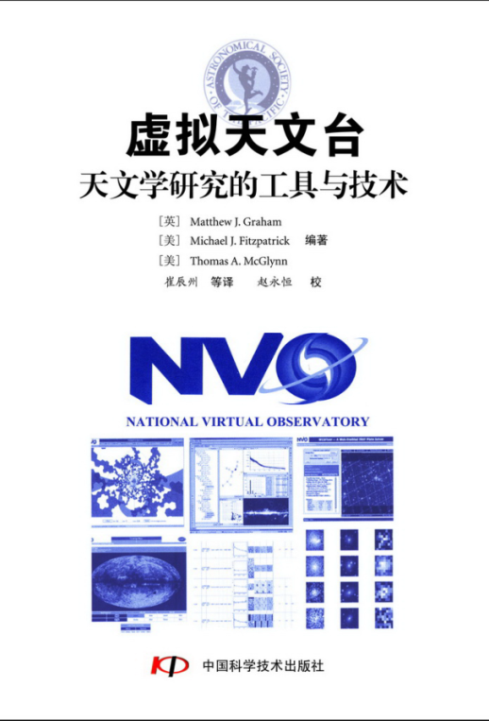
Community
Website
Mailing list
Online forum
Blog
Micro-Blog (twitter)
SNS(Facebook)
IMS (MSN,Skype)
…

Slide 8


WWT Based VO Education
WWT milestones in China 2008-2010

Slide 9
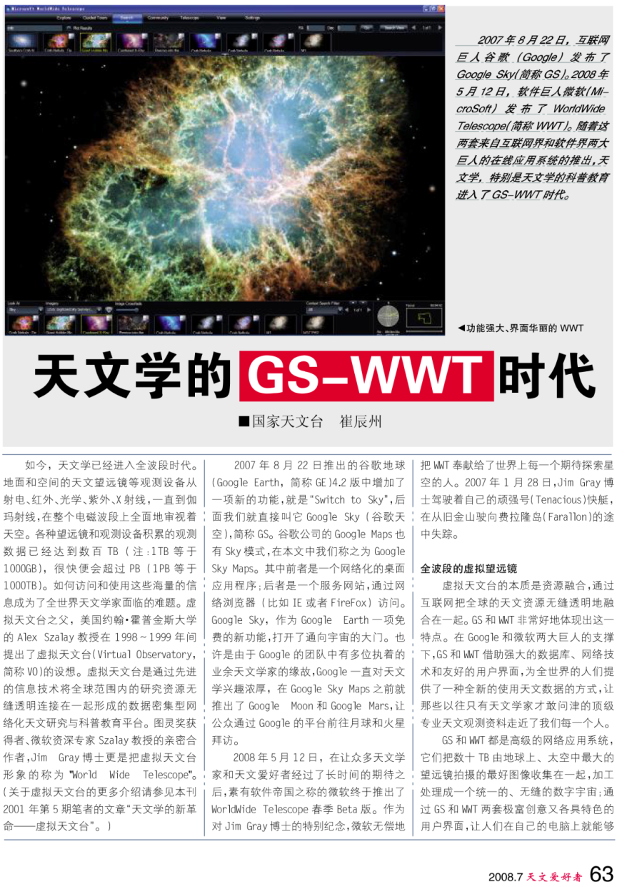
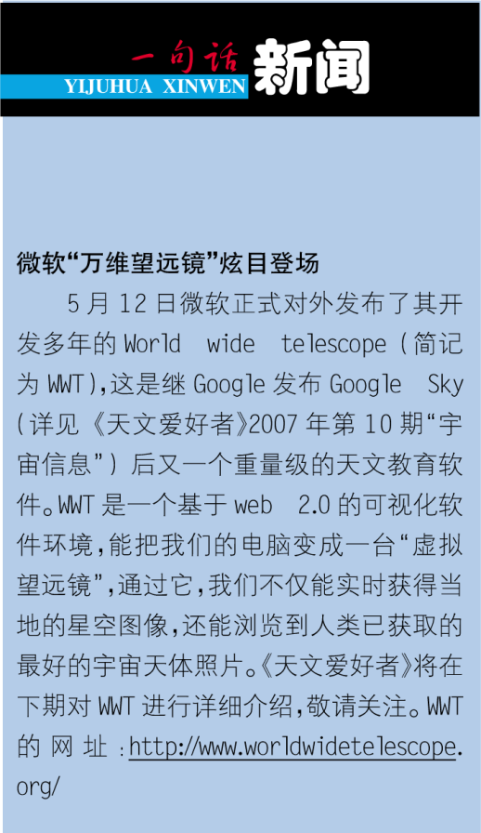

WWT released before Trieste Interop
May 12, 2008

Slide 10
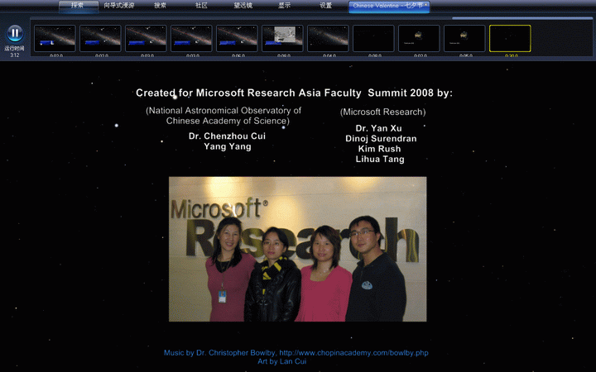


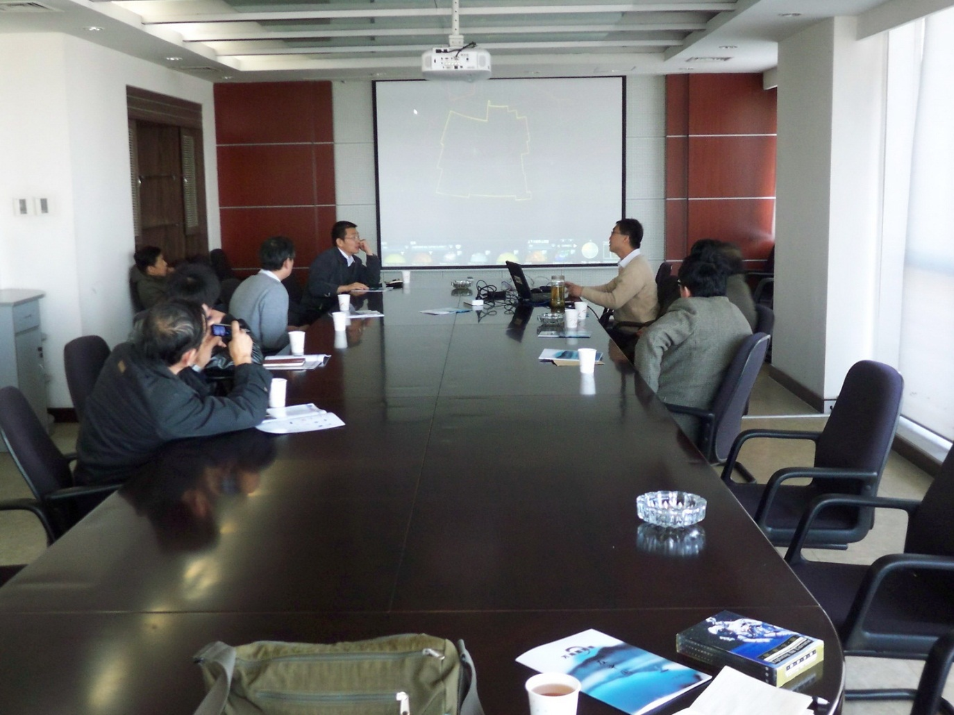
Collaboration between MSR and China-VO started …
MSRA ten years anniversary, November, 2008

Slide 11
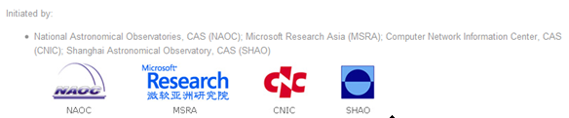

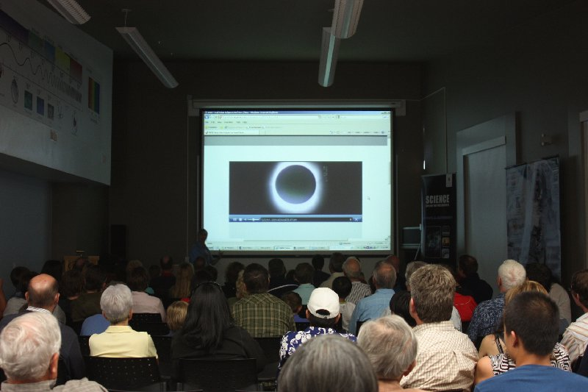
Total Solar Eclipse Live Broadcast in IYA2009
Huge Audience
30 signed clients
Network portal: 17
TV station: 10
Mobile portal: 1
IPv6 portal: 2
Website click: > 230M
WWT was used as backup
Rothney Obs., Canada

Slide 12
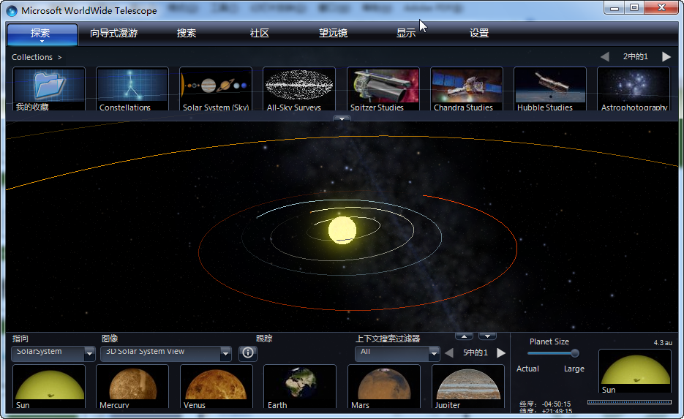
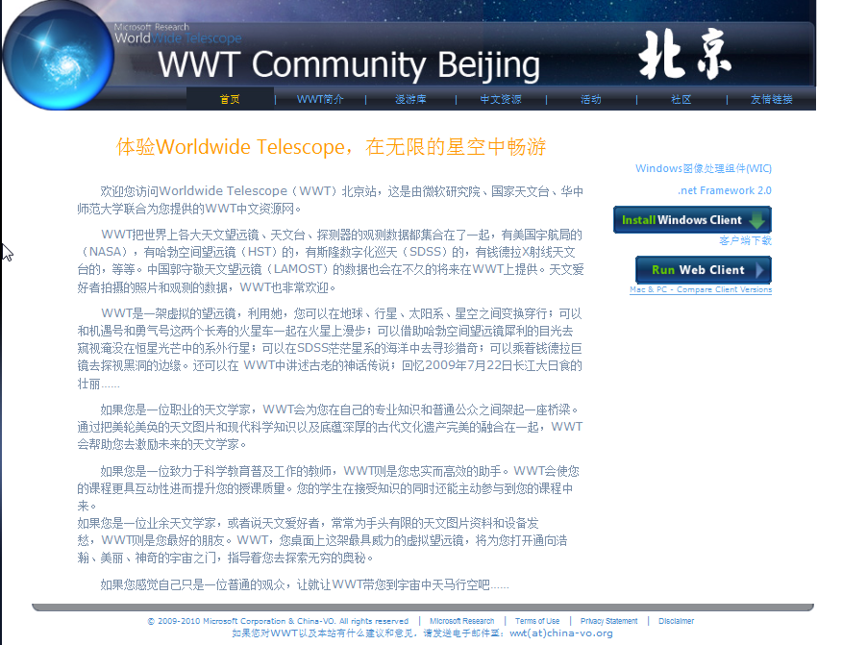
WWT Community Beijing
WWT Localization
Community server and resource mirror/cache
Tutorials and documents in Chinese
BBS forum

Slide 13
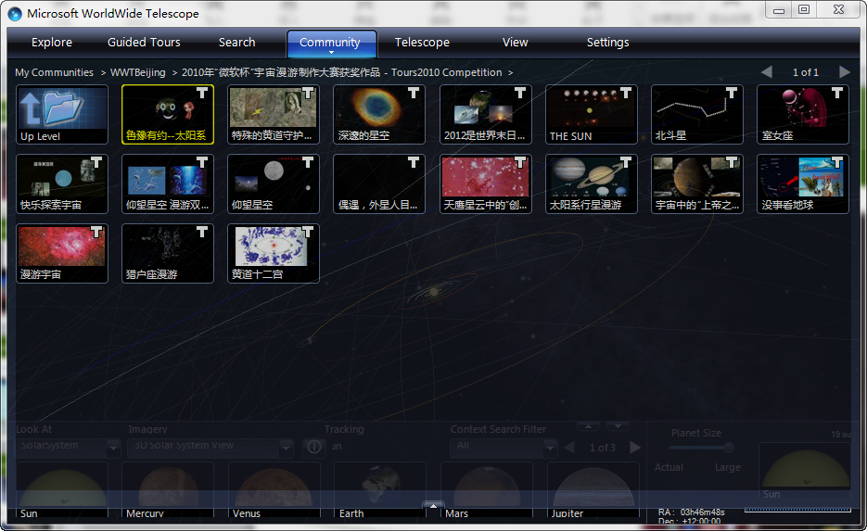
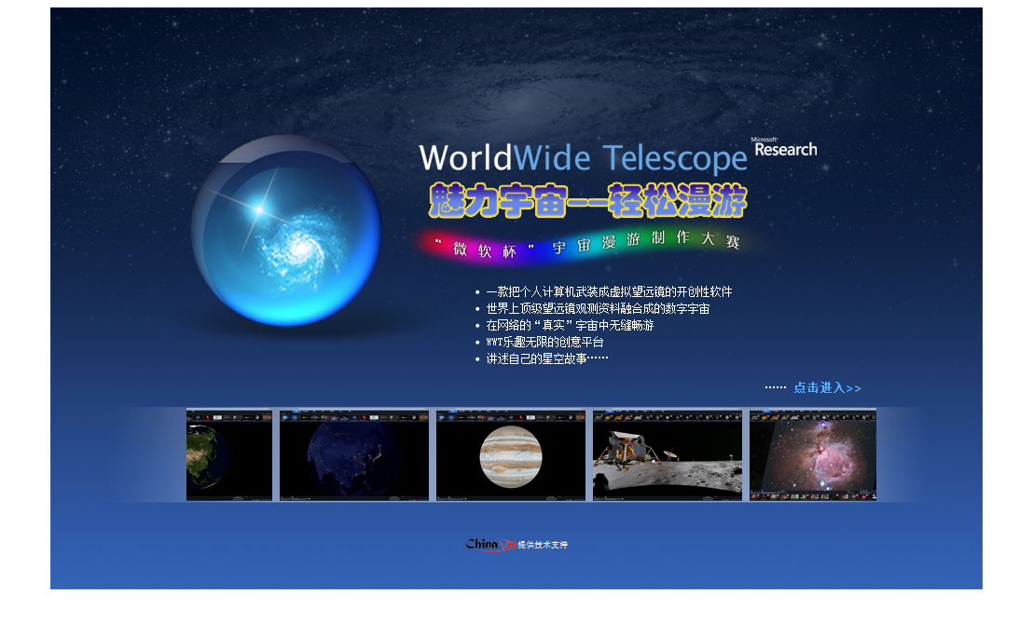
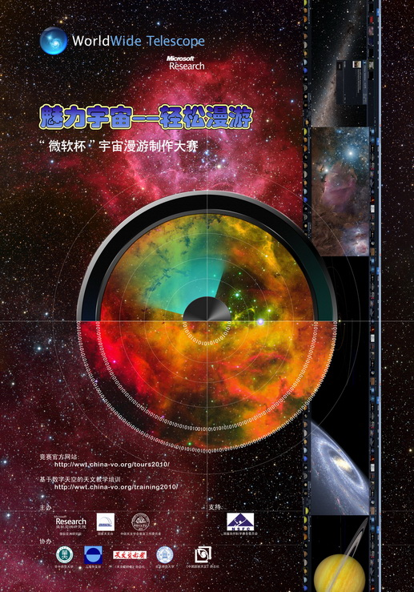
WWT Guided Tour Design Contest
It is just under going …

Slide 14
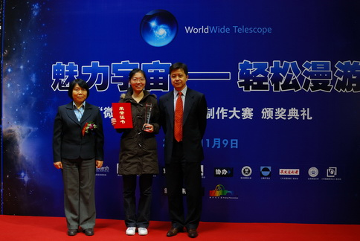
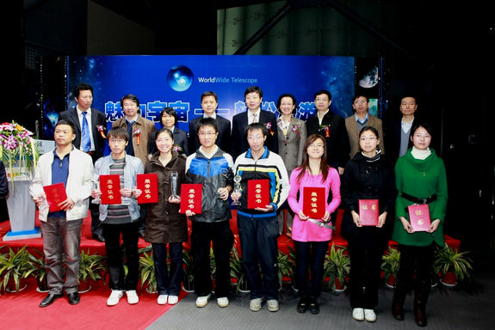
Award Ceremony (2010.11.9)
@ Beijing Planetarium

Slide 15
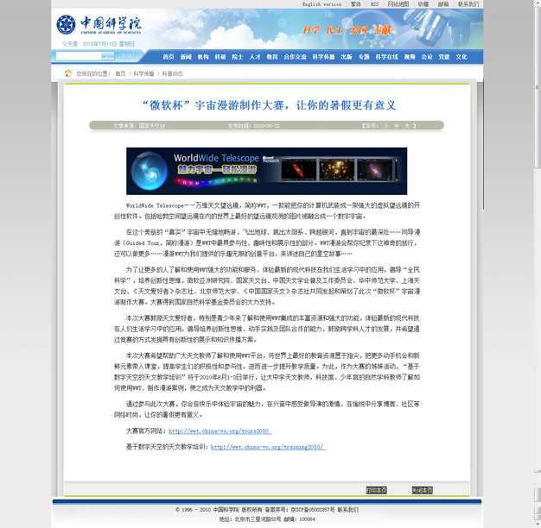
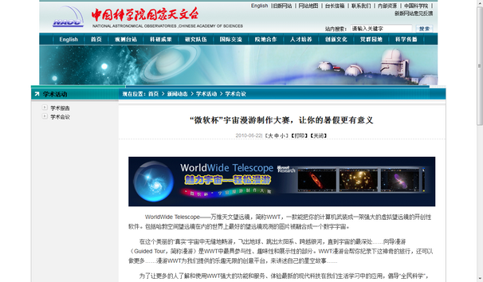
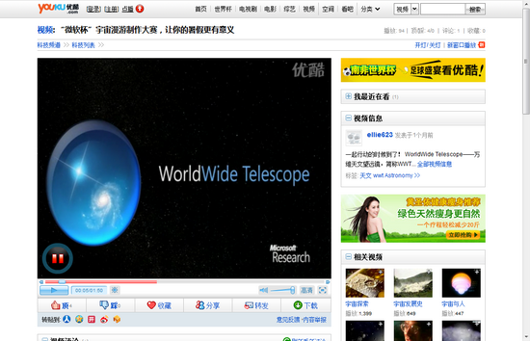

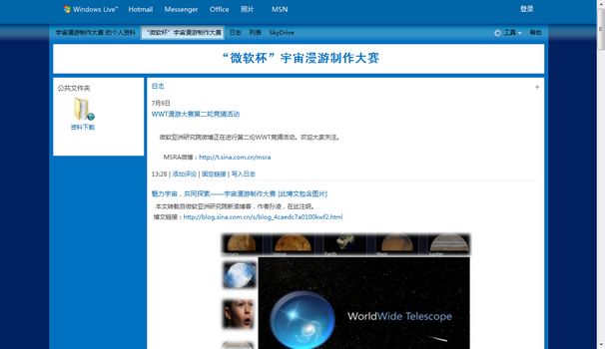

Various Network Media Involved
Academic portals (i.e. NAOC, CAS)
Public portals
Blogs
Twitter similar portals
Video portals
Forums

Slide 16
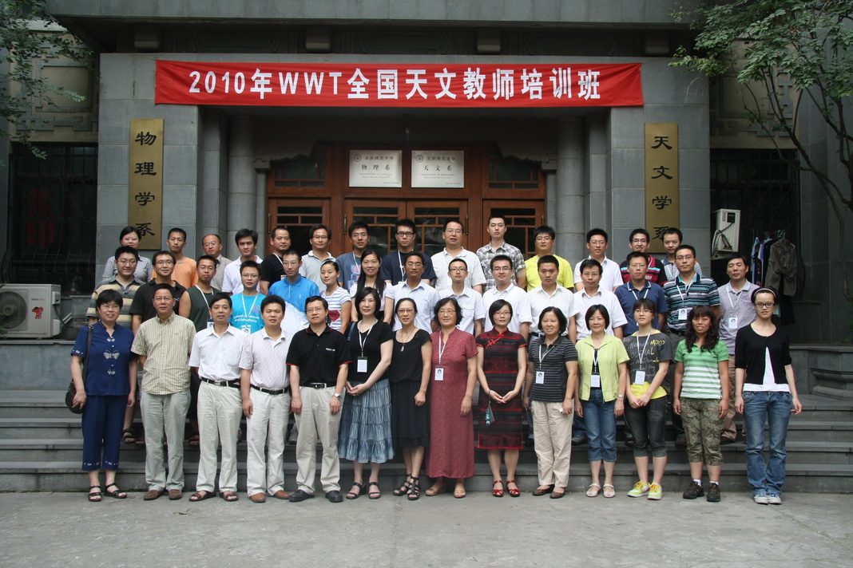

WWT Teacher Training 2010
WWT based curriculum at CCNU
WWT teacher training, Aug 1-3, 2010
~40 attendees
Very positive
feedback

Slide 17

WWT Teachers Training 2011
July 22-26, 2011
Inner Mongolia

Slide 18
Published papers
Google Sky and WorldWide Telescope Era in Astronomy
  Chenzhou Cui. Amateur Astronomer, 2008 (7)
WWT for Your IYA2009 and Beyond
  Yan Xu, Chenzhou Cui. Special issue for IYA 2009, Amateur Astronomer, 2009
Science Data Based Astronomy Education
  Cuilan Qiao, Chenzhou Cui, Xiaoping Zheng, Yan Xu. Proceedings for 2010 2nd International Conference on Education Technology and Computer (ICETC), 2010, Shanghai
The revolution in astronomy curriculums introduced by WorldWide Telescope
  Cuilan Qiao, Chenzhou Cui, Xiaoping Zheng, Yan Xu. INTED2011 (International Technology, Education and Development Conference)

Slide 19

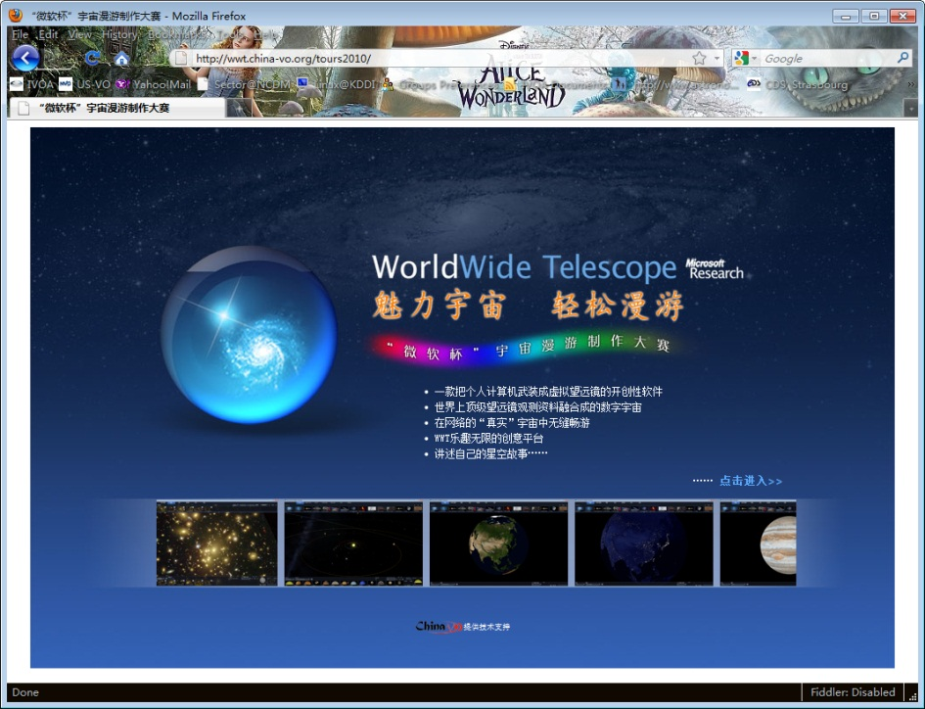
Activities from WWT Community Beijing
WWT Community Beijing
Total solar eclipse broadcast
WWT Tour contest
WWT teacher training

Slide 20
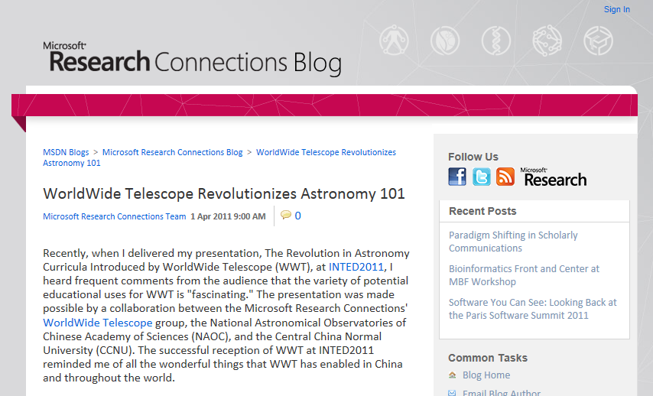
Lessons learned
Manpower and funding of VO projects are very limited
EPO activities of VO projects should be focused on:
  Infrastructure construction (standards, technics)
  Providing services, tools and docs
  Training educators
Reuse and scale up of our efforts

Slide 21

Robotic Autonomous Observatories
An interesting field that IVOA should not ignore.
Strong requirements from both professional and amateur astronomers
Close relationship with the VO:
  VOEvent, Time Domain Astronomy
  Data analyzing full automatically and data mining
  Robust scheduler based on artificial intelligence
  Network and data archiving
  …

Slide 22
Thank You!

